Slide 1

Chapter 1 Sampling and Data
Openstax statistics
Access for free at https://openstax.org/books/introductory-statistics-2e/pages/1-introduction

Slide 2
Objectives
By the end of this chapter, the student should be able to:
Recognize and differentiate between key terms.
Apply various types of sampling methods to data collection.
Create and interpret frequency tables.

Slide 3
Section 1.1
Definitions of Statistics, Probability, and Key Terms

Slide 4
Terms We Will Frequently Use
Statistics
Data
Descriptive statistics
Probability
Inferential statistics
Population
Parameter
Sample
Variables
Numerical variables
Categorical variables
Mean
Proportion

Slide 5
Statistics and Data
The science of statistics deals with the collection, analysis, interpretation, and presentation of data. We see and use data in our everyday lives.

Slide 6
Three Types of Statistics We Will Discuss
In this course, you will learn how to organize and summarize data. Organizing and summarizing data is called descriptive statistics.
  Two ways to summarize data are by graphing and by using numbers (for example, finding an average).
Probability is a mathematical tool used to study randomness. It deals with the chance (the likelihood) of an event occurring.
After you have studied probability and probability distributions, you will use formal methods for drawing conclusions from "good“ data. The formal methods are called inferential statistics.
  Statistical inference uses probability to determine how confident we can be that our conclusions are correct.

Slide 7
Population and Parameter
In statistics, we generally want to study a population. You can think of a population as a collection of persons, things, or objects under study.
The statistic is an estimate of a population parameter. A parameter is a number that is a property of the population.
Example: Since we considered all math classes to be the population, then the average number of points earned per student over all the math classes is an example of a parameter.

Slide 8
Data and Sampling
Data are the actual values of the variable. They may be numbers or they may be words. Datum is a single value. Data are the result of sampling from a population.
Because it takes a lot of time and money to examine an entire population, sampling is a very practical technique.
One of the main concerns in the field of statistics is how accurately a statistic estimates a parameter. The accuracy really depends on how well the sample represents the population.
The sample must contain the characteristics of the population in order to be a representative sample. We are interested in both the sample statistic and the population parameter in inferential statistics.

Slide 9
Variables
A variable, notated by capital letters such as X and Y, is a characteristic of interest for each person or thing in a population. Variables may be numerical or categorical.
Numerical variables take on values with equal units such as weight in pounds and time in hours.
Categorical variables place the person or thing into a category.

Slide 10
Mean and Proportions
Two words that come up often in statistics are mean and proportion. These will be two of the main concepts that we look at in this course.
  A mean is a number that describes the central tendency of the data
  A proportion is the number of successes divided by the total number in the sample
The words "mean" and "average" are often used interchangeably. The substitution of one word for the other is common practice. The technical term is "arithmetic mean," and "average" is technically a center location. However, in practice among non-statisticians, "average" is commonly accepted for "arithmetic mean."

Slide 11
Key Terms Example
A study was conducted at a local college to analyze the average cumulative GPA’s of students who graduated last year. Fill in the letter of the phrase that best describes each of the items below.
1. Population_____ 2. Statistic _____ 3. Parameter _____
4. Sample _____ 5. Variable _____ 6. Data _____
all students who attended the college last year
the cumulative GPA of one student who graduated from the college last year
3.65, 2.80, 1.50, 3.90
a group of students who graduated from the college last year, randomly selected
the average cumulative GPA of students who graduated from the college last year
all students who graduated from the college last year
the average cumulative GPA of students in the study who graduated from the college last year

Slide 12
Key Terms Example - Answers
1. Population_____ 2. Statistic _____ 3. Parameter _____
4. Sample _____ 5. Variable _____ 6. Data _____
Answers: 1. f; 2. g; 3. e; 4. d; 5. b; 6. c
all students who attended the college last year
the cumulative GPA of one student who graduated from the college last year
3.65, 2.80, 1.50, 3.90
a group of students who graduated from the college last year, randomly selected
the average cumulative GPA of students who graduated from the college last year
all students who graduated from the college last year
the average cumulative GPA of students in the study who graduated from the college last year

Slide 13
Example
For the following situation, identify: a. the population, b. the sample, c. the parameter, d. the statistic, e. the variable, and f. the data. We want to know the average (mean) amount of money first year college students spend at ABC College on school supplies that do not include books. We randomly surveyed 100 first year students at the college. Three of those students spent $150, $200, and $225, respectively.

Slide 14
Example - Answers
We want to know the average (mean) amount of money first year college students spend at ABC College on school supplies that do not include books. We randomly surveyed 100 first year students at the college. Three of those students spent $150, $200, and $225, respectively.
The population is all first year students attending ABC College this term.
The sample could be all students enrolled in one section of a beginning statistics course at ABC College (although this sample may not represent the entire population).
The parameter is the average (mean) amount of money spent (excluding books) by first year college students at ABC College this term.
The statistic is the average (mean) amount of money spent (excluding books) by first year college students in the sample.
The variable could be the amount of money spent (excluding books) by one first year student. Let X = the amount of money spent (excluding books) by one first year student attending ABC College.
The data are the dollar amounts spent by the first year students. Examples of the data are $150, $200, and $225.

Slide 15
Example
For the following situation, identify: a. the population, b. the sample, c. the parameter, d. the statistic, e. the variable, and f. the data. Ski resorts are interested in the mean age that children take their first ski and snowboard lessons. They need this information to plan their ski classes optimally.

Slide 16
Example - Answers
For the following situation, identify: a. the population, b. the sample, c. the parameter, d. the statistic, e. the variable, and f. the data. Ski resorts are interested in the mean age that children take their first ski and snowboard lessons. They need this information to plan their ski classes optimally.
all children who take ski or snowboard lessons
a group of these children
the population mean age of children who take their first snowboard lesson
the sample mean age of children who take their first snowboard lesson
X = the age of one child who takes their first ski or snowboard lesson
values for X, such as 3, 7, and so on

Slide 17
Summary
Statistics: deals with the collection, analysis, interpretation, and presentation of data
Population: a collection of persons, things, or objects under study
Parameter: a number that is a property of the population
Data: the actual values of the variable
Variable: notated by capital letters such as X and Y, is a characteristic of interest for each person or thing in a population
Mean: a number that describes the central tendency of the data
Proportion: the number of successes divided by the total number in the sample

Slide 18
Section 1.2
Data, Sampling, and Variation in Data and Sampling

Slide 19
Types of Data
Qualitative data are the result of categorizing or describing attributes of a population. Qualitative data are generally described by words or letters.
  Hair color, blood type, ethnic group, the car a person drives, and the street a person lives on are examples of qualitative data.
Quantitative data are always numbers. Quantitative data are the result of counting or measuring attributes of a population.
  Amount of money, pulse rate, weight, number of people living in your town, and number of students who take statistics are examples of quantitative data.

Slide 20
Quantitative Data Types
Quantitative data may be either discrete or continuous.
All data that are the result of counting are called quantitative discrete data. These data take on only certain numerical values.
All data that are the result of measuring are quantitative continuous data assuming that we can measure accurately.
Note: You may collect data as numbers and report it categorically. For example, the quiz scores for each student are recorded throughout the term. At the end of the term, the quiz scores are reported as A, B, C, D, or F.

Slide 21
Examples
Sample of Quantitative Discrete Data
The data are the number of books students carry in their backpacks. You sample five students. Two students carry three books, one student carries four books, one student carries two books, and one student carries one book. The numbers of books (three, four, two, and one) are the quantitative discrete data.
Sample of Quantitative Continuous Data
The data are the weights of backpacks with books in them. You sample the same five students. The weights (in pounds) of their backpacks are 6.2, 7, 6.8, 9.1, 4.3. Notice that backpacks carrying three books can have different weights. Weights are quantitative continuous data.
Sample of Qualitative Data
The data are the colors of backpacks. Again, you sample the same five students. One student has a red backpack, two students have black backpacks, one student has a green backpack, and one student has a gray backpack. The colors red, black, black, green, and gray are qualitative data.

Slide 22
Example
Indicate whether quantitative data are continuous or discrete. Hint: Data that are discrete often start with the words "the number of."
the number of pairs of shoes you own
the type of car you drive
the distance it is from your home to the nearest grocery store
the number of classes you take per school year.
the type of calculator you use
weights of sumo wrestlers
number of correct answers on a quiz
IQ scores (This may cause some discussion.)

Slide 23
Example - Answers
the number of pairs of shoes you own
the type of car you drive
the distance it is from your home to the nearest grocery store
the number of classes you take per school year.
the type of calculator you use
weights of sumo wrestlers
number of correct answers on a quiz
IQ scores (This may cause some discussion.)
Answer: Items a, d, and g are quantitative discrete; items c, f, and h are quantitative continuous; items b and e are qualitative, or categorical.

Slide 24
Visualizing Quantitative Data
Tables are a good way of organizing and displaying data. But graphs can be even more helpful in understanding the data.
There are no strict rules concerning which graphs to use.
Two graphs that are used to display qualitative data are pie charts and bar graphs.

Slide 25
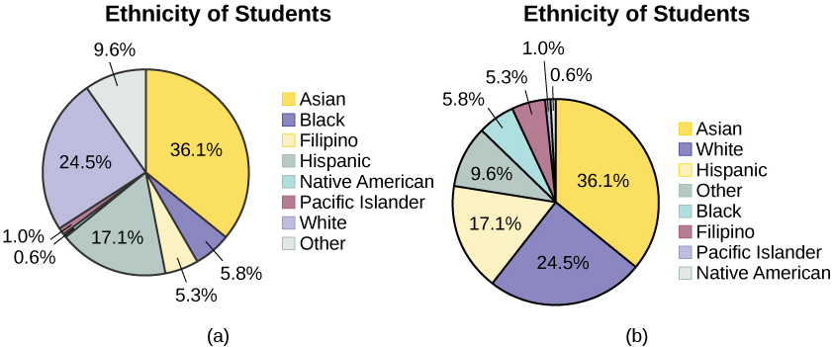
In a pie chart, categories of data are represented by wedges in a circle and are proportional in size to the percent of individuals in each category.

Slide 26
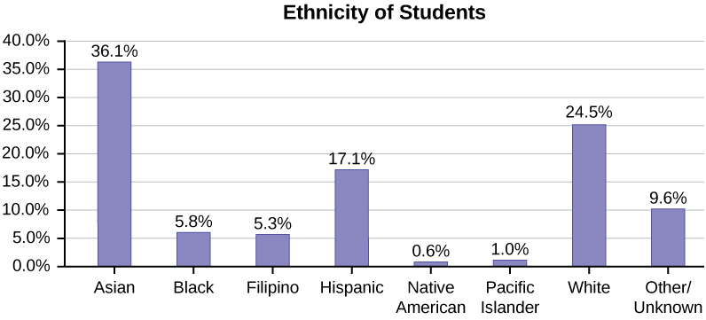
In a bar graph, the length of the bar for each category is proportional to the number or percent of individuals in each category. Bars may be vertical or horizontal.

Slide 27
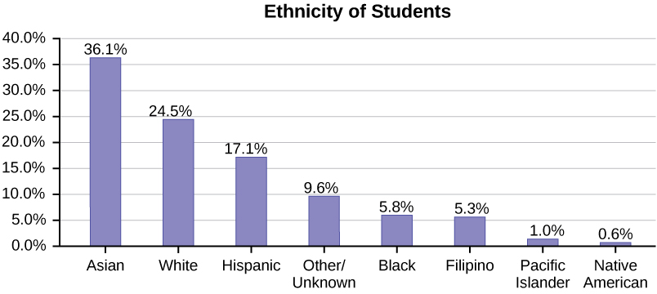
A Pareto chart consists of bars that are sorted into order by category size (largest to smallest).

Slide 28
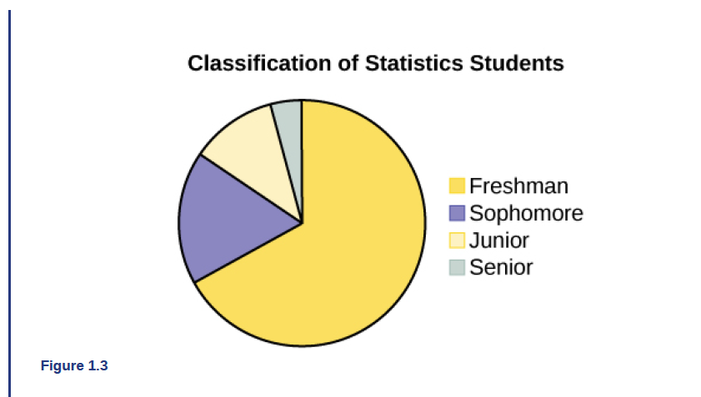
Example
A statistics professor collects information about the classification of her students as freshmen, sophomores, juniors, or seniors. The data she collects are summarized in the pie chart. What type of data does this graph show?

Slide 29
Example - Answer
A statistics professor collects information about the classification of her students as freshmen, sophomores, juniors, or seniors. The data she collects are summarized in the pie chart. What type of data does this graph show?
This pie chart shows the students in each year, which is qualitative (or categorical) data.

Slide 30
Sampling Examples
True random sampling is done with replacement: once a member is picked, that member goes back into the population and thus may be chosen more than once
For practical reasons, in most populations, simple random sampling is done without replacement

Slide 31
A Comparison of Techniques
With Replacement
Without Replacement
You have a deck of 52 cards. You select the ace of spades. You replace the card in the deck and select another one. It is possible that you could select the ace of spades a second time.
You have a have deck of 52 cards. You select the ace of spades. You set the card to the side so that it cannot be select again. In the next selection, you have 51 cards to select from.

Slide 32
Sampling
Besides simple random sampling, there are other forms of sampling that involve a chance process for getting the sample. Other well-known random sampling methods are the stratified sample, the cluster sample, and the systematic sample.
To choose a stratified sample, divide the population into groups called strata and then take a proportionate number from each stratum.
To choose a cluster sample, divide the population into clusters (groups) and then randomly select some of the clusters. All the members from these clusters are in the cluster sample.
To choose a systematic sample, randomly select a starting point and take every nth piece of data from a listing of the population.
A type of sampling that is non-random is convenience sampling. Convenience sampling involves using results that are readily available.

Slide 33
Sampling Types
When you analyze data, it is important to be aware of sampling errors and nonsampling errors.
The actual process of sampling causes sampling errors. For example, the sample may not be large enough.
Factors not related to the sampling process cause nonsampling errors. A defective counting device can cause a nonsampling error.
In statistics, a sampling bias is created when a sample is collected from a population and some members of the population are not as likely to be chosen as others (remember, each member of the population should have an equally likely chance of being chosen).
When a sampling bias happens, there can be incorrect conclusions drawn about the population that is being studied.

Slide 34
Variation in data and samples
Variation is present in any set of data.
  An example: 16-ounce cans of beverage may contain more or less than 16 ounces of liquid.
It was mentioned previously that two or more samples from the same population, taken randomly, and having close to the same characteristics of the population will likely be different from each other.
  If Doreen and Jung took larger samples (i.e. the number of data values is increased), their sample results (the average amount of time a student sleeps) might be closer to the actual population average. But still, their samples would be, in all likelihood, different from each other. This variability in samples cannot be stressed enough.

Slide 35
Sampling Example
Determine the type of sampling used (simple random, stratified, systematic, cluster, or convenience).
A soccer coach selects six players from a group of boys aged eight to ten, seven players from a group of boys aged 11 to 12, and three players from a group of boys aged 13 to 14 to form a recreational soccer team.
A pollster interviews all human resource personnel in five different high tech companies.
A high school educational researcher interviews 50 high school female teachers and 50 high school male teachers.
A medical researcher interviews every third cancer patient from a list of cancer patients at a local hospital.
A high school counselor uses a computer to generate 50 random numbers and then picks students whose names correspond to the numbers.
A student interviews classmates in his algebra class to determine how many pairs of jeans a student owns, on the average.

Slide 36
Sampling Example - Answers
Answers: a. stratified; b. cluster; c. stratified; d. systematic; e. simple random; f.convenience
A soccer coach selects six players from a group of boys aged eight to ten, seven players from a group of boys aged 11 to 12, and three players from a group of boys aged 13 to 14 to form a recreational soccer team.
A pollster interviews all human resource personnel in five different high tech companies.
A high school educational researcher interviews 50 high school female teachers and 50 high school male teachers.
A medical researcher interviews every third cancer patient from a list of cancer patients at a local hospital.
A high school counselor uses a computer to generate 50 random numbers and then picks students whose names correspond to the numbers.
A student interviews classmates in his algebra class to determine how many pairs of jeans a student owns, on the average.

Slide 37
Sampling Example
Suppose ABC College has 10,000 part-time students (the population). We are interested in the average amount of money a part-time student spends on books in the fall term. Asking all 10,000 students is an almost impossible task. Suppose we take two different samples. It is unlikely that any student is in both samples.
First, we use convenience sampling and survey ten students from a first term organic chemistry class. Many of these students are taking first term calculus in addition to the organic chemistry class. The amount of money they spend on books is as follows:
$128; $87; $173; $116; $130; $204; $147; $189; $93; $153
The second sample is taken using a list of senior citizens who take P.E. classes and taking every fifth senior citizen on the list, for a total of ten senior citizens. They spend:
$50; $40; $36; $15; $50; $100; $40; $53; $22; $22
a. Do you think that either of these samples is representative of (or is characteristic of) the entire 10,000 part-time student population?
b. Since these samples are not representative of the entire population, is it wise to use the results to describe the entire population?

Slide 38
Sampling Example - Answers
a. Do you think that either of these samples is representative of (or is characteristic of) the entire 10,000 part-time student population?
Answer: No. The first sample probably consists of science-oriented students. Besides the chemistry course, some of them are also taking first-term calculus. Books for these classes tend to be expensive. Most of these students are, more than likely, paying more than the average part-time student for their books. The second sample is a group of senior citizens who are, more than likely, taking courses for health and interest. The amount of money they spend on books is probably much less than the average parttime student. Both samples are biased. Also, in both cases, not all students have a chance to be in either sample.
b. Since these samples are not representative of the entire population, is it wise to use the results to describe the entire population?
Answer: No. For these samples, each member of the population did not have an equally likely chance of being chosen.

Slide 39
Sample Exercise
Now, suppose we take a third sample. We choose ten different part-time students from the disciplines of chemistry, math, English, psychology, sociology, history, nursing, physical education, art, and early childhood development. (We assume that these are the only disciplines in which part-time students at ABC College are enrolled and that an equal number of part-time students are enrolled in each of the disciplines.) Each student is chosen using simple random sampling. Using a calculator, random numbers are generated and a student from a particular discipline is selected if he or she has a corresponding number. The students spend the following amounts:
$180; $50; $150; $85; $260; $75; $180; $200; $200; $150
c. Is the sample biased?

Slide 40
Sample Exercise - Answer
c. Is the sample biased?
Answer: The sample is unbiased, but a larger sample would be recommended to increase the likelihood that the sample will be close to representative of the population. However, for a biased sampling technique, even a large sample runs the risk of not being representative of the population.

Slide 41
Excel 101
The basics of using excel and how to create graphs using excel (See workbook for chapter 1)

Slide 42
Section 1.3
Frequency, Frequency Tables, and Levels of
Measurement

Slide 43
Levels of Measurement
The way a set of data is measured is called its level of measurement.
Data can be classified into four levels of measurement. They are (from lowest to highest level):
• Nominal scale level
• Ordinal scale level
• Interval scale level
• Ratio scale level

Slide 44
Nominal Scale
Data that is measured using a nominal scale is qualitative.
  Categories, colors, names, labels and favorite foods along with yes or no responses are examples of nominal level data.
Nominal scale data are not ordered.
  For example, trying to classify people according to their favorite food does not make any sense. Putting pizza first and sushi second is not meaningful.
  Smartphone companies are another example of nominal scale data. Some examples are Sony, Motorola, Nokia, Samsung and Apple. This is just a list and there is no agreed upon order. Some people may favor Apple but that is a matter of opinion.
Nominal scale data cannot be used in calculations.

Slide 45
Ordinal Scale
Data that is measured using an ordinal scale is similar to nominal scale data, but the ordinal scale data can be ordered.
  An example of ordinal scale data is a list of the top five national parks in the United States. The top five national parks in the United States can be ranked from one to five but we cannot measure differences between the data.
  Another example of using the ordinal scale is a cruise survey where the responses to questions about the cruise are “excellent,” “good,” “satisfactory,” and “unsatisfactory.” These responses are ordered from the most desired response to the least desired, but the differences between two pieces of data cannot be measured.
Like the nominal scale data, ordinal scale data cannot be used in calculations.

Slide 46
Interval Scale
Data that is measured using the interval scale is similar to ordinal level data because it has a definite ordering but the differences between interval scale data can be measured though the data does not have a starting point.
  Temperature scales like Celsius (C) and Fahrenheit (F) are measured by using the interval scale. In both temperature measurements, 40° is equal to 100° minus 60°. Differences make sense. But 0 degrees does not because, in both scales, 0 is not the absolute lowest temperature. Temperatures like -10° F and -15° C exist and are colder than 0.
Interval level data can be used in calculations, but one type of comparison cannot be done. 80° C is not four times as hot as 20° C (nor is 80° F four times as hot as 20° F). There is no meaning to the ratio of 80 to 20 (or four to one).

Slide 47
Ratio Scale
Data that is measured using the ratio scale takes care of the ratio problem and gives you the most information. Ratio scale data is like interval scale data, but it has a 0 point and ratios can be calculated.
  For example, four multiple choice statistics final exam scores are 80, 68, 20 and 92 (out of a possible 100 points). The exams are machine-graded. The data can be put in order from lowest to highest: 20, 68, 80, 92.
  The differences between the data have meaning. The score 92 is more than the score 68 by 24 points.
  Ratios can be calculated. The smallest score is 0. So 80 is four times 20. The score of 80 is four times better than the score of 20.

Slide 48
Frequency and Frequency Tables
A frequency is the number of times a value of the data occurs. The sum of the values in the frequency column represents the total number of values included in the sample.
A relative frequency is the ratio (fraction or proportion) of the number of times a value of the data occurs in the set of all outcomes to the total number of outcomes. To find the relative frequencies, divide each frequency by the total number of data values. Relative frequencies can be written as fractions, percents, or decimals.
Cumulative relative frequency is the accumulation of the previous relative frequencies. To find the cumulative relative frequencies, add all the previous relative frequencies to the relative frequency for the current row.
NOTE: Because of rounding, the relative frequency column may not always sum to one, and the last entry in the cumulative relative frequency column may not be one. However, they each should be close to one.

Slide 49
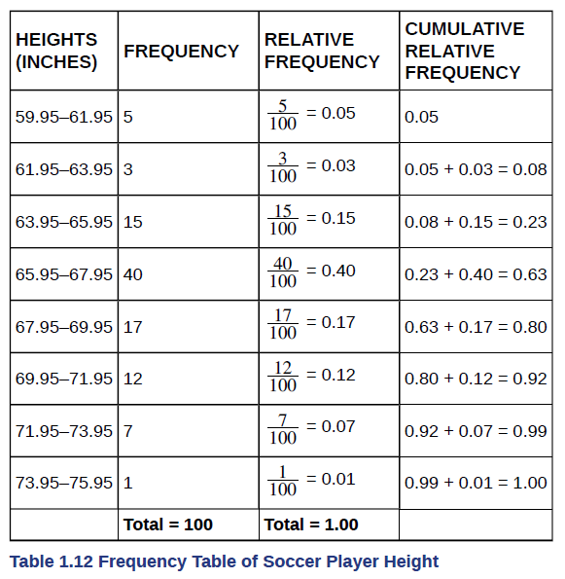
Frequency and Frequency Tables
Example
The percentage of heights that are from 67.95 to 71.95 inches is: ____.
The percentage of heights that are from 67.95 to 73.95 inches is: ____.
The percentage of heights that are more than 65.95 inches is: ____.
The number of players in the sample who are between 61.95 and 71.95 inches tall is: ____.
What kind of data are the heights?
Describe how you could gather this data (the heights) so that the data are characteristic of all male semiprofessional soccer players.

Slide 50
Frequency and Frequency Tables
Example - Answers
The percentage of heights that are from 67.95 to 71.95 inches is: ____.
The percentage of heights that are from 67.95 to 73.95 inches is: ____.
The percentage of heights that are more than 65.95 inches is: ____.
The number of players in the sample who are between 61.95 and 71.95 inches tall is: ____.
What kind of data are the heights?
Describe how you could gather this data (the heights) so that the data are characteristic of all male semiprofessional soccer players.
Answers:
29%
36%
77%
87
quantitative continuous
get rosters from each team and choose a simple random sample from each

Slide 51
Excel Exercises
Computing frequency calculations

Slide 52
Frequency Example with Excel
Number of Years of Service | Number of Federal Employees
24 | 2
25 | 1
26 | 3
27 | 0
28 | 4
29 | 6
30 | 11
31 | 12
32 | 7
33 | 8
34 | 6
35 | 10
What is the cumulative frequency for years of service between 30 and 35 (inclusive)?
What is the relative frequency for 30 years of service?
What is the relative frequency for 30 years of service or less?
What is the relative frequency for 25 years of service or more?

Slide 53
Frequency Example - Answers
What is the cumulative frequency for years of service between 30 and 35 (inclusive)?
What is the relative frequency for 30 years of service?
What is the relative frequency for 30 years of service or less?
What is the relative frequency for 25 years of service or more?
Answers:
Cumulative frequency is 54.
11/70 or 0.157 or 15.7%
27/70 or 0.386 or 38.6%
68/70 or 0.971 or 97.1%

Slide 54
Section 1.4
Experimental Design and Ethics

Slide 55
Experimental Design Variables
The purpose of an experiment is to investigate the relationship between two variables.
When one variable causes change in another, we call the first variable the explanatory variable. The affected variable is called the response variable.
In a randomized experiment, the researcher manipulates values of the explanatory variable and measures the resulting changes in the response variable.
The different values of the explanatory variable are called treatments. An experimental unit is a single object or individual to be measured.

Slide 56
Discussion
What should you consider if you are trying to run an experiment and why?

Slide 57
Experimental Design
Additional variables that can cloud a study are called lurking variables. In order to prove that the explanatory variable is causing a change in the response variable, it is necessary to isolate the explanatory variable.
The researcher must design the experiment in such a way that there is only one difference between groups being compared: the planned treatments. This is accomplished by the random assignment of experimental units to treatment groups.
When subjects are assigned treatments randomly, all of the potential lurking variables are spread equally among the groups.
When participation in a study prompts a physical response from a participant, it is difficult to isolate the effects of the explanatory variable.

Slide 58
Experimental Design (Cont)
To counter the power of suggestion, researchers set aside one treatment group as a control group. This group is given a placebo treatment–a treatment that cannot influence the response variable. The control group helps researchers balance the effects of being in an experiment with the effects of the active treatments.
Of course, if you are participating in a study and you know that you are receiving a pill which contains no actual medication, then the power of suggestion is no longer a factor. Blinding in a randomized experiment preserves the power of suggestion.
When a person involved in a research study is blinded, he does not know who is receiving the active treatment(s) and who is receiving the placebo treatment. A double-blind experiment is one in which both the subjects and the researchers involved with the subjects are blinded.

Slide 59
Ethics
The widespread misuse and misrepresentation of statistical information often gives the field a bad name.
Some say that “numbers don’t lie,” but the people who use numbers to support their claims often do.
Many types of statistical fraud are difficult to spot. Some researchers simply stop collecting data once they have just enough to prove what they had hoped to prove.
They don’t want to take the chance that a more extensive study would complicate their lives by producing data contradicting their hypothesis.

