Slide 1

Chapter 2 Descriptive Statistics
Openstax statistics

Slide 2
Objectives
By the end of this chapter, the student should be able to:
Display data graphically and interpret graphs: stemplots, histograms, and box plots.
Recognize, describe, and calculate the measures of location of data: quartiles and percentiles.
Recognize, describe, and calculate the measures of the center of data: mean, median, and mode.
Recognize, describe, and calculate the measures of the spread of data: variance, standard deviation, and range.

Slide 3
Section 2.1
Stem-and-Leaf Graphs (Stemplots), Line Graphs, and
Bar Graphs

Slide 4
Stem-and-Leaf Graphs (Stemplots)
One simple graph, the stem-and-leaf graph or stemplot, comes from the field of exploratory data analysis. It is a good choice when the data sets are small.
To create the plot, divide each observation of data into a stem and a leaf. The leaf consists of a final significant digit.
For example, 23 has stem two and leaf three. The number 432 has stem 43 and leaf two. Likewise, the number 5,432 has stem 543 and leaf two. The decimal 9.3 has stem nine and leaf three.
Write the stems in a vertical line from smallest to largest. Draw a vertical line to the right of the stems. Then write the leaves in increasing order next to their corresponding stem.

Slide 5
Stem-and-Leaf Graphs (Stemplots)
Continued
The stemplot is a quick way to graph data and gives an exact picture of the data.
You want to look for an overall pattern and any outliers. An outlier is an observation of data that does not fit the rest of the data. It is sometimes called an extreme value.
When you graph an outlier, it will appear not to fit the pattern of the graph.
Some outliers are due to mistakes (for example, writing down 50 instead of 500) while others may indicate that something unusual is happening. It takes some background information to explain outliers, so we will cover them in more detail later.

Slide 6
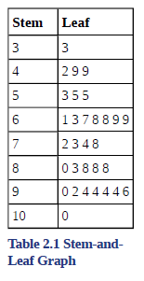
Stem-and-Leaf Graphs (Stemplots)
Example
For Susan Dean's spring pre-calculus class, scores for the first exam were as follows (smallest to largest):
33; 42; 49; 49; 53; 55; 55; 61; 63; 67; 68; 68; 69; 69; 72; 73; 74; 78; 80; 83; 88; 88; 88; 90; 92; 94; 94; 94; 94; 96; 100
The stemplot shows that most scores fell in the 60s, 70s, 80s, and 90s.
Eight out of the 31 scores or approximately 26% (8/31)
were in the 90s or 100, a fairly high number of As.

Slide 7
Stem-and-Leaf Graphs (Stemplots)
Example
A side-by-side stem-and-leaf plot allows a comparison of the two data sets in two columns. In a side-by-side stem-and-leaf plot, two sets of leaves share the same stem. The leaves are to the left and the right of the stems. Table 2.4 and Table 2.5 show the ages of presidents at their inauguration and at their death. Construct a side-by-side stem-and-leaf plot using this data.
See next slide for data and stem-and-leaf plot.

Slide 8
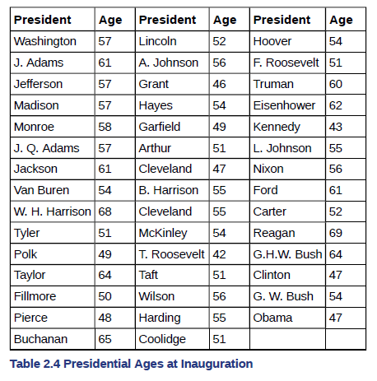
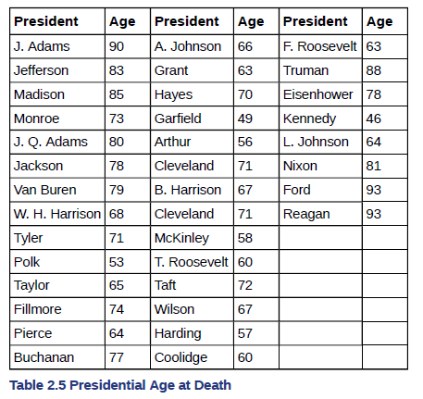
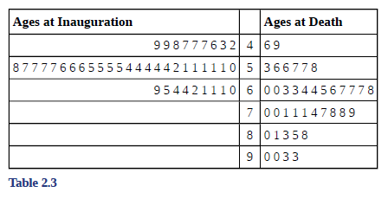

Slide 9
A Note on Excel
Excel does not have an easy way to create stem-and-leaf plots, these are typically created by hand

Slide 10
Line Graphs
Another type of graph that is useful for specific data values is a line graph.
The x-axis (horizontal axis) consists of data values and the y-axis (vertical axis) consists of frequency points.
The frequency points are connected using line segments.

Slide 11
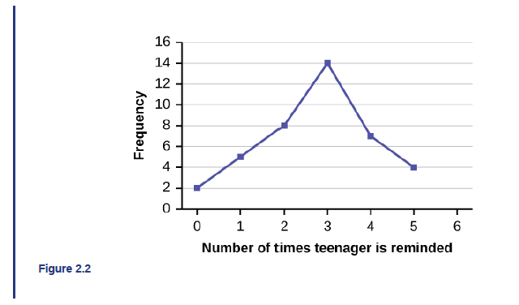
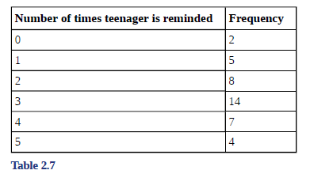
Line Graph Example
In a survey, 40 mothers were asked how many times per week a teenager must be reminded to do his or her chores. The results are shown in Table 2.7 and in Figure 2.2.

Slide 12
Bar Graphs
Bar graphs consist of bars that are separated from each other.
The bars can be rectangles or they can be rectangular boxes (used in three-dimensional plots), and they can be vertical or horizontal.

Slide 13
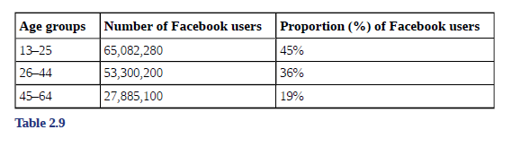
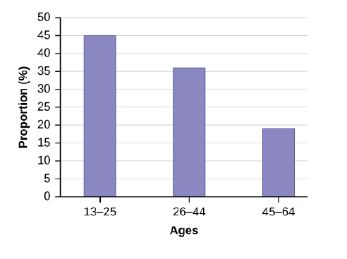
Bar Graph Example
By the end of 2011, Facebook had over 146 million users in the United States. Table 2.9 shows three age groups, the number of users in each age group, and the proportion (%) of users in each age group. A bar graph of this data is shown below.

Slide 14
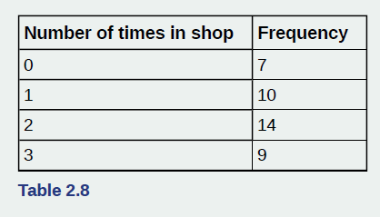
Excel Example
In a survey, 40 people were asked how many times per year they had their car in the shop for repairs. The results are shown in Table 2.8 and the chapter Excel file. Construct a line graph and a bar graph.

Slide 15
Section 2.2
Histograms, Frequency Polygons, and Time Series
Graphs

Slide 16
Histograms
A histogram consists of contiguous (adjoining) boxes. It has both a horizontal axis and a vertical axis.
The horizontal axis is labeled with what the data represents (for instance, distance from your home to school).
The vertical axis is labeled either frequency or relative frequency (or percent frequency or probability).
The graph will have the same shape with either label.
The histogram (like the stemplot) can give you the shape of the data, the center, and the spread of the data.

Slide 17
How to Construct a Histogram
To construct a histogram, first decide how many bars or intervals, also called classes, represent the data. Many histograms consist of five to 15 bars or classes for clarity.
Choose a starting point for the first interval to be less than the smallest data value. A convenient starting point is a lower value carried out to one more decimal place than the value with the most decimal places.
For example, if the value with the most decimal places is 6.1 and this is the smallest value, a convenient starting point is 6.05 (6.1 – 0.05 = 6.05). If all the data happen to be integers and the smallest value is two, then a convenient starting point is 1.5 (2 – 0.5 = 1.5).
Also, when the starting point and other boundaries are carried to one additional decimal place, no data value will fall on a boundary.
Next, calculate the width of each bar or class interval. To calculate this width, subtract the starting point from the ending value and divide by the number of bars (you must choose the number of bars you desire).

Slide 18
Histogram Example
The following data are the heights (in inches to the nearest half inch) of 100 male semiprofessional soccer players. The heights are continuous data, since height is measured.
60; 60.5; 61; 61; 61.5
63.5; 63.5; 63.5
64; 64; 64; 64; 64; 64; 64; 64.5; 64.5; 64.5; 64.5; 64.5; 64.5; 64.5; 64.5
66; 66; 66; 66; 66; 66; 66; 66; 66; 66; 66.5; 66.5; 66.5; 66.5; 66.5; 66.5; 66.5; 66.5; 66.5; 66.5; 66.5; 67; 67; 67; 67; 67; 67; 67; 67; 67; 67; 67; 67; 67.5; 67.5; 67.5; 67.5; 67.5; 67.5; 67.5
68; 68; 69; 69; 69; 69; 69; 69; 69; 69; 69; 69; 69.5; 69.5; 69.5; 69.5; 69.5
70; 70; 70; 70; 70; 70; 70.5; 70.5; 70.5; 71; 71; 71
72; 72; 72; 72.5; 72.5; 73; 73.5
74
The smallest data value is 60. Since the data with the most decimal places has one decimal (for instance, 61.5), we want our starting point to have two decimal places. Since the numbers 0.5, 0.05, 0.005, etc. are convenient numbers, use 0.05 and subtract it from 60, the smallest value, for the convenient starting point.
60 – 0.05 = 59.95 which is more precise than, say, 61.5 by one decimal place. The starting point is, then, 59.95.
The largest value is 74, so 74 + 0.05 = 74.05 is the ending value.
Next, calculate the width of each bar or class interval. To calculate this width, subtract the starting point from the ending value and divide by the number of bars (you must choose the number of bars you desire). Suppose you choose eight bars.

Slide 19
Histogram Example Continued
We will round up to two and make each bar or class interval two units wide. Rounding up to two is one way to prevent a value from falling on a boundary. Rounding to the next number is often necessary even if it goes against the standard rules of rounding. For this example, using 1.76 as the width would also work. A guideline that is followed by some for the number of bars or class intervals is to take the square root of the number of data values and then round to the nearest whole number, if necessary. For example, if there are 150 values of data, take the square root of 150 and round to 12 bars or intervals. Create the boundaries by adding the width to the starting point and so on to create the total number of classes needed. The boundaries are:
59.95
59.95 + 2 = 61.95
61.95 + 2 = 63.95
63.95 + 2 = 65.95
65.95 + 2 = 67.95
67.95 + 2 = 69.95
69.95 + 2 = 71.95
71.95 + 2 = 73.95
73.95 + 2 = 75.95

Slide 20
Histogram Example Continued
The heights 60 through 61.5 inches are in the interval 59.95–61.95. The heights that are 63.5 are in the interval 61.95–63.95. The heights that are 64 through 64.5 are in the interval 63.95–65.95. The heights 66 through 67.5 are in the interval 65.95–67.95. The heights 68 through 69.5 are in the interval 67.95–69.95. The heights 70 through 71 are in the interval 69.95–71.95. The heights 72 through 73.5 are in the interval 71.95–73.95. The height 74 is in the interval 73.95–75.95.
The following histogram displays the heights on the x-axis and relative frequency on the y-axis (see next slide).

Slide 21
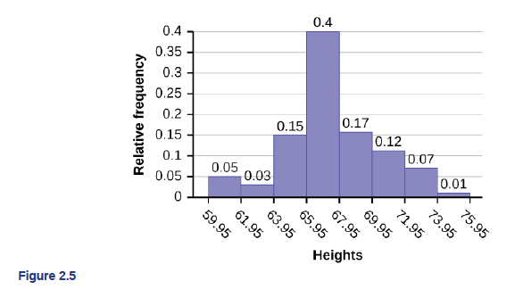

Slide 22
Excel Example
See the chapter 2 workbook to see two ways to make a histogram

Slide 23
Discussion
What are the pros and cons to each method for creating histograms in excel?

Slide 24
Frequency Polygons
Frequency polygons are analogous to line graphs, and just as line graphs make continuous data visually easy to interpret, so too do frequency polygons.
To construct a frequency polygon, first examine the data and decide on the number of intervals, or class intervals, to use on the x-axis and y-axis.
After choosing the appropriate ranges, begin plotting the data points.
After all the points are plotted, draw line segments to connect them.

Slide 25
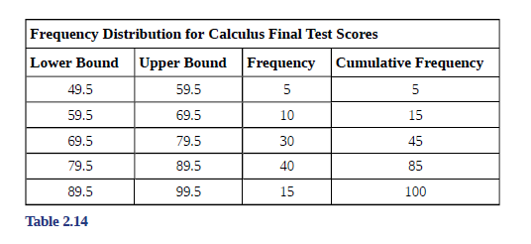
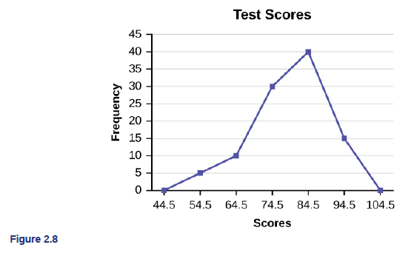
Frequency Polygon Example
A frequency polygon was constructed from the frequency table below.

Slide 26
Time Series Graph
To construct a time series graph, we must look at both pieces of our paired data set. We start with a standard Cartesian coordinate system.
The horizontal axis is used to plot the date or time increments, and the vertical axis is used to plot the values of the variable that we are measuring. By doing this, we make each point on the graph correspond to a date and a measured quantity.
The points on the graph are typically connected by straight lines in the order in which they occur.

Slide 27
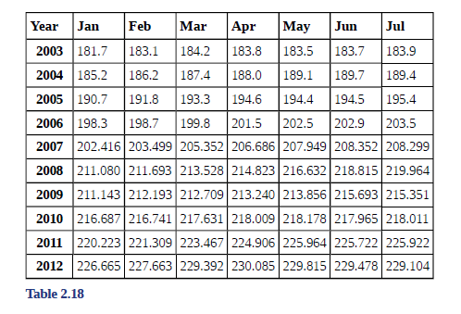
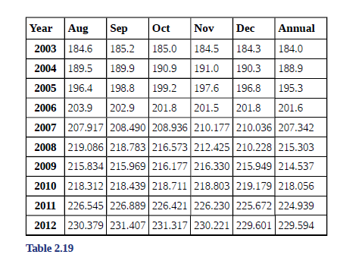
Time Series Example
The following data shows the Annual Consumer Price Index, each month, for ten years. Construct a time series graph for the Annual Consumer Price Index data only. See next slide for graph.

Slide 28
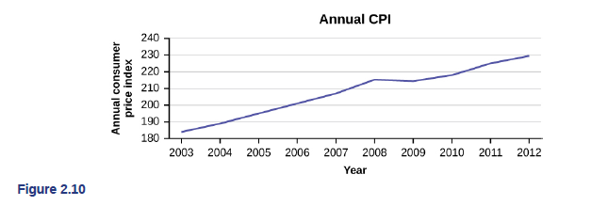
Time Series Example Continued

Slide 29
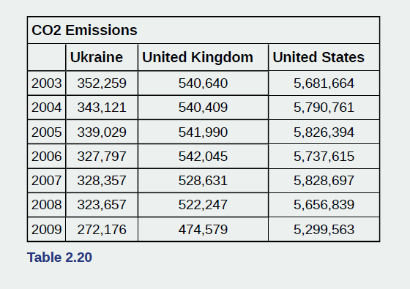
Time Series Excel Example
The following table is a portion of a data set from www.worldbank.org. Use the table to construct a time series graph for CO₂ emissions for the United States. See Excel file.

Slide 30
Section 2.3
Measures of the Location of the Data

Slide 31
Measures of the Location of the Data
The median is a number that measures the "center" of the data.
You can think of the median as the "middle value," but it does not actually have to be one of the observed values.
It is a number that separates ordered data into halves. Half the values are the same number or smaller than the median, and half the values are the same number or larger.
The median, M, is called both the second quartile and the 50th percentile.

Slide 32
Measures of the Location of the Data (Continued)
The common measures of location are quartiles and percentiles.
Percentiles divide ordered data into hundredths.
To score in the 90th percentile of an exam does not mean, necessarily, that you received 90% on a test. It means that 90% of test scores are the same or less than your score and 10% of the test scores are the same or greater than your test score.
To calculate percentiles, the data must be ordered from smallest to largest.

Slide 33
Measures of the Location of the Data (Continued)
Quartiles divide ordered data into quarters.
The first quartile, Q1, is the middle value of the lower half of the data, and the third quartile, Q3, is the middle value of the upper half of the data.
The first quartile, Q1, is the same as the 25th percentile, and the third quartile, Q3, is the same as the 75th percentile.
Quartiles may or may not be part of the data.
To calculate quartiles, the data must be ordered from smallest to largest.

Slide 34
Differences in Quartiles
There are different methods in statistics for computing quartiles. Depending on what statistics book you are using, you might get different answers for Q1 / Q2 / Q3.
Tukey method: find Q1 and Q3 by dividing up the data but not including the median
M&M method: find Q1 and Q3 by dividing up the data and include the median
Excel quartiles: Excel uses a percentile method for computing quartiles and there are formulas to include or exclude the median within this calculation
A comparison of these methods will be explored in the Excel example

Slide 35
Interquartile Range (IQR)
The interquartile range is a number that indicates the spread of the middle half or the middle 50% of the data.
It is the difference between the third quartile (Q3) and the first quartile (Q1).
IQR = Q3 – Q1
The IQR can help to determine potential outliers.
A value is suspected to be a potential outlier if it is less than (1.5)(IQR) below the first quartile or more than (1.5)(IQR) above the third quartile. Potential outliers always require further investigation.
NOTE: A potential outlier is a data point that is significantly different from the other data points. These special data points may be errors or some kind of abnormality or they may be a key to understanding the data.

Slide 36
Median and Quartiles Example
For the following 13 real estate prices:
389,950; 230,500; 158,000; 479,000; 639,000; 114,950; 5,500,000; 387,000; 659,000; 529,000; 575,000; 488,800; 1,095,000
Compute Q1, Q2, Q3, and IQR using:
The Tukey method
The M&M method
The Excel formulas

Slide 37
Which Method Should You Use?
In the OpenStax text: the Tukey method is used for all answers
For large data sets: realistically you would use a computer to compute the quartiles
Your instructor will tell you the method to use for the activity

Slide 38
Interpreting Percentiles, Quartiles, and Median Example
On a timed math test, the first quartile for time it took to finish the exam was 35 minutes. Interpret the first quartile in the context of this situation.

Slide 39
Interpreting Percentiles, Quartiles, and Median Example - Answer
On a timed math test, the first quartile for time it took to finish the exam was 35 minutes. Interpret the first quartile in the context of this situation.
Twenty-five percent of students finished the exam in 35 minutes or less.
Seventy-five percent of students finished the exam in 35 minutes or more.
A low percentile could be considered good, as finishing more quickly on a timed exam is desirable. (If you take too long, you might not be able to finish.)

Slide 40
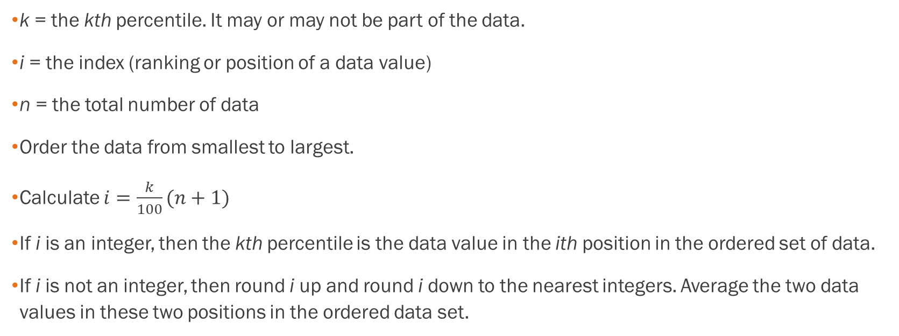
A Formula for Finding the kth Percentile
k = the kth percentile. It may or may not be part of the data.
i = the index (ranking or position of a data value)
n = the total number of data
Order the data from smallest to largest.
Calculate $i=\frac{k}{100}(n+1)$
If i is an integer, then the kth percentile is the data value in the ith position in the ordered set of data.
If i is not an integer, then round i up and round i down to the nearest integers. Average the two data values in these two positions in the ordered data set.

Slide 41
Finding the kth Percentile Example
Listed are 29 ages for Academy Award winning best actors in order from smallest to largest.
18; 21; 22; 25; 26; 27; 29; 30; 31; 33; 36; 37; 41; 42; 47; 52; 55; 57; 58; 62; 64; 67; 69; 71; 72; 73; 74; 76; 77
A) Find the 70th percentile.
B) Find the 83rd percentile.

Slide 42
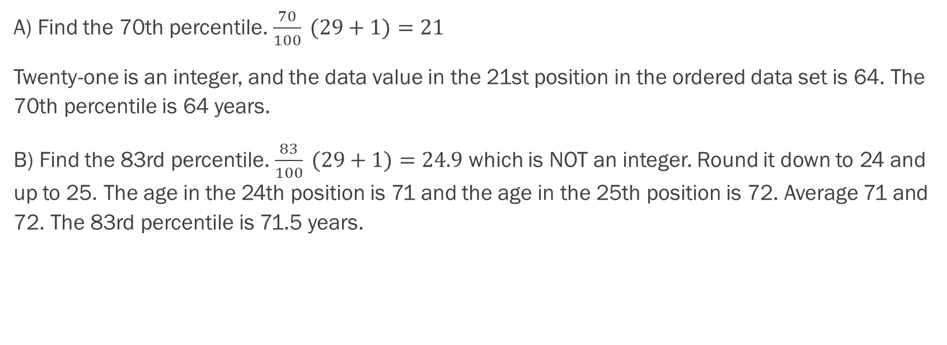
Finding the kth Percentile Example - Answers
A) Find the 70th percentile. $\frac{70}{100} (29+1)=21$
Twenty-one is an integer, and the data value in the 21st position in the ordered data set is 64. The 70th percentile is 64 years.
B) Find the 83rd percentile. $\frac{83}{100} (29+1)=24.9$ which is NOT an integer. Round it down to 24 and up to 25. The age in the 24th position is 71 and the age in the 25th position is 72. Average 71 and 72. The 83rd percentile is 71.5 years.

Slide 43
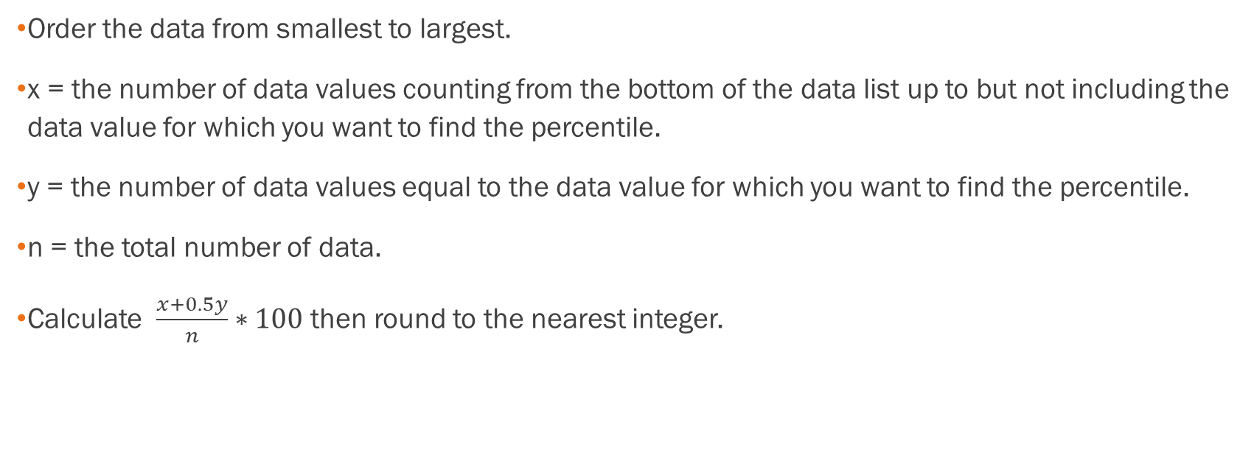
Finding the Percentile of a Value in a Data Set
Order the data from smallest to largest.
x = the number of data values counting from the bottom of the data list up to but not including the data value for which you want to find the percentile.
y = the number of data values equal to the data value for which you want to find the percentile.
n = the total number of data.
Calculate $\frac{x+0.5y}{n}∗100$ then round to the nearest integer.

Slide 44
Finding the Percentile of a Value in a Data Set Example
Listed are 29 ages for Academy Award winning best actors in order from smallest to largest.
18; 21; 22; 25; 26; 27; 29; 30; 31; 33; 36; 37; 41; 42; 47; 52; 55; 57; 58; 62; 64; 67; 69; 71; 72; 73; 74; 76; 77
A) Find the percentile for 58.
B) Find the percentile for 25.

Slide 45
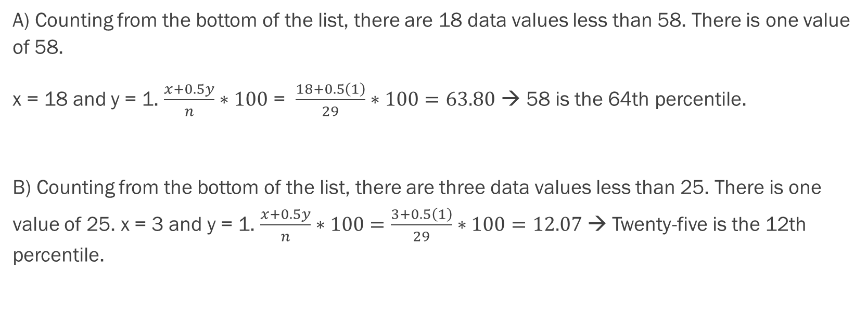
Finding the Percentile of a Value in a Data Set Example - Answers
A) Counting from the bottom of the list, there are 18 data values less than 58. There is one value of 58.
x = 18 and y = 1. $\frac{x+0.5y}{n}∗100$ = $\frac{18+0.5\left(1\right)}{29}∗100=63.80$ → 58 is the 64th percentile.
B) Counting from the bottom of the list, there are three data values less than 25. There is one value of 25. x = 3 and y = 1. $\frac{x+0.5y}{n}∗100=\frac{3+0.5\left(1\right)}{29}∗100=12.07$ → Twenty-five is the 12th percentile.

Slide 46
Excel Exercises
See the excel workbook to see how to compute these previous two examples with excel formulas

Slide 47
Section 2.4
box plots

Slide 48
Box Plots
Box plots (also called box-and-whisker plots or box-whisker plots) give a good graphical image of the concentration of the data.
They also show how far the extreme values are from most of the data.
A box plot is constructed from five values: the minimum value, the first quartile, the median, the third quartile, and the maximum value.

Slide 49
Box Plots (Continued)
To construct a box plot, use a horizontal or vertical number line and a rectangular box.
The smallest and largest data values label the endpoints of the axis. The first quartile marks one end of the box and the third quartile marks the other end of the box. Approximately the middle 50 percent of the data fall inside the box. The "whiskers" extend from the ends of the box to the smallest and largest data values.
The median or second quartile can be between the first and third quartiles, or it can be one, or the other, or both. The box plot gives a good, quick picture of the data.
NOTE: You may encounter box-and-whisker plots that have dots marking outlier values. In those cases, the whiskers are not extending to the minimum and maximum values.

Slide 50
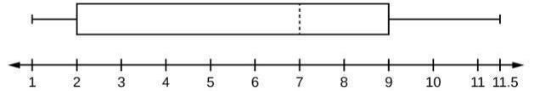
Box Plots (Continued)
The two whiskers extend from the first quartile to the smallest value and from the third quartile to the largest value. The median is shown with a dashed line.
NOTE: It is important to start a box plot with a scaled number line. Otherwise the box plot may not be useful.

Slide 51

Box Plots Example
The following data are the heights of 40 students in a statistics class.
59; 60; 61; 62; 62; 63; 63; 64; 64; 64; 65; 65; 65; 65; 65; 65; 65; 65; 65; 66; 66; 67; 67; 68; 68; 69; 70; 70; 70; 70; 70; 71; 71; 72; 72; 73; 74; 74; 75; 77
Construct a box plot.
Minimum value = 59
Maximum value = 77
Q1: First quartile = 64.5
Q2: Second quartile or median= 66
Q3: Third quartile = 70

Slide 52
Box Plots Example – Some Notes
Each quarter has approximately 25% of the data.
The spreads of the four quarters are 64.5 – 59 = 5.5 (first quarter), 66 – 64.5 = 1.5 (second quarter), 70 – 66 = 4 (third quarter), and 77 – 70 = 7 (fourth quarter). So, the second quarter has the smallest spread and the fourth quarter has the largest spread.
Range = maximum value – the minimum value = 77 – 59 = 18
Interquartile Range: IQR = Q3 – Q1 = 70 – 64.5 = 5.5.
The interval 59–65 has more than 25% of the data so it has more data in it than the interval 66 through 70 which has 25% of the data.
The middle 50% (middle half) of the data has a range of 5.5 inches.

Slide 53
Box Plots – Excel Example
Follow the steps you used to graph a box-and-whisker plot for the data values shown. See Excel.
0; 5; 5; 15; 30; 30; 45; 50; 50; 60; 75; 110; 140; 240; 330

Slide 54
Section 2.5
Measures of the Center of the Data

Slide 55
Measures of the Center
The "center" of a data set is also a way of describing location. The two most widely used measures of the "center" of the data are the mean (average) and the median.
To calculate the mean weight of 50 people, add the 50 weights together and divide by 50.
To find the median weight of the 50 people, order the data and find the number that splits the data into two equal parts.
NOTE: The words “mean” and “average” are often used interchangeably. The substitution of one word for the other is common practice. The technical term is “arithmetic mean” and “average” is technically a center location. However, in practice among non-statisticians, “average" is commonly accepted for “arithmetic mean.”

Slide 56

Measures of the Center (Continued)
The letter used to represent the sample mean is an x with a bar over it (pronounced “x bar”): $\overline{x}$.
The Greek letter μ (pronounced "mew") represents the population mean.
One of the requirements for the sample mean to be a good estimate of the population mean is for the sample taken to be truly random.

Slide 57
Measures of the Center (Continued)
If the total number of data values in the sample is an odd number, the median is the middle value of the ordered data (ordered smallest to largest).
If the total number of data values in the sample is an even number, the median is equal to the two middle values added together and divided by two after the data has been ordered.
The location of the median and the value of the median are not the same.
The upper case letter M is often used to represent the median.

Slide 58
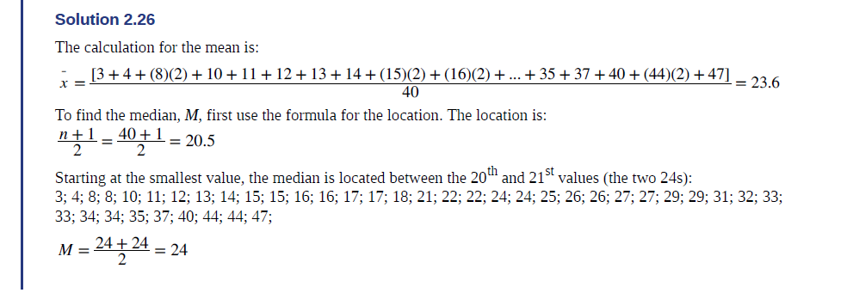
Measures of the Center Example
AIDS data indicating the number of months a patient with AIDS lives after taking a new antibody drug are as follows (smallest to largest):
3; 4; 8; 8; 10; 11; 12; 13; 14; 15; 15; 16; 16; 17; 17; 18; 21; 22; 22; 24; 24; 25; 26; 26; 27; 27; 29; 29; 31; 32; 33; 33; 34; 34; 35; 37; 40; 44; 44; 47
Calculate the mean and the median.

Slide 59
Measures of the Center
Another measure of the center is the mode. The mode is the most frequent value.
There can be more than one mode in a data set as long as those values have the same frequency and that frequency is the highest. A data set with two modes is called bimodal.
NOTE: The mode can be calculated for qualitative data as well as for quantitative data. For example, if the data set is: red, red, red, green, green, yellow, purple, black, blue, the mode is red.

Slide 60
Mode Example
Five real estate exam scores are 430, 430, 480, 480, 495.
The data set is bimodal because the scores 430 and 480 each occur twice.

Slide 61
Discussion
In a sample of 60 households, one house is worth $2,500,000. Half of the rest are worth $280,000, and all the others are worth $315,000. Which is the better measure of the “center”: the mean, median, or mode?

Slide 62
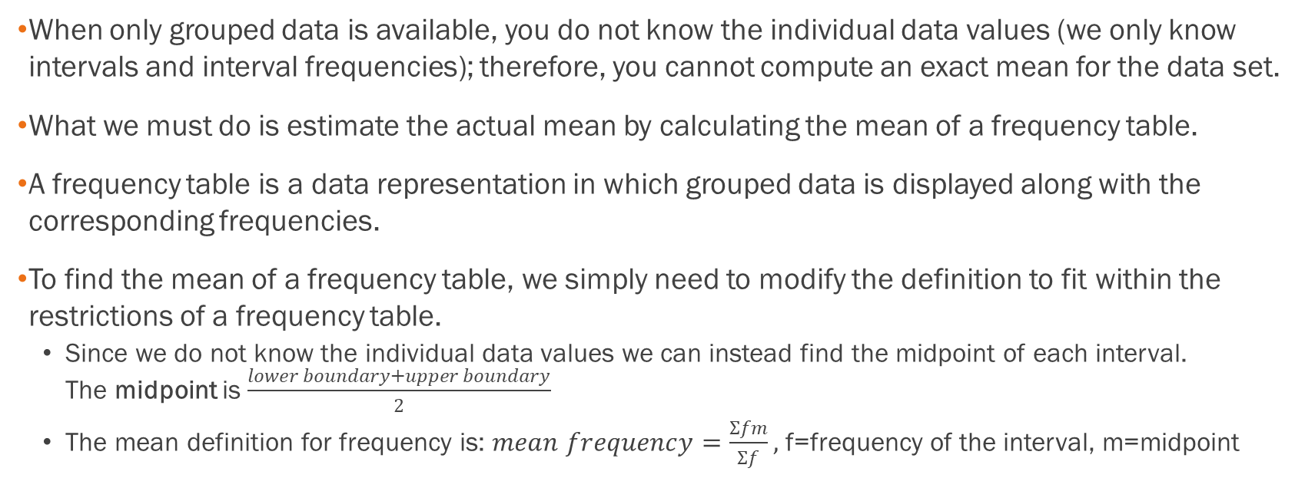
Calculating the Mean of Grouped
Frequency Tables
When only grouped data is available, you do not know the individual data values (we only know intervals and interval frequencies); therefore, you cannot compute an exact mean for the data set.
What we must do is estimate the actual mean by calculating the mean of a frequency table.
A frequency table is a data representation in which grouped data is displayed along with the corresponding frequencies.
To find the mean of a frequency table, we simply need to modify the definition to fit within the restrictions of a frequency table.
  Since we do not know the individual data values we can instead find the midpoint of each interval. The midpoint is $\frac{lower boundary+upper boundary}{2}$
  The mean definition for frequency is: $mean frequency=\frac{Σfm}{Σf},$ f=frequency of the interval, m=midpoint

Slide 63
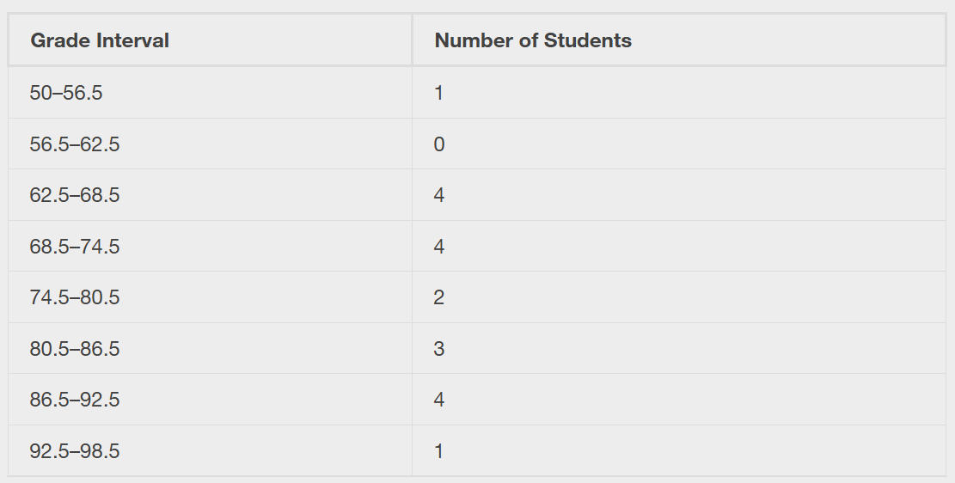
Example
A frequency table displaying professor Blount’s last statistic test is shown. Find the best estimate of the class mean. See the Excel spreadsheet for data.

Slide 64
Solution
Find the midpoints for all intervals
Grade interval Midpoint
50–56.5 53.25
56.5–62.5 59.5
62.5–68.5 65.5
68.5–74.5 71.5
74.5–80.5 77.5
80.5–86.5 83.5
86.5–92.5 89.5
92.5–98.5 95.5

Slide 65

Solution, Continued
Calculate the sum of the product of each interval frequency and midpoint. ∑​fm
53.25(1)+59.5(0)+65.5(4)+71.5(4)+77.5(2)+83.5(3)+89.5(4)+95.5(1)=1460.25
$μ=\frac{∑fm}{∑f}=\frac{1460.25}{19}=76.86$

Slide 66
Section 2.6
Skewness and the Mean, Median, and Mode

Slide 67
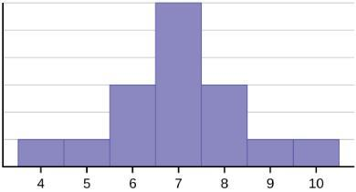
Skewness and the Mean, Median, and Mode
The histogram displays a symmetrical distribution of data.
A distribution is symmetrical if a vertical line can be drawn at some point in the histogram such that the shape to the left and the right of the vertical line are mirror images of each other.
In a perfectly symmetrical distribution, the mean and the median are the same.
This example has one mode (unimodal), and the mode is the same as the mean and median.
In a symmetrical distribution that has two modes (bimodal), the two modes would be different from the mean and median.

Slide 68
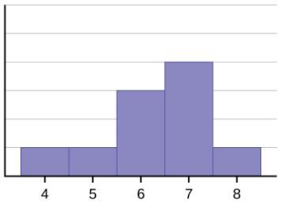
Skewness and the Mean, Median, and Mode (Continued)
The right-hand side seems "chopped off" compared to the left side.
A distribution of this type is called skewed to the left because it is pulled out to the left.
Notice that the mean is less than the median, and they are both less than the mode. The mean and the median both reflect the skewing, but the mean reflects it more so.
To summarize, generally if the distribution of data is skewed to the left, the mean is less than the median, which is often less than the mode.

Slide 69
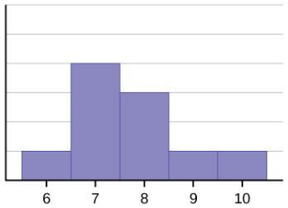
Skewness and the Mean, Median, and Mode (Continued)
A distribution of this type is called skewed to the right because it is pulled out to the right.
Of the three statistics, the mean is the largest, while the mode is the smallest. Again, the mean reflects the skewing the most.
To summarize, if the distribution of data is skewed to the right, the mode is often less than the median, which is less than the mean.

Slide 70
Symmetric vs Skewed Data
The mean is affected by outliers that do not influence the median.
When the distribution of data is skewed to the left, the mean is often less than the median.
When the distribution is skewed to the right, the mean is often greater than the median.
In symmetric distributions, we expect the mean and median to be approximately equal in value.
Skewness and symmetry become important when we discuss probability distributions in later chapters.

Slide 71
Section 2.7
Measures of the Spread of the Data

Slide 72
Measures of the Spread of the Data
An important characteristic of any set of data is the variation in the data.
In some data sets, the data values are concentrated closely near the mean; in other data sets, the data values are more widely spread out from the mean.
The most common measure of variation, or spread, is the standard deviation. The standard deviation is a number that measures how far data values are from their mean.

Slide 73
Measures of the Spread of the Data
(Continued)
The standard deviation provides a measure of the overall variation in a data set
The standard deviation is always positive or zero.
The standard deviation is small when the data are all concentrated close to the mean, exhibiting little variation or spread.
The standard deviation is larger when the data values are more spread out from the mean, exhibiting more variation.

Slide 74
Measures of the Spread of the Data
(Continued)
The standard deviation can be used to determine whether a data value is close to or far from the mean.
A data value that is two standard deviations from the average is just on the borderline for what many statisticians would consider to be far from the average.
Considering data to be far from the mean if it is more than two standard deviations away is more of an approximate "rule of thumb" than a rigid rule.
In general, the shape of the distribution of the data affects how much of the data is further away than two standard deviations. (You will learn more about this in later chapters.)

Slide 75
Calculating the Standard Deviation
The procedure to calculate the standard deviation depends on whether the numbers are the entire population or are data from a sample.
The calculations are similar, but not identical. Therefore the symbol used to represent the standard deviation depends on whether it is calculated from a population or a sample.
The lower case letter s represents the sample standard deviation and the Greek letter σ (sigma, lower case) represents the population standard deviation.
If the sample has the same characteristics as the population, then s should be a good estimate of σ.

Slide 76
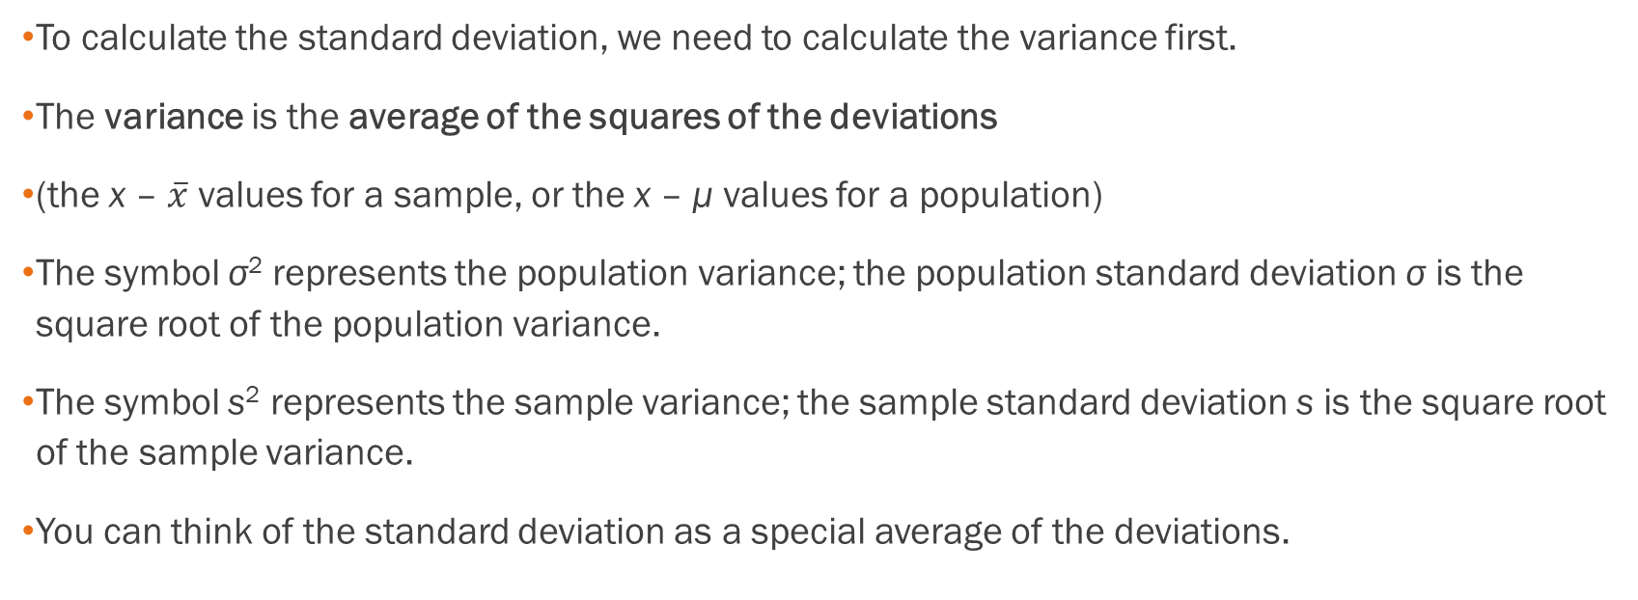
Calculating the Standard Deviation
(Continued)
To calculate the standard deviation, we need to calculate the variance first.
The variance is the average of the squares of the deviations
(the x – $\overline{x}$ values for a sample, or the x – μ values for a population)
The symbol σ² represents the population variance; the population standard deviation σ is the square root of the population variance.
The symbol s² represents the sample variance; the sample standard deviation s is the square root of the sample variance.
You can think of the standard deviation as a special average of the deviations.

Slide 77
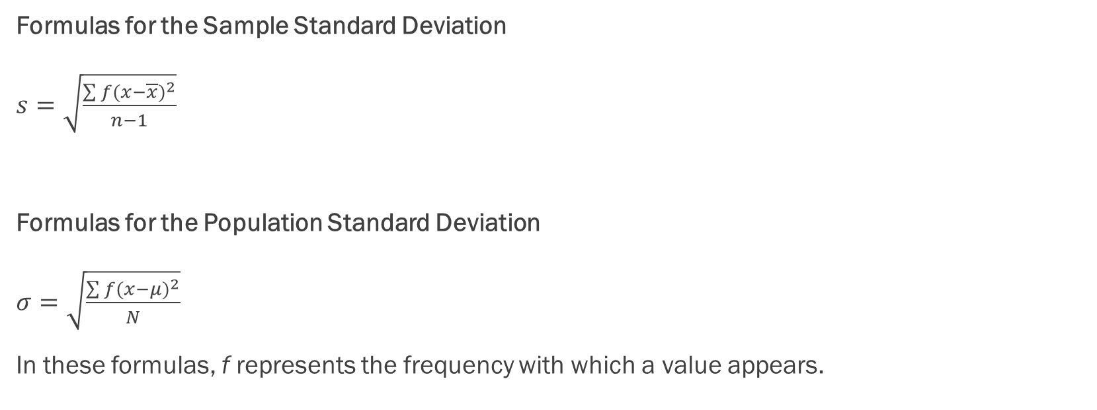
Formulas
Formulas for the Sample Standard Deviation
$s=\sqrt{\frac{\sum{{f(x−\overline{x})}^{2}}}{n−1}}$
Formulas for the Population Standard Deviation
$σ=\sqrt{\frac{\sum{f{(x−μ)}^{2}}}{N}}$
In these formulas, f represents the frequency with which a value appears.

Slide 78
Standard Deviation Example
In a fifth grade class, the teacher was interested in the average age and the sample standard deviation of the ages of her students. The following data are the ages for a SAMPLE of n = 20 fifth grade students.
The ages are rounded to the nearest half year:
9; 9.5; 9.5; 10; 10; 10; 10; 10.5; 10.5; 10.5; 10.5; 11; 11; 11; 11; 11; 11; 11.5; 11.5; 11.5;
The average age is 10.53 years, rounded to two places. The variance may be calculated by using a table.

Slide 79
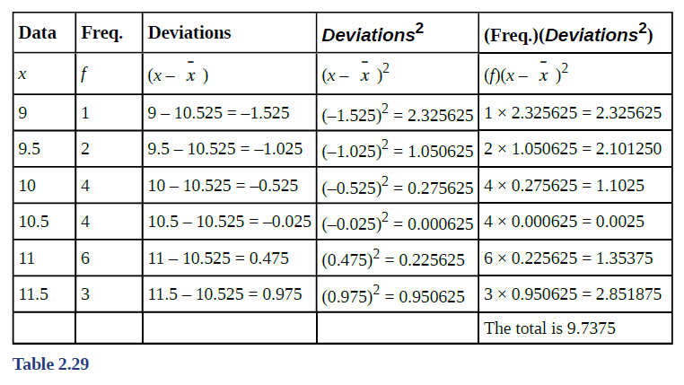
Standard Deviation Example
The ages are rounded to the nearest half year:
9; 9.5; 9.5; 10; 10; 10; 10; 10.5; 10.5; 10.5; 10.5; 11; 11; 11; 11; 11; 11; 11.5; 11.5; 11.5;
The variance may be calculated by using a table. Then the standard deviation is calculated by taking the square root of the variance.
We will explain the parts of the table after calculating s.
  The sample variance, s²,
  is equal to the sum of the last column (9.7375)
  divided by the total number of data values
  minus one (20 – 1):
  s² = 9.7375/(20−1) = 0.5125
  The sample standard deviation s is equal to the
  square root of the sample variance:
  s =√0.5125 = 0.715891,
  which is rounded to two decimal places, s = 0.72.

Slide 80
Standard Deviation Excel Example
On a baseball team, the ages of each of the players are as follows. See the Excel data file.
21; 21; 22; 23; 24; 24; 25; 25; 28; 29; 29; 31; 32; 33; 33; 34; 35; 36; 36; 36; 36; 38; 38; 38; 40
Find the mean and standard deviation. Then find the value that is two standard deviations above the mean.

Slide 81
Types of Variability
When trying to study a population, a sample is often used, either for convenience or because it is not possible to access the entire population.
Variability is the term used to describe the differences that may occur in these outcomes.
Common types of variability include the following:
  Observational or measurement variability: occurs when there are differences in the instruments used to measure or in the people using those instruments.
  Natural variability: arises from the differences that naturally occur because members of a population differ from each other.
  Induced variability: the counterpart to natural variability; this occurs because we have artificially induced an element of variation (that, by definition, was not present naturally):
  Sample variability: occurs when multiple random samples are taken from the same population.

Slide 82
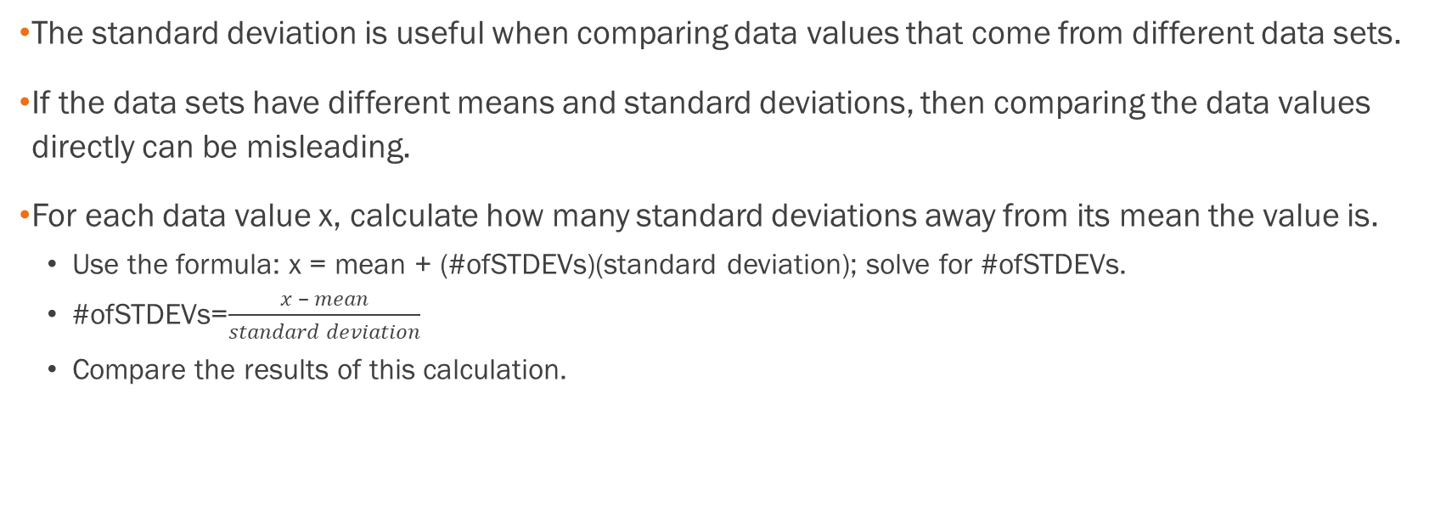
Comparing Values from Different Data Sets
The standard deviation is useful when comparing data values that come from different data sets.
If the data sets have different means and standard deviations, then comparing the data values directly can be misleading.
For each data value x, calculate how many standard deviations away from its mean the value is.
  Use the formula: x = mean + (#ofSTDEVs)(standard deviation); solve for #ofSTDEVs.
  #ofSTDEVs=$\frac{x – mean}{standard deviation}$
  Compare the results of this calculation.

Slide 83
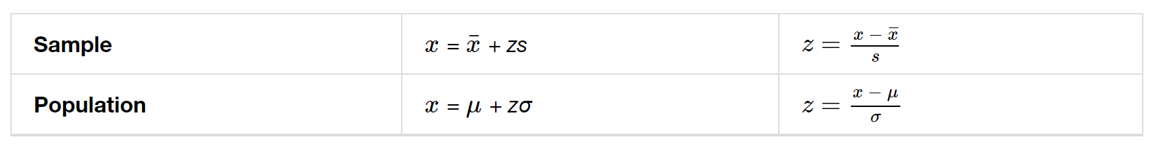
Z-Scores
#ofSTDEVs is often called a "z-score"; we can use the symbol z. In symbols, the formulas become:

Slide 84
Example
Two students, John and Ali, from different high schools, wanted to find out who had the highest GPA when compared to his school. Which student had the highest GPA when compared to his school?
Student GPA School mean GPA School standard deviation
John 2.85 3.0 0.7
Ali 77 80 10

Slide 85
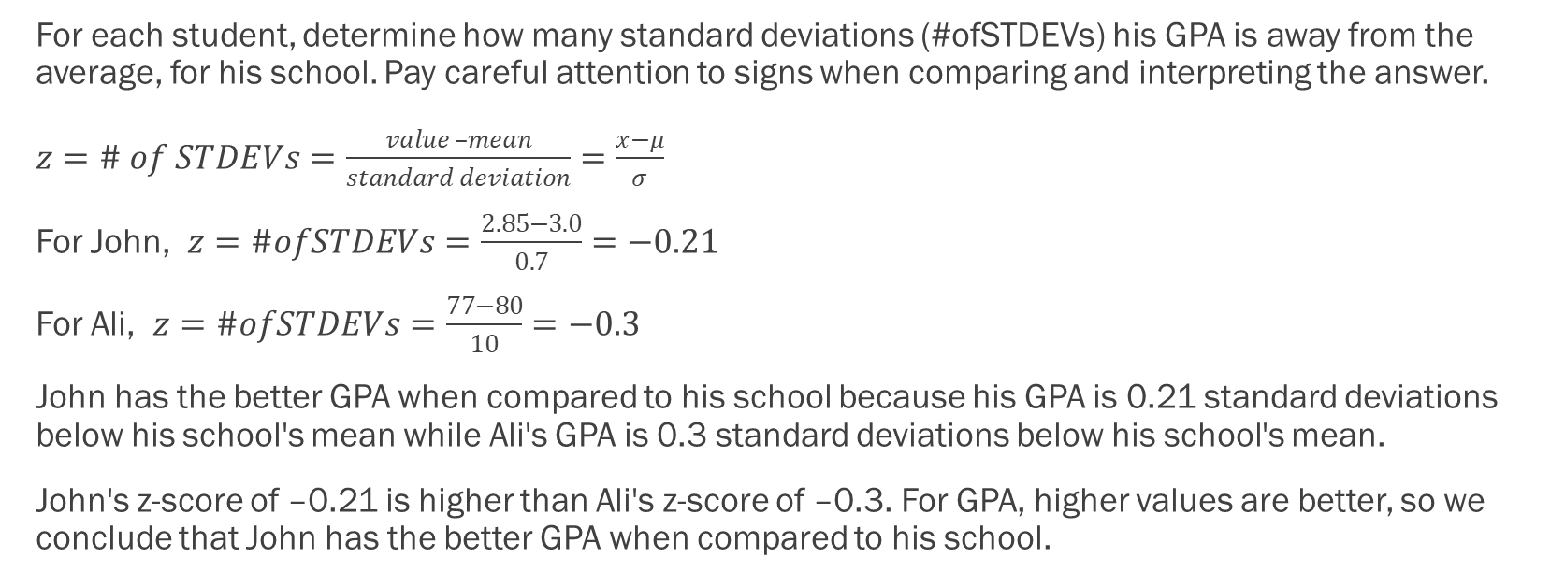
Example - Answer
For each student, determine how many standard deviations (#ofSTDEVs) his GPA is away from the average, for his school. Pay careful attention to signs when comparing and interpreting the answer.
$z=\# of STDEVs=\frac{value –mean}{standard deviation}=\frac{x−μ}{σ}$
For John, $z=\#ofSTDEVs=\frac{2.85−3.0}{0.7}=−0.21$
For Ali, $z=\#ofSTDEVs=\frac{77−80}{10}=−0.3$
John has the better GPA when compared to his school because his GPA is 0.21 standard deviations below his school's mean while Ali's GPA is 0.3 standard deviations below his school's mean.
John's z-score of –0.21 is higher than Ali's z-score of –0.3. For GPA, higher values are better, so we conclude that John has the better GPA when compared to his school.

Slide 86
For ANY data set, no matter what the distribution of the data is:
At least 75% of the data is within two standard deviations of the mean.
At least 89% of the data is within three standard deviations of the mean.
At least 95% of the data is within 4.5 standard deviations of the mean.
This is known as Chebyshev's Rule.

Slide 87
For data having a Normal Distribution, (which we will examine in great detail later)
Approximately 68% of the data is within one standard deviation of the mean.
Approximately 95% of the data is within two standard deviations of the mean.
More than 99% of the data is within three standard deviations of the mean.
This is known as the Empirical Rule.
It is important to note that this rule only applies when the shape of the distribution of the data is bell-shaped and symmetric. We will learn more about this when studying the "Normal" or "Gaussian" probability distribution in later chapters.

