Slide 1

Chapter 3 Probability
Openstax statistics

Slide 2
Objectives
By the end of this chapter, the student should be able to:
Understand and use the terminology of probability.
Determine whether two events are mutually exclusive and whether two events are independent.
Calculate probabilities using the Addition Rules and Multiplication Rules.
Construct and interpret Contingency Tables.
Construct and interpret Venn Diagrams.
Construct and interpret Tree Diagrams.

Slide 3
Section 3.1
Terminology

Slide 4
Terminology
Probability is a measure that is associated with how certain we are of outcomes of a particular experiment or activity.
An experiment is a planned operation carried out under controlled conditions. If the result is not predetermined, then the experiment is said to be a chance experiment.
  Flipping one fair coin twice is an example of an experiment.
A result of an experiment is called an outcome. The sample space of an experiment is the set of all possible outcomes.
The uppercase letter S is used to denote the sample space.
  For example, if you flip one fair coin, S = {H, T} where H = heads and T = tails are the outcomes.

Slide 5
Terminology (Continued)
An event is any combination of outcomes. Upper case letters like A and B represent events.
  For example, if the experiment is to flip one fair coin, event A might be getting at most one head.
The probability of an event A is written P(A).
The probability of any outcome is the long-term relative frequency of that outcome.

Slide 6
Terminology (Continued)
Probabilities are between zero and one, inclusive (that is, zero and one and all numbers between these values).
  P(A) = 0 means the event A can never happen.
  P(A) = 1 means the event A always happens.
  P(A) = 0.5 means the event A is equally likely to occur or not to occur.
Equally likely means that each outcome of an experiment occurs with equal probability.
  If you toss a fair coin, a Head (H) and a Tail (T) are equally likely to occur.

Slide 7
Terminology (Continued)
To calculate the probability of an event A when all outcomes in the sample space are equally likely, count the number of outcomes for event A and divide by the total number of outcomes in the sample space.
  For example, if you toss a fair dime and a fair nickel, the sample space is {HH, TH, HT, TT} where T = tails and H = heads.
  The sample space has four outcomes. Let A = getting one head.
  There are two outcomes that meet this condition {HT, TH}, so P(A) = 2/4 = 0.5.

Slide 8
Law of Large Numbers
An important characteristic of probability experiments is known as the law of large numbers which states that as the number of repetitions of an experiment is increased, the relative frequency obtained in the experiment tends to become closer and closer to the theoretical probability.
Even though the outcomes do not happen according to any set pattern or order, overall, the long-term observed relative frequency will approach the theoretical probability. (The word empirical is often used instead of the word observed.)

Slide 9
“Or” and “And” Events
"OR" Event:
An outcome is in the event A OR B if the outcome is in A or is in B or is in both A and B.
For example, let A = {1, 2, 3, 4,5} and B = {4, 5, 6, 7, 8}. A OR B = {1, 2, 3, 4, 5, 6, 7, 8}. Notice that 4 and 5 are NOT listed twice.
"AND" Event:
An outcome is in the event A AND B if the outcome is in both A and B at the same time.
For example, let A and B be {1, 2, 3, 4, 5} and {4, 5, 6, 7, 8}, respectively. Then A AND B = {4, 5}.

Slide 10
Complement
The complement of event A is denoted A′ (read "A prime").
A′ consists of all outcomes that are NOT in A.
Notice that P(A) + P(A′) = 1.
  For example, let S = {1, 2, 3, 4, 5, 6} and let A = {1, 2, 3, 4}.
  Then, A′ = {5, 6}.

Slide 11
Conditional Probability
The conditional probability of A given B is written P(A|B).
P(A|B) is the probability that event A will occur given that the event B has already occurred.
A conditional reduces the sample space.
We calculate the probability of A from the reduced sample space B.
The formula to calculate P(A|B) is P(A|B) = P(A AND B)/P(B) where
P(B) is greater than zero.

Slide 12
Probability Example
The sample space S is the whole numbers starting at one and less than 20.
S = _____________________________Let event A = the even numbers and event B = numbers greater than 13.
A = _____________________, B = _____________________
P(A) = _____________, P(B) = ________________
A AND B = ____________________, A OR B = ________________
P(A AND B) = _________, P(A OR B) = _____________
A′ = _____________, P(A′) = _____________
P(A) + P(A′) = ____________
P(A|B) = ___________, P(B|A) = _____________; are the probabilities equal?

Slide 13
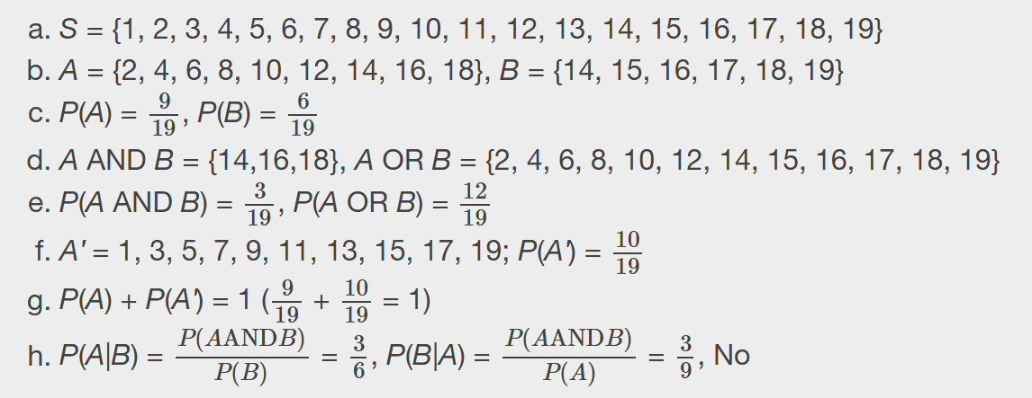
Probability Example - Answers

Slide 14

Probability Example
The table describes the distribution of a random sample S of 100 individuals, organized by sex assigned at birth and whether they are right- or left-handed. Compute the probabilities on the next slide.

Slide 15
Probability Example
P(M)
P(R)
P(M AND R)
P(M OR F)
P(F OR L)
P(M')
P(R|M)
P(F|L)
P(L|F)

Slide 16
Probability Example - Answers
P(M) = 0.52
P(R) = 0.87
P(M AND R) = 0.43
P(M OR F) = 1
P(F OR L) = 0.57
P(M') = 0.48
P(R|M) = 0.8269 (rounded to four decimal places)
P(F|L) = 0.3077 (rounded to four decimal places)
P(L|F) = 0.0833

Slide 17
Section 3.2
Independent and Mutually Exclusive Events

Slide 18
Independent Events
Two events A and B are independent if the knowledge that one occurred does not affect the chance the other occurs.
For example, the outcomes of two roles of a fair die are independent events. The outcome of the first roll does not change the probability for the outcome of the second roll.
Two events are independent if the following are true:
    P(A|B) = P(A) Remember, P(A|B) = P(A AND B)/P(B)
    P(B|A) = P(B) and P(B|A) = P(A AND B)/P(A)
    P(A AND B) = P(A)P(B)
To show two events are independent, you must show only one of the above conditions.
If two events are NOT independent, then we say that they are dependent. If it is not known whether A and B are independent or dependent, assume they are dependent until you can show otherwise.

Slide 19
Sampling
Sampling may be done with replacement or without replacement.
With replacement: If each member of a population is replaced after it is picked, then that member has the possibility of being chosen more than once.
When sampling is done with replacement, then events are considered to be independent, meaning the result of the first pick will not change the probabilities for the second pick.
Without replacement: When sampling is done without replacement, each member of a population may be chosen only once. In this case, the probabilities for the second pick are affected by the result of the first pick.
When sampling is done without replacement, then events are considered to be dependent or not independent.

Slide 20
Examples of Sampling
You have a fair, well-shuffled deck of 52 cards. It consists of four suits. The suits are clubs, diamonds, hearts and spades. There are 13 cards in each suit consisting of 1, 2, 3, 4, 5, 6, 7, 8, 9, 10, J (jack), Q (queen), K (king) of that suit.
a. Sampling with replacement:
Suppose you pick three cards with replacement. The first card you pick out of the 52 cards is the Q of spades. You put this card back, reshuffle the cards and pick a second card from the 52-card deck. It is the ten of clubs. You put this card back, reshuffle the cards and pick a third card from the 52-card deck. This time, the card is the Q of spades again. Your picks are {Q of spades, ten of clubs, Q of spades}. You have picked the Q of spades twice. You pick each card from the 52-card deck.
b. Sampling without replacement:
Suppose you pick three cards without replacement. The first card you pick out of the 52 cards is the K of hearts. You put this card aside and pick the second card from the 51 cards remaining in the deck. It is the three of diamonds. You put this card aside and pick the third card from the remaining 50 cards in the deck. The third card is the J of spades. Your picks are {K of hearts, three of diamonds, J of spades}. Because you have picked the cards without replacement, you cannot pick the same card twice.

Slide 21
Example of Sampling
You have a fair, well-shuffled deck of 52 cards. It consists of four suits. The suits are clubs, diamonds, hearts, and spades. There are 13 cards in each suit consisting of 1, 2, 3, 4, 5, 6, 7, 8, 9, 10, J (jack), Q (queen), and K (king) of that suit. S = spades, H = Hearts, D = Diamonds, C = Clubs.
A) Suppose you pick four cards, but do not put any cards back into the deck. Your cards are QS, 1D, 1C, QD.
B) Suppose you pick four cards and put each card back before you pick the next card. Your cards are KH, 7D, 6D, KH.
Which of a. or b. did you sample with replacement and which did you sample without replacement?

Slide 22
Example of Sampling - Answer
A) Suppose you pick four cards, but do not put any cards back into the deck. Your cards are QS, 1D, 1C, QD.
B) Suppose you pick four cards and put each card back before you pick the next card. Your cards are KH, 7D, 6D, KH.
Which of a. or b. did you sample with replacement and which did you sample without replacement? Answer: a. Without replacement; b. With replacement

Slide 23
Mutually Exclusive Events
A and B are mutually exclusive events if they cannot occur at the same time.
This means that A and B do not share any outcomes and P(A AND B) = 0.
If it is not known whether A and B are mutually exclusive, assume they are not until you can show otherwise.

Slide 24
Independent and mutually exclusive do not mean the same thing.

Slide 25
Example
Flip two fair coins. Find the probabilities of the events.
Let F = the event of getting at most one tail (zero or one tail).
Let G = the event of getting two faces that are the same.
Let H = the event of getting a head on the first flip followed by a head or tail on the second flip.
Are F and G mutually exclusive?
Let J = the event of getting all tails. Are J and H mutually exclusive?

Slide 26
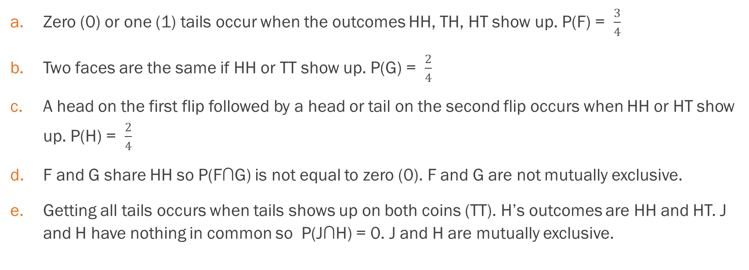
Example - Answers
Zero (0) or one (1) tails occur when the outcomes HH, TH, HT show up. P(F) = $\frac{3}{4}$
Two faces are the same if HH or TT show up. P(G) = $\frac{2}{4}$
A head on the first flip followed by a head or tail on the second flip occurs when HH or HT show up. P(H) = $\frac{2}{4}$
F and G share HH so P(F∩G) is not equal to zero (0). F and G are not mutually exclusive.
Getting all tails occurs when tails shows up on both coins (TT). H’s outcomes are HH and HT. J and H have nothing in common so P(J∩H) = 0. J and H are mutually exclusive.

Slide 27
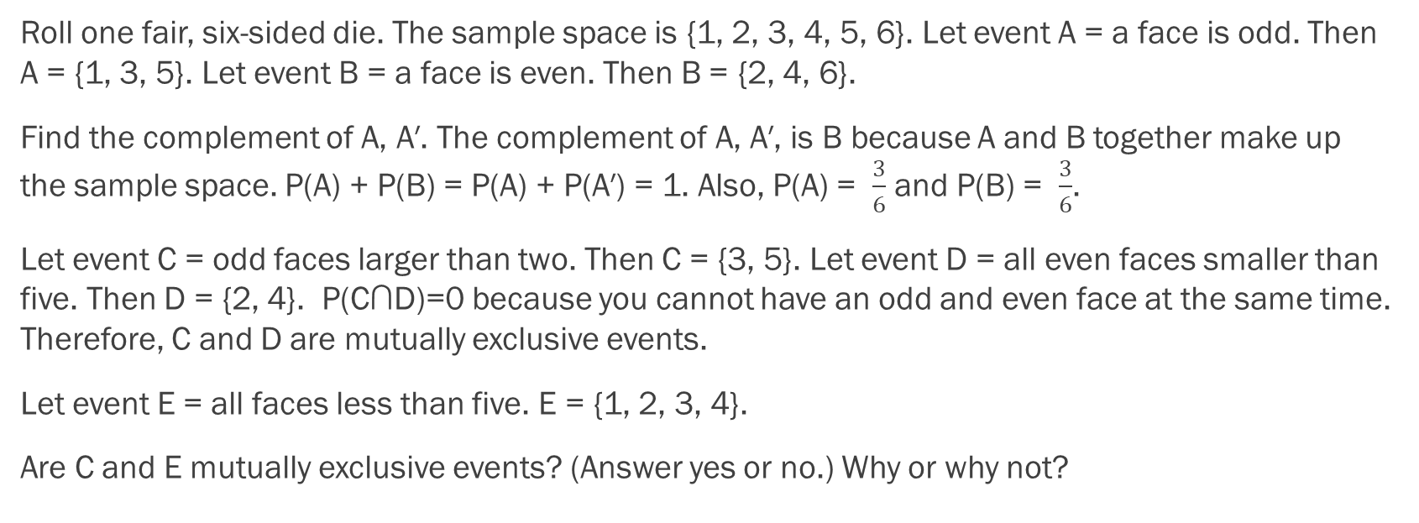
Example
Roll one fair, six-sided die. The sample space is {1, 2, 3, 4, 5, 6}. Let event A = a face is odd. Then A = {1, 3, 5}. Let event B = a face is even. Then B = {2, 4, 6}.
Find the complement of A, A′. The complement of A, A′, is B because A and B together make up the sample space. P(A) + P(B) = P(A) + P(A′) = 1. Also, P(A) = $\frac{3}{6}$ and P(B) = $\frac{3}{6}$.
Let event C = odd faces larger than two. Then C = {3, 5}. Let event D = all even faces smaller than five. Then D = {2, 4}. P(C∩D)=0 because you cannot have an odd and even face at the same time. Therefore, C and D are mutually exclusive events.
Let event E = all faces less than five. E = {1, 2, 3, 4}.
Are C and E mutually exclusive events? (Answer yes or no.) Why or why not?

Slide 28

Example - Answers
Find P(C|A). This is a conditional probability. Recall that the event C is {3, 5} and event A is {1, 3, 5}. To find P(C|A), find the probability of C using the sample space A. You have reduced the sample space from the original sample space {1, 2, 3, 4, 5, 6} to {1, 3, 5}. So, P(C∣A)=$\frac{2}{3}$.

Slide 29
Example
Let event G = taking a math class. Let event H = taking a science class. Then, G ∩ H = taking a math class and a science class. Suppose P(G)=0.6,P(H)=0.5, and P(G∩H)=0.3. Are G and H independent?
If G and H are independent, then you must show ONE of the following:
  P(G|H)=P(G)
  P(H|G)=P(H)
  P(G∩H)=P(G)P(H)
  NOTE: The choice you make depends on the information you have. You could choose any of the methods here because you have the necessary information.

Slide 30
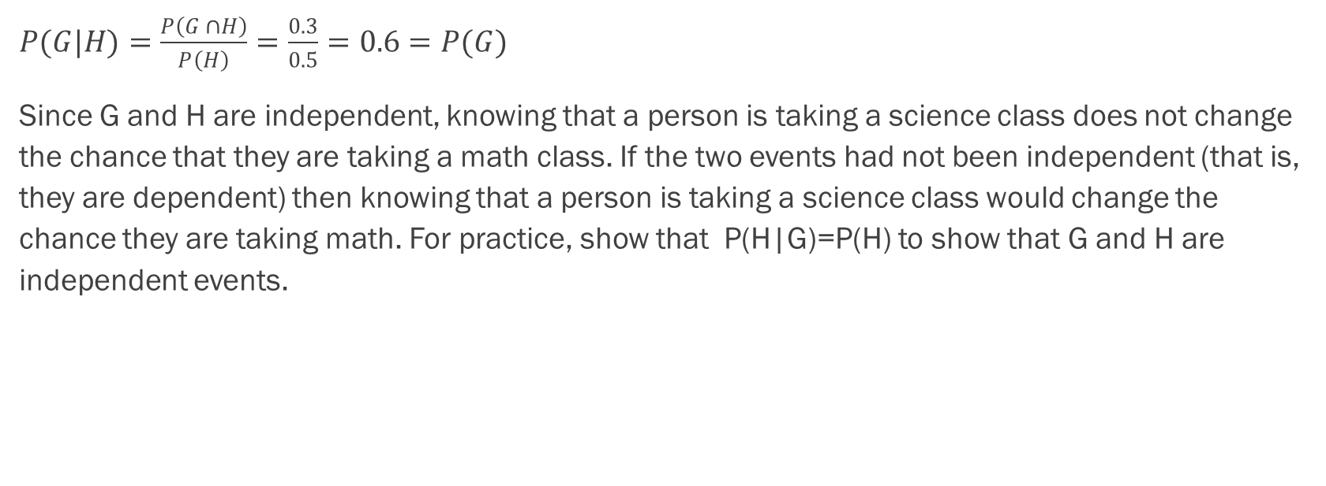
Example - Answers
$P(G|H)=\frac{P\left(G ∩H\right)}{P\left(H\right)}=\frac{0.3}{0.5}=0.6=P(G)$
Since G and H are independent, knowing that a person is taking a science class does not change the chance that they are taking a math class. If the two events had not been independent (that is, they are dependent) then knowing that a person is taking a science class would change the chance they are taking math. For practice, show that P(H|G)=P(H) to show that G and H are independent events.

Slide 31
Example
Event A = heads (H) on the coin followed by an even number (2, 4, 6) on the die. A = {_________________}. Find P(A).
Event B = heads on the coin followed by a three on the die. B = {________}. Find P(B).
Are A and B mutually exclusive? (Hint: What is P(A∩B)? If P(A∩B)=0, then A and B are mutually exclusive.)
Are A and B independent? (Hint: Is P(A∩B)=P(A)P(B)? If P(A∩B)=P(A)P(B), then A and B are independent. If not, then they are dependent).

Slide 32
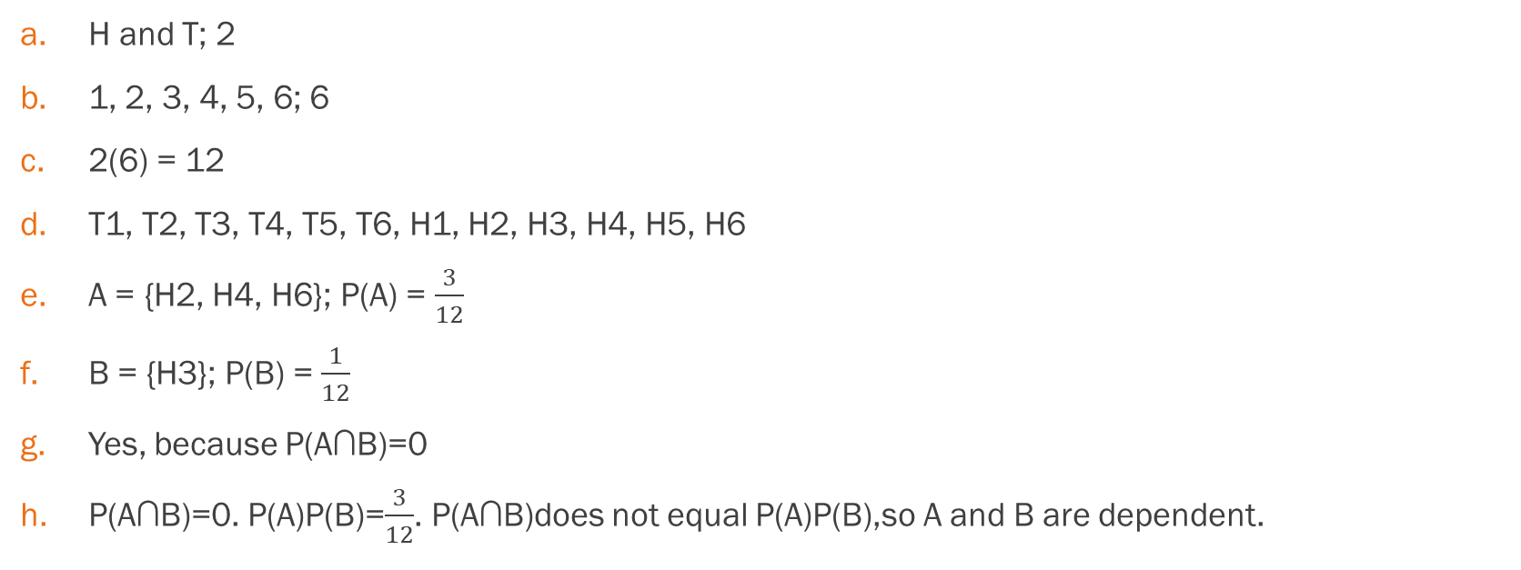
Example - Answers
H and T; 2
1, 2, 3, 4, 5, 6; 6
2(6) = 12
T1, T2, T3, T4, T5, T6, H1, H2, H3, H4, H5, H6
A = {H2, H4, H6}; P(A) = $\frac{3}{12}$
B = {H3}; P(B) = $\frac{1}{12}$
Yes, because P(A∩B)=0
P(A∩B)=0. P(A)P(B)=$\frac{3}{12}$. P(A∩B)does not equal P(A)P(B),so A and B are dependent.

Slide 33
Section 3.3
Two Basic Rules of Probability

Slide 34
The Multiplication Rule
Remember the rule: P(A|B) = P(A AND B)/P(B)
If A and B are two events defined on a sample space, then:
P(A AND B) = P(B)P(A|B).
If A and B are independent, then P(A|B) = P(A).
Then P(A AND B) = P(A|B)P(B) becomes P(A AND B) = P(A)P(B).

Slide 35
The Addition Rule
If A and B are defined on a sample space, then:
P(A OR B) = P(A) + P(B) - P(A AND B).
If A and B are mutually exclusive, then P(A AND B) = 0.
Then P(A OR B) = P(A) + P(B) - P(A AND B) becomes
P(A OR B) = P(A) + P(B).

Slide 36
Example
Klaus is trying to choose where to go on vacation. His two choices are: A = New Zealand and B = Alaska. Klaus can only afford one vacation. The probability that he chooses A is P(A) = 0.6 and the probability that he chooses B is P(B) = 0.35.
P(A∩B)=0 because Klaus can only afford to take one vacation
Therefore, the probability that he chooses either New Zealand or Alaska is P(A∪B)=P(A)+P(B)=0.6+0.35=0.95.
Note that the probability that he does not choose to go anywhere on vacation must be 0.05.

Slide 37
Example
Carlos plays college soccer. He makes a goal 65% of the time he shoots. Carlos is going to attempt two goals in a row in the next game. A = the event Carlos is successful on his first attempt. P(A) = 0.65. B = the event Carlos is successful on his second attempt. P(B) = 0.65. Carlos tends to shoot in streaks. The probability that he makes the second goal GIVEN that he made the first goal is 0.90.
a. What is the probability that he makes both goals?
b. What is the probability that Carlos makes either the first goal or the second goal?
c. Are A and B independent?
d. Are A and B mutually exclusive?

Slide 38
Example - Answers
a. The problem is asking you to find P(A AND B) = P(B AND A). Since P(B|A) = 0.90: P(B AND A) = P(B|A) P(A) = (0.90)(0.65) = 0.585
Carlos makes the first and second goals with probability 0.585.
b. The problem is asking you to find P(A OR B).
P(A OR B) = P(A) + P(B) - P(A AND B) = 0.65 + 0.65 - 0.585 = 0.715
Carlos makes either the first goal or the second goal with probability 0.715.
c. No, they are not, because P(B AND A) = 0.585.
P(B)P(A) = (0.65)(0.65) = 0.423
0.423 ≠ 0.585 = P(B AND A)
So, P(B AND A) is not equal to P(B)P(A).
d. No, they are not because P(A and B) = 0.585.
To be mutually exclusive, P(A AND B) must equal zero.

Slide 39
Example
Felicity attends Modesto JC in Modesto, CA. The probability that Felicity enrolls in a math class is 0.2 and the probability that she enrolls in a speech class is 0.65. The probability that she enrolls in a math class GIVEN that she enrolls in speech class is 0.25.
Let: M = math class, S = speech class, M|S = math given speech
What is the probability that Felicity enrolls in math and speech? Find P(M AND S) = P(M|S)P(S).
What is the probability that Felicity enrolls in math or speech classes? Find P(M OR S) = P(M) + P(S) - P(M AND S).
Are M and S independent? Is P(M|S) = P(M)?
Are M and S mutually exclusive? Is P(M AND S) = 0?

Slide 40
Example - Answers
a. 0.1625, b. 0.6875, c. No, d. No

Slide 41
Example
Studies show that about one woman in seven (approximately 14.3%) who live to be 90 will develop breast cancer. Suppose that of those women who develop breast cancer, a test is negative 2% of the time. Also suppose that in the general population of women, the test for breast cancer is negative about 85% of the time. Let B = woman develops breast cancer and let N = tests negative. Suppose one woman is selected at random.
a. What is the probability that the woman develops breast cancer? What is the probability that woman tests negative?
b. Given that the woman has breast cancer, what is the probability that she tests negative?
c. What is the probability that the woman has breast cancer AND tests negative?
d. What is the probability that the woman has breast cancer or tests negative?
e. Are having breast cancer and testing negative independent events?
f. Are having breast cancer and testing negative mutually exclusive?

Slide 42
Example - Answers
a. P(B) = 0.143; P(N) = 0.85
b. P(N|B) = 0.02
c. P(B AND N) = P(B)P(N|B) = (0.143)(0.02) = 0.0029
d. P(B OR N) = P(B) + P(N) - P(B AND N) = 0.143 + 0.85 - 0.0029 = 0.9901
e. No. P(N) = 0.85; P(N|B) = 0.02. So, P(N|B) does not equal P(N).
f. No. P(B AND N) = 0.0029. For B and N to be mutually exclusive, P(B AND N) must be zero.

Slide 43
Section 3.4
Contingency tables

Slide 44
Contingency Tables
A contingency table provides a way of portraying data that can facilitate calculating probabilities.
The table helps in determining conditional probabilities quite easily.
The table displays sample values in relation to two different variables that may be dependent or contingent on one another.

Slide 45
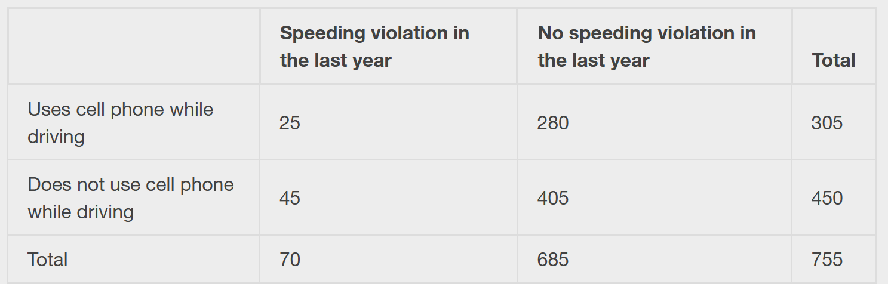
Contingency Table Examples
Suppose a study of speeding violations and drivers who use cell phones produced the following fictional data:

Slide 46
Contingency Table Examples
a. Find P(Driver is a cell phone user).
b. Find P(driver had no violation in the last year).
c. Find P(Driver had no violation in the last year AND was a cell phone user).
d. Find P(Driver is a cell phone user OR driver had no violation in the last year).
e. Find P(Driver is a cell phone user GIVEN driver had a violation in the last year).
f. Find P(Driver had no violation last year GIVEN driver was not a cell phone user)

Slide 47
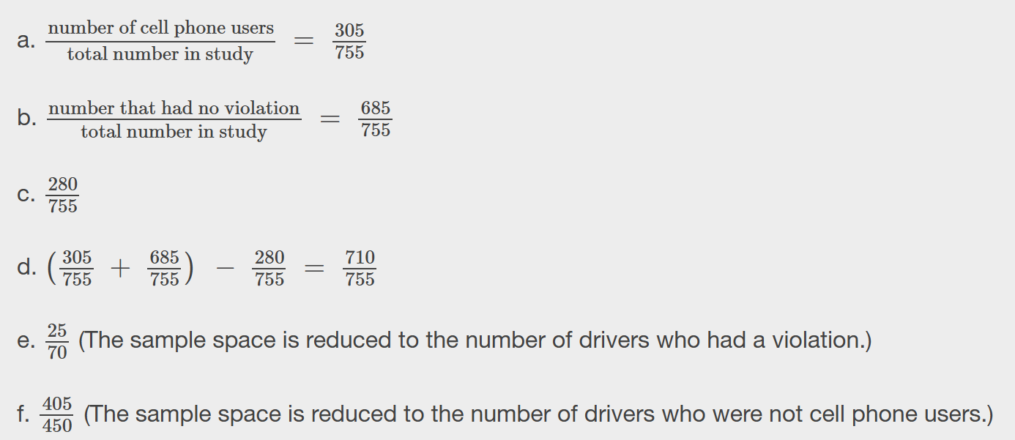
Contingency Table Examples - Answers

Slide 48
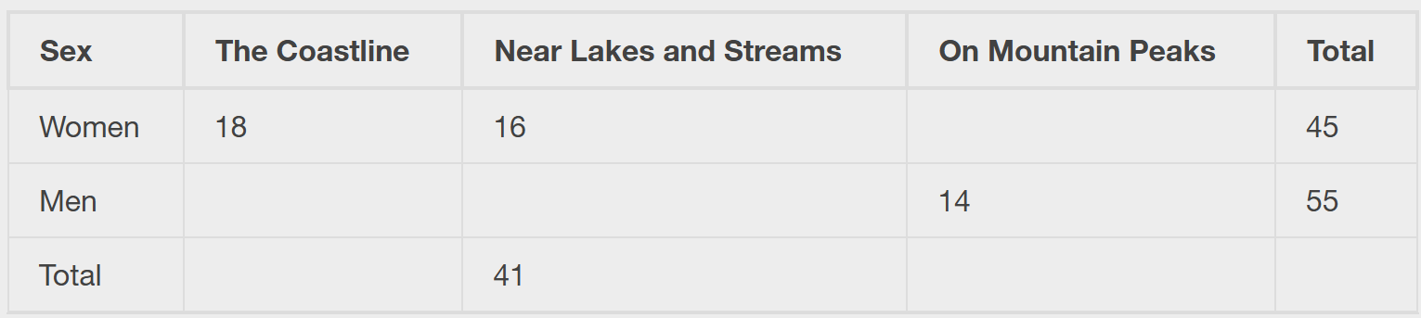
Example
Complete the contingency table. You can use the class Excel file and fill that in:
Are the events "being a woman" and "preferring the coastline" independent events?

Slide 49

Example - Answers
P(F AND C) = $\frac{18}{100}$ = 0.18
P(F)P(C) = $(\frac{45}{100})(\frac{34}{100})$ = (0.45)(0.34) = 0.153
P(F AND C) ≠ P(F)P(C), so the events F and C are not independent.

Slide 50
Example
Find the probability that a person is a woman or prefers hiking on mountain peaks. Let F = being a woman, and let P = prefers mountain peaks.
Find P(F).
Find P(P).
Find P(F AND P).
Find P(F OR P).

Slide 51

Example - Answers
P(F) = $\frac{45}{100}$
P(P) = $\frac{25}{100}$
P(F AND P) = $\frac{11}{100}$
P(F OR P) = $\frac{45}{100}+\frac{25}{100} −\frac{11}{100}$ $= \frac{59}{100}$

Slide 52
Section 3.5
Tree and Venn Diagrams

Slide 53
Tree Diagrams
A tree diagram is a special type of graph used to determine the outcomes of an experiment.
It consists of "branches" that are labeled with either frequencies or probabilities.
Tree diagrams can make some probability problems easier to visualize and solve.

Slide 54
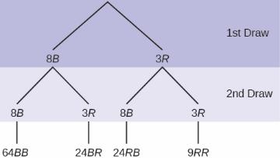
Tree Diagram Example
In an urn, there are 11 balls. Three balls are red (R) and eight balls are blue (B). Draw two balls, one at a time, with replacement. "With replacement" means that you put the first ball back in the urn before you select the second ball. The tree diagram using frequencies that show all the possible outcomes follows. The first set of branches represents the first draw. The second set of branches represents the second draw. Each of the outcomes is distinct. In fact, we can list each red ball as R1, R2, and R3 and each blue ball as B1, B2, B3, B4, B5, B6, B7, and B8. Then the nine RR outcomes can be written as: R1R1; R1R2; R1R3; R2R1; R2R2; R2R3; R3R1; R3R2; R3R3.
The other outcomes are similar. There are a total of 11 balls in the urn. Draw two balls, one at a time, with replacement. There are 11(11) = 121 outcomes, the size of the sample space. (OR Total = 64 + 24 + 24 + 9 = 121).

Slide 55
Tree Diagram Example
Using the tree diagram, calculate P(RR).
Using the tree diagram, calculate P(R on 1st draw and B on 2nd draw)
Using the tree diagram, calculate P(BB).

Slide 56
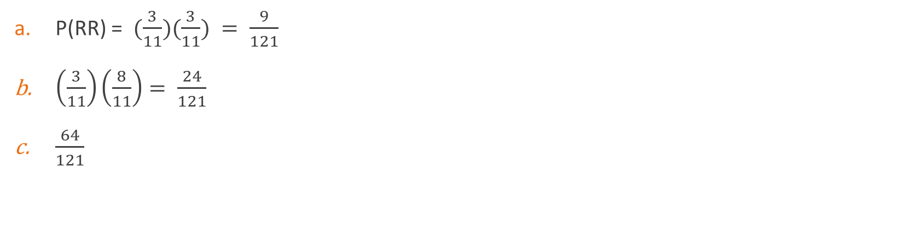
Tree Diagram Example - Answers
P(RR) = $(\frac{3}{11})(\frac{3}{11}) = \frac{9}{121}$
$\left(\frac{3}{11}\right)\left(\frac{8}{11}\right)= \frac{24}{121}$
$\frac{64}{121}$

Slide 57
Venn Diagrams
A Venn diagram is a picture that represents the outcomes of an experiment.
It generally consists of a box that represents the sample space S together with circles or ovals. The circles or ovals represent events.

Slide 58
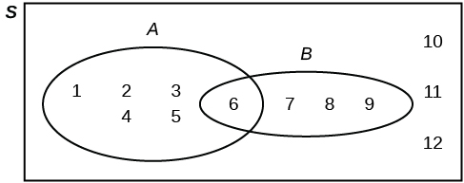
Venn Diagram Example
Suppose an experiment has the outcomes 1, 2, 3, ... , 12 where each outcome has an equal chance of occurring.
Let event A = {1, 2, 3, 4, 5, 6} and event B = {6, 7, 8, 9}.
Then A AND B = {6} and A OR B = {1, 2, 3, 4, 5, 6, 7, 8, 9}.
The Venn diagram is as follows:

Slide 59
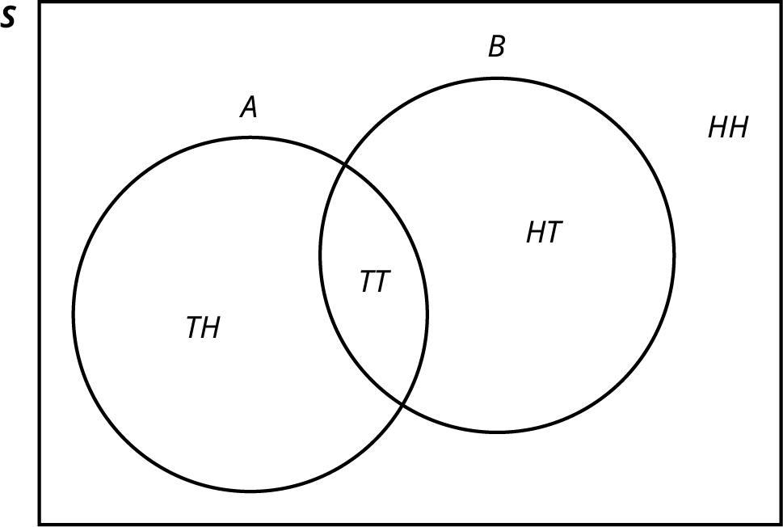
Example
Flip two fair coins. Let A = tails on the first coin. Let B = tails on the second coin. Then A = {TT, TH} and B = {TT, HT}. Therefore, A∩B={TT}. A∪B={TH, TT, HT}
The sample space when you flip two fair coins is X = {HH, HT, TH, TT}. The outcome HH is in NEITHER A NOR B. The Venn diagram is as follows:

Slide 60
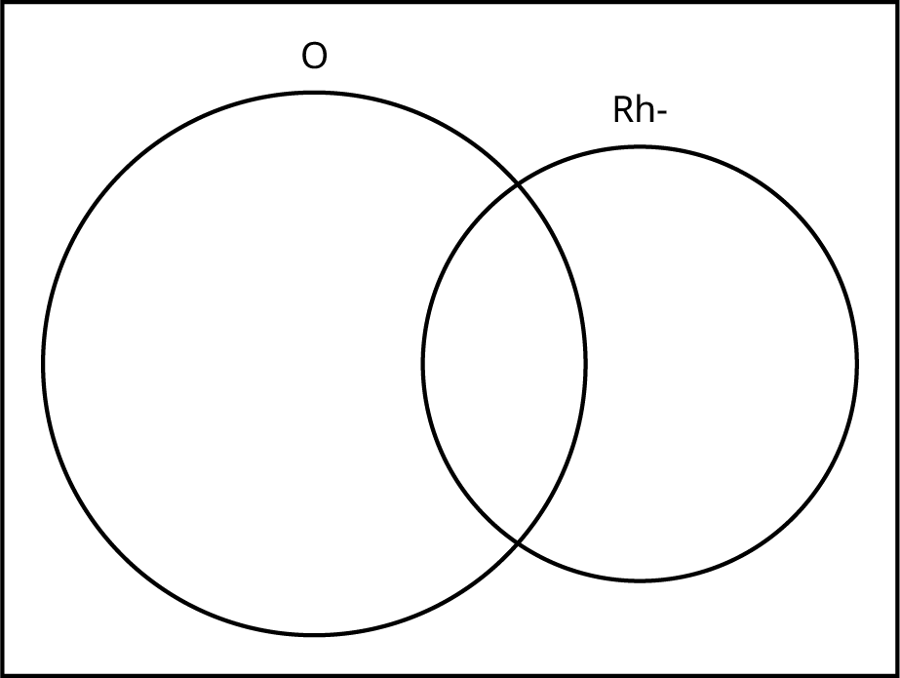
Example
A person with type O blood and a negative Rh factor (Rh-) can donate blood to any person with any blood type. Four percent of African Americans have type O blood and a negative RH factor, 5−10% of African Americans have the Rh- factor, and 51% have type O blood.
We will take the average of 5% and 10% and use 7.5% as the percent of African Americans who have the Rh- factor. Let O = African American with Type O blood and R = African American with Rh- factor. Find the following:
P(O)
P(R)
P(O∩R)
P(O∪R)

Slide 61
Solution
A person with type O blood and a negative Rh factor (Rh-) can donate blood to any person with any blood type. Four percent of African Americans have type O blood and a negative RH factor, 5−10% of African Americans have the Rh- factor, and 51% have type O blood.
We will take the average of 5% and 10% and use 7.5% as the percent of African Americans who have the Rh- factor. Let O = African American with Type O blood and R = African American with Rh- factor. Find the following:
P(O) = 0.51
P(R) = 0.075
P(O∩R) = 0.04
P(O∪R) = 0.545

