Slide 1

Chapter 4 Discrete Random Variables
Openstax statistics

Slide 2
Objectives
By the end of this chapter, the student should be able to:
Recognize and understand discrete probability distribution functions, in general.
Calculate and interpret expected values.
Recognize the binomial probability distribution and apply it appropriately.
Classify discrete word problems by their distributions.

Slide 3
Section 4.1
Probability Distribution Function (PDF) for a Discrete
Random Variable

Slide 4
Random Variable Notation
A random variable describes the outcomes of a statistical experiment in words. The values of a random variable can vary with each repetition of an experiment.
Upper case letters such as X or Y denote a random variable. Lower case letters like x or y denote the value of a random variable.
If X is a random variable, then X is written in words, and x is given as a number.
For example, let X = the number of heads you get when you toss three fair coins. The sample space for the toss of three fair coins is TTT; THH; HTH; HHT; HTT; THT; TTH; HHH. Then, x = 0, 1, 2, 3. X is in words and x is a number.
Notice that for this example, the x values are countable outcomes. Because you can count the possible values that X can take on and the outcomes are random (the x values 0, 1, 2, 3), X is a discrete random variable.

Slide 5
Probability Distribution Function for a Discrete Random Variable
A discrete probability distribution function has two characteristics:
1. Each probability is between zero and one, inclusive.
2. The sum of the probabilities is one.

Slide 6
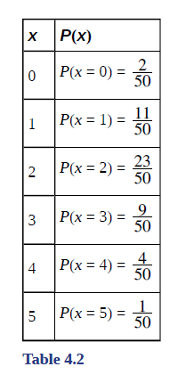
Probability Distribution Function for a Discrete Random Variable Example
A child psychologist is interested in the number of times a newborn baby's crying wakes its mother after midnight. For a random sample of 50 mothers, the following information was obtained. Let X = the number of times per week a newborn baby's crying wakes its mother after midnight. For this example, x = 0, 1, 2, 3, 4, 5.
P(x) = probability that X takes on a value x.
X takes on the values 0, 1, 2, 3, 4, 5.
This is a discrete PDF because:
Each P(x) is between zero and one, inclusive.
The sum of the probabilities is one.

Slide 7
Example
Suppose Nancy has classes three days a week. She attends classes three days a week 80% of the time, two days 15% of the time, one day 4% of the time, and no days 1% of the time. Suppose one week is randomly selected.
a. Let X = the number of days Nancy ____________________.
b. X takes on what values?
c. Suppose one week is randomly chosen. Construct a probability distribution table (called a PDF table). The table should have two columns labeled x and P(x). What does the P(x) column sum to?

Slide 8
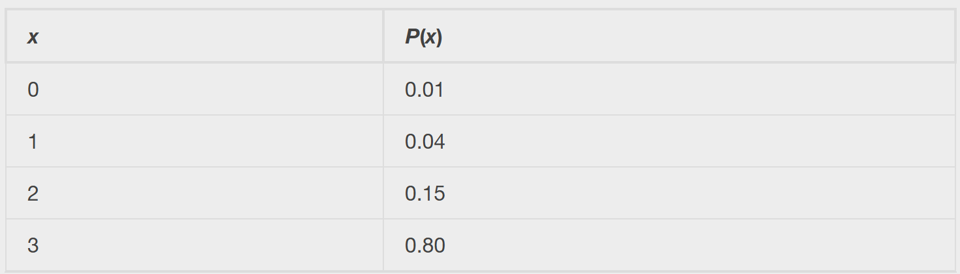
Example - Answers
a. Let X = the number of days Nancy attends class per week.
b. 0, 1, 2, and 3
c. See table:

Slide 9
Section 4.2
Mean or Expected Value and Standard Deviation

Slide 10
Mean or Expected Value
The expected value is often referred to as the "long-term" average or mean.
This means that over the long term of doing an experiment over and over, you would expect this average.
The Law of Large Numbers states that, as the number of trials in a probability experiment increases, the difference between the theoretical probability of an event and the relative frequency approaches zero (the theoretical probability and the relative frequency get closer and closer together).

Slide 11
Mean or Expected Value (Continued)
When evaluating the long-term results of statistical experiments, we often want to know the “average” outcome.
This “long-term average” is known as the mean or expected value of the experiment and is denoted by the Greek letter μ.
In other words, after conducting many trials of an experiment, you would expect this average value.
NOTE: To find the expected value or long term average, μ, simply multiply each value of the random variable by its probability and add the products.

Slide 12
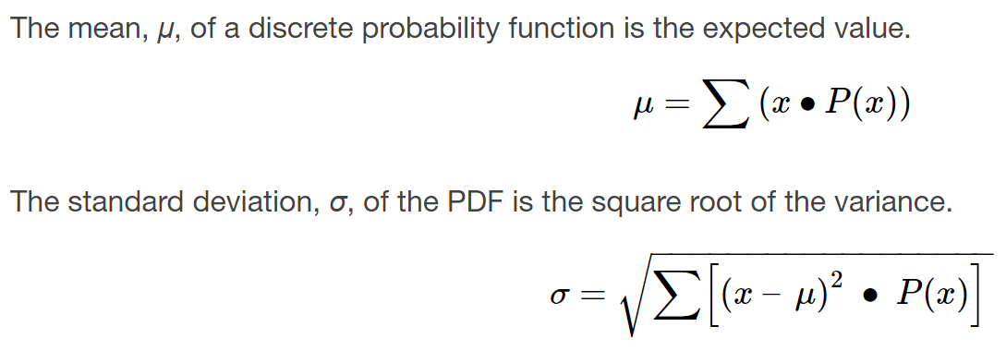
Formulas for Expected Value and Standard Deviation

Slide 13
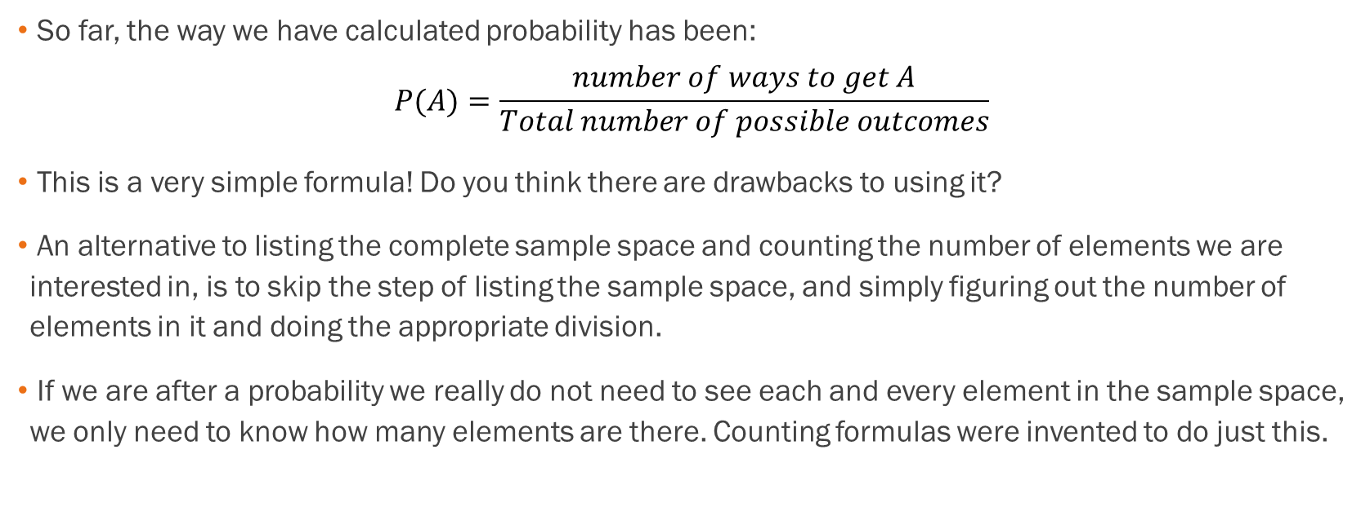
Why Do We Have Different Formulas?
So far, the way we have calculated probability has been:
$$P(A)=\frac{number of ways to get A}{Total number of possible outcomes}$$
This is a very simple formula! Do you think there are drawbacks to using it?
An alternative to listing the complete sample space and counting the number of elements we are interested in, is to skip the step of listing the sample space, and simply figuring out the number of elements in it and doing the appropriate division.
If we are after a probability we really do not need to see each and every element in the sample space, we only need to know how many elements are there. Counting formulas were invented to do just this.

Slide 14




One Situation, Two Ways
Let’s suppose we flip 2 coins and record the outcomes on each face, which would look like:
$$\{HH, HT, TH, TT\}$$
We are curious about the probability of getting at least 1 heads in the 2 flips.
# Possible Heads | Probability
0 | $$\frac{1}{4}$$
1 | $$\frac{2}{4}$$
2 | $$\frac{1}{4}$$
Method 1:
List the outcomes, then count the number of outcomes with heads:
P(at least 1 head) = $\frac{3}{4}$
Method 2:
Make a table of the possible outcomes then add up the ones you need:
P(at least 1 head) =
$$\frac{2}{4}+\frac{1}{4}=\frac{3}{4}$$

Slide 15
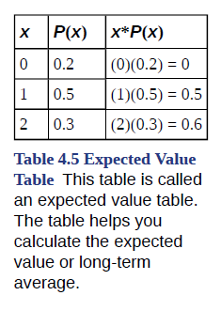
Expected Value Example
A men's soccer team plays soccer zero, one, or two days a week. The probability that they play zero days is 0.2, the probability that they play one day is 0.5, and the probability that they play two days is 0.3. Find the long-term average or expected value, μ, of the number of days per week the men's soccer team plays soccer. To do the problem, first let the random variable X = the number of days the men's soccer team plays soccer per week. X takes on the values 0, 1, 2. Construct a PDF table adding a column x*P(x). In this column, you will multiply each x value by its probability.
Add the last column x*P(x) to find the long term average or expected value: (0)(0.2) + (1)(0.5) + (2)(0.3) = 0 + 0.5 + 0.6 = 1.1.
The expected value is 1.1. The men's soccer team would, on the average, expect to play soccer 1.1 days per week. The number 1.1 is the long-term average or expected value if the men's soccer team plays soccer week after week after week.
We say μ = 1.1.

Slide 16
Example
Suppose these are the probabilities for each outcome. Find the missing value:
x | P(x)
0 | 0.12
1 | 0.18
2 | 0.30
3 | 0.15
4
5 | 0.10
6 | 0.05
a. What do the probabilities need to sum to?
b. P(x = 4) = _______
c. P(x ≥ 5) = _______
d. On average, how long would you expect a new hire to stay with the company? (see Excel workbook)
e. What is the standard deviation?

Slide 17
Example - Answers
Suppose these are the probabilities for each outcome. Find the missing value:
x | P(x)
0 | 0.12
1 | 0.18
2 | 0.30
3 | 0.15
4
5 | 0.10
6 | 0.05
a. They should sum to 1. The missing value is 0.1
b. P(x = 4) = 0.1
c. P(x ≥ 5) = 0.15
d. 2.43
e. 1.65

Slide 18
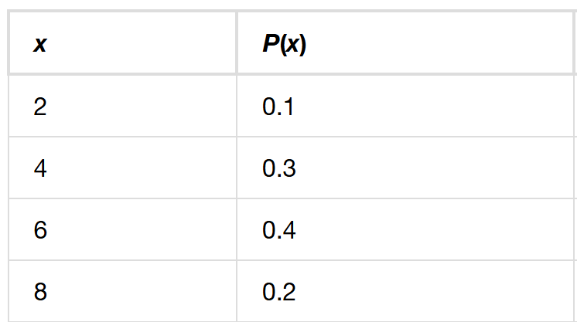
Example
Find the expected value and standard deviation from the expected value table. See the Excel workbook.

Slide 19
Example - Answers
Expected value should be 5.4 and standard deviation should be 1.8.

Slide 20
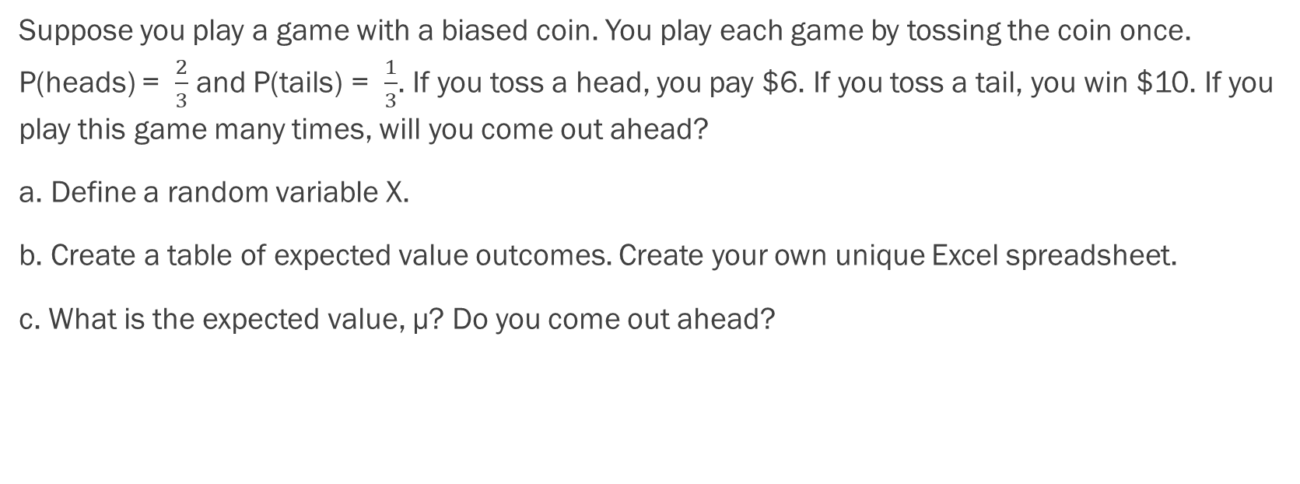
Example
Suppose you play a game with a biased coin. You play each game by tossing the coin once. P(heads) = $\frac{2}{3}$ and P(tails) = $\frac{1}{3}$. If you toss a head, you pay $6. If you toss a tail, you win $10. If you play this game many times, will you come out ahead?
a. Define a random variable X.
b. Create a table of expected value outcomes. Create your own unique Excel spreadsheet.
c. What is the expected value, μ? Do you come out ahead?

Slide 21


Example - Answers
a. X = amount of profit
b. See table:
c. Add the last column of the table. The expected value μ = $−\frac{2}{3}$. You lose, on average, about 67 cents each time you play the game so you do not come out ahead.

Slide 22
Example
Toss a fair, six-sided die twice. Let X = the number of faces that show an even number. Construct a table of outcomes and calculate the mean μ and standard deviation σ of X. Create your own unique Excel spreadsheet.

Slide 23
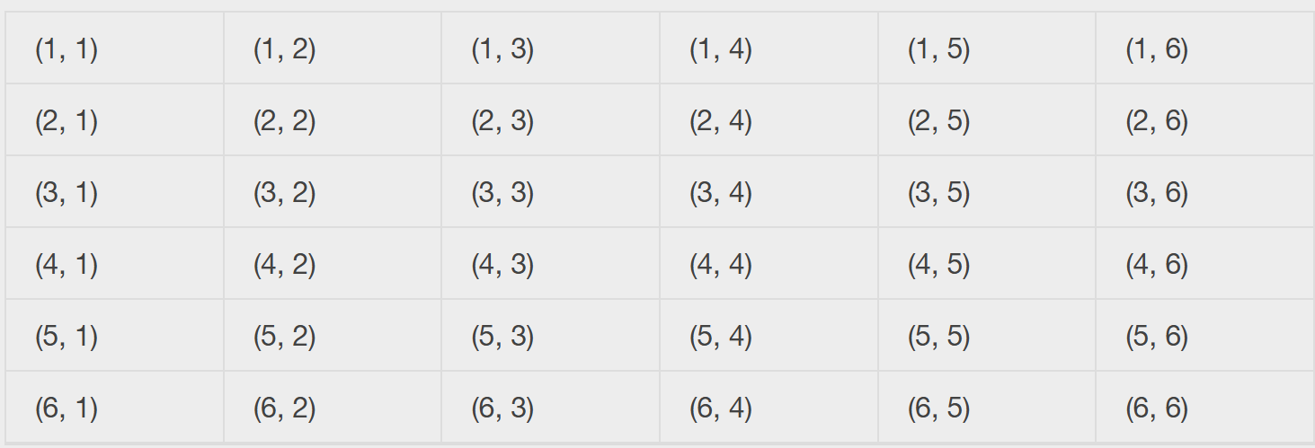
Example - Answers
Tossing one fair six-sided die twice has the same sample space as tossing two fair six-sided dice. The sample space has 36 outcomes, which can be used to create a probability table (next slide).

Slide 24
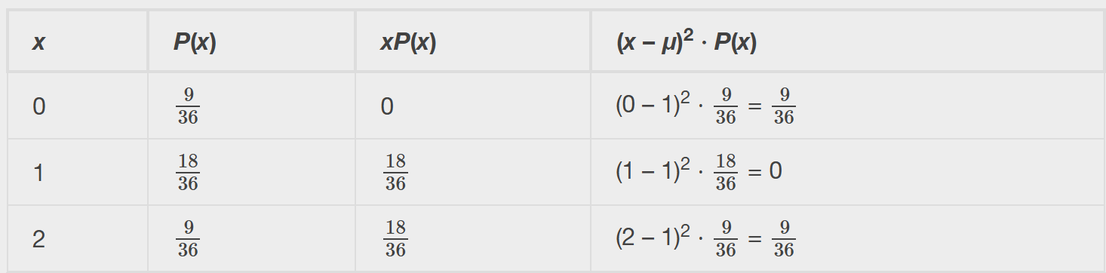

Example - Answers
Using the table from the previous slide, we get the following probability table:
Add the values in the third column to find the expected value: μ = $\frac{36}{36}$= 1. Use this value to complete the fourth column.
Add the values in the fourth column and take the square root of the sum: σ = $\sqrt{\frac{18}{36}}$≈ 0.7071.

Slide 25
Section 4.3
The Binomial distribution

Slide 26
Binomial Distribution
There are three characteristics of a binomial experiment.
1. There are a fixed number of trials. Think of trials as repetitions of an experiment. The letter n denotes the number of trials.
2. There are only two possible outcomes, called "success" and "failure," for each trial. The letter p denotes the probability of a success on one trial, and q denotes the probability of a failure on one trial. p + q = 1.
3. The n trials are independent and are repeated using identical conditions. Because the n trials are independent, the outcome of one trial does not help in predicting the outcome of another trial. Another way of saying this is that for each individual trial, the probability, p, of a success and probability, q, of a failure remain the same.

Slide 27
Example of “Success”
At ABC College, the withdrawal rate from an elementary physics course is 30% for any given term. This implies that, for any given term, 70% of the students stay in the class for the entire term.
A "success" could be defined as an individual who withdrew.
The random variable X = the number of students who withdraw from the randomly selected elementary physics class.

Slide 28
Notation for the Binomial Probability Distribution Function
The outcomes of a binomial experiment fit a binomial probability distribution.
The random variable X = the number of successes obtained in the n independent trials.
  X ~ B(n, p)
  Read this as "X is a random variable with a binomial distribution."
The parameters are n and p:
  n = number of trials
  p = probability of a success on each trial.
Binomial probabilities are found by using the binomial distribution function. Stating the probability question mathematically is the start.

Slide 29
Example of Binomial Distribution Problem
Suppose you play a game that you can only either win or lose. The probability that you win any game is 55%, and the probability that you lose is 45%. Each game you play is independent. If you play the game 20 times, write the function that describes the probability that you win 15 of the 20 times. Here, if you define X as the number of wins, then X takes on the values 0, 1, 2, 3, ..., 20. The probability of a success is p = 0.55. The probability of a failure is q = 0.45. The number of trials is n = 20. The probability question can be stated mathematically as P(x = 15).

Slide 30
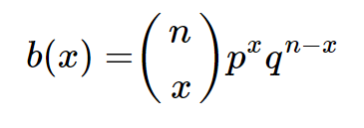
The Binomial Formula
where b(x) is the probability of X successes in n trials when the probability of a success in ANY ONE TRIAL is p. And q=(1-p) and is the probability of a failure in any one trial

Slide 31
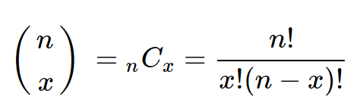

What is $\left({n \atop x}\right)$??
This is the formula that tells the number of unique unordered subsets of size x that can be created from n unique elements.
The formula is read “n combinatorial x”.
Sometimes it is read as “n choose x."
We can use Excel to calculate this for us (combin function) or we can compute it using a calculator

Slide 32


Situations that Use $\left({n \atop x}\right)$
How to choose 5 cards from a standard deck of 52 cards:
$$\left({52 \atop 5}\right)=\frac{52!}{5!\left(52−5\right)!}$$
How to choose 3 people from a group of 12:
$$\left({12 \atop 3}\right)=\frac{12!}{3!\left(12−3\right)!}$$

Slide 33
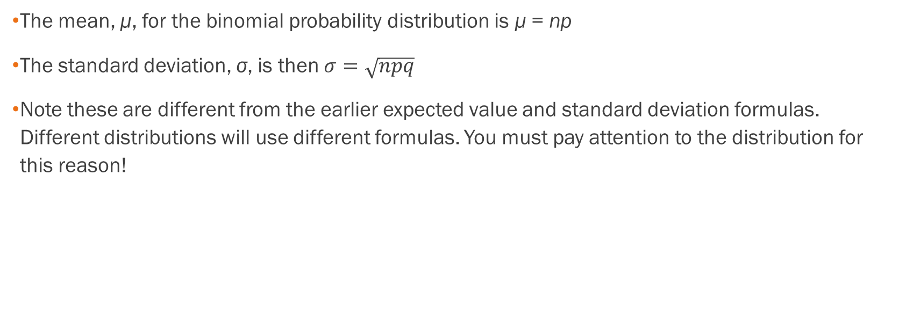
Other Binomial Distribution Formulas
The mean, μ, for the binomial probability distribution is μ = np
The standard deviation, σ, is then $σ=\sqrt{npq}$
Note these are different from the earlier expected value and standard deviation formulas. Different distributions will use different formulas. You must pay attention to the distribution for this reason!

Slide 34
Example
A coin has been altered to weight the heads outcome from 0.5 to 0.25 and is flipped 5 times. Each flip is independent.
Let X = the number of heads in 5 flips of the coin. X takes on the values 0, 1, 2, 3, 4, 5.
Since the coin is altered to result in p = 0.25, q is 0.75. The number of trials is n = 5.
a. What is the probability of getting more than 3 heads?
b. What is the probability of getting exactly 2 heads?
c. What is the expected number of heads in 5 flips?
We will need to create a table of probabilities, refer to the filled in Excel spreadsheet.

Slide 35

Example - Answers
a. P($x>3)$ = 0.0015
b. P(x=2) = 0.264
c. $μ=np=5∗0.25=1.25$

Slide 36
Example
In the 2013 Jerry’s Artarama art supplies catalog, there are 560 pages. Eight of the pages feature signature artists. Suppose we randomly sample 100 pages. Let X = the number of pages that feature signature artists. Use the Excel spreadsheet to build out this situation.
What values does x take on?
What is the probability distribution? Find the following probabilities:
  the probability that two pages feature signature artists
  the probability that at most six pages feature signature artists
  the probability that more than three pages feature signature artists.
Using the formulas, calculate the (i) mean and (ii) standard deviation.

Slide 37
Example - Answers
x = 0, 1, 2, 3, 4, 5, 6, 7, 8
X ~ B (100,8560)
  P(x = 2) = = 0.2466
  P(x ≤ 6) = = 0.9994
  P(x > 3) = 1 – P(x ≤ 3) = = 1 – 0.9443 = 0.0557
i) Mean = 1.4286 ii) Standard Deviation = 1.1867

Slide 38
Example
According to a recent article the average number of babies born with significant hearing loss (deafness) is approximately two per 1,000 babies in a healthy baby nursery. The number climbs to an average of 30 per 1,000 babies in an intensive care nursery.
Suppose that 1,000 babies from healthy baby nurseries were randomly surveyed. Find the probability that exactly two babies were born deaf.
Create your own Excel model for this situation.

Slide 39
Example - Answer
According to a recent article the average number of babies born with significant hearing loss (deafness) is approximately two per 1,000 babies in a healthy baby nursery. The number climbs to an average of 30 per 1,000 babies in an intensive care nursery.
Suppose that 1,000 babies from healthy baby nurseries were randomly surveyed. Find the probability that exactly two babies were born deaf.
Answer: 0.2709

Slide 40
Other Discrete Probability Distributions Exist!
Though we are not covering them, please note that other discrete distributions exist, such as:
  Geometric Distribution
  Poisson Distribution
  Hypergeometric Distribution

