Slide 1
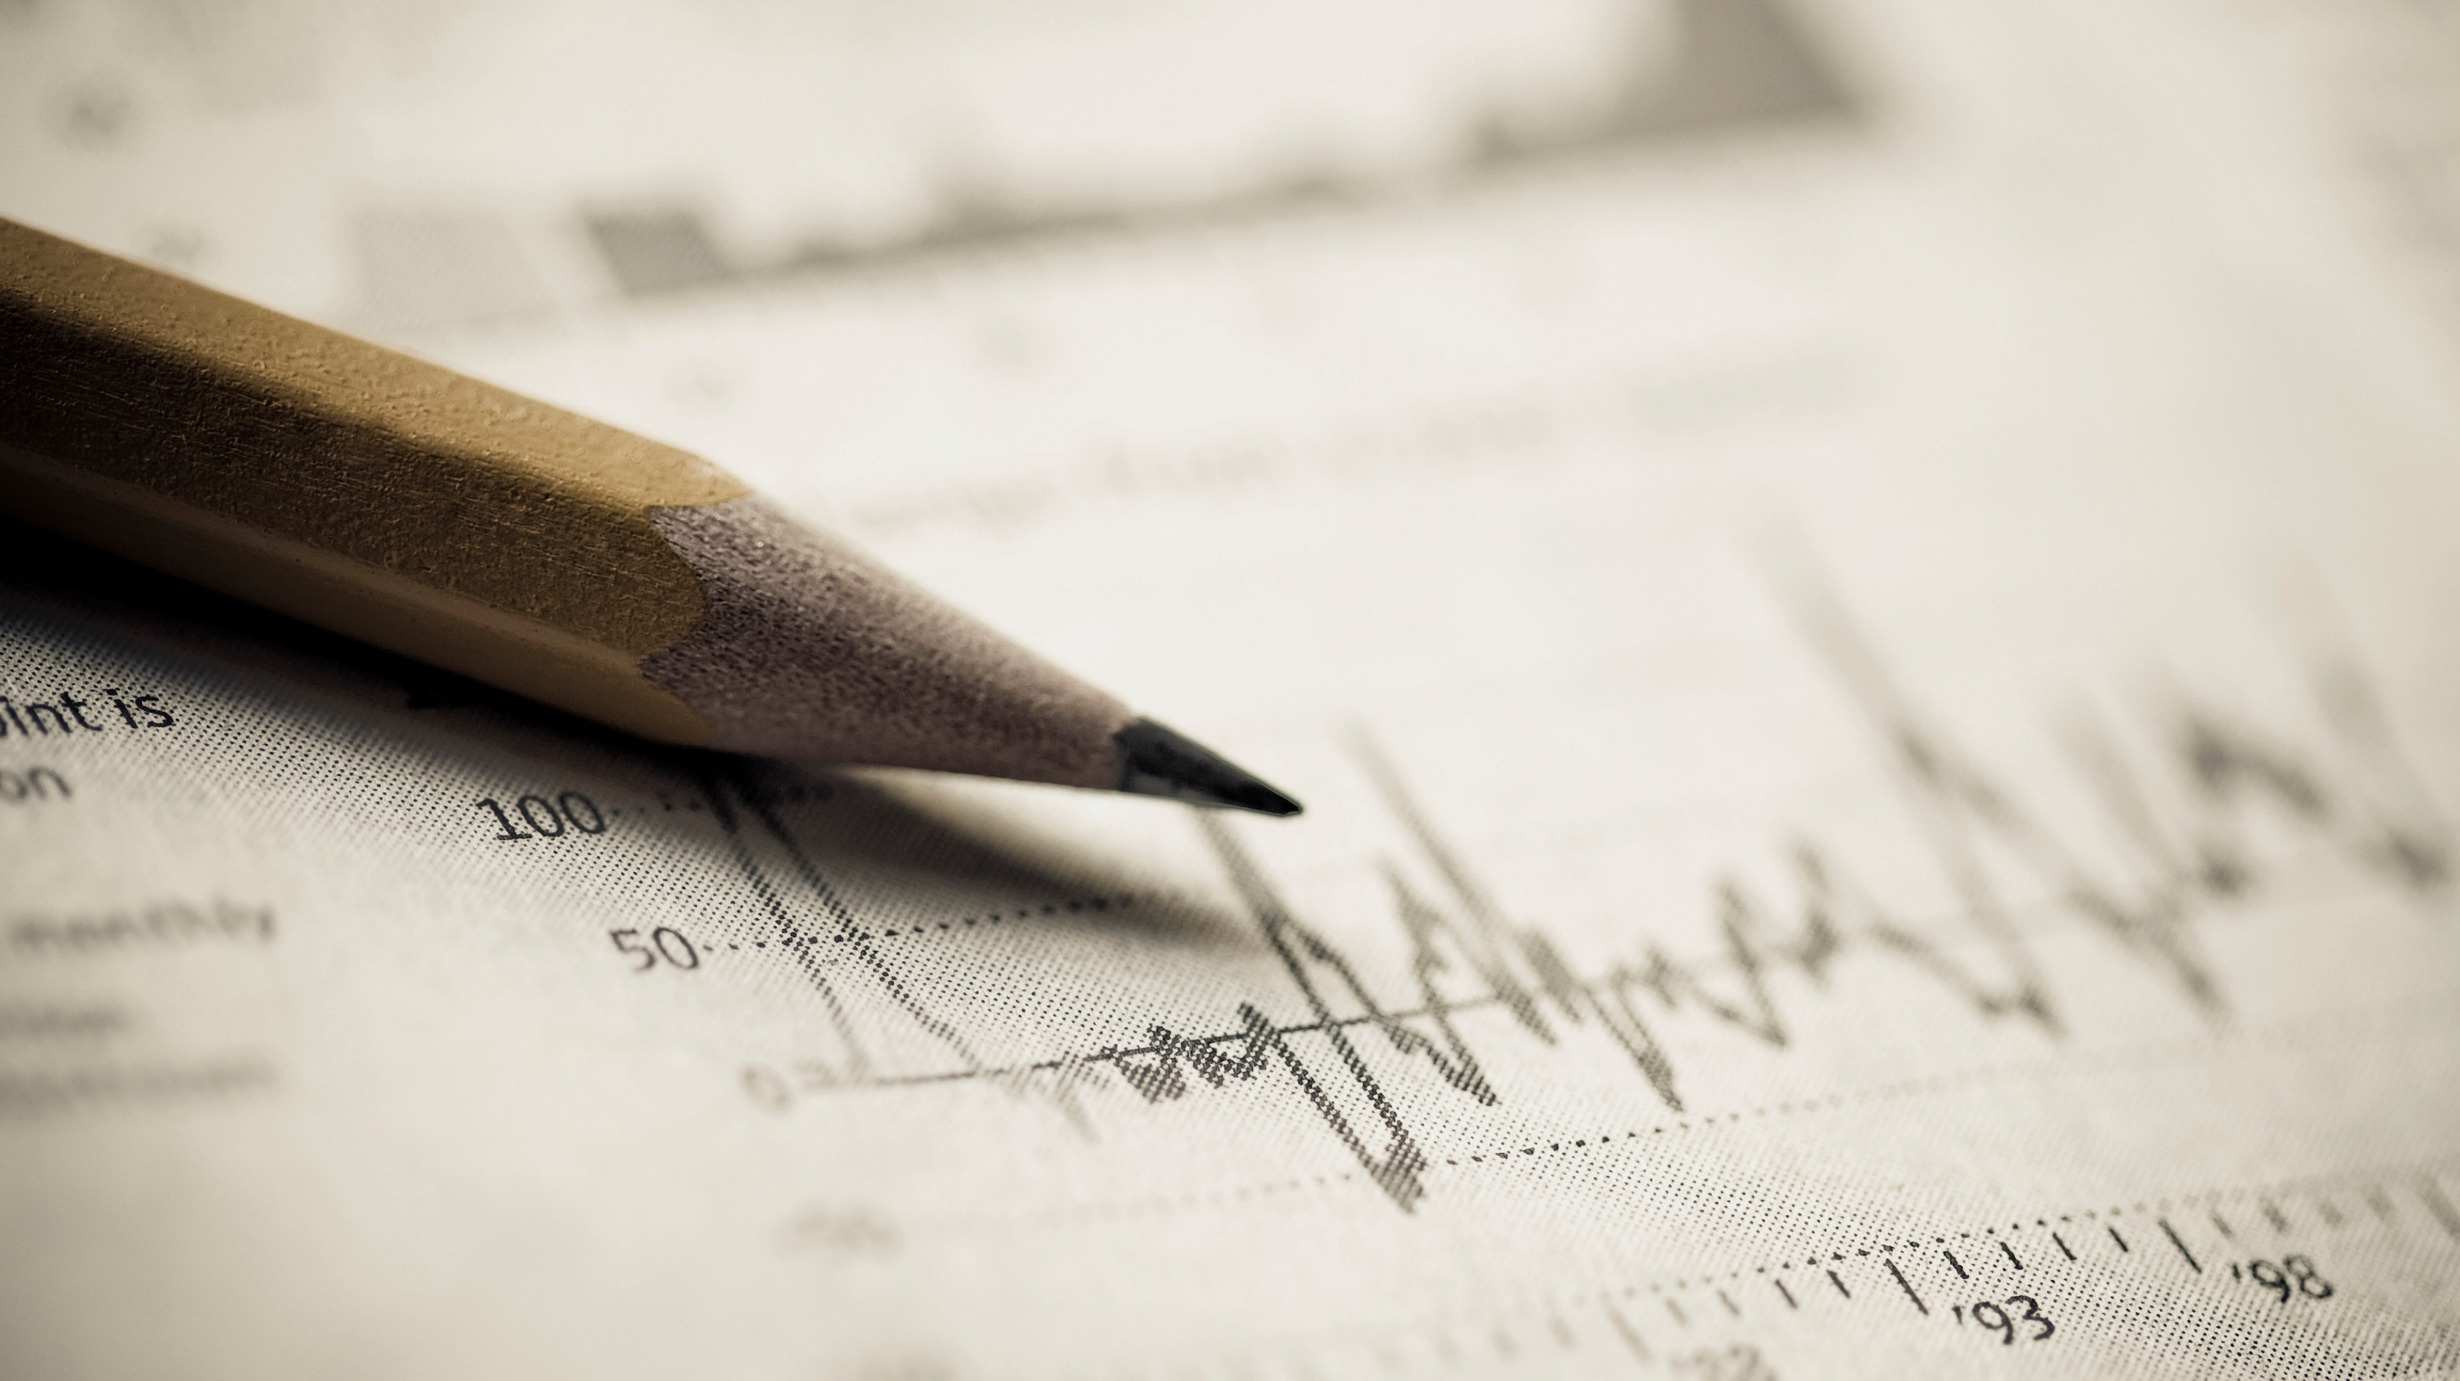
Chapter 5 Continuous Random Variables
Openstax statistics

Slide 2
Objectives
By the end of this chapter, the student should be able to:
Recognize and understand continuous probability density functions in general.
Recognize the uniform probability distribution and apply it appropriately.
Recognize the exponential probability distribution and apply it appropriately.

Slide 3
Additional Note
There is no dedicated Excel file for this section. You can build your own models as needed or just use Excel as a calculator!

Slide 4
Section 5.1
Continuous probability functions

Slide 5
Properties of Continuous Probability Distributions
The graph of a continuous probability distribution is a curve. Probability is represented by area under the curve.
The curve is called the probability density function (abbreviated as pdf). We use the symbol f(x) to represent the curve. f(x) is the function that corresponds to the graph; we use the density function f(x) to draw the graph of the probability distribution.

Slide 6
Properties of Continuous Probability Distributions (Continued)
Area under the curve is given by a different function called the cumulative distribution function (abbreviated as cdf). The cumulative distribution function is used to evaluate probability as area.
  The outcomes are measured, not counted.
  The entire area under the curve and above the x-axis is equal to one.
  Probability is found for intervals of x values rather than for individual x values.
  P(c < x < d) is the probability that the random variable X is in the interval between the values c and d. P(c < x < d) is the area under the curve, above the x-axis, to the right of c and the left of d.
  P(x = c) = 0 The probability that x takes on any single individual value is zero. The area below the curve, above the x-axis, and between x = c and x = c has no width, and therefore no area (area = 0). Since the probability is equal to the area, the probability is also zero.
  P(c < x < d) is the same as P(c ≤ x ≤ d) because probability is equal to area.

Slide 7
Properties of Continuous Probability Distributions (Continued)
We will find the area that represents probability by using geometry, formulas, technology, or probability tables.
Since the maximum probability is one, the maximum area is also one. For continuous probability distributions, PROBABILITY = AREA.
There are many continuous probability distributions. When using a continuous probability distribution to model probability, the distribution used is selected to model and fit the particular situation in the best way. A few common ones are:
  Uniform Distribution
  Exponential Distribution
  Normal Distribution

Slide 8
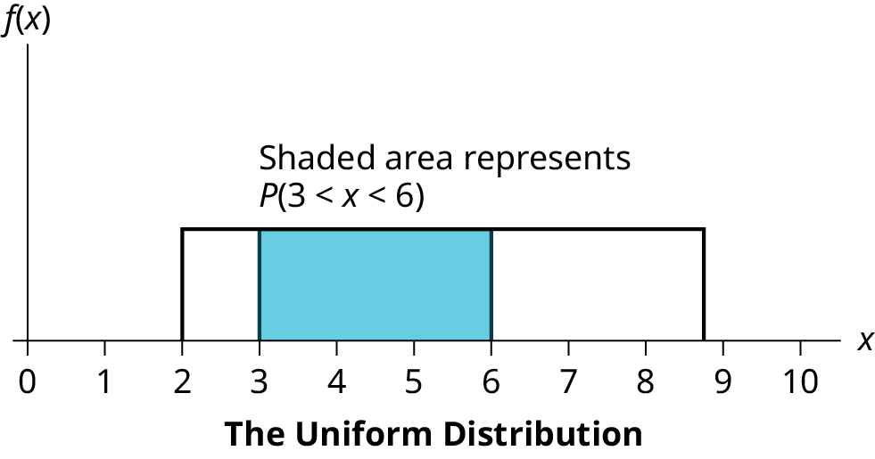
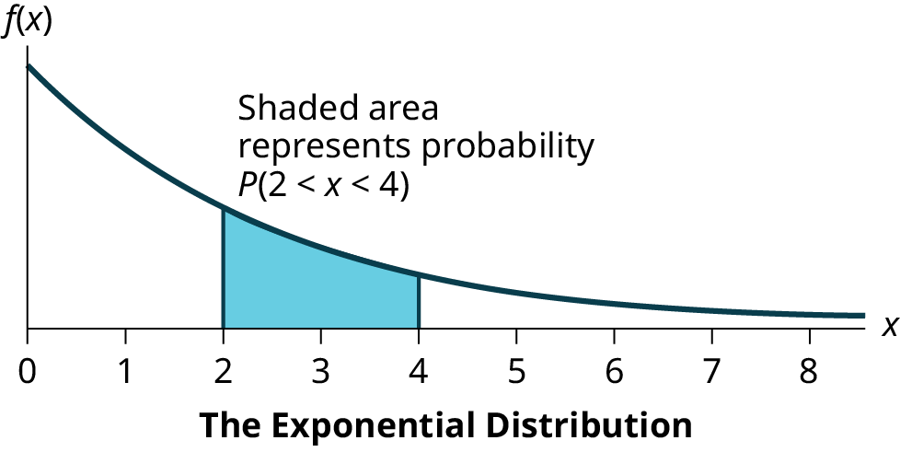
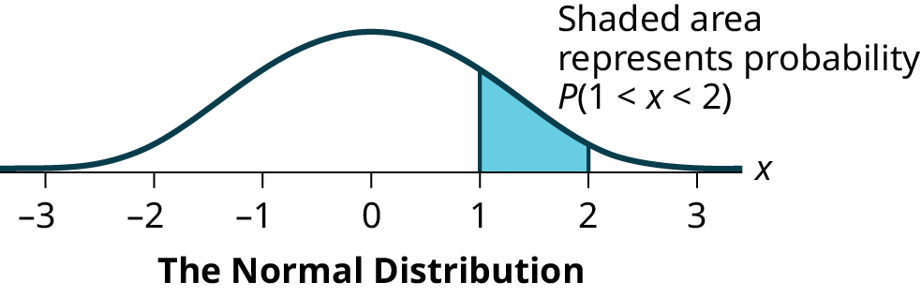
What Different Distributions Can Look Like

Slide 9
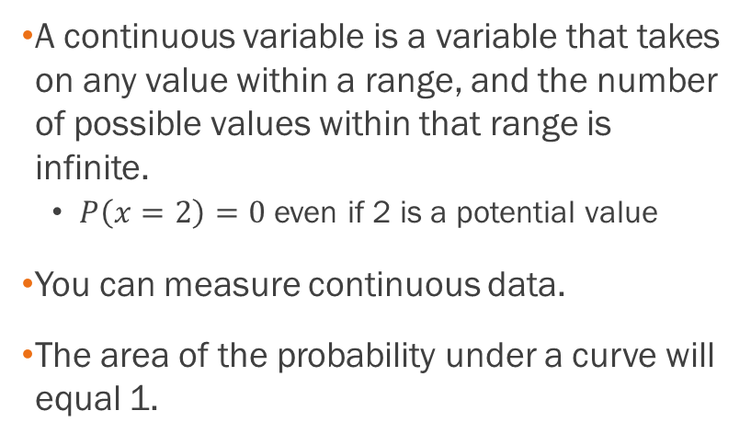
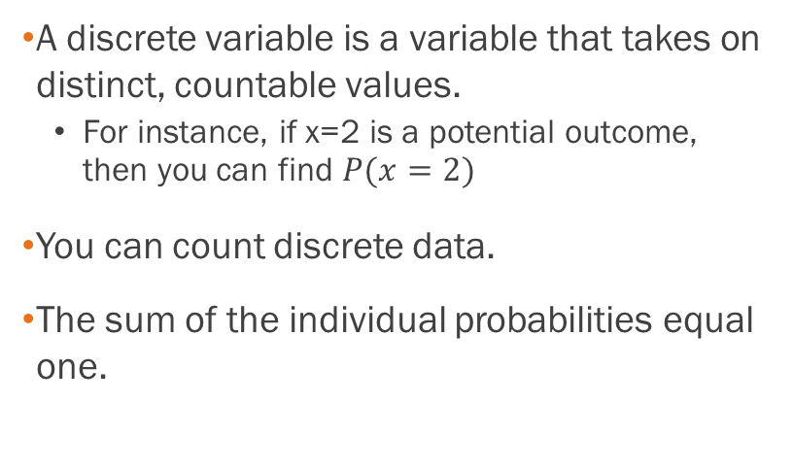
What’s the Difference Between Discrete and Continuous Distributions?
Discrete
continuous
A discrete variable is a variable that takes on distinct, countable values.
  For instance, if x=2 is a potential outcome, then you can find $P(x=2)$
You can count discrete data.
The sum of the individual probabilities equal one.
A continuous variable is a variable that takes on any value within a range, and the number of possible values within that range is infinite.
  $P\left(x=2\right)=0$ even if 2 is a potential value
You can measure continuous data.
The area of the probability under a curve will equal 1.

Slide 10
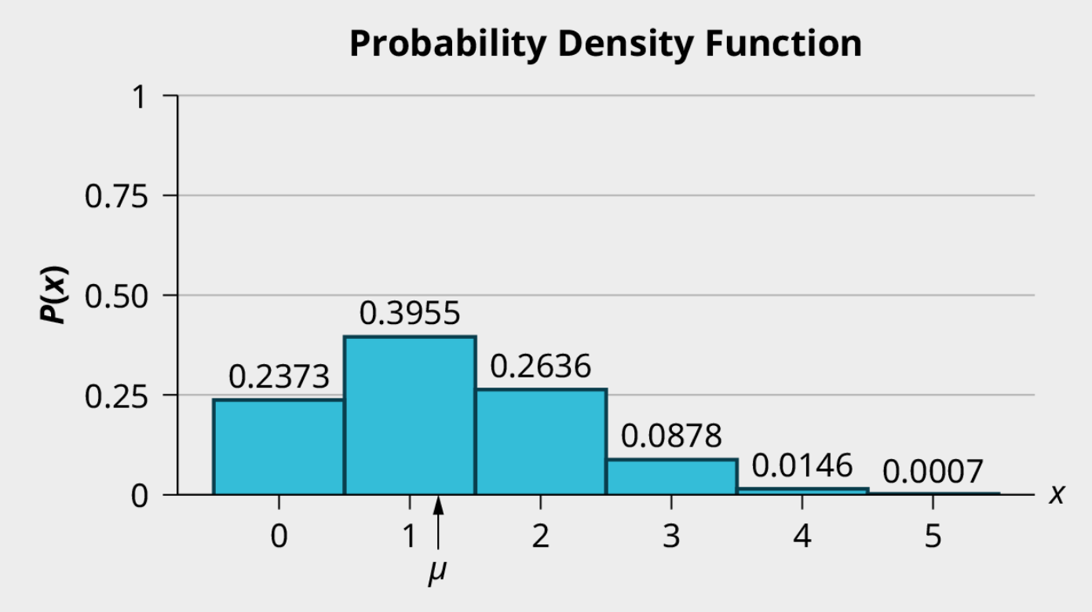
What’s the Difference Between Discrete and Continuous Distributions?
Discrete probability graph (example)
Continuous probability graph (Example)

Slide 11
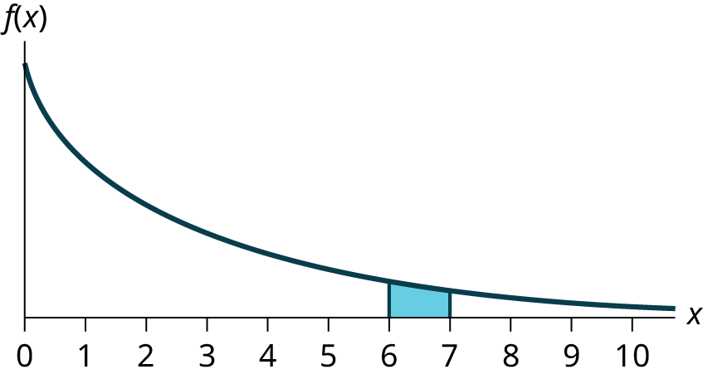
Example
What does the shaded area represent? P(___< x < ___)

Slide 12
Example - Answer
P(6< x < 7)

Slide 13
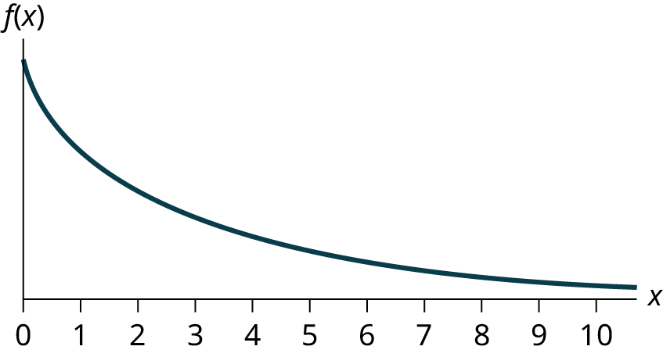
Example
For a continuous probability distribution, 0 ≤ x ≤ 10. What is P(x = 7)?

Slide 14
Example - Answer
This is equal to 0. Consider the width of the area contained at x=7.

Slide 15
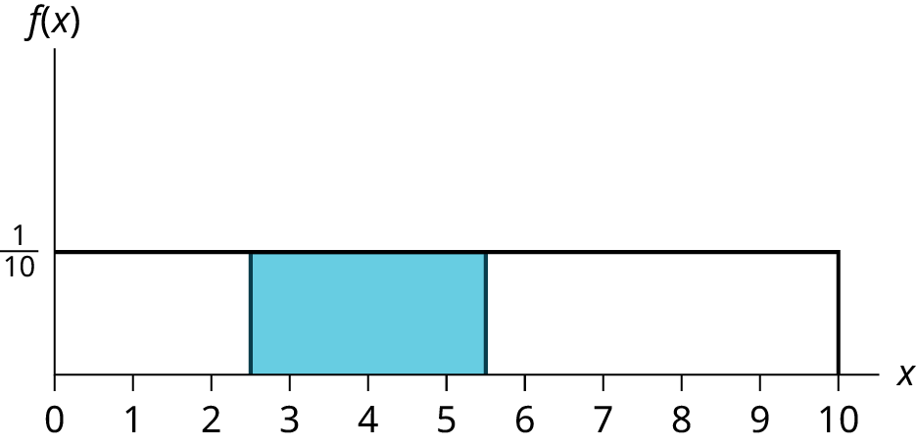
Example
Find the probability that x falls in the shaded area.

Slide 16

Example - Answer
We just need to find the area of the rectangle. Width: 5.5 – 2.5 = 3. $3×\frac{1}{10}=\frac{3}{10}=0.3$

Slide 17
Section 5.2
The uniform distribution

Slide 18
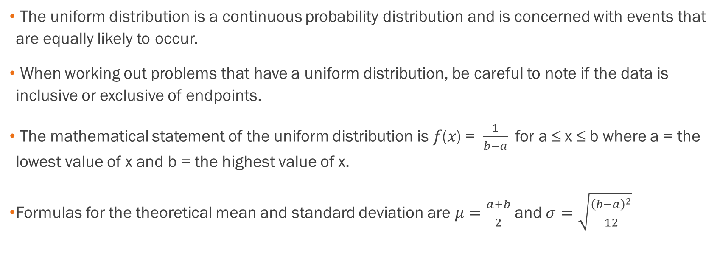
The Uniform Distribution
The uniform distribution is a continuous probability distribution and is concerned with events that are equally likely to occur.
When working out problems that have a uniform distribution, be careful to note if the data is inclusive or exclusive of endpoints.
The mathematical statement of the uniform distribution is 𝑓(𝑥) = $\frac{1}{b−a}$for a ≤ x ≤ b where a = the lowest value of x and b = the highest value of x.
Formulas for the theoretical mean and standard deviation are $μ=\frac{a+b}{2}$and $σ=\sqrt{\frac{{\left(b−a\right)}^{2}}{12}}$

Slide 19
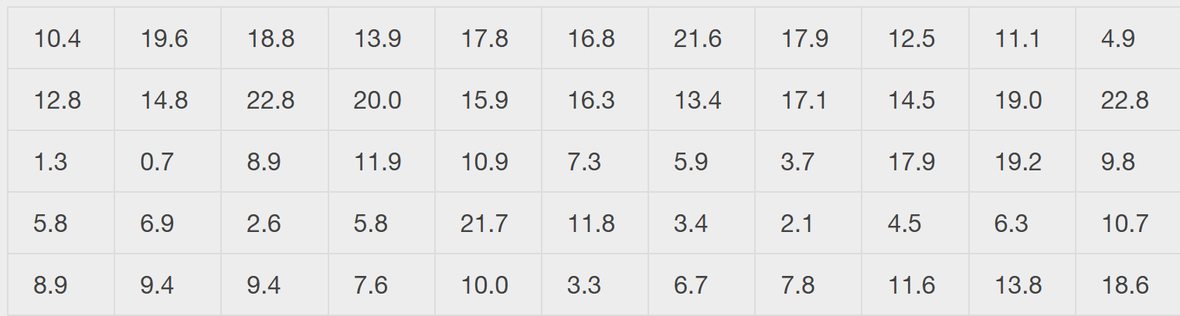
Example of the Uniform Distribution
The data in the table are 55 smiling times, in seconds, of an eight-week-old baby.
The sample mean = 11.65 and the sample standard deviation = 6.08.
The sample mean = 11.65 and the sample standard deviation = 6.08. We will assume that the smiling times, in seconds, follow a uniform distribution between zero and 23 seconds, inclusive. This means that any smiling time from zero to and including 23 seconds is equally likely. The histogram that could be constructed from the sample is an empirical distribution that closely matches the theoretical uniform distribution.

Slide 20
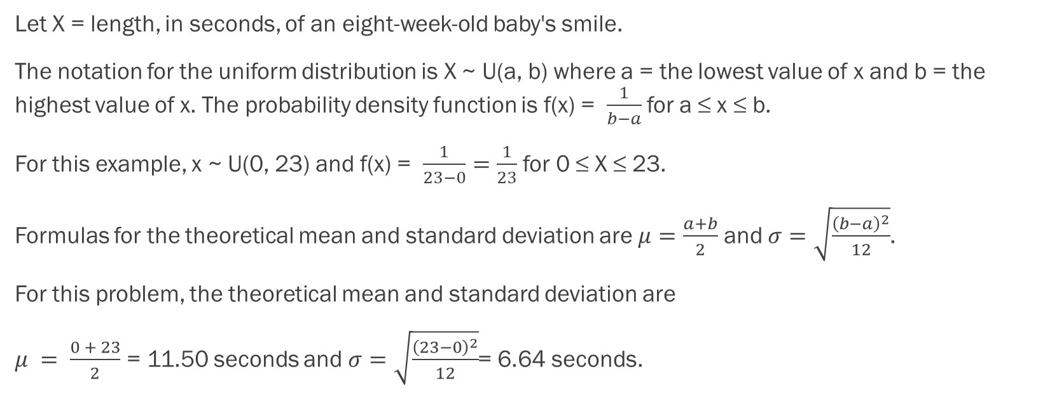
Example of the Uniform Distribution (Continued)
Let X = length, in seconds, of an eight-week-old baby's smile.
The notation for the uniform distribution is X ~ U(a, b) where a = the lowest value of x and b = the highest value of x. The probability density function is f(x) = $\frac{1}{b−a}$for a ≤ x ≤ b.
For this example, x ~ U(0, 23) and f(x) = $\frac{1}{23−0}=\frac{1}{23}$ for 0 ≤ X ≤ 23.
Formulas for the theoretical mean and standard deviation are $μ=\frac{a+b}{2}$ and $σ=\sqrt{\frac{{\left(b−a\right)}^{2}}{12}}$.
For this problem, the theoretical mean and standard deviation are
$μ = \frac{0 + 23}{2}$ = 11.50 seconds and $σ=\sqrt{\frac{{\left(23−0\right)}^{2}}{12}}$= 6.64 seconds.

Slide 21
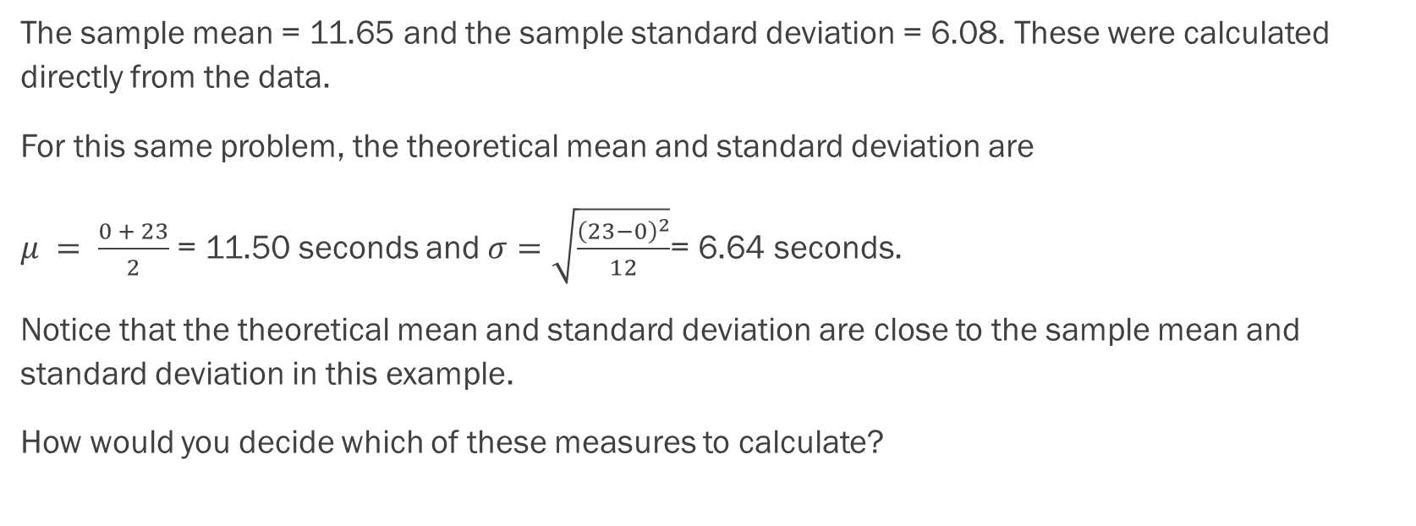
Example of the Uniform Distribution (Continued)
The sample mean = 11.65 and the sample standard deviation = 6.08. These were calculated directly from the data.
For this same problem, the theoretical mean and standard deviation are
$μ = \frac{0 + 23}{2}$ = 11.50 seconds and $σ=\sqrt{\frac{{\left(23−0\right)}^{2}}{12}}$= 6.64 seconds.
Notice that the theoretical mean and standard deviation are close to the sample mean and standard deviation in this example.
How would you decide which of these measures to calculate?

Slide 22
Example
The amount of time, in minutes, that a person must wait for a bus is uniformly distributed between zero and 15 minutes, inclusive.
What is the probability that a person waits fewer than 12.5 minutes?

Slide 23
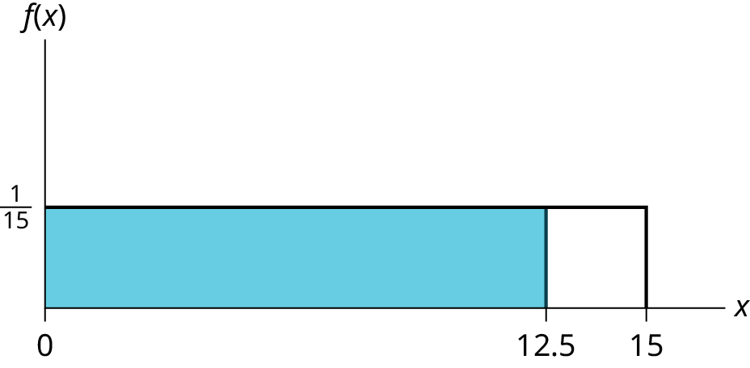
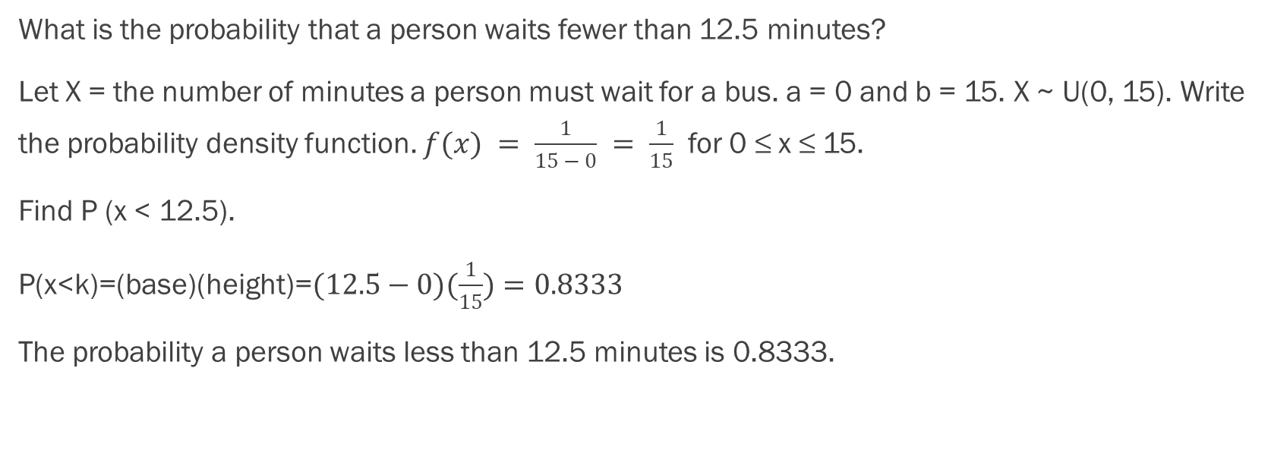
Example - Answers
What is the probability that a person waits fewer than 12.5 minutes?
Let X = the number of minutes a person must wait for a bus. a = 0 and b = 15. X ~ U(0, 15). Write the probability density function. $f(x) = \frac{1}{15 − 0} = \frac{1}{15}$ for 0 ≤ x ≤ 15.
Find P (x < 12.5).
P(x<k)=(base)(height)=$(12.5−0)(\frac{1}{15})=0.8333$
The probability a person waits less than 12.5 minutes is 0.8333.

Slide 24
Example
The amount of time, in minutes, that a person must wait for a bus is uniformly distributed between zero and 15 minutes, inclusive.
On the average, how long must a person wait? Find the mean, μ, and the standard deviation, σ.

Slide 25

Example - Answers
On the average, how long must a person wait? Find the mean, μ, and the standard deviation, σ.
$μ = \frac{a + b}{2} =\frac{15 + 0}{2} = 7.5$. On the average, a person must wait 7.5 minutes.
$σ =\sqrt{\frac{{\left(b−a\right)}^{2}}{12}}=\sqrt{\frac{{\left(15−0\right)}^{2}}{12}}= 4.3$. The Standard deviation is 4.3 minutes.

Slide 26
Example
The amount of time, in minutes, that a person must wait for a bus is uniformly distributed between zero and 15 minutes, inclusive.
Ninety percent of the time, the time a person must wait falls below what value?

Slide 27
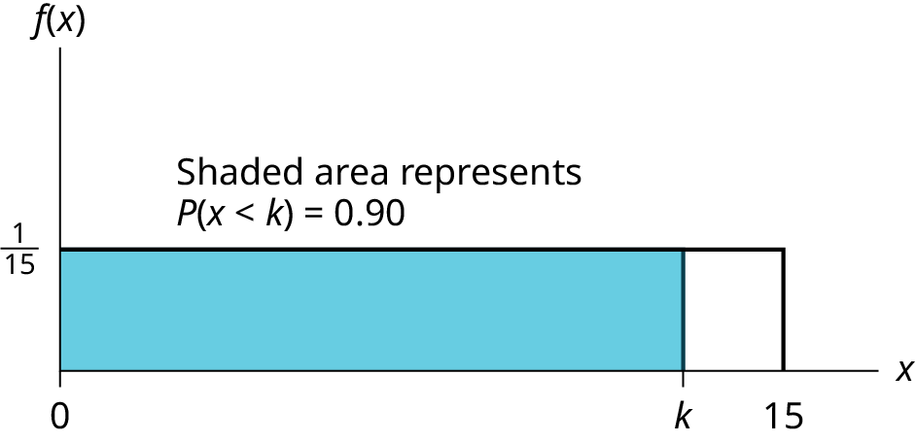
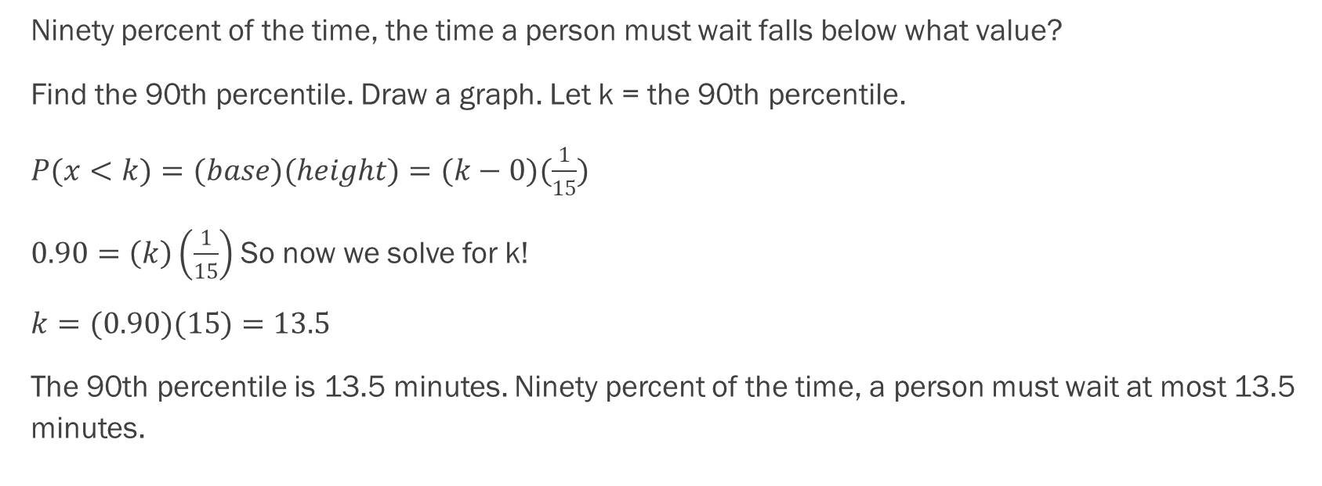
Example - Answers
Ninety percent of the time, the time a person must wait falls below what value?
Find the 90th percentile. Draw a graph. Let k = the 90th percentile.
$P(x<k)=(base)(height)=(k−0)(\frac{1}{15})$
$0.90=\left(k\right)\left(\frac{1}{15}\right)$ So now we solve for k!
$k=(0.90)(15)=13.5$
The 90th percentile is 13.5 minutes. Ninety percent of the time, a person must wait at most 13.5 minutes.

Slide 28
Example
Ace Heating and Air Conditioning Service finds that the amount of time a repair tech needs to fix a furnace is uniformly distributed between 1.5 and four hours. Let x = the time needed to fix a furnace. Then x ~ U (1.5, 4).
Find the probability that a randomly selected furnace repair requires more than two hours.
Find the probability that a randomly selected furnace repair requires less than three hours.
Find the 30th percentile of furnace repair times.
The longest 25% of furnace repair times take at least how long? (In other words: find the minimum time for the longest 25% of repair times.) What percentile does this represent?
Find the mean and standard deviation

Slide 29
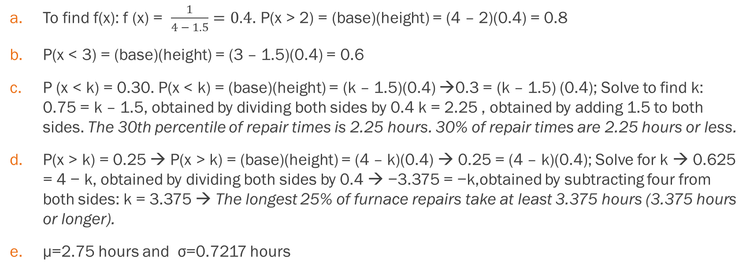
Example - Answers
To find f(x): f (x) = $\frac{1}{4 − 1.5}=0.4$. P(x > 2) = (base)(height) = (4 – 2)(0.4) = 0.8
P(x < 3) = (base)(height) = (3 – 1.5)(0.4) = 0.6
P (x < k) = 0.30. P(x < k) = (base)(height) = (k – 1.5)(0.4) →0.3 = (k – 1.5) (0.4); Solve to find k: 0.75 = k – 1.5, obtained by dividing both sides by 0.4 k = 2.25 , obtained by adding 1.5 to both sides. The 30th percentile of repair times is 2.25 hours. 30% of repair times are 2.25 hours or less.
P(x > k) = 0.25 → P(x > k) = (base)(height) = (4 – k)(0.4) → 0.25 = (4 – k)(0.4); Solve for k → 0.625 = 4 − k, obtained by dividing both sides by 0.4 → −3.375 = −k,obtained by subtracting four from both sides: k = 3.375 → The longest 25% of furnace repairs take at least 3.375 hours (3.375 hours or longer).
μ=2.75 hours and σ=0.7217 hours

Slide 30
Putting It All Together
A quick review

Slide 31
Putting It All Together
In each situation, calculate the probability question. Then find the mean and standard deviation.
Ellen has music practice three days a week. She practices for all of the three days 85% of the time, two days 8% of the time, one day 4% of the time, and no days 3% of the time. What is the probability that she practices one day or less?
The average cost of textbooks for 8 college students is $124, $250, $75, $95, $105, $116, $205, $55. What is the probability that a randomly selected book from this sample costs less than $100?
According to a study by Dr. John McDougall of his live-in weight loss program, the people who follow his program lose between six and 15 pounds a month until they approach trim body weight. Let’s suppose that the weight loss is uniformly distributed. What is the probability than a participant in this program lost 8 pounds or less?
The literacy rate for a nation measures the proportion of people age 15 and over that can read and write. The literacy rate in a certain country is 28.1%. Suppose you choose 15 people in that country at random. Let X = the number of people who are literate. What is the probability that 3 or fewer people in your selection are literate?

Slide 32
Putting It All Together
Answer the question in each situation. Then find the average or expected value, and interpret what it means.
It has been estimated that only about 30% of California residents have adequate earthquake supplies. Suppose you randomly survey 11 California residents. We are interested in the number who have adequate earthquake supplies. What is the probability that 5 or fewer people have adequate earthquake supplies?
The age of cars in the staff parking lot of a suburban college is uniformly distributed from six months (0.5 years) to 9.5 years. What is the probability that a car is 8 years or older?
You ask 5 parkers in a parking lot what the age of their cars are. The responses you get are 0, 3, 2, 4, and 4. Is the average age of cars in your sample a good estimate for the population of all cars in the parking lot?

Slide 33
Putting It All Together
In each situation, calculate the probability question. Then find the mean and standard deviation.
Ellen has music practice three days a week. She practices for all of the three days 85% of the time, two days 8% of the time, one day 4% of the time, and no days 3% of the time. What is the probability that she practices one day or less?
The average cost of textbooks for 8 college students is $124, $250, $75, $95, $105, $116, $205, $55. What is the probability that a randomly selected book from this sample costs less than $100?
According to a study by Dr. John McDougall of his live-in weight loss program, the people who follow his program lose between six and 15 pounds a month until they approach trim body weight. Let’s suppose that the weight loss is uniformly distributed. What is the probability than a participant in this program lost 8 pounds or less?
The literacy rate for a nation measures the proportion of people age 15 and over that can read and write. The literacy rate in a certain country is 28.1%. Suppose you choose 15 people in that country at random. Let X = the number of people who are literate. What is the probability that 3 or fewer people in your selection are literate?

