Slide 1
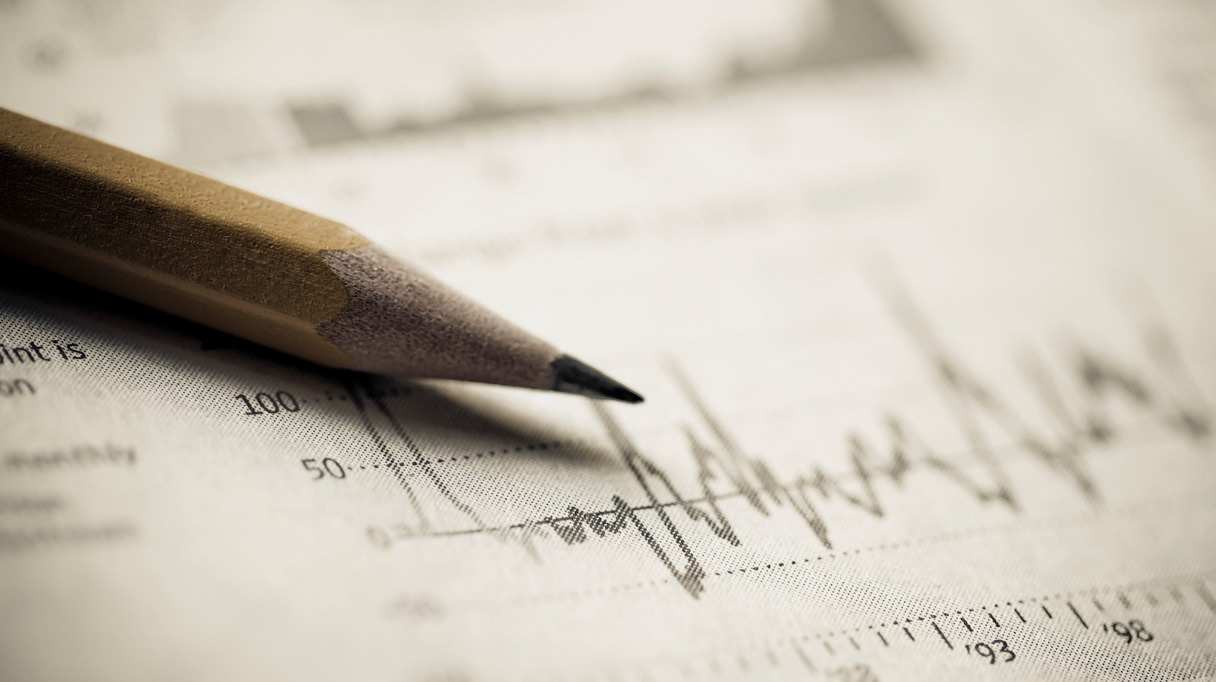
Chapter 6 Normal Distribution
Openstax statistics

Slide 2
Objectives
By the end of this chapter, the student should be able to:
Recognize and differentiate between key terms.
Apply various types of sampling methods to data collection.
Create and interpret frequency tables.

Slide 3
Introduction
The Normal Distribution

Slide 4
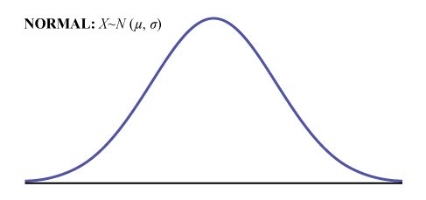
The Normal Distribution
The normal, a continuous distribution, is the most important of all the distributions. It is widely used and even more widely abused.
Its graph is bell-shaped. You see the bell curve in almost all disciplines. Two important points about this curve are:
1. The curve is symmetrical about a vertical line drawn through the mean, μ.
2. The area under the curve must equal one

Slide 5
The Normal Distribution (Continued)
The normal distribution has two parameters (two numerical descriptive measures), the mean (μ) and the standard deviation (σ).
If X is a quantity to be measured that has a normal distribution with mean (μ) and standard deviation (σ), we designate this by writing X ~ N(μ, σ).
The cumulative distribution function is P(X < x). It is calculated either by a calculator or a computer, or it is looked up in a table.

Slide 6
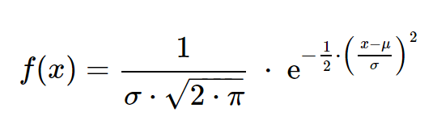
The Probability Density Function
The probability density function is what models the normal curve is a rather complicated mathematical function. Do not memorize it. It is not necessary.
The curve is symmetric about a vertical line drawn through the mean, μ.
The mean is the same as the median, which is the same as the mode, because the graph is symmetric about μ.
As the notation indicates, the normal distribution depends only on the mean and the standard deviation.

Slide 7
We can see how real data can create a normal curve with an Excel activity

Slide 8
Section 6.1
The Standard Normal Distribution

Slide 9
The Standard Normal Distribution
The standard normal distribution is a normal distribution of standardized values called z-scores.
The mean for the standard normal distribution is zero, and the standard deviation is one. When the z-score is used, the distribution is Z ~ N(0, 1).
The value x comes from a normal distribution with mean μ and standard deviation σ.

Slide 10
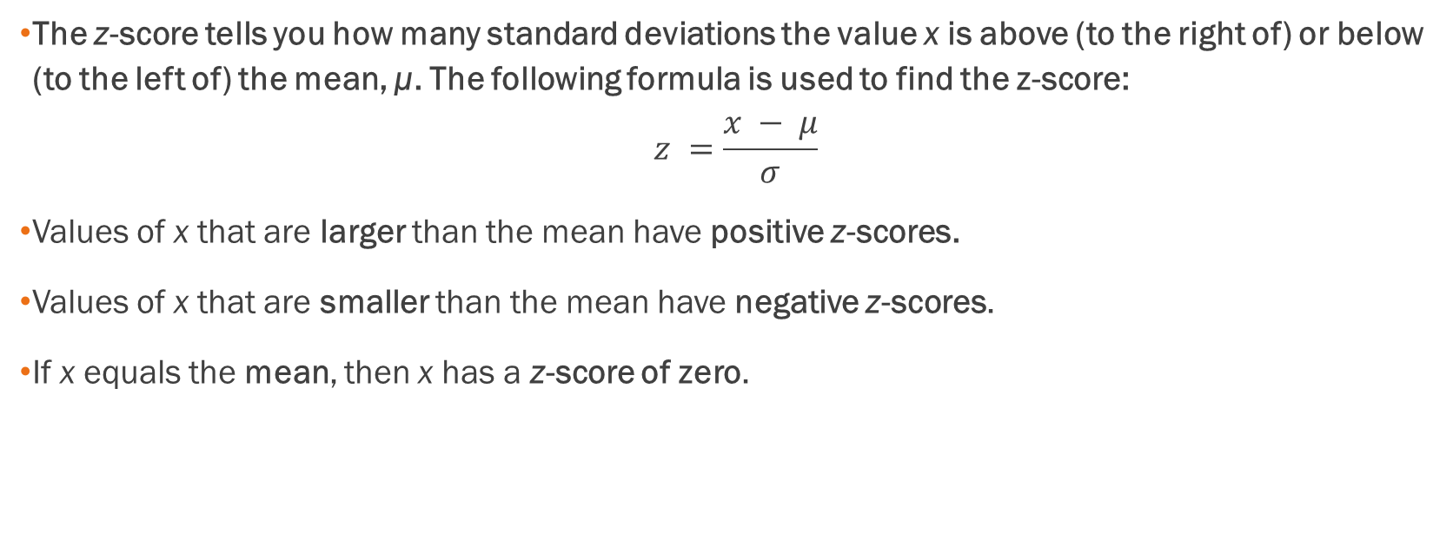
Z-Scores
The z-score tells you how many standard deviations the value x is above (to the right of) or below (to the left of) the mean, μ. The following formula is used to find the z-score:
$$z =\frac{x − μ}{σ}$$
Values of x that are larger than the mean have positive z-scores.
Values of x that are smaller than the mean have negative z-scores.
If x equals the mean, then x has a z-score of zero.

Slide 11
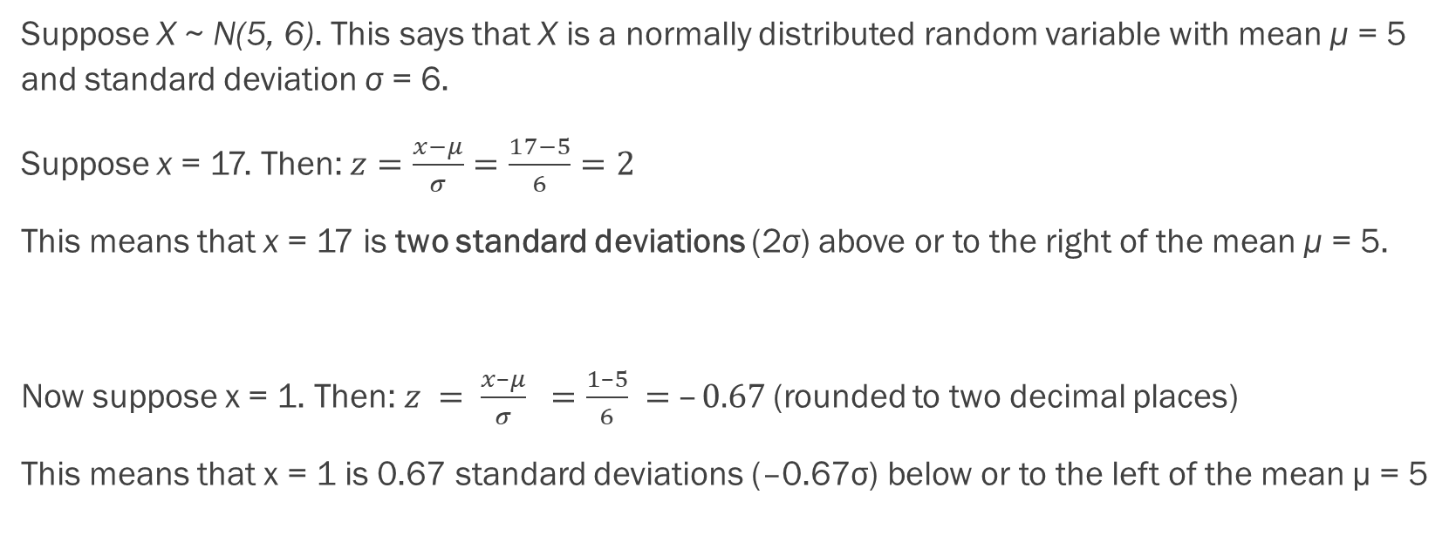
The Standard Normal Distribution
Example
Suppose X ~ N(5, 6). This says that X is a normally distributed random variable with mean μ = 5 and standard deviation σ = 6.
Suppose x = 17. Then: $z=\frac{x−μ}{σ}=\frac{17−5}{6}=2$
This means that x = 17 is two standard deviations (2σ) above or to the right of the mean μ = 5.
Now suppose x = 1. Then: $z = \frac{x–μ}{σ} =\frac{1–5}{6} = –0.67$(rounded to two decimal places)
This means that x = 1 is 0.67 standard deviations (–0.67σ) below or to the left of the mean μ = 5

Slide 12

The Standard Normal Distribution
Example
Suppose X ~ N(5, 6). This says that X is a normally distributed random variable with mean μ = 5 and standard deviation σ = 6. Using this data, compare how the normal distribution will looked compared to the normal distribution. Plot where $x=17$ and $x=1$fits in each of these distributions.

Slide 13
Let’s refer to Excel and see and create an example of how the normal distribution compares to the standard normal distribution

Slide 14
The Empirical Rule
If X is a random variable and has a normal distribution with mean µ and standard deviation σ, then the Empirical Rule states the following:
  About 68% of the x values lie between –1σ and +1σ of the mean µ (within one standard deviation of the mean). The z-scores for +1σ and –1σ are +1 and –1, respectively.
  About 95% of the x values lie between –2σ and +2σ of the mean µ (within two standard deviations of the mean). The z-scores for +2σ and –2σ are +2 and –2, respectively.
  About 99.7% of the x values lie between –3σ and +3σ of the mean µ (within three standard deviations of the mean). Notice that almost all the x values lie within three standard deviations of the mean. The z-scores for +3σ and –3σ are +3 and –3 respectively.

Slide 15
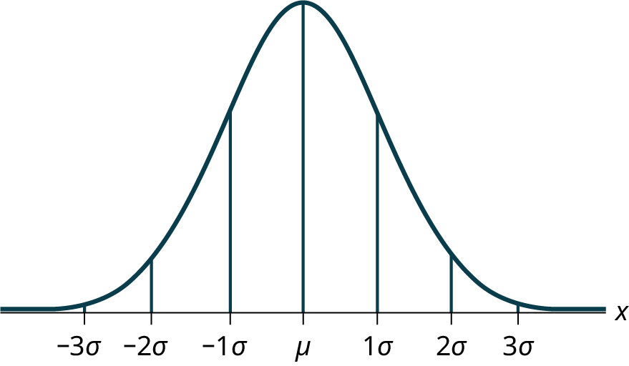
The Empirical Rule as a Graph

Slide 16
Example of the Empirical Rule
Suppose x has a normal distribution with mean 50 and standard deviation 6.
About 68% of the x values lie within one standard deviation of the mean. Therefore, about 68% of the x values lie between –1σ = (–1)(6) = –6 and 1σ = (1)(6) = 6 of the mean 50. The values 50 – 6 = 44 and 50 + 6 = 56 are within one standard deviation from the mean 50. The z-scores are –1 and +1 for 44 and 56, respectively.
About 95% of the x values lie within two standard deviations of the mean. Therefore, about 95% of the x values lie between –2σ = (–2)(6) = –12 and 2σ = (2)(6) = 12. The values 50 – 12 = 38 and 50 + 12 = 62 are within two standard deviations from the mean 50. The z-scores are –2 and +2 for 38 and 62, respectively.
About 99.7% of the x values lie within three standard deviations of the mean. Therefore, about 99.7% of the x values lie between –3σ = (–3)(6) = –18 and 3σ = (3)(6) = 18 of the mean 50. The values 50 – 18 = 32 and 50 + 18 = 68 are within three standard deviations from the mean 50. The z-scores are –3 and +3 for 32 and 68, respectively.

Slide 17
Example
In a normal distribution, x = 5 and z = –1.25. This tells you that x = 5 is ____ standard deviations to the ____ (right or left) of the mean. Draw a graph of how these values could fit into both a normal distribution versus a standard normal distribution.

Slide 18
Example - Answer
In a normal distribution, x = 5 and z = –1.25. This tells you that x = 5 is ____ standard deviations to the ____ (right or left) of the mean.
1.25, left

Slide 19
Example
Suppose X ~ N(8, 1). What value of x has a z-score of –2.25? Draw both the normal distribution and standard normal distribution that would align with this situation.

Slide 20
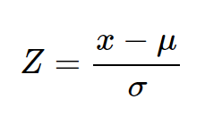

Example - Answer
Suppose X ~ N(8, 1). What value of x has a z-score of –2.25?
$−2.25=\frac{x−8}{1}$
$x=5.75$

Slide 21
Example
From 1984 to 1985, the mean height of 15 to 18-year-old males from Chile was 172.36 cm, and the standard deviation was 6.34 cm. Let Y = the height of 15 to 18-year-old males in 1984 to 1985. Then Y ~ N(172.36, 6.34).
About 68% of the y values lie between what two values? These values are ________________. The z-scores are ________________, respectively.
About 95% of the y values lie between what two values? These values are ________________. The z-scores are ________________ respectively.
About 99.7% of the y values lie between what two values? These values are ________________. The z-scores are ________________, respectively.
Draw the normal distribution and standard normal distribution associated with this situation.

Slide 22
Example - Answers
About 68% of the values lie between 166.02 cm and 178.7 cm. The z-scores are –1 and 1.
About 95% of the values lie between 159.68 cm and 185.04 cm. The z-scores are –2 and 2.
About 99.7% of the values lie between 153.34 cm and 191.38 cm. The z-scores are –3 and 3.
The curves:

Slide 23
Section 6.2
Using The Normal Distribution

Slide 24
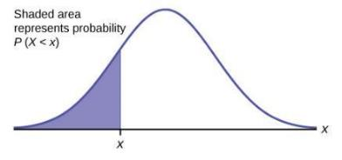
Using the Normal Distribution
The shaded area in the following graph indicates the area to the left of x. This area is represented by the probability P(X < x).
P(X < x) = Area to the left of the vertical line through x.
P(X < x) is the same as P(X ≤ x) for continuous distributions.
Calculators are used to calculate the probability P(X < x).
We can use Excel instead of a calculator.
Excel always calculates area to the left by default!

Slide 25
Using the Normal Distribution (Continued)
P(X > x) = 1 – P(X < x) = Area to the right of the vertical line through x.
P(X > x) is the same as P(X ≥ x) for continuous distributions.
Calculators or Excel are used to calculate the probability P(X > x).

Slide 26
Example of Probability Calculations to the Right
If the area to the left of x is 0.0228, then the area to the right is 1 – 0.0228 = 0.9772.

Slide 27
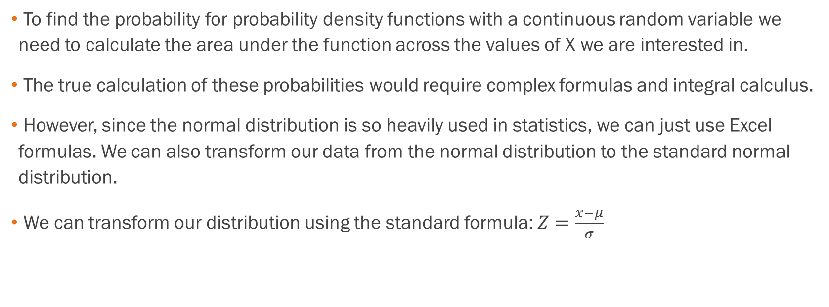
Calculation of Probabilities
To find the probability for probability density functions with a continuous random variable we need to calculate the area under the function across the values of X we are interested in.
The true calculation of these probabilities would require complex formulas and integral calculus.
However, since the normal distribution is so heavily used in statistics, we can just use Excel formulas. We can also transform our data from the normal distribution to the standard normal distribution.
We can transform our distribution using the standard formula: $Z=\frac{x−μ}{σ}$

Slide 28
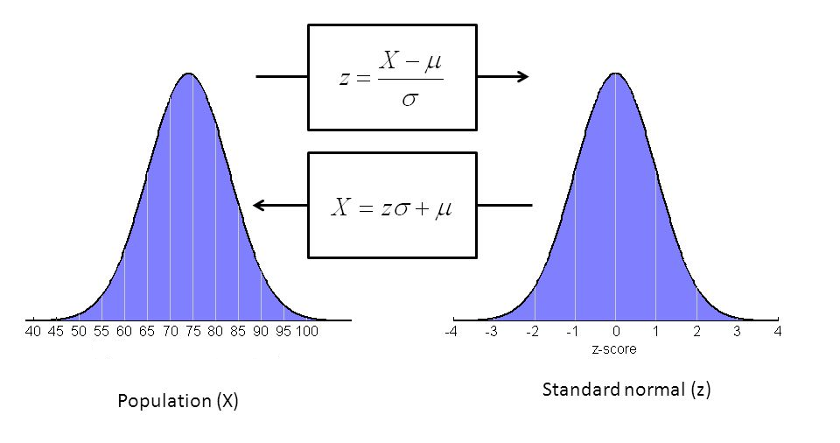
A Comparison of the Normal Distribution vs the Standard Normal Distribution

Slide 29
Example
The final exam scores in a statistics class were normally distributed with a mean of 63 and a standard deviation of five. Refer to the Excel spreadsheet for hints on how to do the computations for this problem.
a. Find the probability that a randomly selected student scored more than 65 on the exam. Compare these results for both the normal and standard normal distributions.
b. Find the probability that a randomly selected student scored less than 85. Compare these results for both the normal and standard normal distributions.

Slide 30
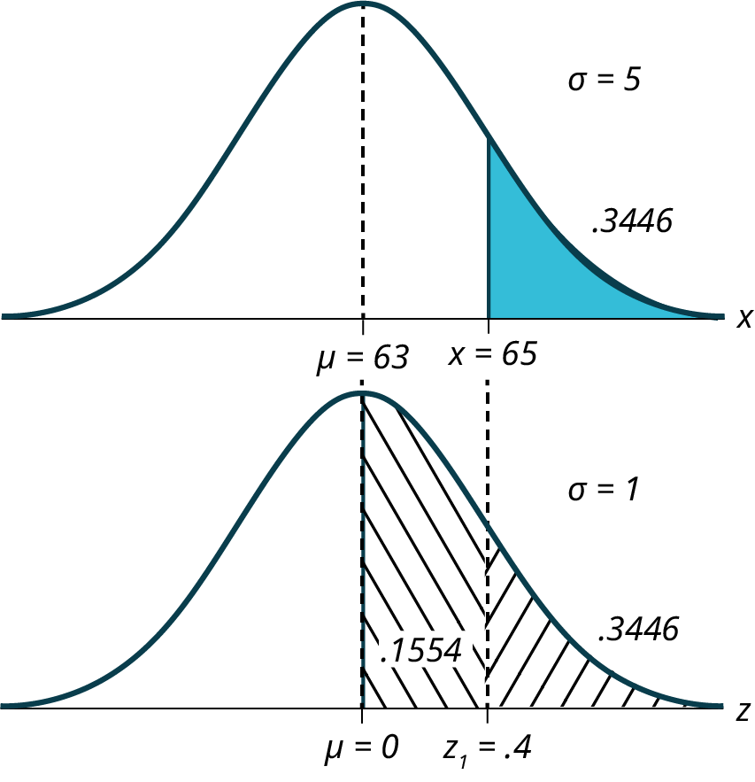
Example - Answer
a. Find the probability that a randomly selected student scored more than 65 on the exam.
Let X = a score on the final exam. X ~ N(63, 5), where μ = 63 and σ = 5. Draw a graph.
Then, find P(x > 65). P(x > 65) = 0.3446. We will use Excel for this.

Slide 31
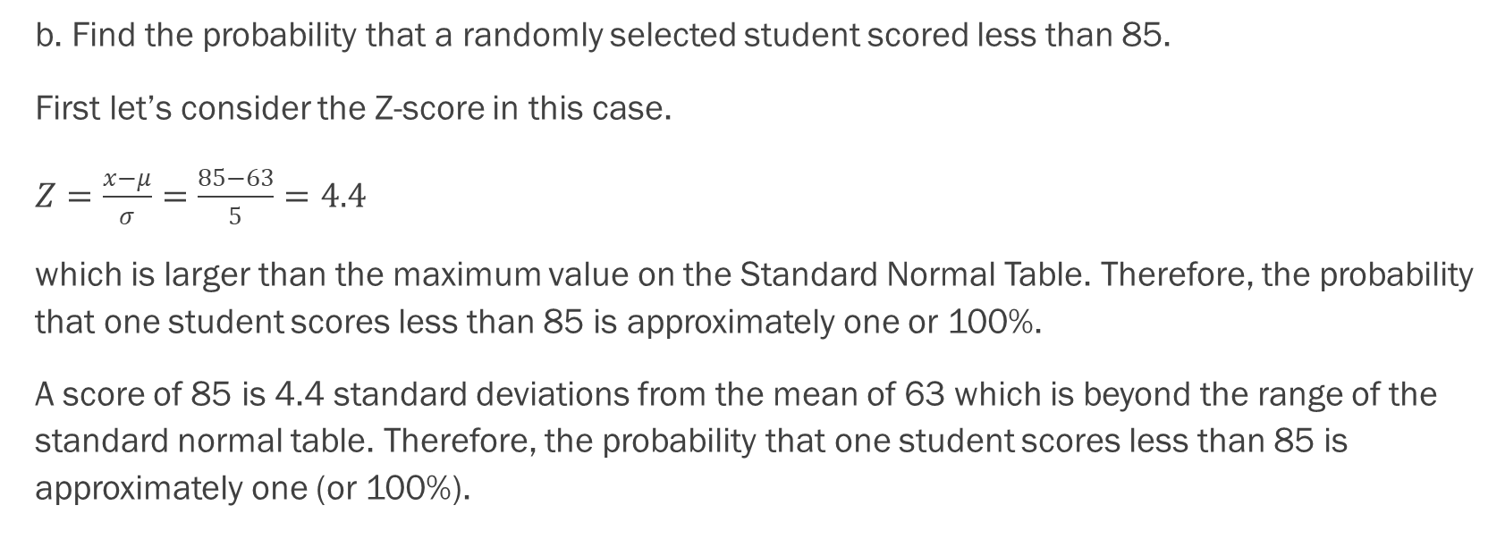
Example - Answer
b. Find the probability that a randomly selected student scored less than 85.
First let’s consider the Z-score in this case.
$Z=\frac{x−μ}{σ}=\frac{85−63}{5}=4.4$
which is larger than the maximum value on the Standard Normal Table. Therefore, the probability that one student scores less than 85 is approximately one or 100%.
A score of 85 is 4.4 standard deviations from the mean of 63 which is beyond the range of the standard normal table. Therefore, the probability that one student scores less than 85 is approximately one (or 100%).

Slide 32
Example
A personal computer is used for office work at home, research, communication, personal finances, education, entertainment, social networking, and a myriad of other things. Suppose that the average number of hours a household personal computer is used for entertainment is two hours per day. Assume the times for entertainment are normally distributed and the standard deviation for the times is half an hour.
Find the probability that a household personal computer is used for entertainment between 1.8 and 2.75 hours per day.
Find the maximum number of hours per day that the bottom quartile of households uses a personal computer for entertainment.

Slide 33
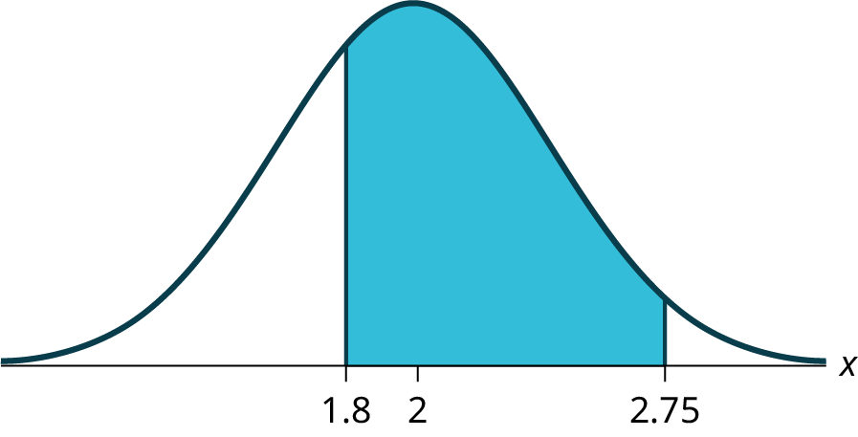
Example - Answer
a. Let X = the amount of time (in hours) a household personal computer is used for entertainment. X ~ N(2, 0.5) where μ = 2 and σ = 0.5.
Find P(1.8 < x < 2.75).
The probability for which you are looking is the area between x = 1.8 and x = 2.75. P(1.8 < x < 2.75) = 0.5886
The probability that a household personal computer is used between 1.8 and 2.75 hours per day for entertainment is 0.5886.

Slide 34
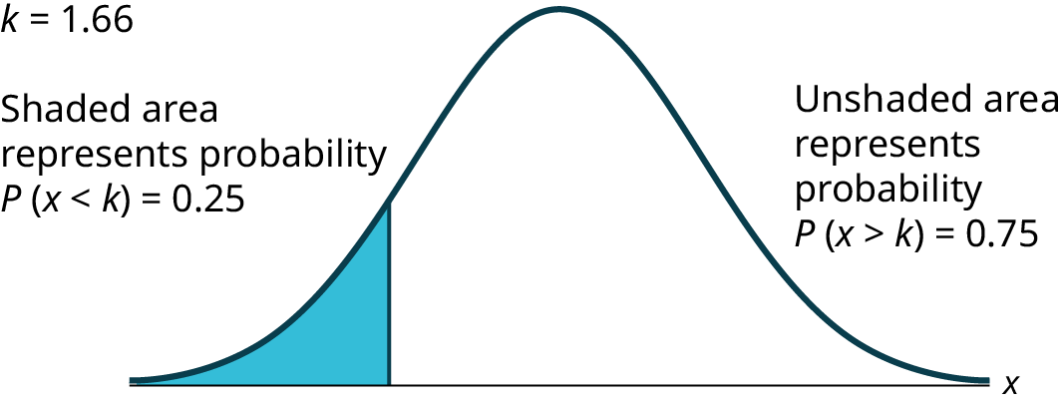
Example - Answer
b. To find the maximum number of hours per day that the bottom quartile of households uses a personal computer for entertainment, find the 25th percentile, k, where P(x < k) = 0.25.
The maximum number of hours per day that the bottom quartile of households uses a personal computer for entertainment is 1.66 hours.

Slide 35
Example
In the United States the ages 13 to 55+ of smartphone users approximately follow a normal distribution with approximate mean and standard deviation of 36.9 years and 13.9 years, respectively.
a. Determine the probability that a random smartphone user in the age range 13 to 55+ is between 23 and 64.7 years old.
b. Determine the probability that a randomly selected smartphone user in the age range 13 to 55+ is at most 50.8 years old.
You will need to use Excel for both of these. Draw a graph to accompany each situation.

Slide 36
Example - Answer
a. Determine the probability that a random smartphone user in the age range 13 to 55+ is between 23 and 64.7 years old.
0.8186
b. Determine the probability that a randomly selected smartphone user in the age range 13 to 55+ is at most 50.8 years old.
b. 0.8413

Slide 37
Example
A citrus farmer who grows mandarin oranges finds that the diameters of mandarin oranges harvested on their farm follow a normal distribution with a mean diameter of 5.85 cm and a standard deviation of 0.24 cm.
The middle 20% of mandarin oranges from this farm have diameters between ______ and ______.

Slide 38
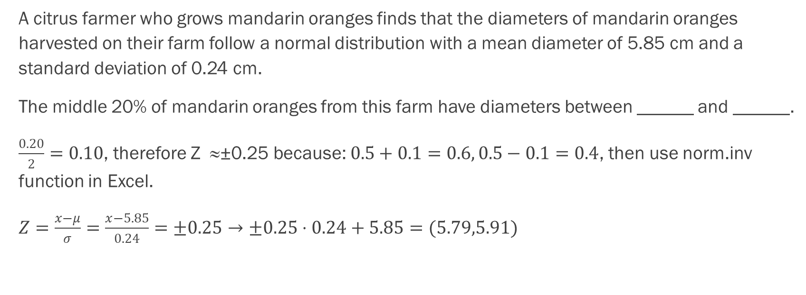
Example - Answer
A citrus farmer who grows mandarin oranges finds that the diameters of mandarin oranges harvested on their farm follow a normal distribution with a mean diameter of 5.85 cm and a standard deviation of 0.24 cm.
The middle 20% of mandarin oranges from this farm have diameters between ______ and ______.
$\frac{0.20}{2}=0.10$, therefore Z ≈±0.25 because: $0.5+0.1=0.6, 0.5−0.1=0.4$, then use norm.inv function in Excel.
$Z=\frac{x−μ}{σ}=\frac{x−5.85}{0.24}=±0.25→±0.25⋅0.24+5.85=(5.79,5.91)$

Slide 39
Example
In the United States the ages 13 to 55+ of smartphone users approximately follow a normal distribution with approximate mean and standard deviation of 36.9 years and 13.9 years respectively. Using this information, answer the following questions (round answers to one decimal place).
a. Calculate the interquartile range (IQR).
b. Forty percent of the smartphone users from 13 to 55+ are at least what age?

Slide 40
Example - Answers
a.
IQR = Q₃ – Q₁
Calculate Q₃ = 75th percentile and Q₁ = 25th percentile.
invNorm(0.75,36.9,13.9) = Q₃ = 46.2754
invNorm(0.25,36.9,13.9) = Q₁ = 27.5246
IQR = Q₃ – Q₁ = 18.8

Slide 41
Example - Answers
b.
Find k where P(x ≥ k) = 0.40 ("At least" translates to "greater than or equal to.")
0.40 = the area to the right.
Area to the left = 1 – 0.40 = 0.60.
The area to the left of k = 0.60.
invNorm(0.60,36.9,13.9) = 40.4215.
k = 40.4.
Forty percent of the smartphone users from 13 to 55+ are at least 40.4 years.

Slide 42
Estimating the Binomial Distribution with the Normal Distribution
Additional material (taken from the openstax business statistics text)

Slide 43
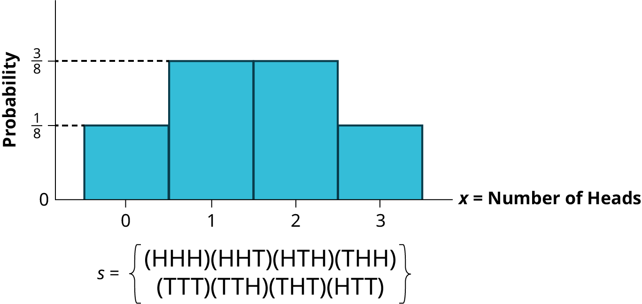
The Binomial Process can be Estimated with the Normal Distribution
We found earlier that various probability density functions are the limiting distributions of others; thus, we can estimate one with another under certain circumstances.
We will find here that the normal distribution can be used to estimate a binomial process. You can see how this would work in certain circumstances:

Slide 44
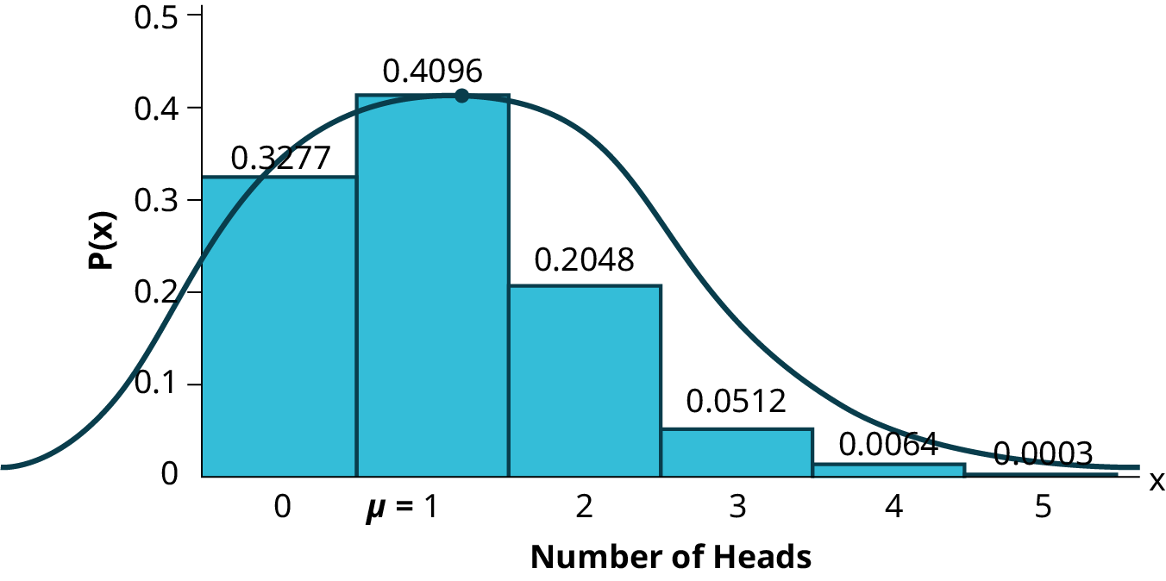
Some Binomial Processes are Skewed
The reason the skewness of the binomial distribution is important is because if it is to be estimated with a normal distribution, then we need to recognize that the normal distribution is symmetrical. In the example below, we used a coin that did not have 50/50 odds.
The closer the underlying binomial distribution is to being symmetrical, the better the estimate that is produced by the normal distribution.

Slide 45
Requirements to Use the Normal Distribution to Mimic the Binomial Process
The criteria for using a normal distribution to estimate a binomial requires BOTH np AND n(1 − p) are greater than five. Ensuring this allows for acceptable estimates of the binomial probability.

Slide 46
Example
Imagine that it is known that only 10% of Australian Shepherd puppies are born with what is called "perfect symmetry" in their three colors, black, white, and copper. Perfect symmetry is defined as equal coverage on all parts of the dog when looked at in the face and measuring left and right down the centerline. A kennel would have a good reputation for breeding Australian Shepherds if they had a high percentage of dogs that met this criterion. During the past 5 years and out of the 100 dogs born to Dundee Kennels, 16 were born with this coloring characteristic.
What is the probability that, in 100 births, more than 16 would have this characteristic?
Use the class Excel spreadsheet to compare the binomial distribution versus the normal distribution.

Slide 47
Example - Answers
If we assume that one dog's coloring is independent of other dogs' coloring, a bit of a brave assumption, this becomes a classic binomial probability problem.
The statement of the probability requested is 1 − [p(X = 0) + p(X = 1) + p(X = 2)+ … + p(X = 16)]. This requires us to calculate 17 binomial formulas and add them together and then subtract from one to get the right hand part of the distribution. Alternatively, we can use the normal distribution to get an acceptable answer and in much less time.
First, we need to check if the binomial distribution is symmetrical enough to use the normal distribution. This is the requirement of testing np and n(1-p). We know that the binomial for this problem is skewed because the probability of success, 0.1, is not the same as the probability of failure, 0.9. Nevertheless, both np=10 and n(1−p)=90 are larger than 5, the cutoff for using the normal distribution to estimate the binomial.

Slide 48
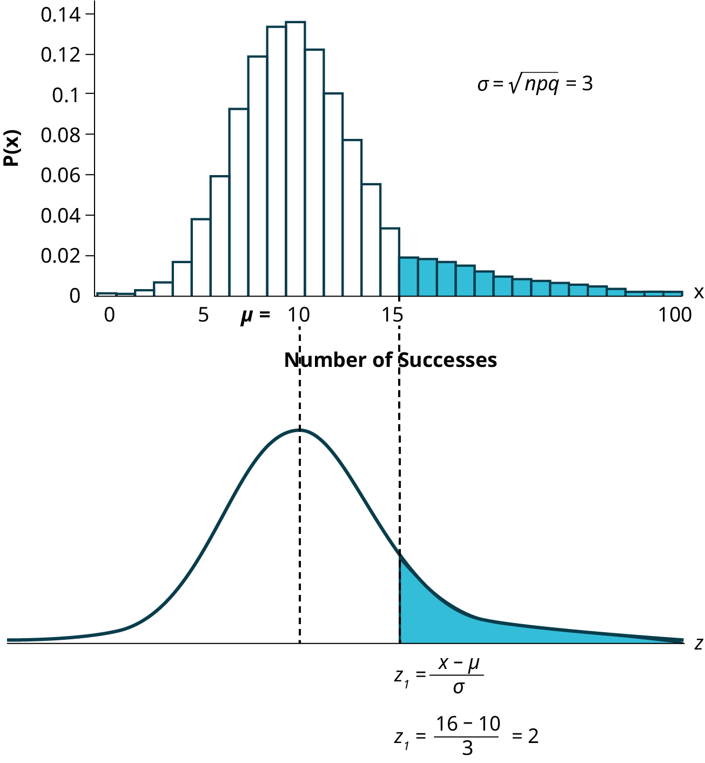
Example - Answers
Here is how the binomial process can be visualized as a normal distribution:

Slide 49
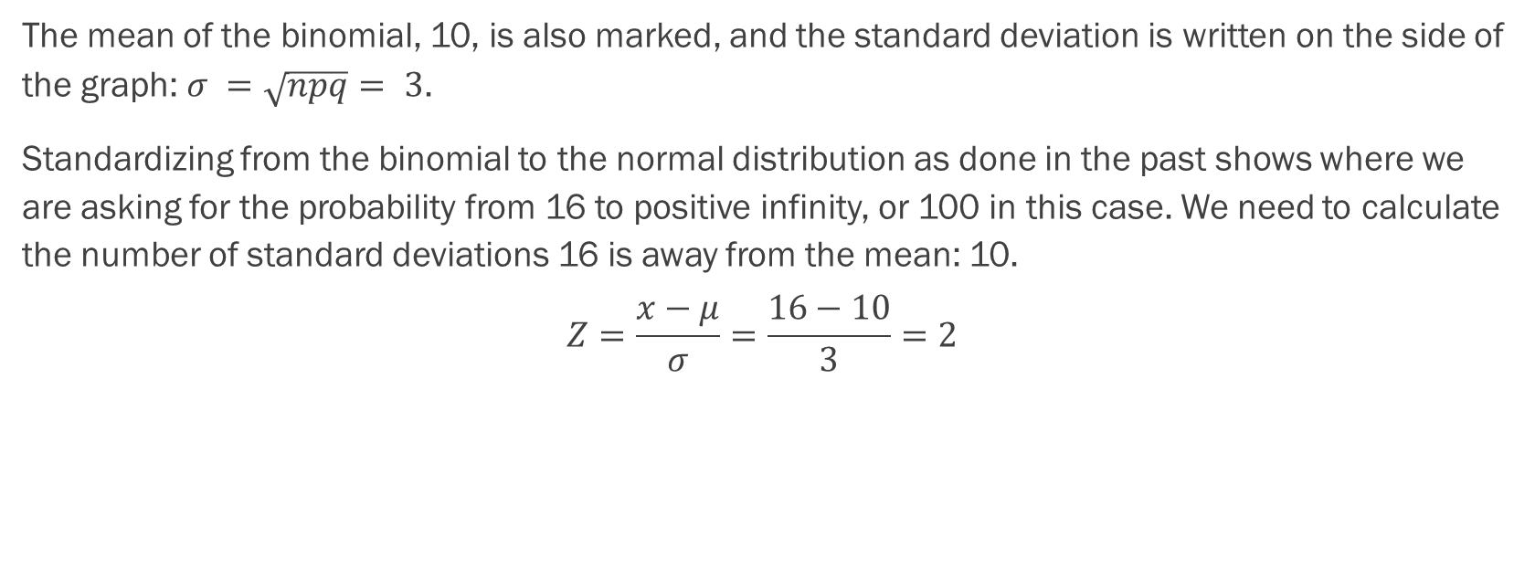
Example - Answers
The mean of the binomial, 10, is also marked, and the standard deviation is written on the side of the graph: $σ =\sqrt{npq}= 3$.
Standardizing from the binomial to the normal distribution as done in the past shows where we are asking for the probability from 16 to positive infinity, or 100 in this case. We need to calculate the number of standard deviations 16 is away from the mean: 10.
$$Z=\frac{x−μ}{σ}=\frac{16−10}{3}=2$$

Slide 50
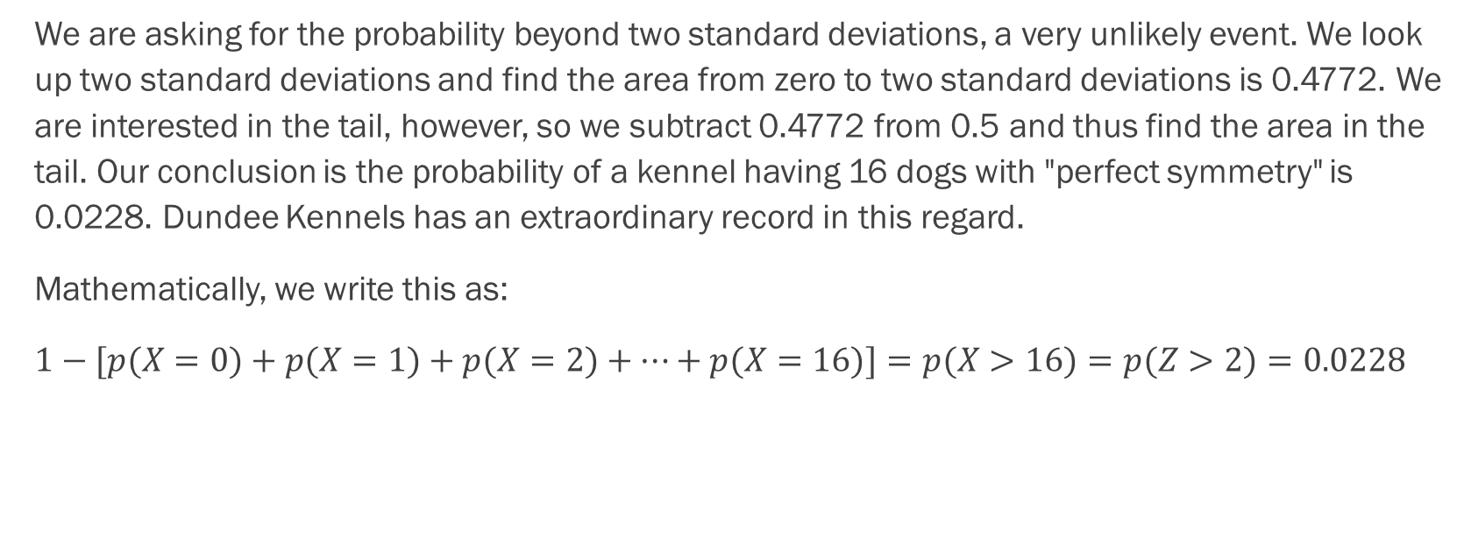
Example - Answers
We are asking for the probability beyond two standard deviations, a very unlikely event. We look up two standard deviations and find the area from zero to two standard deviations is 0.4772. We are interested in the tail, however, so we subtract 0.4772 from 0.5 and thus find the area in the tail. Our conclusion is the probability of a kennel having 16 dogs with "perfect symmetry" is 0.0228. Dundee Kennels has an extraordinary record in this regard.
Mathematically, we write this as:
$1−[p(X=0)+p(X=1)+p(X=2)+…+p(X=16)]=p(X>16)=p(Z>2)=0.0228$

Slide 51
Example
An experiment with a probability of success given as 0.40 is repeated 100 times. Use the normal distribution to approximate the binomial distribution, and find the probability the experiment will have from 35 to 45 successes.

Slide 52
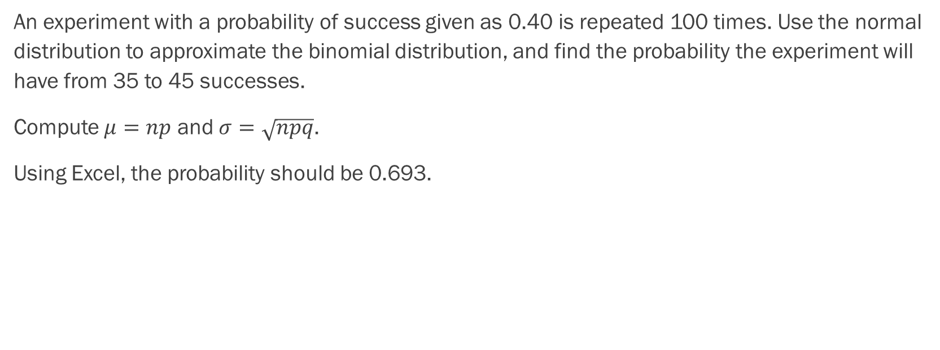
Example - Answers
An experiment with a probability of success given as 0.40 is repeated 100 times. Use the normal distribution to approximate the binomial distribution, and find the probability the experiment will have from 35 to 45 successes.
Compute $μ=np$ and $σ=\sqrt{npq}$.
Using Excel, the probability should be 0.693.

Slide 53
Example
Historically, a final exam in a course is passed with a probability of 0.9. The exam is given to a group of 70 students. What is the probability that at least 65 of them passed?

Slide 54
Example - Answers
Historically, a final exam in a course is passed with a probability of 0.9. The exam is given to a group of 70 students. What is the probability that at least 65 of them passed?

Slide 55
Example
A tree in an orchard has 200 oranges. Of the oranges, 40 are not ripe. Use the normal distribution to approximate the binomial distribution, and determine the probability a box containing 35 oranges has at most two oranges that are not ripe.

Slide 56
Putting It All Together
A Brief Review

Slide 57
Review
A fair coin is flipped 2 times. What is the probability of getting a heads first in this situation?
In a large city one in ten fire hydrants are in need of repair. If a crew examines 100 fire hydrants in a week, what is the probability they will find nine of fewer fire hydrants that need repair? Use the normal distribution to approximate the binomial distribution.
You buy a lottery ticket to a lottery that costs $10 per ticket. There are only 100 tickets available to be sold in this lottery. In this lottery there are one $500 prize, two $100 prizes, and four $25 prizes. Find your expected gain or loss.
Suppose that the duration of a particular type of criminal trial is known to be normally distributed with a mean of 21 days and a standard deviation of seven days. Sixty percent of all trials of this type are completed within how many days?

Slide 58
Review
Find the mean and standard deviation from a sample consisting of the amount of money spent on groceries in a single trip: $25.12, $82.12, $123.23, $75.23, $88.12, $105.27, $65.45, $49.23. What percentage of grocery bills in this sample were less than $75?
A subway train arrives every eight minutes during rush hour. We are interested in the length of time a commuter must wait for a train to arrive. The time follows a uniform distribution. Find the mean and standard deviation. What is the probability that a commuter waits more than 5 minutes for the train?
A venture capitalist, willing to invest $1,000,000, has three investments to choose from. The first investment, a software company, has a 10% chance of returning $5,000,000 profit, a 30% chance of returning $1,000,000 profit, and a 60% chance of losing the million dollars. The second company, a hardware company, has a 20% chance of returning $3,000,000 profit, a 40% chance of returning $1,000,000 profit, and a 40% chance of losing the million dollars. The third company, a biotech firm, has a 10% chance of returning $6,000,000 profit, a 70% of no profit or loss, and a 20% chance of losing the million dollars. Which invest has the highest expected return?
The patient recovery time from a particular surgical procedure is normally distributed with a mean of 5.3 days and a standard deviation of 2.1 days. What is the probability of spending more than two days in recovery?

