Slide 1

Chapter 7 The Central Limit Theorem
Openstax statistics

Slide 2
Objectives
By the end of this chapter, the student should be able to:
Recognize central limit theorem problems.
Classify continuous word problems by their distributions.
Apply and interpret the central limit theorem for means.
Apply and interpret the central limit theorem for sums.

Slide 3
The Central Limit Theorem is one of the most powerful and useful ideas in all of statistics.

Slide 4
The Central Limit Theorem
There are two alternative forms of the theorem, and both alternatives are concerned with drawing finite samples size n from a population with a known mean, μ, and a known standard deviation, σ.
The first alternative says that if we collect samples of size n with a "large enough n," calculate each sample's mean, and create a histogram of those means, then the resulting histogram will tend to have an approximate normal bell shape.
The second alternative says that if we again collect samples of size n that are "large enough," calculate the sum of each sample and create a histogram, then the resulting histogram will again tend to have a normal bell-shape.

Slide 5
The Central Limit Theorem (cont.)
In either case, it does not matter what the distribution of the original population is, or whether you even need to know it.
The important fact is that the distribution of sample means and the sums tend to follow the normal distribution.
The size of the sample, n, that is required in order to be "large enough" depends on the original population from which the samples are drawn (the sample size should be at least 30 or the data should come from a normal distribution).

Slide 6
The astounding result is that it does not matter what the distribution of the original population is, or whether you even need to know it. The important fact is that the distribution of sample means tend to follow the normal distribution.

Slide 7
Section 7.1
The Central Limit Theorem for Sample Means (Averages)

Slide 8
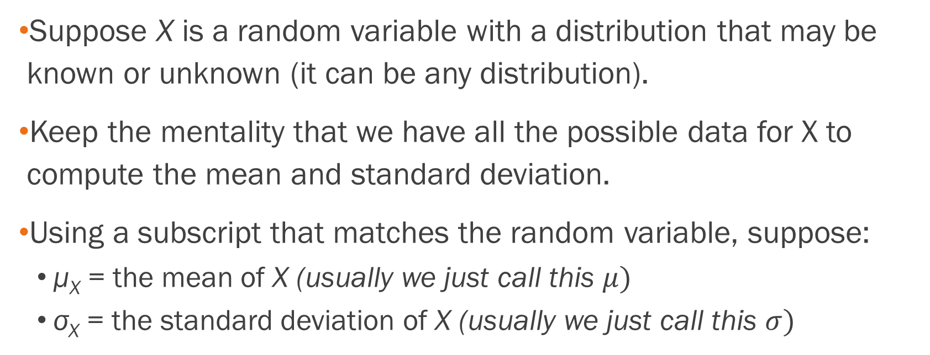
The Central Limit Theorem for
Sample Means (Averages)
Suppose X is a random variable with a distribution that may be known or unknown (it can be any distribution).
Keep the mentality that we have all the possible data for X to compute the mean and standard deviation.
Using a subscript that matches the random variable, suppose:
  μ_{X} = the mean of X (usually we just call this $μ)$
  σ_{X} = the standard deviation of X (usually we just call this $σ)$

Slide 9
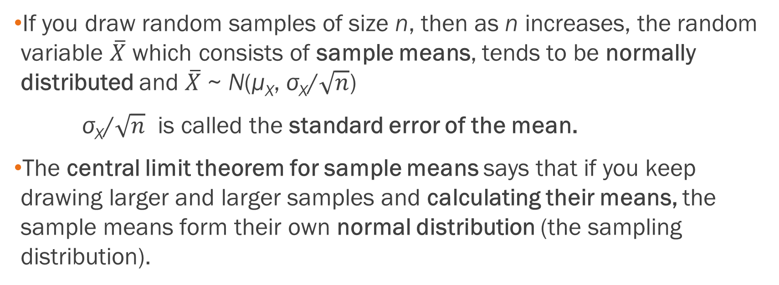
The Central Limit Theorem for
Sample Means (Averages), Cont.
If you draw random samples of size n, then as n increases, the random variable $\overline{X}$ which consists of sample means, tends to be normally distributed and $\overline{X}$ ~ N(μ_{X}, σ_{X}/$\sqrt{n}$)
σ_{X}/$\sqrt{n}$ is called the standard error of the mean.
The central limit theorem for sample means says that if you keep drawing larger and larger samples and calculating their means, the sample means form their own normal distribution (the sampling distribution).

Slide 10
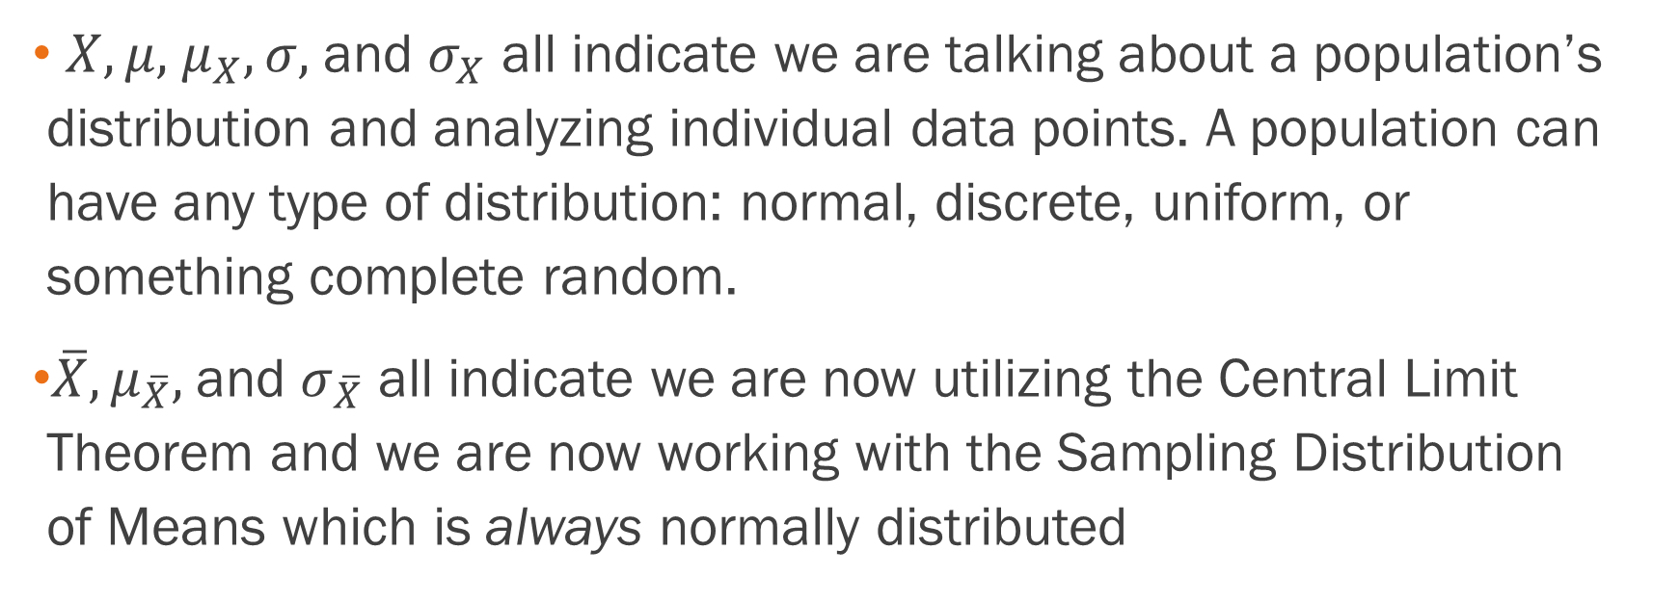
Notice There is A Difference In Notation Now!
$X, μ,$ $μ_{X}, σ,$and $σ_{X}$ all indicate we are talking about a population’s distribution and analyzing individual data points. A population can have any type of distribution: normal, discrete, uniform, or something complete random.
$\overline{X}, μ_{\overline{X}},$and $σ_{\overline{X}}$ all indicate we are now utilizing the Central Limit Theorem and we are now working with the Sampling Distribution of Means which is always normally distributed

Slide 11
The Central Limit Theorem focuses on the sampling distribution of means.

Slide 12
It is crucial that you understand the differences between a population distribution versus a sampling distribution of means.

Slide 13
Refer to the Excel Lab to see an example of how the Central Limit Theorem works!

Slide 14
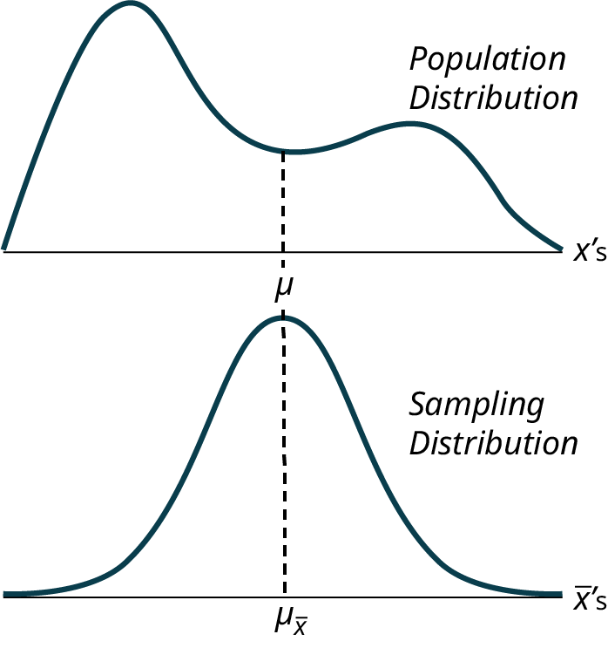
The Difference Graphically
For Single Data Points
For Means

Slide 15
On the Population Distribution
Notice that the horizontal axis in the top panel is labeled X. These are the individual observations of the population.
This is the unknown distribution of the population values.
The graph is purposefully drawn all squiggly to show that it does not matter just how odd ball it really is.
Remember, we will never know what this distribution looks like, or its mean or standard deviation for that matter.

Slide 16
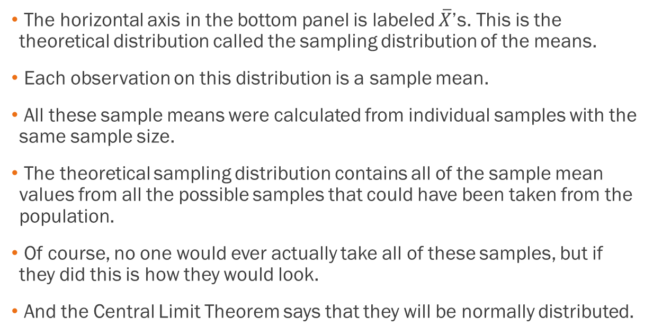
On the Sampling Distribution
The horizontal axis in the bottom panel is labeled $\overline{X}$’s. This is the theoretical distribution called the sampling distribution of the means.
Each observation on this distribution is a sample mean.
All these sample means were calculated from individual samples with the same sample size.
The theoretical sampling distribution contains all of the sample mean values from all the possible samples that could have been taken from the population.
Of course, no one would ever actually take all of these samples, but if they did this is how they would look.
And the Central Limit Theorem says that they will be normally distributed.

Slide 17
The Central Limit Theorem works with any type of data distribution
Here are some other examples

Slide 18
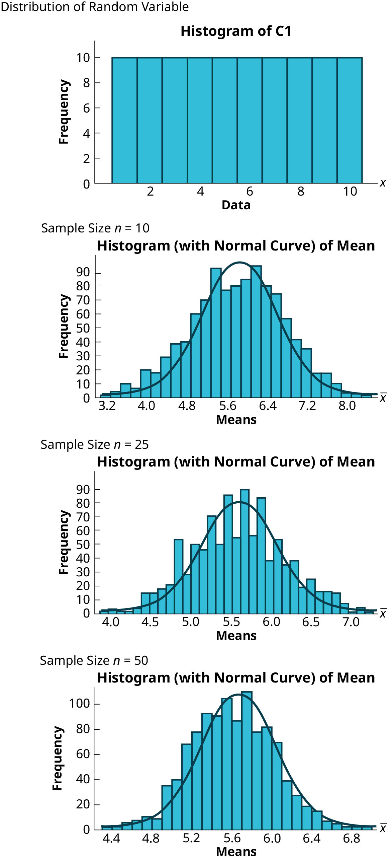
Examples with a Uniform Distribution

Slide 19
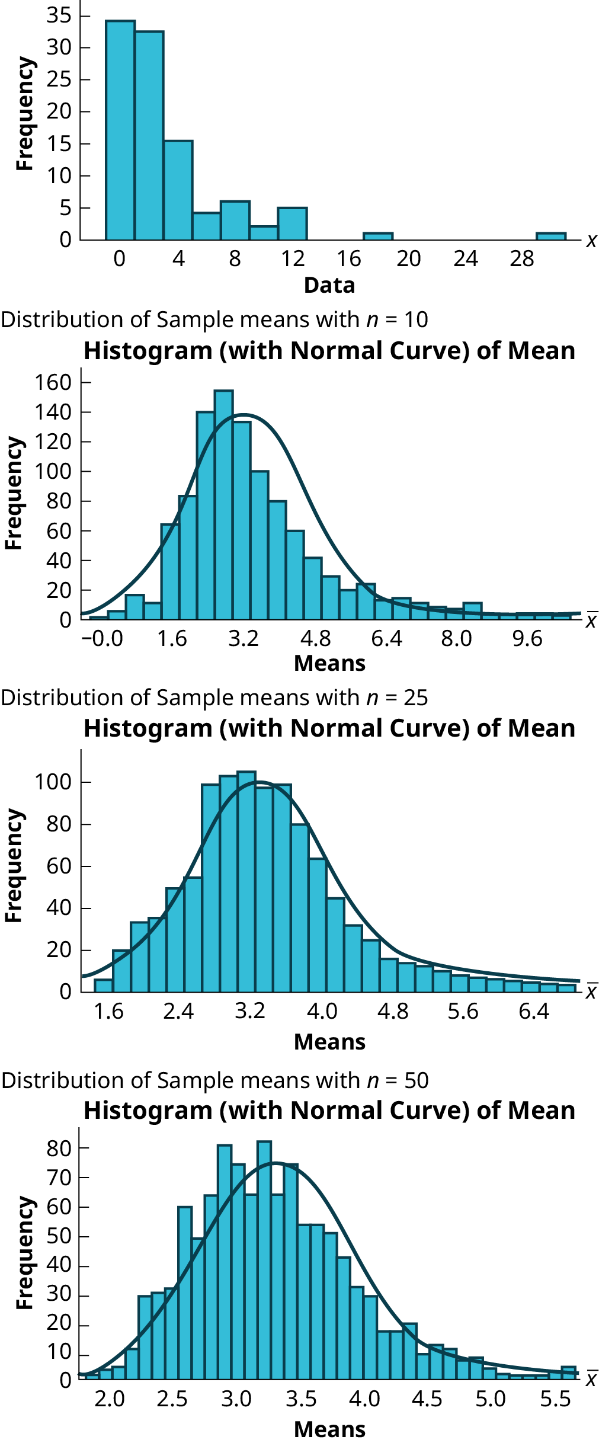
Examples with a Skewed Distribution

Slide 20
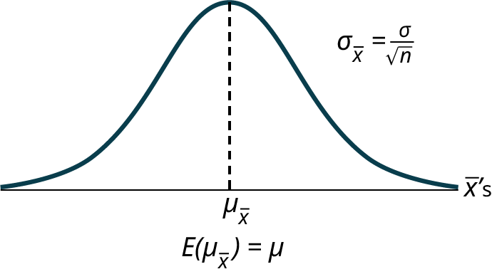
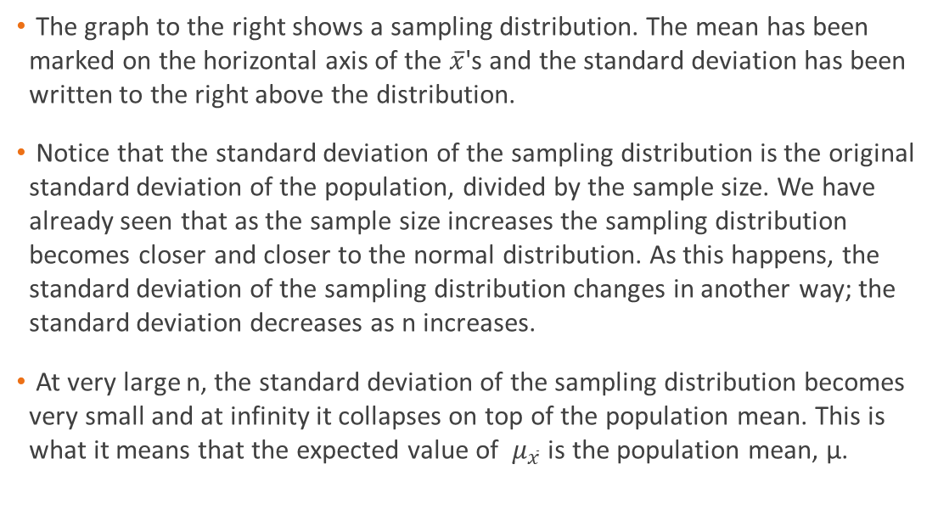
On the Sampling Distribution
The graph to the right shows a sampling distribution. The mean has been marked on the horizontal axis of the $\overline{x}$'s and the standard deviation has been written to the right above the distribution.
Notice that the standard deviation of the sampling distribution is the original standard deviation of the population, divided by the sample size. We have already seen that as the sample size increases the sampling distribution becomes closer and closer to the normal distribution. As this happens, the standard deviation of the sampling distribution changes in another way; the standard deviation decreases as n increases.
At very large n, the standard deviation of the sampling distribution becomes very small and at infinity it collapses on top of the population mean. This is what it means that the expected value of $μ_{\overline{x}}$ is the population mean, µ.

Slide 21
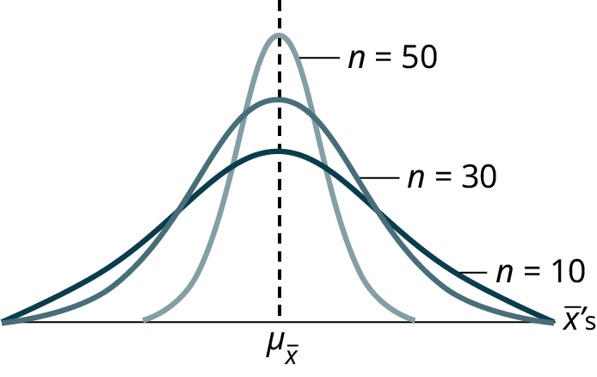
Different Sample Sizes
To the right are three sampling distributions. The only change that was made is the sample size that was used to get the sample means for each distribution.
As the sample size increases, n goes from 10 to 30 to 50, the standard deviations of the respective sampling distributions decrease because the sample size is in the denominator of the standard deviations of the sampling distributions.

Slide 22
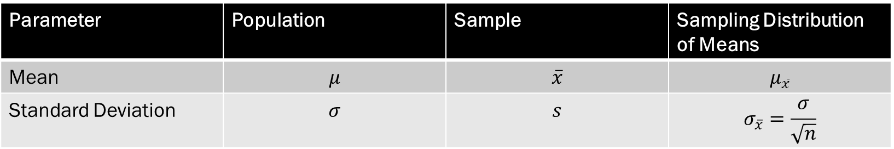
Formula Comparison
The Central Limit Theorem goes even further and tells us the mean and standard deviation of this theoretical distribution.
Parameter | Population | Sample | Sampling Distribution of Means
Mean | $$μ$$ | $$\overline{x}$$ | $$μ_{\overline{x}}$$
Standard Deviation | $$σ$$ | $$s$$ | $$σ_{\overline{x}}=\frac{σ}{\sqrt{n}}$$

Slide 23
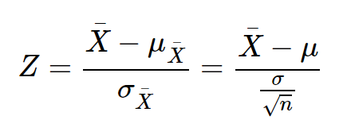
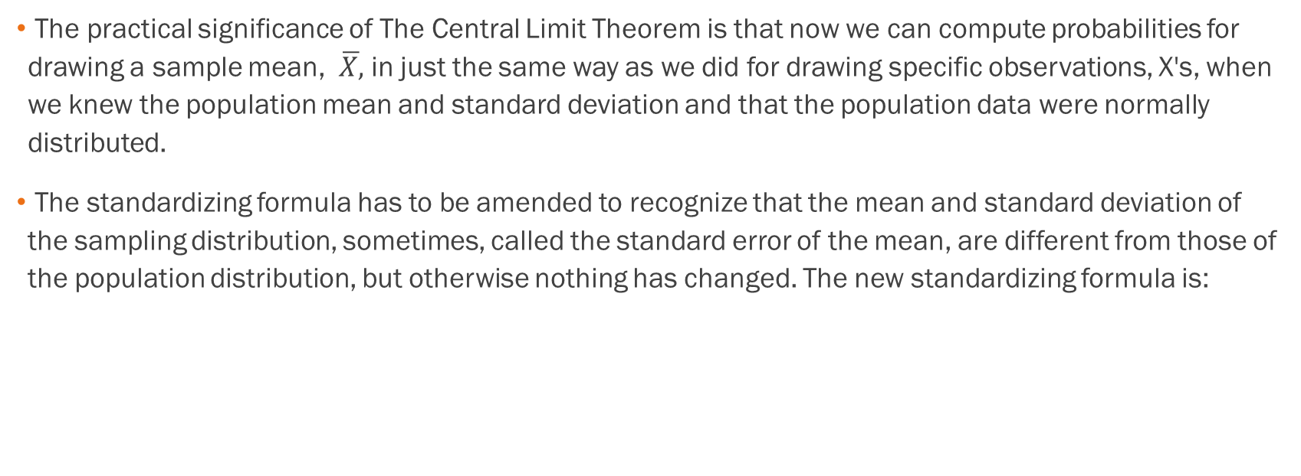
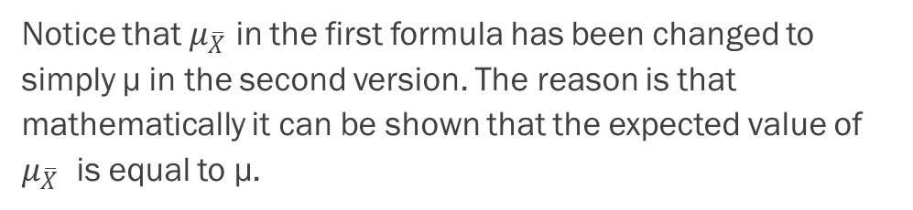
The Significance
The practical significance of The Central Limit Theorem is that now we can compute probabilities for drawing a sample mean, $\overline{X,}$ in just the same way as we did for drawing specific observations, X's, when we knew the population mean and standard deviation and that the population data were normally distributed.
The standardizing formula has to be amended to recognize that the mean and standard deviation of the sampling distribution, sometimes, called the standard error of the mean, are different from those of the population distribution, but otherwise nothing has changed. The new standardizing formula is:
Notice that $μ_{\overline{X}}$ in the first formula has been changed to simply µ in the second version. The reason is that mathematically it can be shown that the expected value of $μ_{\overline{X}}$ is equal to µ.

Slide 24
Example
An unknown distribution has a mean of 90 and a standard deviation of 15. Samples of size n = 25 are drawn randomly from the population. See the Excel spreadsheet.
a. Find the probability that the sample mean is between 85 and 92.
b. Find the value that is two standard deviations above the expected value, 90, of the sample mean.

Slide 25
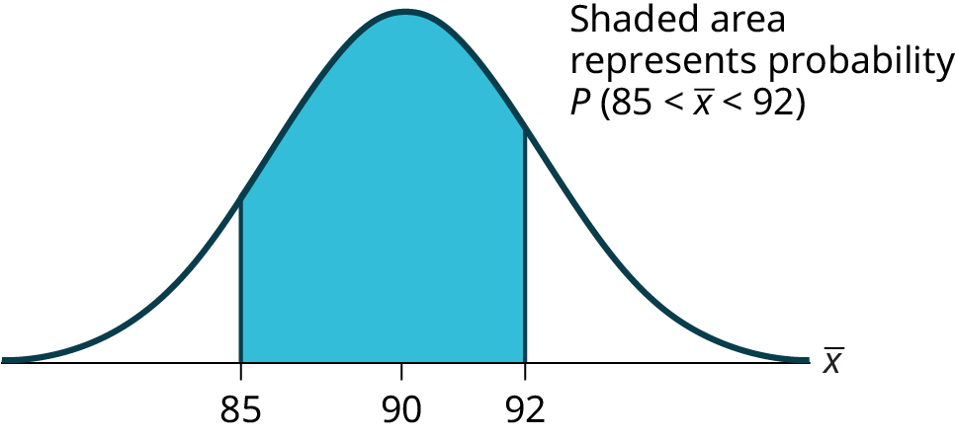
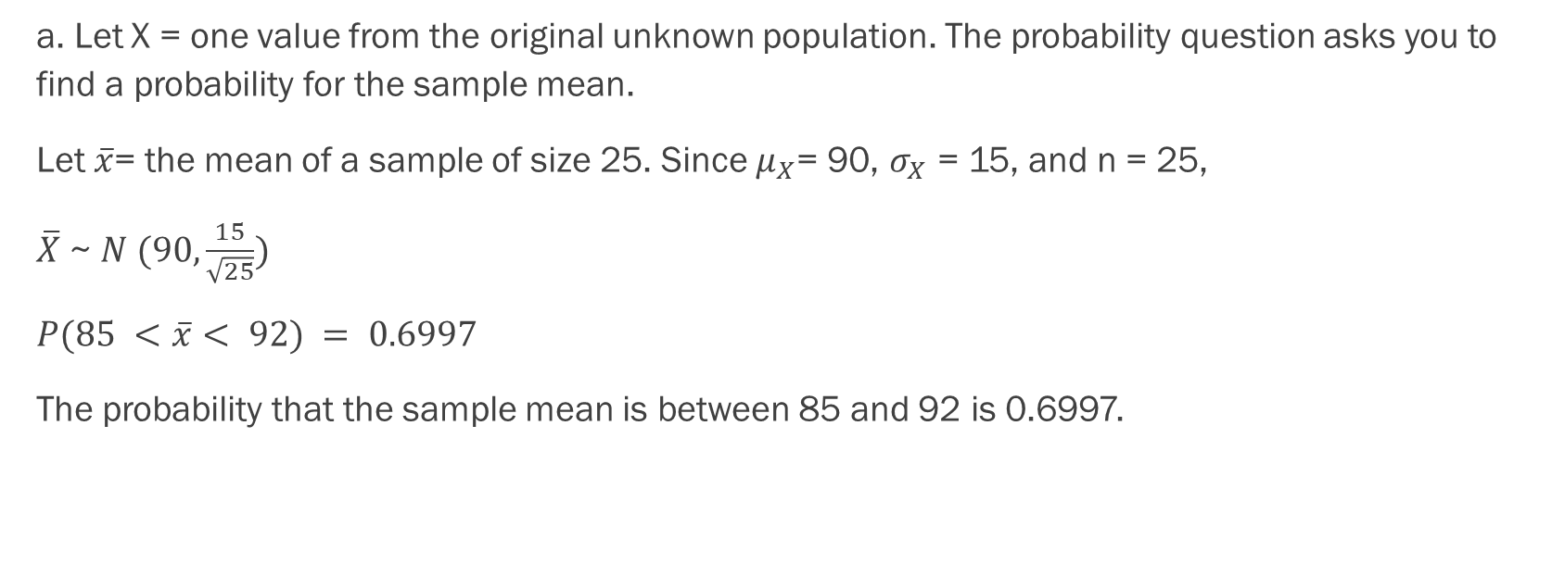
Example - Answers
a. Let X = one value from the original unknown population. The probability question asks you to find a probability for the sample mean.
Let $\overline{x}$= the mean of a sample of size 25. Since $μ_{X}$= 90, $σ_{X}$ = 15, and n = 25,
$\overline{X}$ ~ $N (90,\frac{15}{\sqrt{25}})$
$P(85 <\overline{x}< 92) = 0.6997$
The probability that the sample mean is between 85 and 92 is 0.6997.

Slide 26
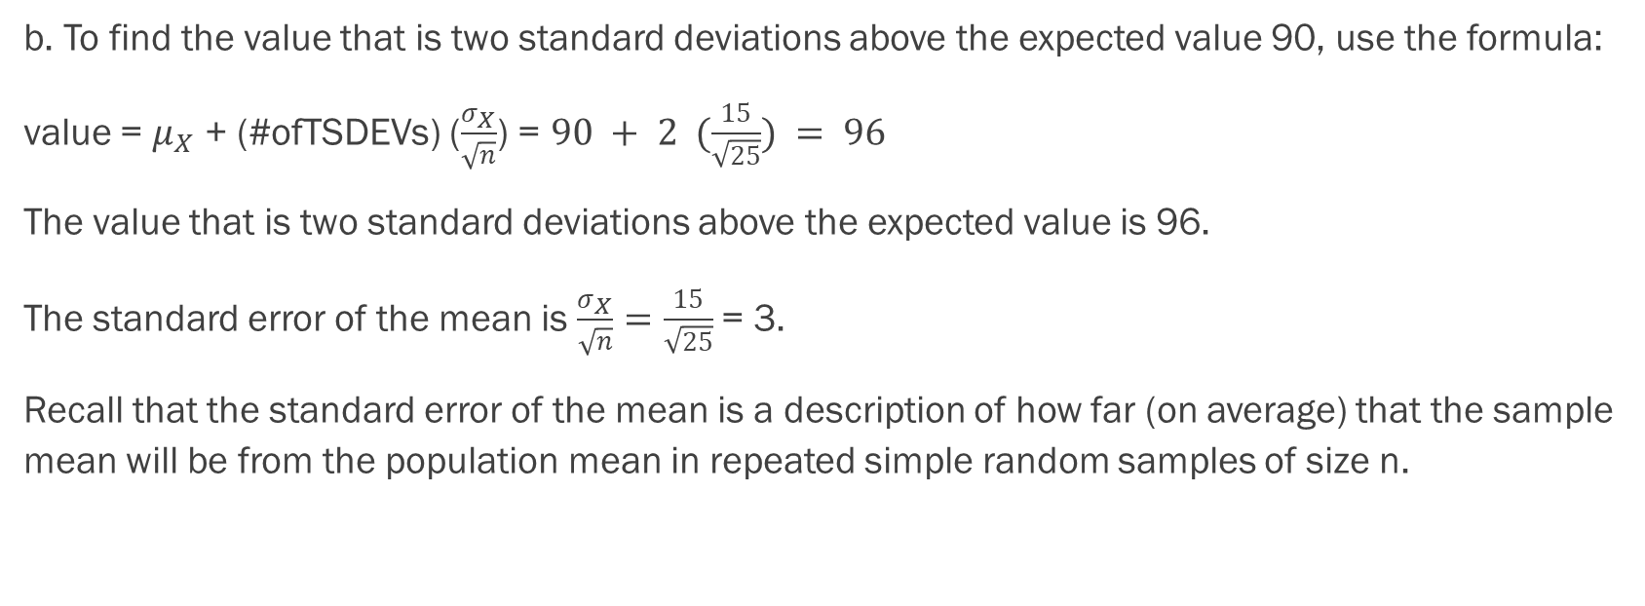
Example - Answers
b. To find the value that is two standard deviations above the expected value 90, use the formula:
value = $μ_{X}$ + (#ofTSDEVs) ($\frac{σ_{X}}{\sqrt{n}}$) = $90 + 2 (\frac{15}{\sqrt{25}}) = 96$
The value that is two standard deviations above the expected value is 96.
The standard error of the mean is $\frac{σ_{X}}{\sqrt{n}}=\frac{15}{\sqrt{25}}$= 3.
Recall that the standard error of the mean is a description of how far (on average) that the sample mean will be from the population mean in repeated simple random samples of size n.

Slide 27
Example
The length of time, in hours, it takes an "over 40" group of people to play one soccer match is normally distributed with a mean of two hours and a standard deviation of 0.5 hours. A sample of size n = 50 is drawn randomly from the population. Find the probability that the sample mean is between 1.8 hours and 2.3 hours. See the Excel spreadsheet.

Slide 28
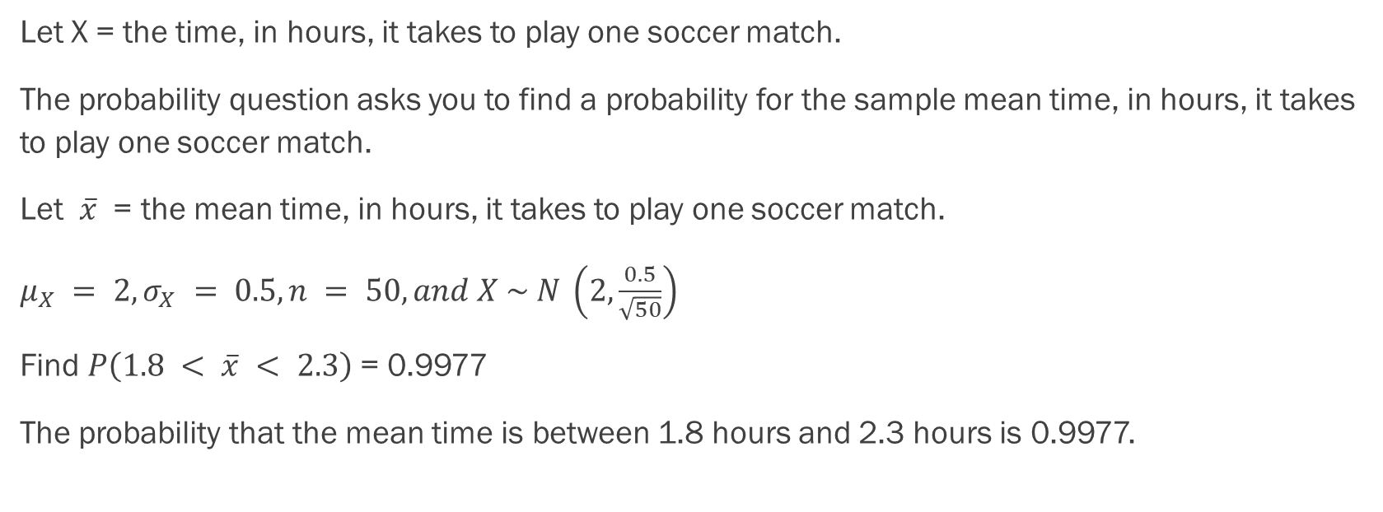
Example - Answers
Let X = the time, in hours, it takes to play one soccer match.
The probability question asks you to find a probability for the sample mean time, in hours, it takes to play one soccer match.
Let $\overline{x}$ = the mean time, in hours, it takes to play one soccer match.
$μ_{X} = 2, σ_{X} = 0.5, n = 50, and X \sim N \left(2,\frac{0.5}{\sqrt{50}}\right)$
Find $P\left(1.8 < \overline{x} < 2.3\right)$= 0.9977
The probability that the mean time is between 1.8 hours and 2.3 hours is 0.9977.

Slide 29
Example
In a recent study, it was reported that the mean age of iPad users is 34 years. Suppose the standard deviation is 15 years. Take a sample of size n = 100. See the Excel spreadsheet.
What are the mean and standard deviation for the sample mean ages of iPad users?
What does the distribution look like?
Find the probability that the sample mean age is more than 30 years (the reported mean age of iPad users in this particular study).
Find the 95th percentile for the sample mean age (to one decimal place).

Slide 30
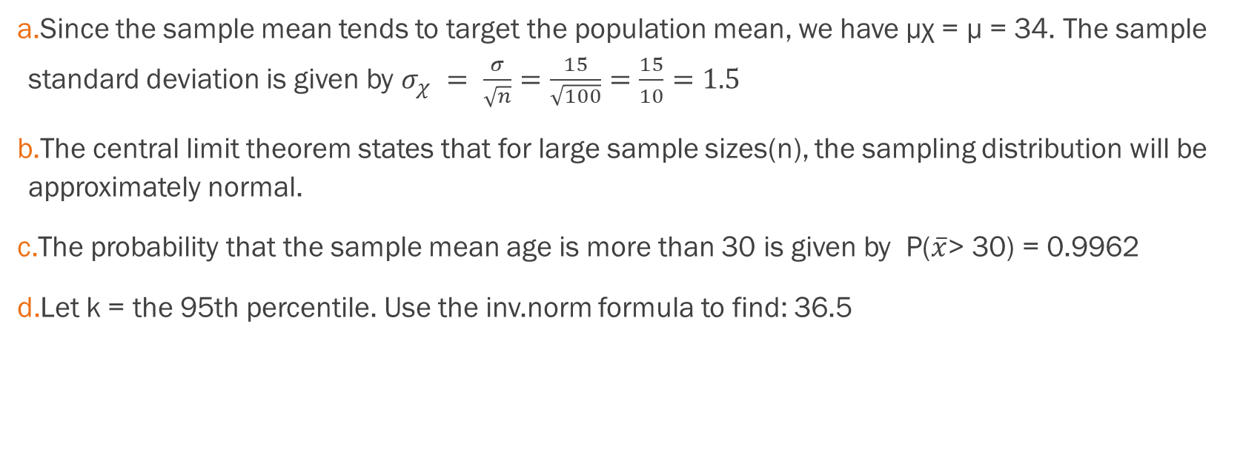
Example - Answers
Since the sample mean tends to target the population mean, we have μχ = μ = 34. The sample standard deviation is given by $σ_{χ} = \frac{σ}{\sqrt{n}}=\frac{15}{\sqrt{100}}=\frac{15}{10}=1.5$
The central limit theorem states that for large sample sizes(n), the sampling distribution will be approximately normal.
The probability that the sample mean age is more than 30 is given by P($\overline{x}$> 30) = 0.9962
Let k = the 95th percentile. Use the inv.norm formula to find: 36.5

Slide 31
Section 7.2
The Central Limit Theorem for Sums

Slide 32
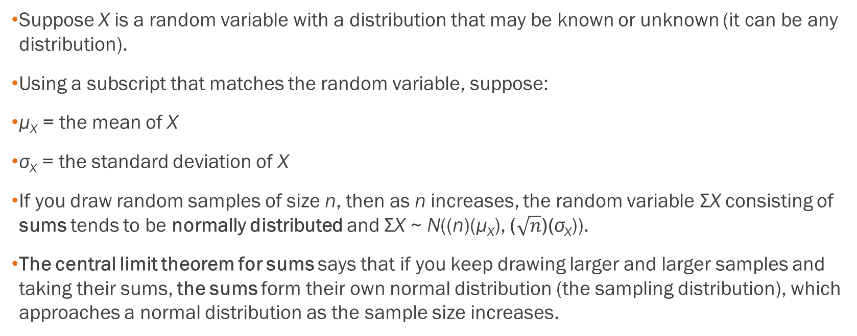
The Central Limit Theorem for
Sums
Suppose X is a random variable with a distribution that may be known or unknown (it can be any distribution).
Using a subscript that matches the random variable, suppose:
μ_{X} = the mean of X
σ_{X} = the standard deviation of X
If you draw random samples of size n, then as n increases, the random variable ΣX consisting of sums tends to be normally distributed and ΣΧ ~ N((n)(μ_{Χ}), ($\sqrt{n}$)(σ_{Χ})).
The central limit theorem for sums says that if you keep drawing larger and larger samples and taking their sums, the sums form their own normal distribution (the sampling distribution), which approaches a normal distribution as the sample size increases.

Slide 33
Let’s Revisit Our Excel Central Limit Theorem Experiment

Slide 34

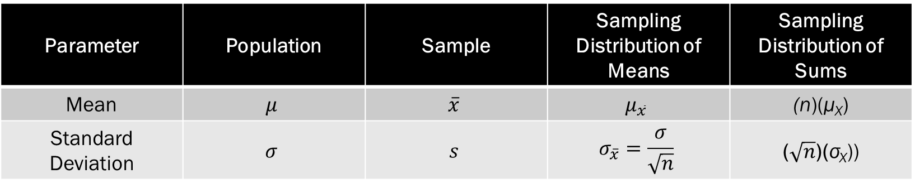
Formula Comparison
Parameter | Population | Sample | Sampling Distribution of Means | Sampling Distribution of Sums
Mean | $$μ$$ | $$\overline{x}$$ | $$μ_{\overline{x}}$$ | (n)(μ_{Χ})
Standard Deviation | $$σ$$ | $$s$$ | $$σ_{\overline{x}}=\frac{σ}{\sqrt{n}}$$ | ($\sqrt{n}$)(σ_{Χ}))
ΣΧ ~ N((n)(μ_{Χ}), ($\sqrt{n}$)(σ_{Χ}))

Slide 35
Example
An unknown distribution has a mean of 90 and a standard deviation of 15. A sample of size 80 is drawn randomly from the population.
Problem
Find the probability that the sum of the 80 values (or the total of the 80 values) is more than 7,500.
Find the sum that is 1.5 standard deviations above the mean of the sums.
See the Excel spreadsheet.

Slide 36
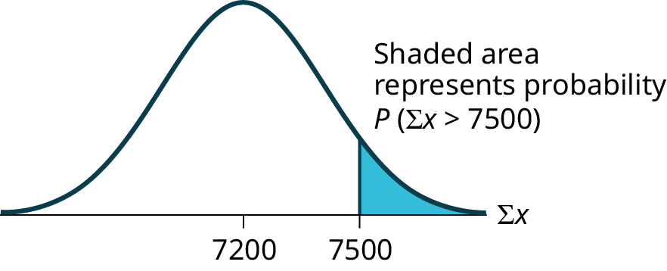
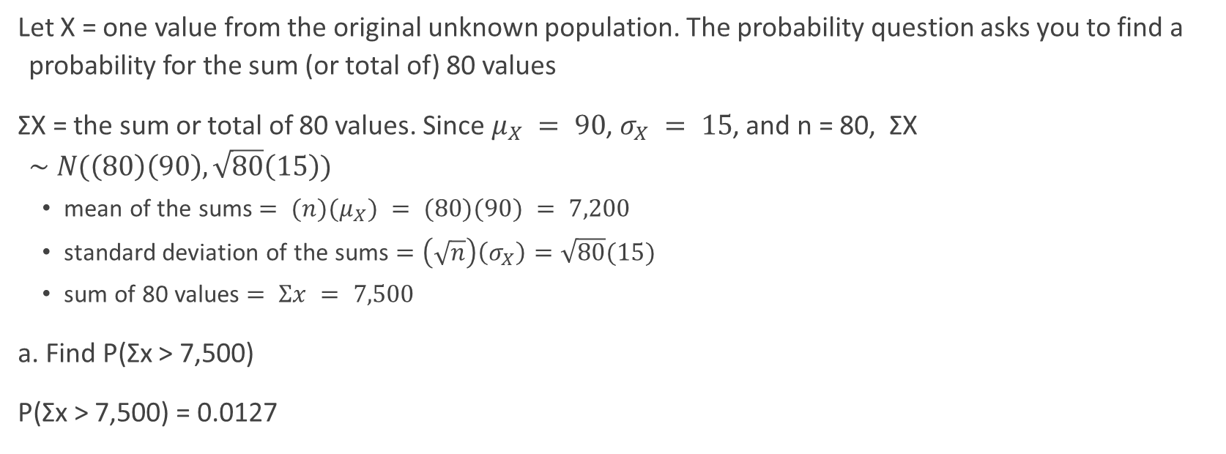
Example - Answers
Let X = one value from the original unknown population. The probability question asks you to find a probability for the sum (or total of) 80 values
ΣX = the sum or total of 80 values. Since $μ_{X} = 90$, $σ_{X} = 15$, and n = 80, ΣX $\sim N(\left(80\right)\left(90\right), \sqrt{80}\left(15\right))$
  mean of the sums $= (n)(μ_{X}) = (80)(90) = 7,200$
  standard deviation of the sums $=\left(\sqrt{n}\right)\left(σ_{X}\right)=\sqrt{80}(15)$
  sum of 80 values $= Σx = 7,500$
a. Find P(Σx > 7,500)
P(Σx > 7,500) = 0.0127

Slide 37

Example - Answers
b. Find Σx where z = 1.5.
$Σx = \left(n\right)\left(μ_{X}\right)+\left(z\right)= 7,401.2\left(\sqrt{n}\right)\left(σ_{X}\right)= \left(80\right)\left(90\right)+\left(1.5\right)\left(\sqrt{80}\right)\left(15\right)=7,401.2$

Slide 38
Example
In a recent study, it was reported that the mean age of iPad users is 34 years. Suppose the standard deviation is 15 years. The sample of size is 50. See the Excel spreadsheet.
What are the mean and standard deviation for the sum of the ages of iPad users? What is the distribution?
Find the probability that the sum of the ages is between 1,500 and 1,800 years.
Find the 80th percentile for the sum of the 50 ages.

Slide 39
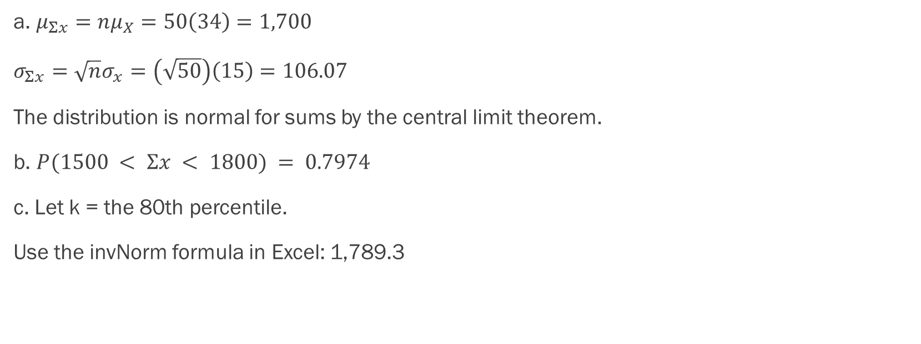
Example - Answers
a. $μ_{Σx}=nμ_{X}=50\left(34\right)=1,700$
$σ_{Σx}=\sqrt{n}σ_{x}=\left(\sqrt{50}\right)\left(15\right)=106.07$
The distribution is normal for sums by the central limit theorem.
b. $P(1500 < Σx < 1800) = 0.7974$
c. Let k = the 80th percentile.
Use the invNorm formula in Excel: 1,789.3

Slide 40
Example
The mean number of minutes for app engagement by a tablet user is 8.2 minutes. Suppose the standard deviation is one minute. Take a sample of size 70.
What are the mean and standard deviation for the sums?
Find the 95th percentile for the sum of the sample. Interpret this value in a complete sentence.
Find the probability that the sum of the sample is at least ten hours.

Slide 41

Example - Answers
The mean is $574$ and the standard deviation is $8.366$
The 95th percentile is 587.76. Ninety five percent of the sums of app engagement times are at most 587.76 minutes.
10 hours = 600 minutes, $P\left(x>600\right)=0.09\%=\text{0.0009}$

Slide 42
Section 7.3
Using the Central Limit Theorem

Slide 43

The Law of Large Numbers
The Law of Large Numbers, along with the Central Limit Theorem, provides another critical piece of information to allow us to engage in inferential statistics. In short, the Law of Large Numbers proves that the expected value of the sampling distribution of the sample mean is the population mean:
Suppose you were to take a sample and calculate a sample mean. Then you take another sample, combine it with the previous sample, and calculate the sample mean of the combined sample. Then you repeat this process over and over, creating bigger and bigger samples and calculating a sample mean each time along the way.
The sample means from larger and larger samples will get closer and closer to the population mean, μ. The proof of the Law of Large Numbers mathematically was perfected during a period of 20 years and was presented by Jacob Bernoulli in 1713.

Slide 44
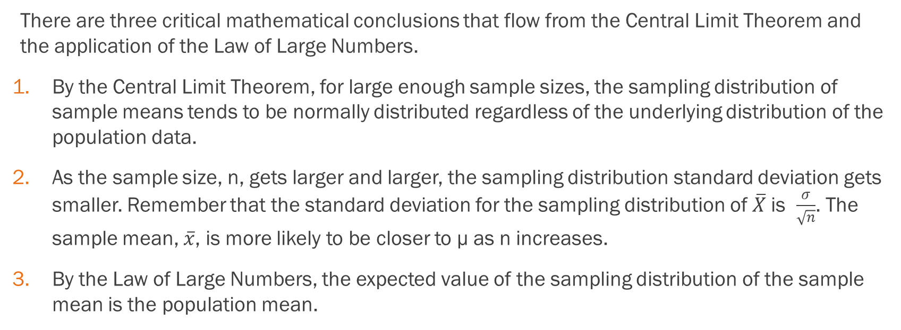
The Law of Large Numbers and The Central Limit Theorem
There are three critical mathematical conclusions that flow from the Central Limit Theorem and the application of the Law of Large Numbers.
By the Central Limit Theorem, for large enough sample sizes, the sampling distribution of sample means tends to be normally distributed regardless of the underlying distribution of the population data.
As the sample size, n, gets larger and larger, the sampling distribution standard deviation gets smaller. Remember that the standard deviation for the sampling distribution of $\overline{X}$is $\frac{σ}{\sqrt{n}}$. The sample mean, $\overline{x}$, is more likely to be closer to μ as n increases.
By the Law of Large Numbers, the expected value of the sampling distribution of the sample mean is the population mean.

Slide 45
Example
A manufacturer produces 25-pound lifting weights. The lowest actual weight is 24 pounds, and the highest is 26 pounds. Each weight is equally likely so the distribution of weights is uniform. A sample of 100 weights is taken.
What is the distribution for the weights of one 25-pound lifting weight? What is the mean and standard deviation?
What is the distribution for the mean weight of 100 25-pound lifting weights?
Find the probability that the mean actual weight for the 100 weights is less than 24.9.

Slide 46
Example - Answers
a. What is the distribution for the weights of one 25-pound lifting weight? What is the mean and standard deviation?
U(24, 26), 25, 0.5774
b. What is the distribution for the mean weight of 100 25-pound lifting weights?
N(25, 0.0577)
c. Find the probability that the mean actual weight for the 100 weights is less than 24.9.
0.0416

Slide 47
Example
A manufacturer produces 25-pound lifting weights. The lowest actual weight is 24 pounds, and the highest is 26 pounds. Each weight is equally likely so the distribution of weights is uniform. A sample of 100 weights is taken.
Find the probability that the mean actual weight for the 100 weights is greater than 25.2.

Slide 48
Example - Answers
Find the probability that the mean actual weight for the 100 weights is greater than 25.2.
0.0003

Slide 49
Example
A manufacturer produces 25-pound lifting weights. The lowest actual weight is 24 pounds, and the highest is 26 pounds. Each weight is equally likely so the distribution of weights is uniform. A sample of 100 weights is taken.
Find the 90th percentile for the total weight of the 100 weights.

Slide 50
Example - Answers
Find the 90th percentile for the total weight of the 100 weights.
2,507.40

Slide 51
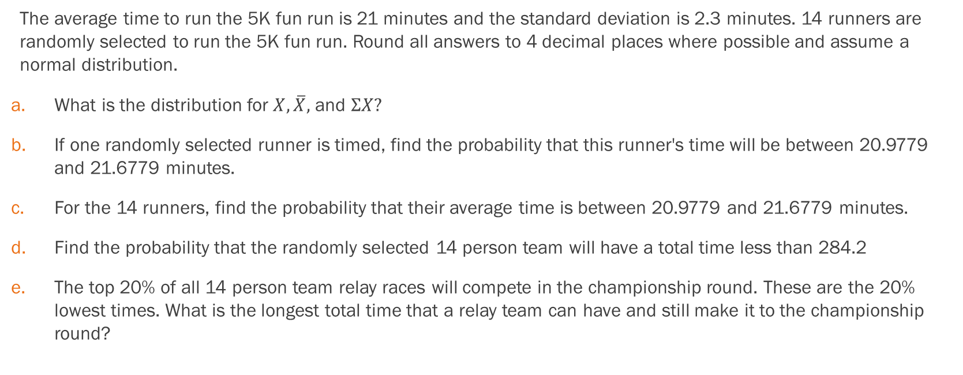
Example
The average time to run the 5K fun run is 21 minutes and the standard deviation is 2.3 minutes. 14 runners are randomly selected to run the 5K fun run. Round all answers to 4 decimal places where possible and assume a normal distribution.
What is the distribution for $X, \overline{X},$ and $ΣX?$
If one randomly selected runner is timed, find the probability that this runner's time will be between 20.9779 and 21.6779 minutes.
For the 14 runners, find the probability that their average time is between 20.9779 and 21.6779 minutes.
Find the probability that the randomly selected 14 person team will have a total time less than 284.2
The top 20% of all 14 person team relay races will compete in the championship round. These are the 20% lowest times. What is the longest total time that a relay team can have and still make it to the championship round?

Slide 52

Example - Answers
What is the distribution for $X, \overline{X},$ and $ΣX?$ $N\left(21, 2.3\right);N\left(21, 0.6147\right);N(294, 8.6058)$
0.1197
0.3793
0.1274
286.7572

Slide 53
The Central Limit Theorem and Proportions

Slide 54
So Far We’ve Seen …
If you find a sample mean, we can relate it and compute probability around it that will be from a normal distribution
If you find a sum of data points, we can also compute probabilities around it related to the normal distribution
Now: what about proportions?

Slide 55
On Using Proportions
If the random variable is discrete, such as for categorical data, then the parameter we wish to estimate is the population proportion.
The probability of drawing a success in any one random draw.
Unlike the case just discussed for a continuous random variable where we did not know the population distribution of X's, here we actually know the underlying probability density function for these data; it is the binomial distribution.
The random variable is X = the number of successes and the parameter we wish to know is p, the probability of drawing a success which is of course the proportion of successes in the population.

Slide 56
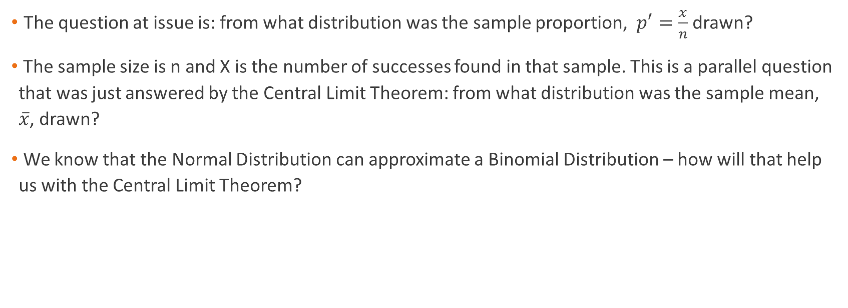
From the Normal Distribution to the Binomial Distribution
The question at issue is: from what distribution was the sample proportion, $p′=\frac{x}{n}$ drawn?
The sample size is n and X is the number of successes found in that sample. This is a parallel question that was just answered by the Central Limit Theorem: from what distribution was the sample mean, $\overline{x}$, drawn?
We know that the Normal Distribution can approximate a Binomial Distribution – how will that help us with the Central Limit Theorem?

Slide 57
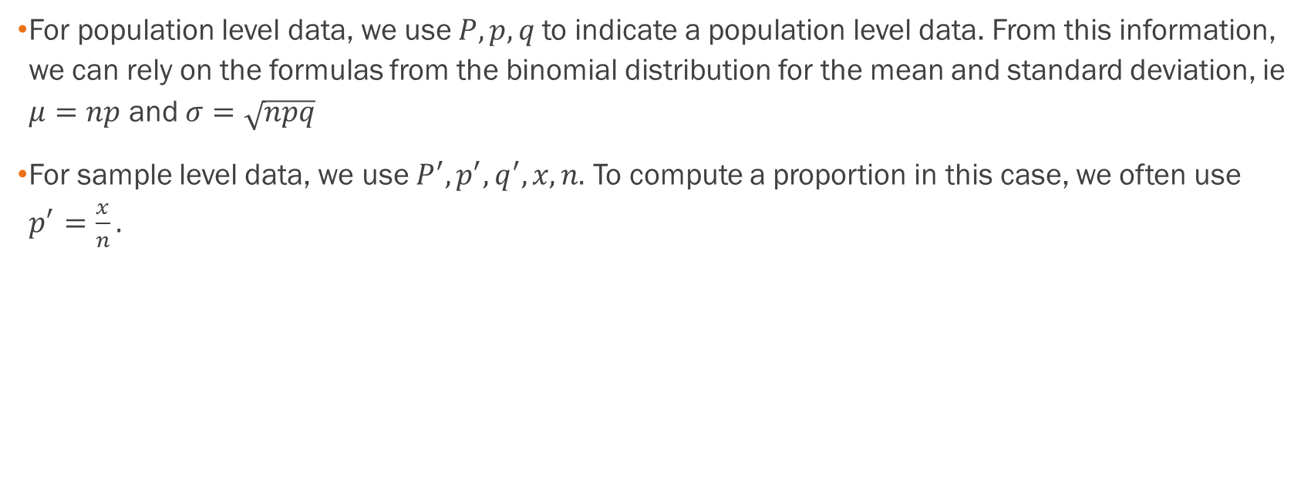
Notes on Formulas
For population level data, we use $P, p, q$to indicate a population level data. From this information, we can rely on the formulas from the binomial distribution for the mean and standard deviation, ie $μ=np$ and $σ=\sqrt{npq}$
For sample level data, we use $P^{′}, p^{′}, q^{′}, x, n.$ To compute a proportion in this case, we often use $p^{′}=\frac{x}{n}.$

Slide 58
Once again, we can look at our simulation to see how this works with proportions

Slide 59
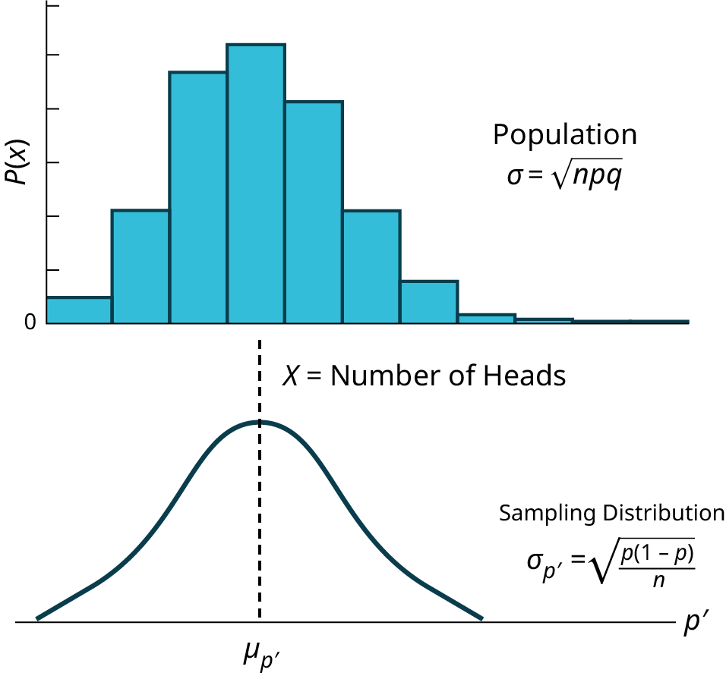
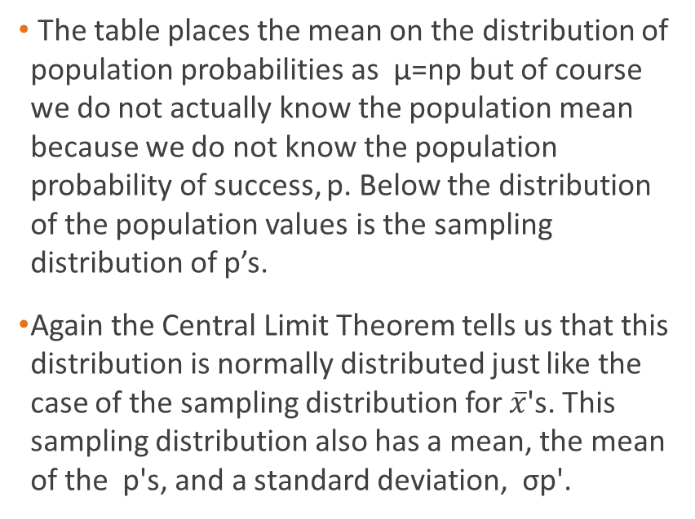
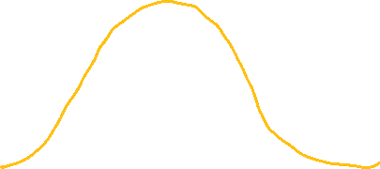
With Graphs
The table places the mean on the distribution of population probabilities as µ=np but of course we do not actually know the population mean because we do not know the population probability of success, p. Below the distribution of the population values is the sampling distribution of p’s.
Again the Central Limit Theorem tells us that this distribution is normally distributed just like the case of the sampling distribution for $\overline{x}$'s. This sampling distribution also has a mean, the mean of the p's, and a standard deviation, σp'.

Slide 60
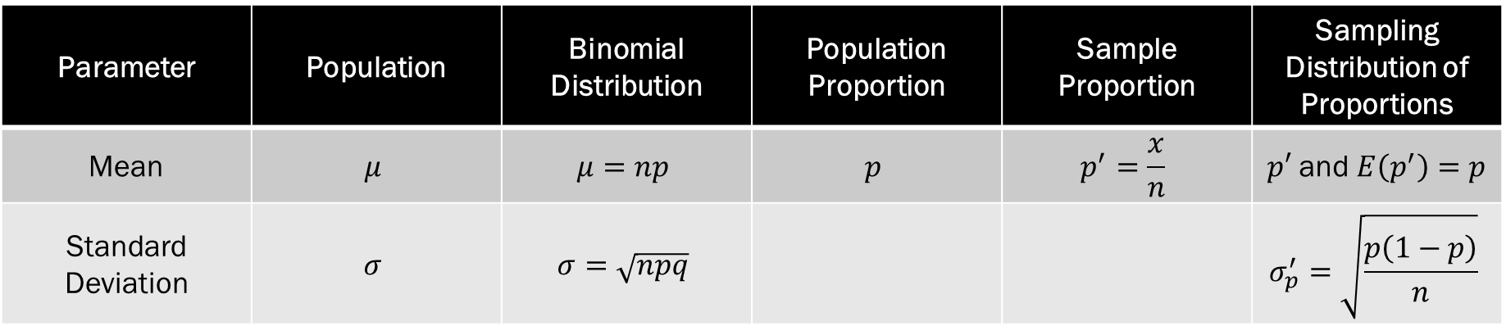

Formula Comparison for Proportions
The expected value of the mean of sampling distribution of sample proportions, $µ_{p}$, is the population proportion, p.
The standard deviation of the sampling distribution of sample proportions, $σ_{p}$', is the population standard deviation divided by the square root of the sample size, n.
Parameter | Population | Binomial Distribution | Population Proportion | Sample Proportion | Sampling Distribution of Proportions
Mean | $$μ$$ | $$μ=np$$ | $$p$$ | $$p^{′}=\frac{x}{n}$$ | $p′$ and $E\left(p^{′}\right)=p$
Standard Deviation | $$σ$$ | $$σ=\sqrt{npq}$$ |  |  | $$σ_{p}^{′}=\sqrt{\frac{p\left(1−p\right)}{n}}$$

Slide 61
Example
A company inspects products coming through its production process, and rejects detected products. One-tenth of the items are rejected. If samples of 50 items are taken, what is the standard deviation of the mean of the sampling distribution of sample proportions?

Slide 62

Example - Answers
A company inspects products coming through its production process, and rejects detected products. One-tenth of the items are rejected. If samples of 50 items are taken, what is the standard deviation of the mean of the sampling distribution of sample proportions?
$σ_{p}^{′}=\sqrt{\frac{p(1−p)}{n}}$ $=\sqrt{\frac{(1/10)∗(9/10)}{50}}=0.042$

Slide 63
Example
Suppose that 4 out of 5 dentists recommend MintyFresh toothpaste. Suppose 149 dentists are sampled.
Is the success-failure condition of the Central Limit Theorem satisfied?
From a sample of 149 dentists, how unusual would it be to have more than 125 of them recommend MintyFresh toothpaste?

Slide 64
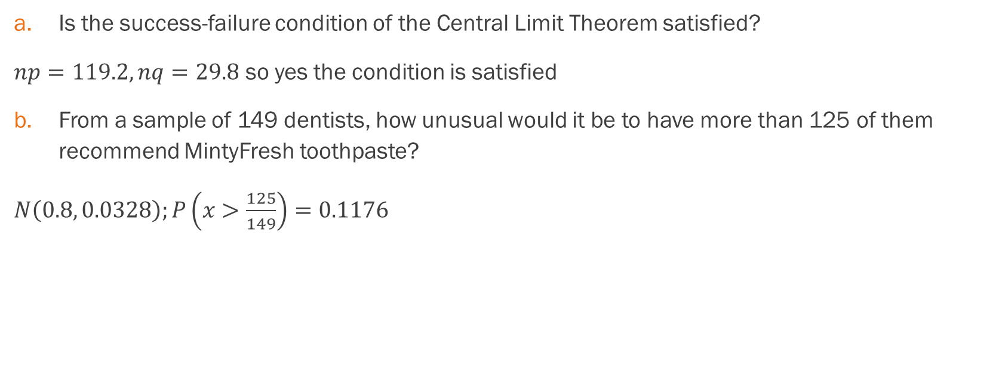
Example - Answers
Is the success-failure condition of the Central Limit Theorem satisfied?
$np=119.2, nq=29.8$ so yes the condition is satisfied
From a sample of 149 dentists, how unusual would it be to have more than 125 of them recommend MintyFresh toothpaste?
$N\left(0.8, 0.0328\right);P\left(x>\frac{125}{149}\right)=0.1176$

