Slide 1

Chapter 8 Confidence Intervals
Openstax statistics

Slide 2
Objectives
By the end of this chapter, the student should be able to:
Calculate and interpret confidence intervals for estimating a population mean and a population proportion.
Interpret the Student's t probability distribution as the sample size changes.
Discriminate between problems applying the normal and the Student's t distributions.
Calculate the sample size required to estimate a population mean and a population proportion given a desired confidence level and margin of error.

Slide 3
Section 8.1
A Single Population Mean using the Normal
Distribution

Slide 4
Review
There are 3 main areas of statistics we cover in this class:
Descriptive Statistics
Probability
Inferential Statistics (this is what we are focusing on now)

Slide 5
Introduction
We use sample data to make generalizations about an unknown population. This part of statistics is called inferential statistics.
The sample data help us to make an estimate of a population parameter.
Recall that often it is impossible to get an exact population parameter so we use a sample to estimate it
  Population parameter: the population mean height of all students at a college
  We use sample data to get a sample mean instead
  Every sample we take will be a little different – so what is the best way to handle that?

Slide 6
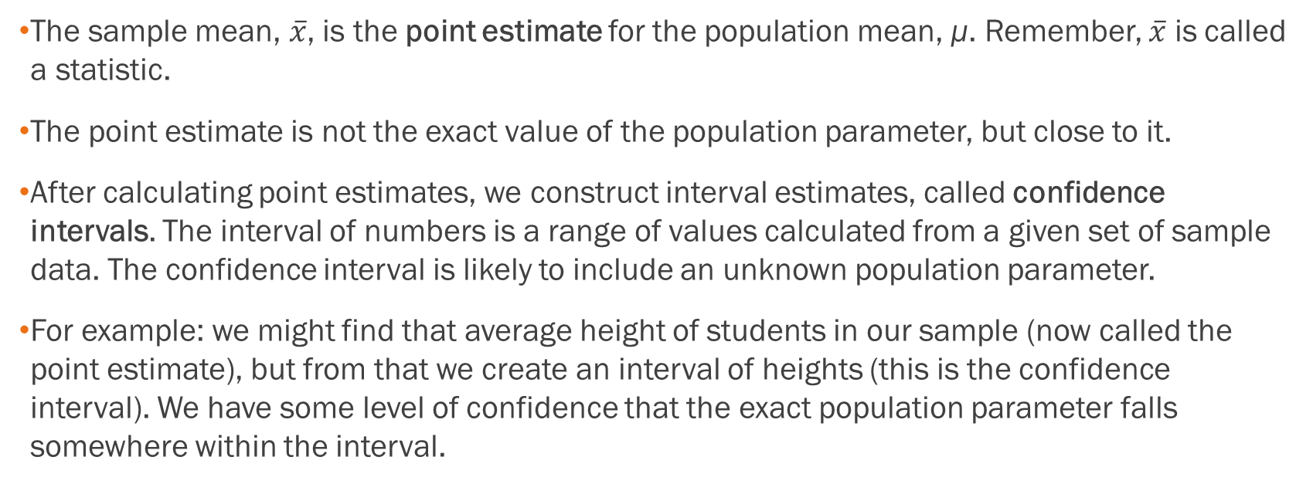
Introduction
The sample mean, $\overline{x}$, is the point estimate for the population mean, μ. Remember, $\overline{x}$ is called a statistic.
The point estimate is not the exact value of the population parameter, but close to it.
After calculating point estimates, we construct interval estimates, called confidence intervals. The interval of numbers is a range of values calculated from a given set of sample data. The confidence interval is likely to include an unknown population parameter.
For example: we might find that average height of students in our sample (now called the point estimate), but from that we create an interval of heights (this is the confidence interval). We have some level of confidence that the exact population parameter falls somewhere within the interval.

Slide 7
In this chapter, you will learn to construct and interpret confidence intervals. You will also learn a new distribution, the Student's-t, and how it is used with these intervals.

Slide 8
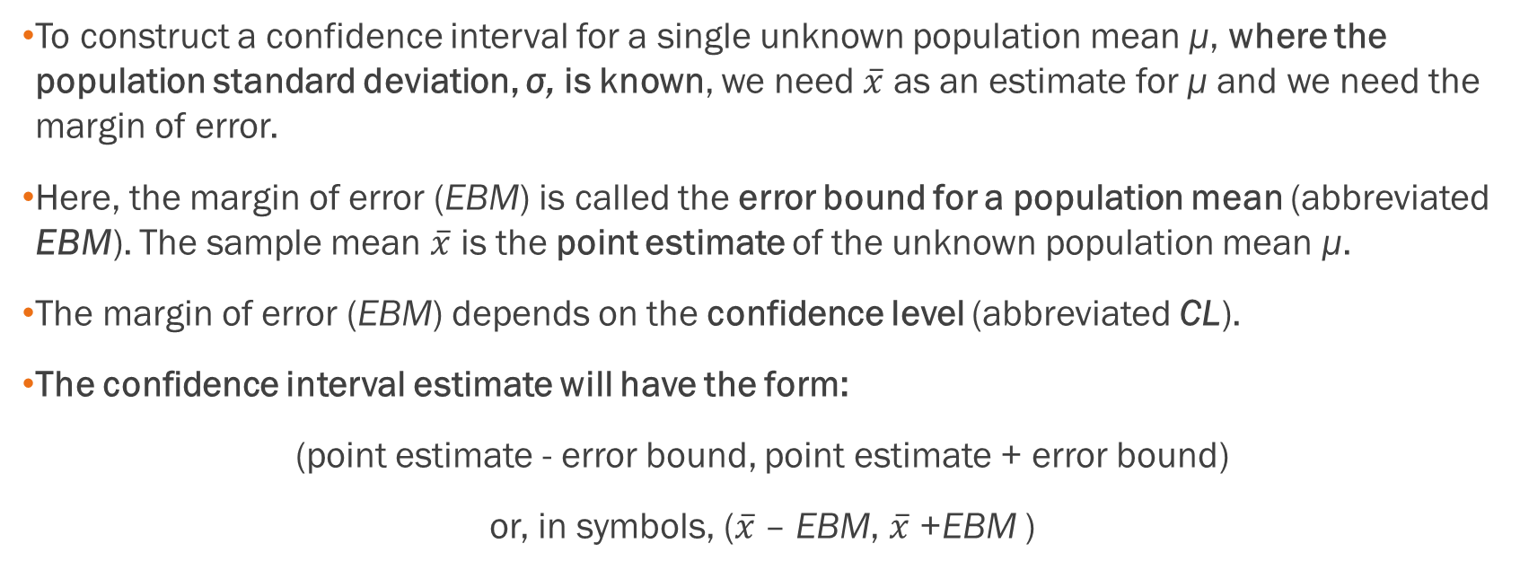
Calculating the Confidence
Interval
To construct a confidence interval for a single unknown population mean μ, where the population standard deviation, σ, is known, we need $\overline{x}$ as an estimate for μ and we need the margin of error.
Here, the margin of error (EBM) is called the error bound for a population mean (abbreviated EBM). The sample mean $\overline{x}$ is the point estimate of the unknown population mean μ.
The margin of error (EBM) depends on the confidence level (abbreviated CL).
The confidence interval estimate will have the form:
(point estimate - error bound, point estimate + error bound)
or, in symbols, ($\overline{x}$ – EBM, $\overline{x}$ +EBM )

Slide 9
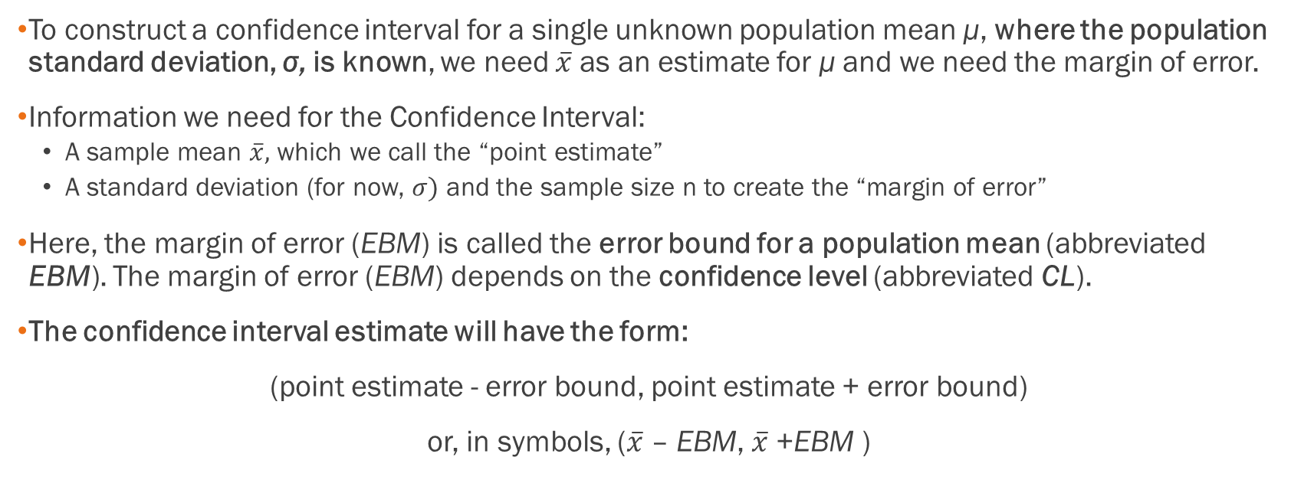
Calculating the Confidence
Interval
To construct a confidence interval for a single unknown population mean μ, where the population standard deviation, σ, is known, we need $\overline{x}$ as an estimate for μ and we need the margin of error.
Information we need for the Confidence Interval:
  A sample mean $\overline{x},$ which we call the “point estimate”
  A standard deviation (for now, $σ)$ and the sample size n to create the “margin of error”
Here, the margin of error (EBM) is called the error bound for a population mean (abbreviated EBM). The margin of error (EBM) depends on the confidence level (abbreviated CL).
The confidence interval estimate will have the form:
(point estimate - error bound, point estimate + error bound)
or, in symbols, ($\overline{x}$ – EBM, $\overline{x}$ +EBM )

Slide 10
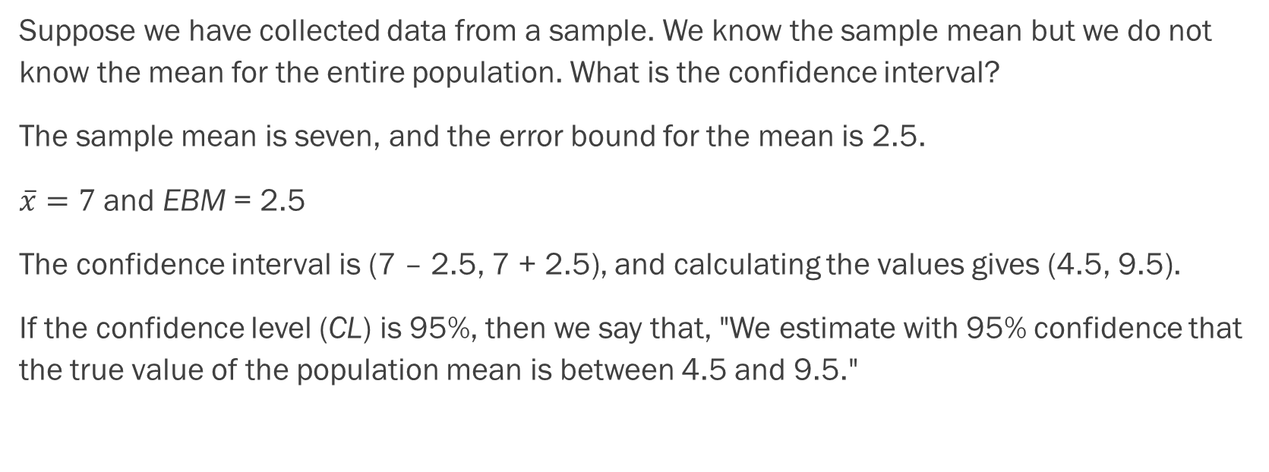
Example
Suppose we have collected data from a sample. We know the sample mean but we do not know the mean for the entire population. What is the confidence interval?
The sample mean is seven, and the error bound for the mean is 2.5.
$\overline{x}=7$ and EBM = 2.5
The confidence interval is (7 – 2.5, 7 + 2.5), and calculating the values gives (4.5, 9.5).
If the confidence level (CL) is 95%, then we say that, "We estimate with 95% confidence that the true value of the population mean is between 4.5 and 9.5."

Slide 11

Calculating the Confidence
Interval, cont.
The error bound formula for an unknown population mean μ when the population standard deviation σ is known is:
EBM = (z_{α/2})(σ/$\sqrt{n}$)
Since σ is known, the part that is challenging is finding z_{α/2}

Slide 12
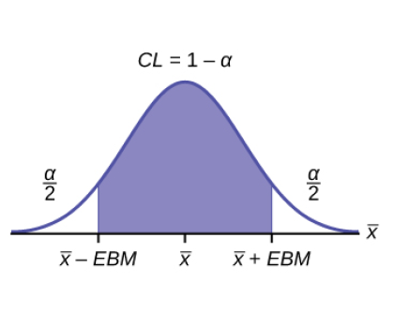
Finding the z-score for the Stated Confidence Level
Remember, the margin of error (EBM) depends on the confidence level (abbreviated CL).
The confidence level, CL, is the area in the middle of the standard normal distribution. CL = 1 – α, so α is the area that is split equally between the two tails. Each of the tails contains an area equal to α/2.
The z-score that has an area to the right of α/2 is denoted by z_{α/2}.
For example, when CL = 0.95, α = 0.05 and α/2 = 0.025; we write z_{α/2} = z_{0.025}.
The area to the right of z_{0.025} is 0.025 and the area to the left of z_{0.025} is 1 – 0.025 = 0.975.
Using Excel can actually find the z-score – see class Excel workbook.

Slide 13
Where Does the Critical Value Come From?
The critical value comes from the Empirical Rule, it is technically an estimated z-score
Confidence levels are referring to the area at the edges of the normal distribution
Let’s see what these values would look like if we were to compute them in Excel using the norm.s.inv function that gives up z-scores
There are some common critical values are worth memorizing or putting on a notecard, otherwise your answers will be slightly off. If a different critical value is given, then you can safely use Excel to estimate that (for instance, if you wanted a 97% confidence interval).

Slide 14
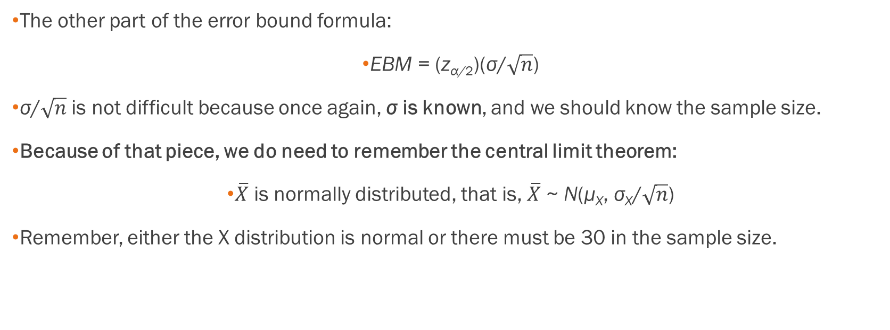
Calculating the Confidence
Interval, Cont.
The other part of the error bound formula:
EBM = (z_{α/2})(σ/$\sqrt{n}$)
σ/$\sqrt{n}$ is not difficult because once again, σ is known, and we should know the sample size.
Because of that piece, we do need to remember the central limit theorem:
$\overline{X}$ is normally distributed, that is, $\overline{X}$ ~ N(μ_{X}, σ_{X}/$\sqrt{n}$)
Remember, either the X distribution is normal or there must be 30 in the sample size.

Slide 15
Calculating the Confidence
Interval, Cont.
Writing the Interpretation
The interpretation should clearly state the confidence level (CL), explain what population parameter is being estimated (here, a population mean), and state the confidence interval (both endpoints).
"We estimate with ___% confidence that the true population mean (include the context of the problem) is between ___ and ___ (include appropriate units)."

Slide 16
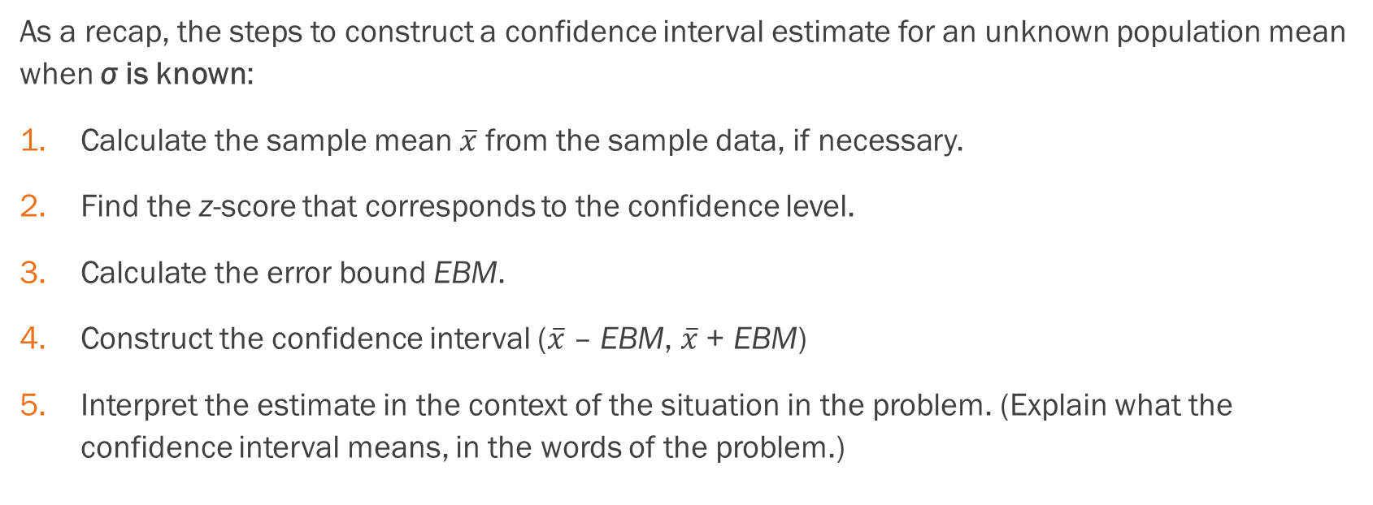
Calculating the Confidence
Interval, Cont.
As a recap, the steps to construct a confidence interval estimate for an unknown population mean when σ is known:
Calculate the sample mean $\overline{x}$ from the sample data, if necessary.
Find the z-score that corresponds to the confidence level.
Calculate the error bound EBM.
Construct the confidence interval ($\overline{x}$ – EBM, $\overline{x}$ + EBM)
Interpret the estimate in the context of the situation in the problem. (Explain what the confidence interval means, in the words of the problem.)

Slide 17
Example
Suppose scores on exams in statistics are normally distributed with an unknown population mean and a population standard deviation of three points. A random sample of 36 scores is taken and gives a sample mean (sample mean score) of 68. Find a confidence interval estimate for the population mean exam score (the mean score on all exams).
Find a 90% confidence interval for the true (population) mean of statistics exam scores.

Slide 18
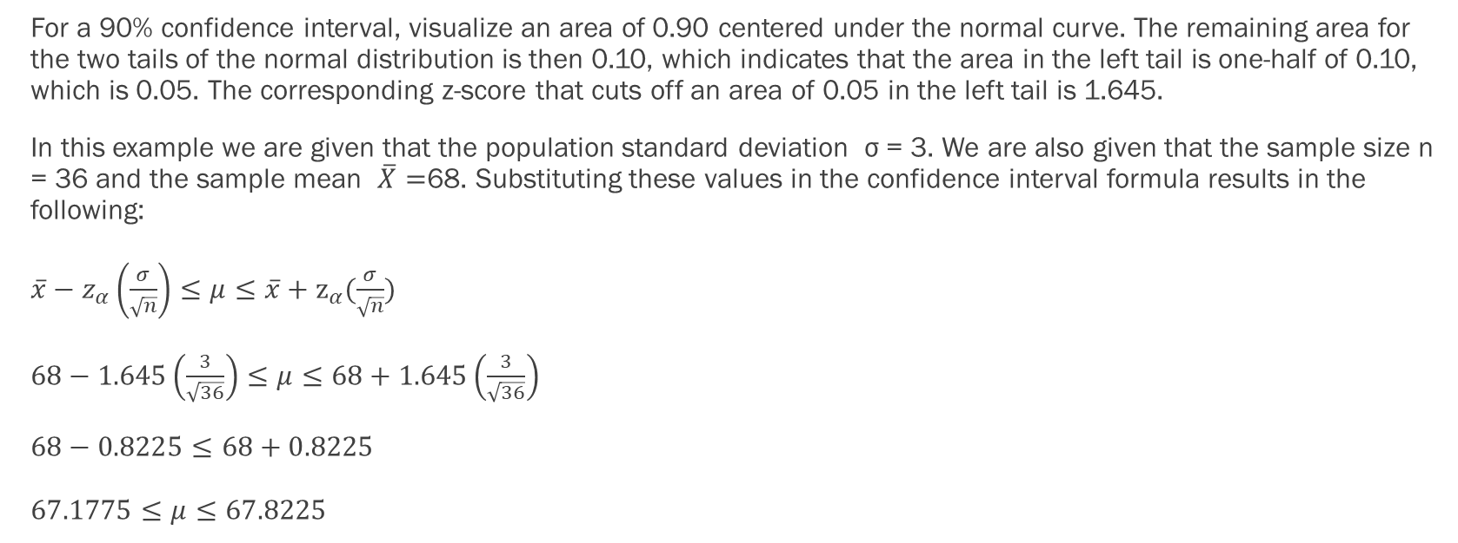
Example - Answers
For a 90% confidence interval, visualize an area of 0.90 centered under the normal curve. The remaining area for the two tails of the normal distribution is then 0.10, which indicates that the area in the left tail is one-half of 0.10, which is 0.05. The corresponding z-score that cuts off an area of 0.05 in the left tail is 1.645.
In this example we are given that the population standard deviation σ = 3. We are also given that the sample size n = 36 and the sample mean $\overline{X}=$68. Substituting these values in the confidence interval formula results in the following:
$\overline{x}−z_{α}\left(\frac{σ}{\sqrt{n}}\right)≤μ≤\overline{x}+z_{α}(\frac{σ}{\sqrt{n}})$
$68−1.645\left(\frac{3}{\sqrt{36}}\right)≤μ≤68+1.645\left(\frac{3}{\sqrt{36}}\right)$
$68−0.8225≤68+0.8225$
$67.1775≤μ≤67.8225$

Slide 19
Example
The Specific Absorption Rate (SAR) for a cell phone measures the amount of radio frequency (RF) energy absorbed by the user’s body when using the handset. Every cell phone emits RF energy. Different phone models have different SAR measures. To receive certification from the Federal Communications Commission (FCC) for sale in the United States, the SAR level for a cell phone must be no more than 1.6 watts per kilogram. The table on the next slide shows the highest SAR level for a random selection of cell phone models as measured by the FCC. Find a 98% confidence interval for the true (population) mean of the Specific Absorption Rates (SARs) for cell phones. Assume that the population standard deviation is σ = 0.337. See the class Excel spreadsheet.

Slide 20
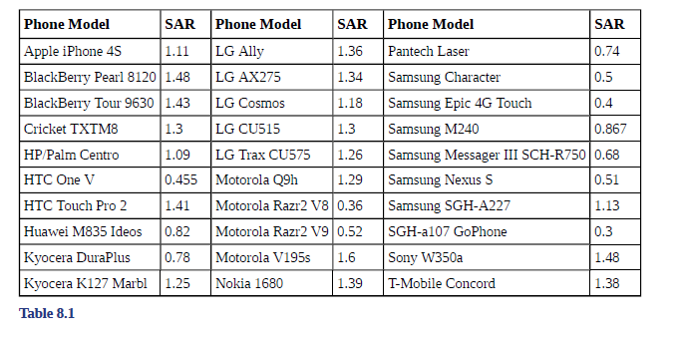
Example

Slide 21
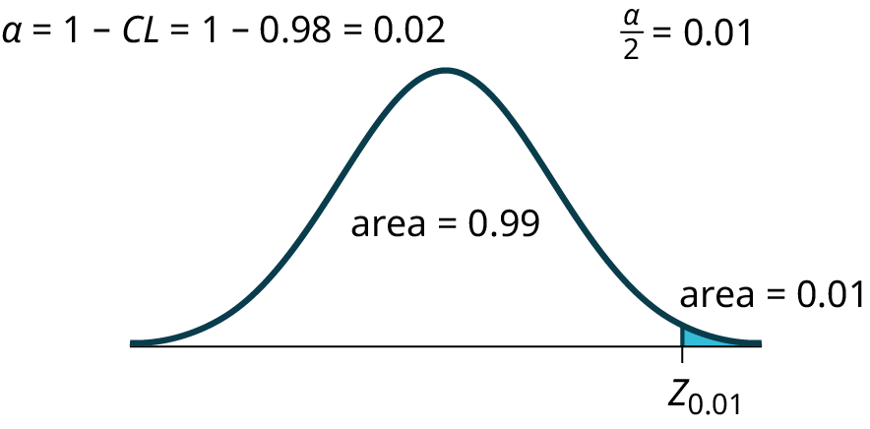
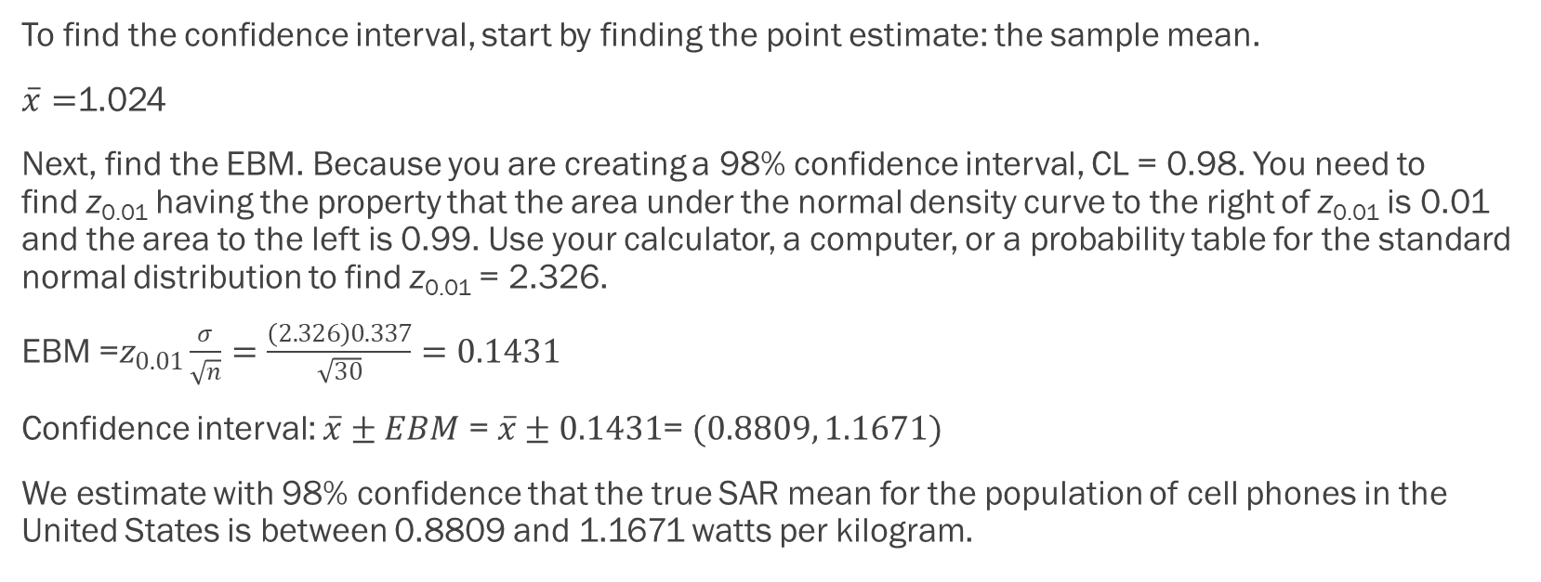
Example - Answers
To find the confidence interval, start by finding the point estimate: the sample mean.
$\overline{x}=$1.024
Next, find the EBM. Because you are creating a 98% confidence interval, CL = 0.98. You need to find z_{0.01} having the property that the area under the normal density curve to the right of z_{0.01} is 0.01 and the area to the left is 0.99. Use your calculator, a computer, or a probability table for the standard normal distribution to find z_{0.01} = 2.326.
EBM =$z_{0.01}\frac{σ}{\sqrt{n}}=\frac{\left(2.326\right)0.337}{\sqrt{30}}=0.1431$
Confidence interval: $\overline{x}±EBM$ = $\overline{x}±0.1431$= $(0.8809, 1.1671)$
We estimate with 98% confidence that the true SAR mean for the population of cell phones in the United States is between 0.8809 and 1.1671 watts per kilogram.

Slide 22
Example
Suppose we change the first example by using a 95% confidence level. Find a 95% confidence interval for the true (population) mean statistics exam score.
Original example: Suppose scores on exams in statistics are normally distributed with an unknown population mean and a population standard deviation of three points. A random sample of 36 scores is taken and gives a sample mean (sample mean score) of 68. Find a confidence interval estimate for the population mean exam score (the mean score on all exams).
Find a 90% confidence interval for the true (population) mean of statistics exam scores.

Slide 23
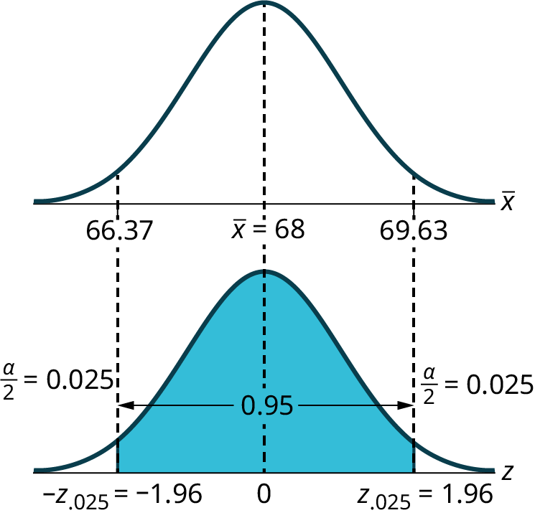
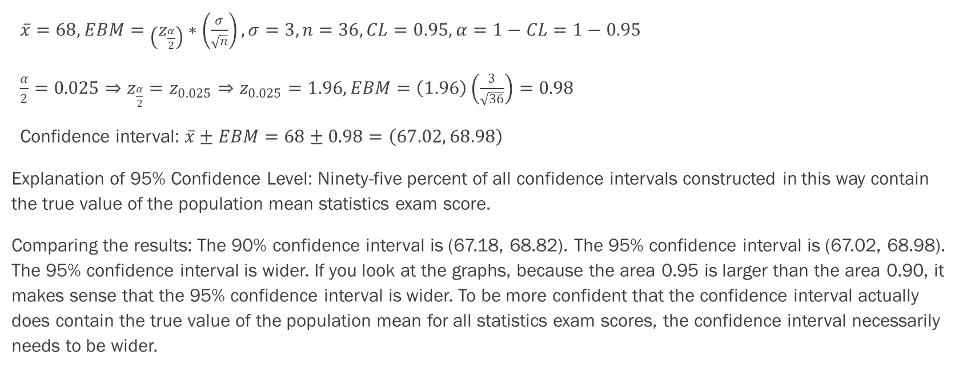
Example - Answers
$\overline{x}=68, EBM=\left(z_{\frac{α}{2}}\right)∗\left(\frac{σ}{\sqrt{n}}\right), σ=3, n=36, CL=0.95, α=1−CL=1−0.95$
$\frac{α}{2}=0.025⇒z_{\frac{α}{2}}=z_{0.025}⇒z_{0.025}=1.96, EBM=\left(1.96\right)\left(\frac{3}{\sqrt{36}}\right)=0.98$
Confidence interval: $\overline{x}±EBM=68±0.98=\left(67.02, 68.98\right)$
Explanation of 95% Confidence Level: Ninety-five percent of all confidence intervals constructed in this way contain the true value of the population mean statistics exam score.
Comparing the results: The 90% confidence interval is (67.18, 68.82). The 95% confidence interval is (67.02, 68.98). The 95% confidence interval is wider. If you look at the graphs, because the area 0.95 is larger than the area 0.90, it makes sense that the 95% confidence interval is wider. To be more confident that the confidence interval actually does contain the true value of the population mean for all statistics exam scores, the confidence interval necessarily needs to be wider.

Slide 24
Example
Leave everything the same except the sample size. Use the original 90% confidence level. What happens to the error bound if we decrease the sample size to n = 25 instead of n = 36?
Original example: Suppose scores on exams in statistics are normally distributed with an unknown population mean and a population standard deviation of three points. A random sample of 36 scores is taken and gives a sample mean (sample mean score) of 68. Find a confidence interval estimate for the population mean exam score (the mean score on all exams).
Find a 90% confidence interval for the true (population) mean of statistics exam scores.

Slide 25
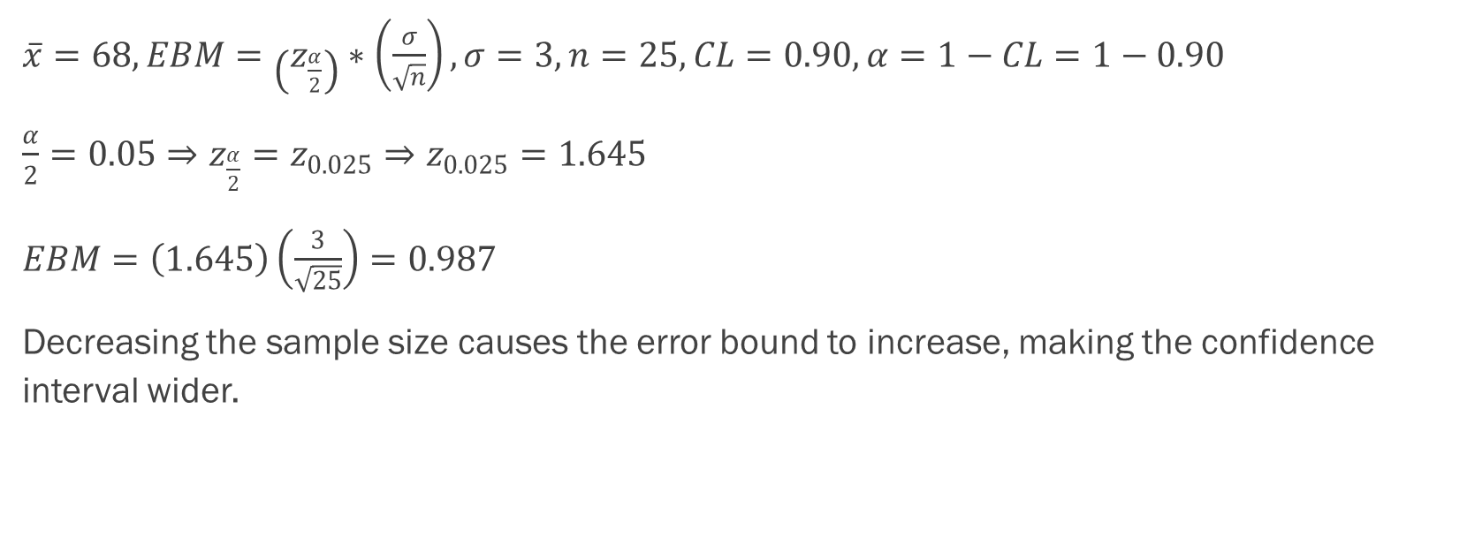
Example - Answers
$\overline{x}=68, EBM=\left(z_{\frac{α}{2}}\right)∗\left(\frac{σ}{\sqrt{n}}\right), σ=3, n=25, CL=0.90, α=1−CL=1−0.90$
$\frac{α}{2}=0.05⇒z_{\frac{α}{2}}=z_{0.025}⇒z_{0.025}=1.645$
$EBM=\left(1.645\right)\left(\frac{3}{\sqrt{25}}\right)=0.987$
Decreasing the sample size causes the error bound to increase, making the confidence interval wider.

Slide 26
Working Backwards to Find the Error Bound or Sample Mean
When we calculate a confidence interval, we find the sample mean, calculate the error bound, and use them to calculate the confidence interval. However, sometimes when we read statistical studies, the study may state the confidence interval only. If we know the confidence interval, we can work backwards to find both the error bound and the sample mean.
Finding the Error Bound
  From the upper value for the interval, subtract the sample mean,
  OR, from the upper value for the interval, subtract the lower value. Then divide the difference by two.
Finding the Sample Mean
  Subtract the error bound from the upper value of the confidence interval,
  OR, average the upper and lower endpoints of the confidence interval.
Notice that there are two methods to perform each calculation. You can choose the method that is easier to use with the information you know.

Slide 27
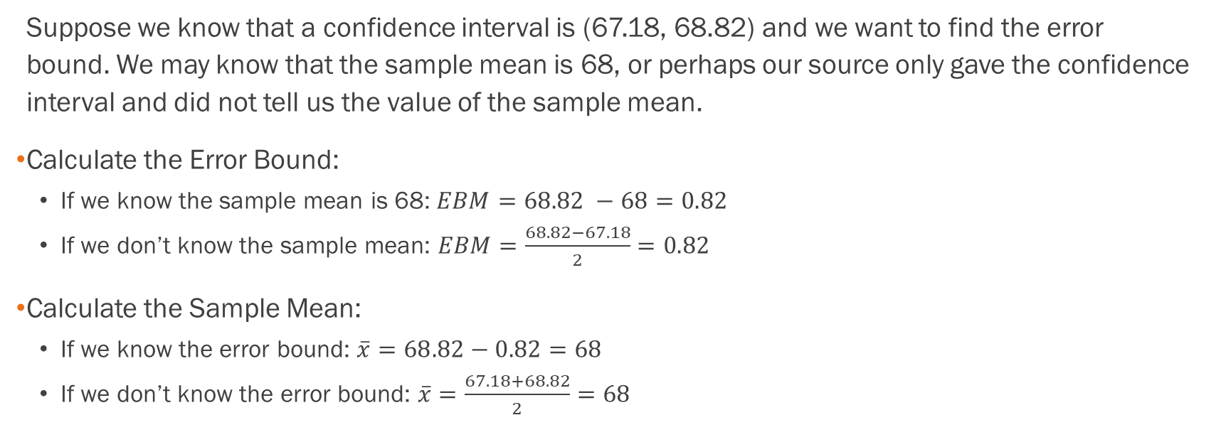
Example
Suppose we know that a confidence interval is (67.18, 68.82) and we want to find the error bound. We may know that the sample mean is 68, or perhaps our source only gave the confidence interval and did not tell us the value of the sample mean.
Calculate the Error Bound:
  If we know the sample mean is 68: $EBM=68.82 −68=0.82$
  If we don’t know the sample mean: $EBM=\frac{68.82−67.18}{2}=0.82$
Calculate the Sample Mean:
  If we know the error bound: $\overline{x}=68.82−0.82=68$
  If we don’t know the error bound: $\overline{x}=\frac{67.18+68.82}{2}=68$

Slide 28
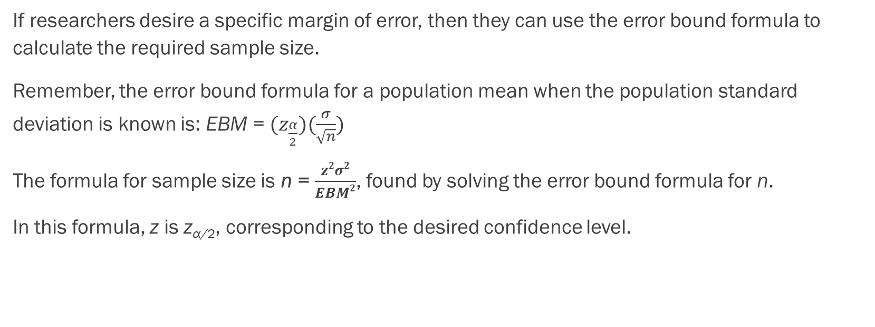
Calculating the Sample Size n
If researchers desire a specific margin of error, then they can use the error bound formula to calculate the required sample size.
Remember, the error bound formula for a population mean when the population standard deviation is known is: EBM = $(z_{\frac{α}{2}})(\frac{σ}{\sqrt{n}})$
The formula for sample size is n = $\frac{z2σ2}{EBM2}$, found by solving the error bound formula for n.
In this formula, z is z_{α/2}, corresponding to the desired confidence level.

Slide 29
Example
The population standard deviation for the age of Foothill College students is 15 years. If we want to be 95% confident that the sample mean age is within two years of the true population mean age of Foothill College students, how many randomly selected Foothill College students must be surveyed?

Slide 30
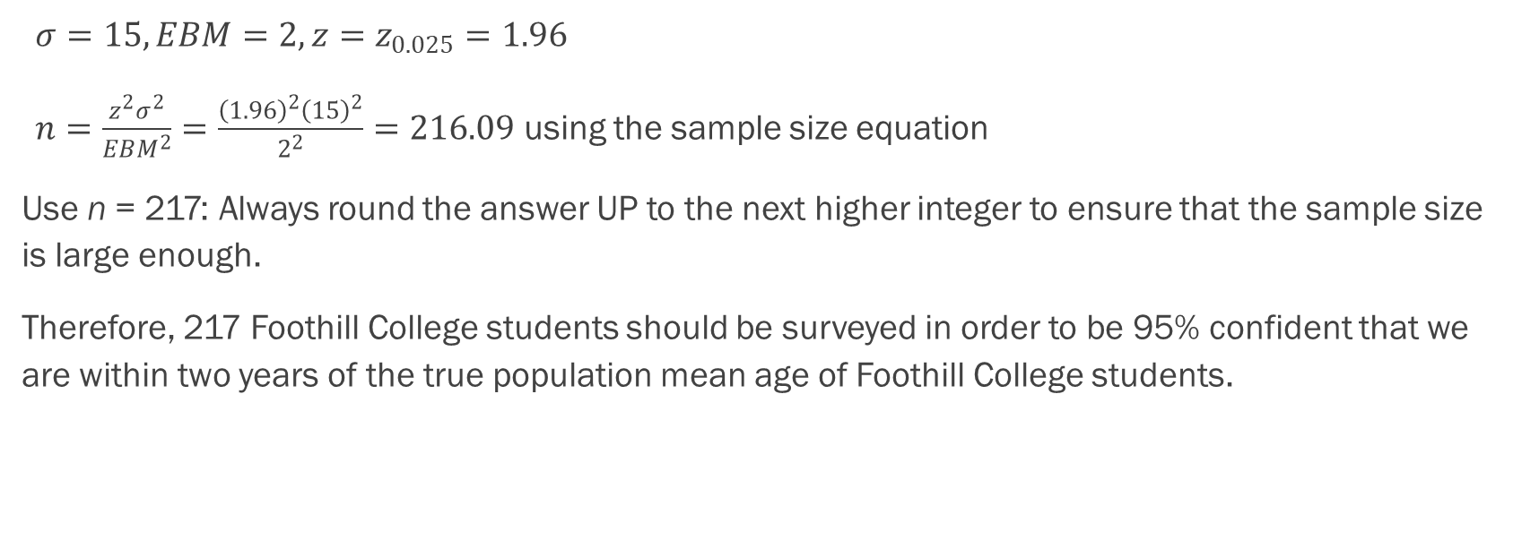
Example - Answers
$σ=15, EBM=2, z=z_{0.025}=1.96$
$n=\frac{z^{2}σ^{2}}{EBM^{2}}=\frac{{\left(1.96\right)}^{2}{\left(15\right)}^{2}}{2^{2}}=216.09$ using the sample size equation
Use n = 217: Always round the answer UP to the next higher integer to ensure that the sample size is large enough.
Therefore, 217 Foothill College students should be surveyed in order to be 95% confident that we are within two years of the true population mean age of Foothill College students.

Slide 31
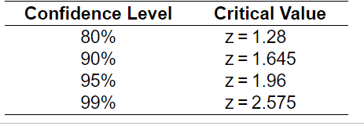
Common Critical Z Values (Potentially Useful to Memorize)

Slide 32
Section 8.2
A Single Population Mean using the
Student t Distribution

Slide 33
A Single Population Mean using the
Student t Distribution
In practice, we rarely know the population standard deviation, σ.
When the population standard deviation is unknown, we do not use the standard normal distribution. Rather we use the Student's t-distribution.
The one big difference is the calculation of the number n – 1, which is called the degrees of freedom (df).
The notation for the Student's t-distribution (using T as the random variable) is:
  T ~ t_{df} where df = n – 1.
  For example, if we have a sample of size n = 20 items, then we calculate the degrees of freedom as df = n - 1 = 20 – 1 = 19 and we write the distribution as T ~ t₁₉.

Slide 34
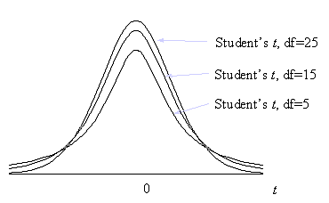
Different Student’s t Distributions
The degrees of freedom will dictate the shape:

Slide 35
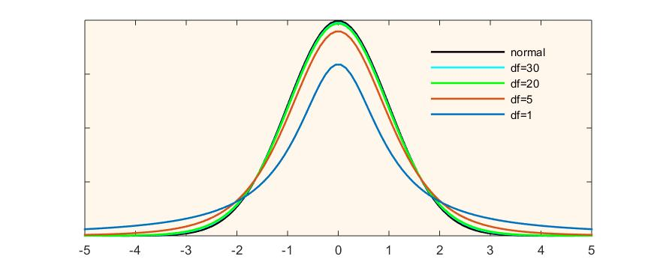
Student’s t vs The Normal Distribution

Slide 36
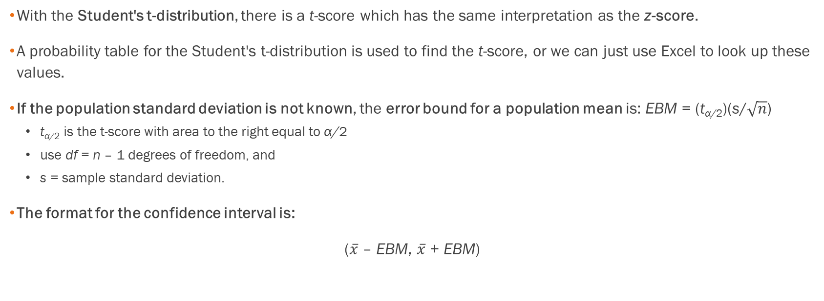
A Single Population Mean using the
Student t Distribution, Cont.
With the Student's t-distribution, there is a t-score which has the same interpretation as the z-score.
A probability table for the Student's t-distribution is used to find the t-score, or we can just use Excel to look up these values.
If the population standard deviation is not known, the error bound for a population mean is: EBM = (t_{α/2})(s/$\sqrt{n}$)
  t_{α/2} is the t-score with area to the right equal to α/2
  use df = n – 1 degrees of freedom, and
  s = sample standard deviation.
The format for the confidence interval is:
($\overline{x}$ – EBM, $\overline{x}$ + EBM)

Slide 37
Example
Suppose you do a study of acupuncture to determine how effective it is in relieving pain. You measure sensory rates for 15 subjects with the results given. Use the sample data to construct a 95% confidence interval for the mean sensory rate for the population (assumed normal) from which you took the data. See the class Excel spreadsheet.
8.6; 9.4; 7.9; 6.8; 8.3; 7.3; 9.2; 9.6; 8.7; 11.4; 10.3; 5.4; 8.1; 5.5; 6.9

Slide 38
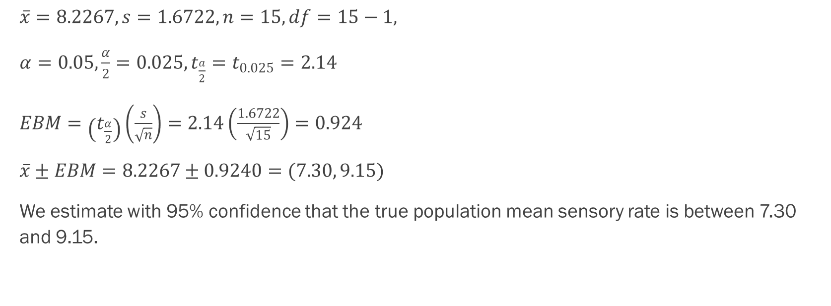
Example - Answers
$\overline{x}=8.2267, s=1.6722, n=15, df=15−1,$
$α=0.05,\frac{α}{2}=0.025, t_{\frac{a}{2}}=t_{0.025}=2.14$
$EBM=\left(t_{\frac{α}{2}}\right)\left(\frac{s}{\sqrt{n}}\right)=2.14\left(\frac{1.6722}{\sqrt{15}}\right)=0.924$
$\overline{x}±EBM=8.2267±0.9240=(7.30, 9.15)$
We estimate with 95% confidence that the true population mean sensory rate is between 7.30 and 9.15.

Slide 39
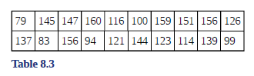
Example
The Human Toxome Project (HTP) is working to understand the scope of industrial pollution in the human body. Industrial chemicals may enter the body through pollution or as ingredients in consumer products. In October 2008, the scientists at HTP tested cord blood samples for 20 newborn infants in the United States. The cord blood of the "In utero/newborn" group was tested for 430 industrial compounds, pollutants, and other chemicals, including chemicals linked to brain and nervous system toxicity, immune system toxicity, and reproductive toxicity, and fertility problems. There are health concerns about the effects of some chemicals on the brain and nervous system. The table shows how many of the targeted chemicals were found in each infant’s cord blood. See the Excel spreadsheet.
Use this sample data to construct a 90% confidence interval for the mean number of targeted industrial chemicals to be found in an in infant’s blood.

Slide 40
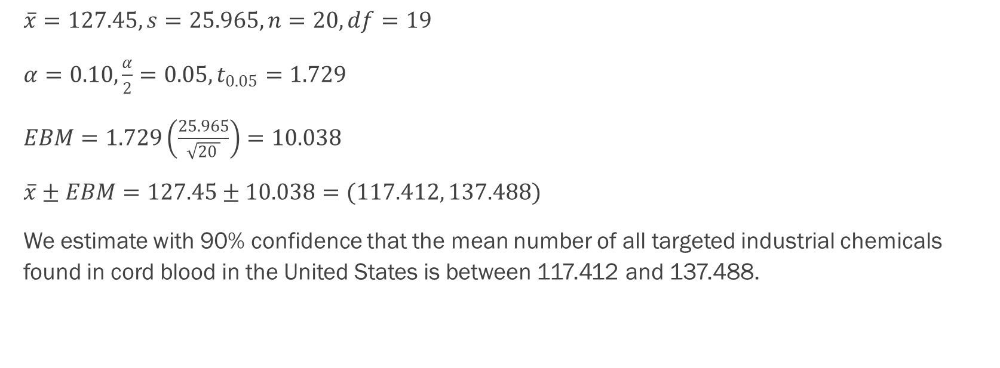
Example - Answers
$\overline{x}=127.45, s=25.965, n=20, df=19$
$α=0.10,\frac{α}{2}=0.05, t_{0.05}=1.729$
$EBM=1.729\left(\frac{25.965}{\sqrt{20 }}\right)=10.038$
$\overline{x}±EBM=127.45±10.038=(117.412, 137.488)$
We estimate with 90% confidence that the mean number of all targeted industrial chemicals found in cord blood in the United States is between 117.412 and 137.488.

Slide 41
Example
You are interested in finding a 95% confidence interval for the average commute that non-residential students have to their college. The data below show the number of commute miles for 14 randomly selected non-residential college students. Round answers to 3 decimal places where possible.
Which distribution should we use and why?
Find the 95% confidence interval for the population mean commute for non-residential college students:
If many groups of 14 randomly selected non-residential college students are surveyed, then a different confidence interval would be produced from each group. What percent of these confidence intervals would contain the true population mean? What percent would not contain the true population mean?
26 | 28 | 10 | 20 | 11 | 12 | 9 | 22 | 18 | 27 | 28 | 9 | 17 | 14

Slide 42
Section 8.3
A population proportion

Slide 43
An Example Where We Would Be Interested in a Population Proportion
During an election year, we see articles in the newspaper that state confidence intervals in terms of proportions or percentages. For example, a poll for a particular candidate running for president might show that the candidate has 40% of the vote within three percentage points (if the sample is large enough). Often, election polls are calculated with 95% confidence, so, the pollsters would be 95% confident that the true proportion of voters who favored the candidate would be between 0.37 and 0.43: (0.40 – 0.03,0.40 + 0.03).
The procedure to find the confidence interval, the sample size, the error bound, and the confidence level for a proportion is similar to that for the population mean, but the formulas are different.

Slide 44
Confidence Intervals for Proportions
While the formulas are different, they are based upon the same mathematical foundation given to us by the Central Limit Theorem.
Because of this we will see the same basic format using the same three pieces of information: the sample value of the parameter in question, the standard deviation of the relevant sampling distribution, and the number of standard deviations we need to have the confidence in our estimate that we desire.

Slide 45
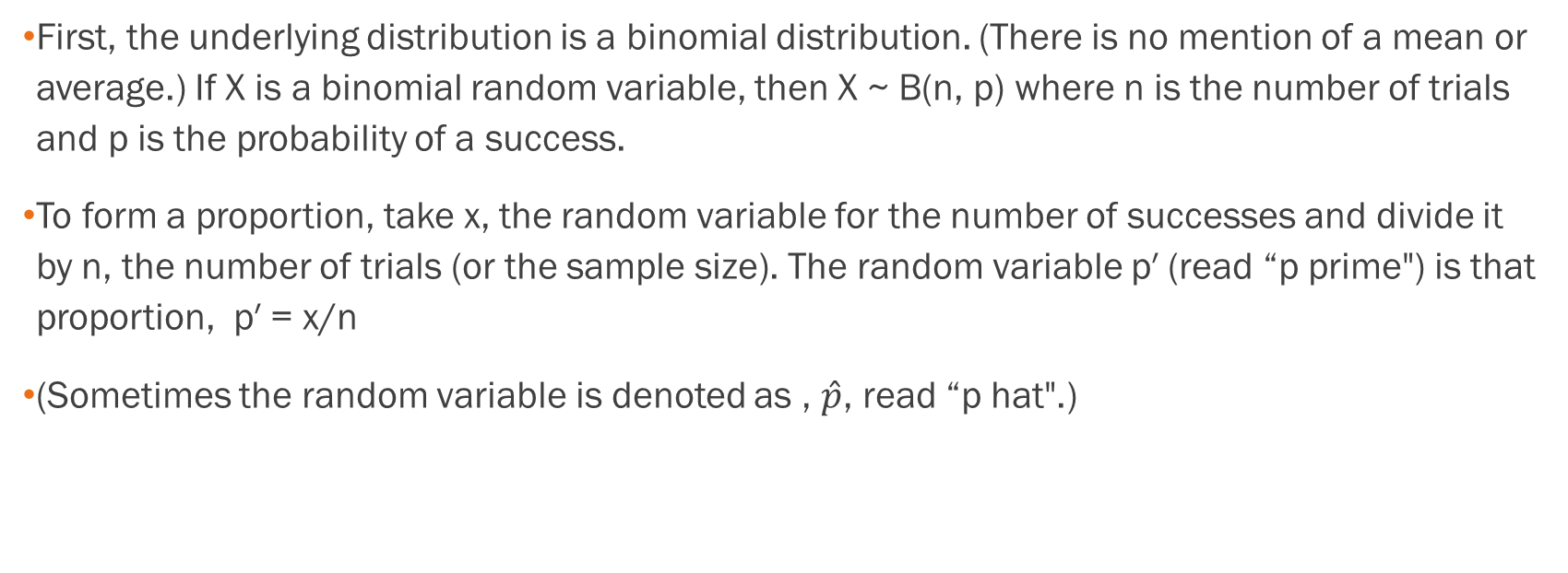
How Do You Know You Are Dealing with a Population Proportion?
First, the underlying distribution is a binomial distribution. (There is no mention of a mean or average.) If X is a binomial random variable, then X ~ B(n, p) where n is the number of trials and p is the probability of a success.
To form a proportion, take x, the random variable for the number of successes and divide it by n, the number of trials (or the sample size). The random variable p′ (read “p prime") is that proportion, p′ = x/n
(Sometimes the random variable is denoted as , $\hat{p}$, read “p hat".)

Slide 46
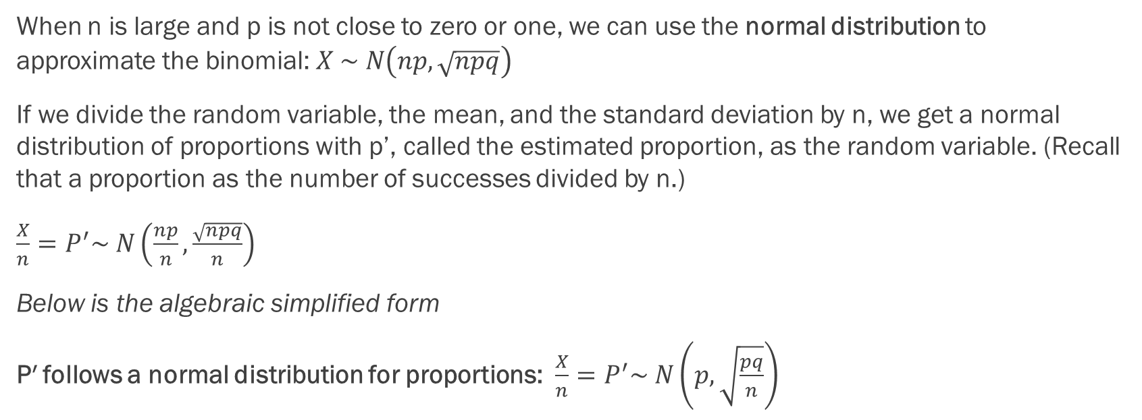
From Binomial to Normal Distributions
When n is large and p is not close to zero or one, we can use the normal distribution to approximate the binomial: $X \sim N\left(np, \sqrt{npq}\right)$
If we divide the random variable, the mean, and the standard deviation by n, we get a normal distribution of proportions with p’, called the estimated proportion, as the random variable. (Recall that a proportion as the number of successes divided by n.)
$\frac{X}{n}=P^{′}\sim N\left(\frac{np}{n}, \frac{\sqrt{npq}}{n}\right)$
Below is the algebraic simplified form
P′ follows a normal distribution for proportions: $\frac{X}{n}=P^{′}\sim N\left(p,\sqrt{\frac{pq}{n}}\right)$

Slide 47
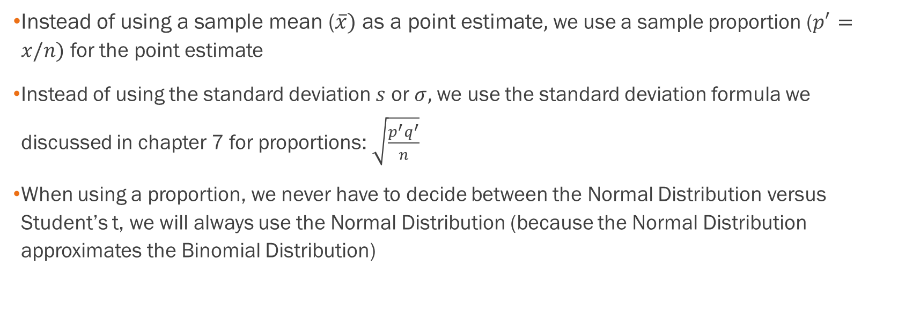
Some Quick Notes on Differences
Instead of using a sample mean ($\overline{x})$ as a point estimate$,$ we use a sample proportion ($p^{′}=x/n)$ for the point estimate
Instead of using the standard deviation $s$ or $σ,$ we use the standard deviation formula we discussed in chapter 7 for proportions: $\sqrt{\frac{p^{′}q^{′}}{n}}$
When using a proportion, we never have to decide between the Normal Distribution versus Student’s t, we will always use the Normal Distribution (because the Normal Distribution approximates the Binomial Distribution)

Slide 48
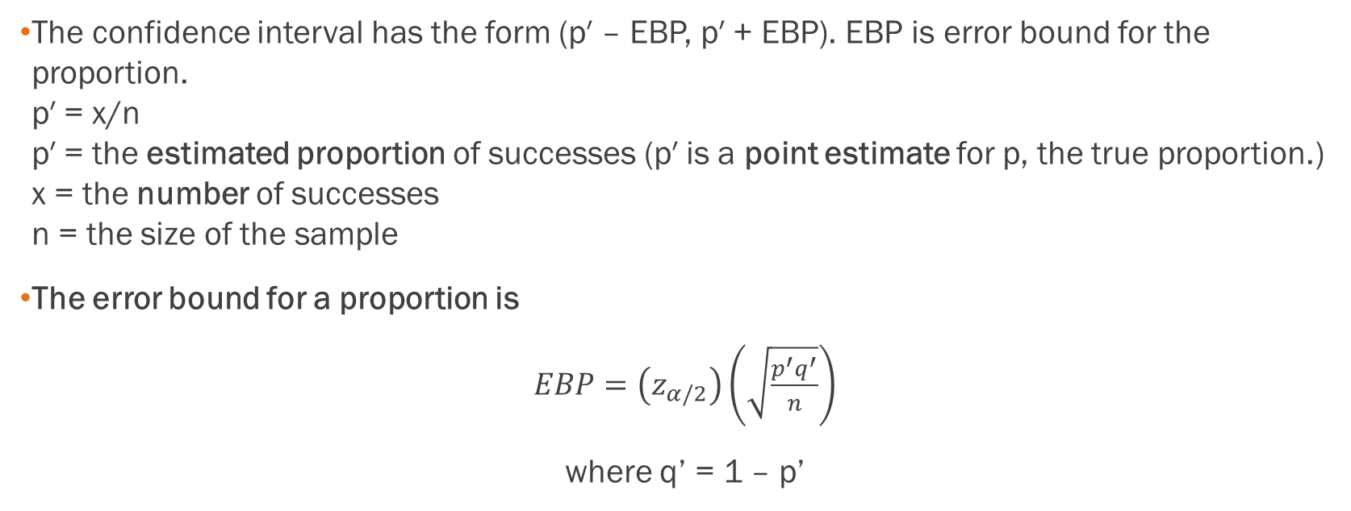
Confidence Intervals for Proportions
The confidence interval has the form (p′ – EBP, p′ + EBP). EBP is error bound for the proportion.
p′ = x/n
p′ = the estimated proportion of successes (p′ is a point estimate for p, the true proportion.)
x = the number of successes
n = the size of the sample
The error bound for a proportion is
$EBP=\left(z_{α/2}\right)\left(\sqrt{\frac{p^{′}q^{′}}{n}}\right)$
where q’ = 1 – p’

Slide 49
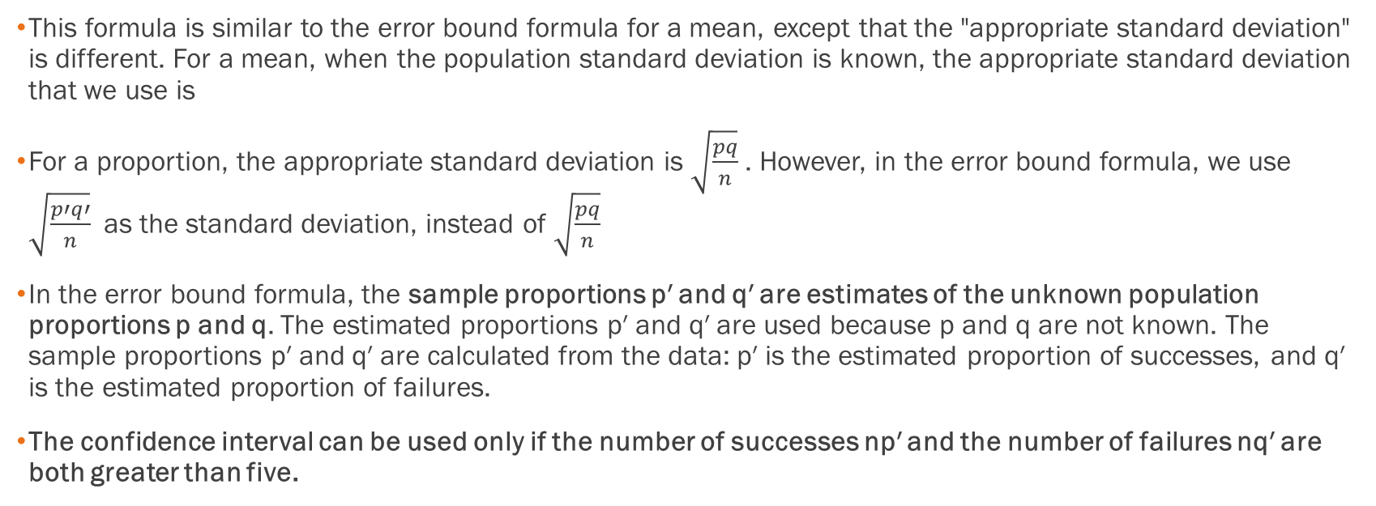
Error Bound Formula and Standard Deviation
This formula is similar to the error bound formula for a mean, except that the "appropriate standard deviation" is different. For a mean, when the population standard deviation is known, the appropriate standard deviation that we use is
For a proportion, the appropriate standard deviation is $\sqrt{\frac{pq}{n}}$. However, in the error bound formula, we use $\sqrt{\frac{p′q′}{n}}$ as the standard deviation, instead of $\sqrt{\frac{pq}{n}}$
In the error bound formula, the sample proportions p′ and q′ are estimates of the unknown population proportions p and q. The estimated proportions p′ and q′ are used because p and q are not known. The sample proportions p′ and q′ are calculated from the data: p′ is the estimated proportion of successes, and q′ is the estimated proportion of failures.
The confidence interval can be used only if the number of successes np′ and the number of failures nq′ are both greater than five.

Slide 50
Example
Suppose that a market research firm is hired to estimate the percent of adults living in a large city who have cell phones. Five hundred randomly selected adult residents in this city are surveyed to determine whether they have cell phones. Of the 500 people surveyed, 421 responded yes - they own cell phones. Using a 95% confidence level, compute a confidence interval estimate for the true proportion of adult residents of this city who have cell phones.

Slide 51
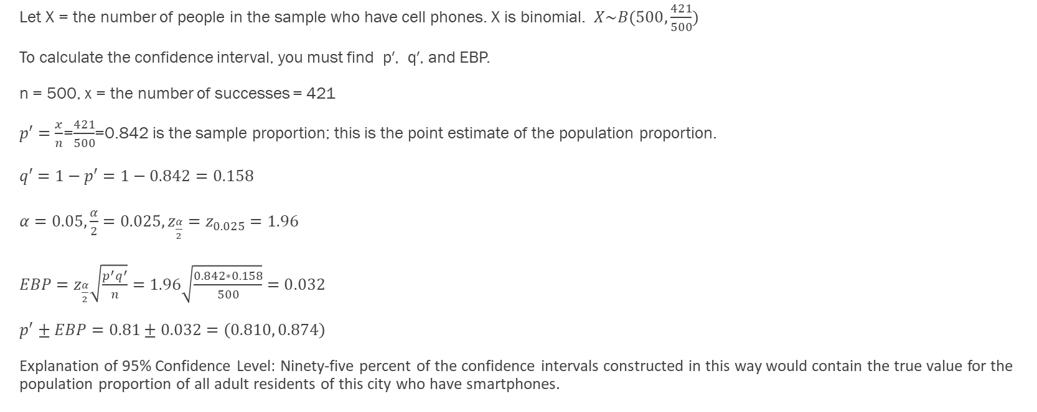
Example - Answers
Let X = the number of people in the sample who have cell phones. X is binomial. $X\sim B(500,\frac{421}{500})$
To calculate the confidence interval, you must find p′, q′, and EBP.
n = 500, x = the number of successes = 421
$p′=\frac{x}{n}$=$\frac{421}{500}$=0.842 is the sample proportion; this is the point estimate of the population proportion.
$q′=1−p′=1−0.842=0.158$
$α=0.05,\frac{α}{2}=0.025, z_{\frac{α}{2}}=z_{0.025}=1.96$
$EBP=z_{\frac{α}{2}}\sqrt{\frac{p^{′}q^{′}}{n}}=1.96\sqrt{\frac{0.842∗0.158}{500}}=0.032$
$p^{′}±EBP=0.81±0.032=\left(0.810, 0.874\right)$
Explanation of 95% Confidence Level: Ninety-five percent of the confidence intervals constructed in this way would contain the true value for the population proportion of all adult residents of this city who have smartphones.

Slide 52
Example
For a class project, a political science student at a large university wants to estimate the percent of students who are registered voters. He surveys 500 students and finds that 300 are registered voters. Compute a 90% confidence interval for the true percent of students who are registered voters, and interpret the confidence interval.

Slide 53
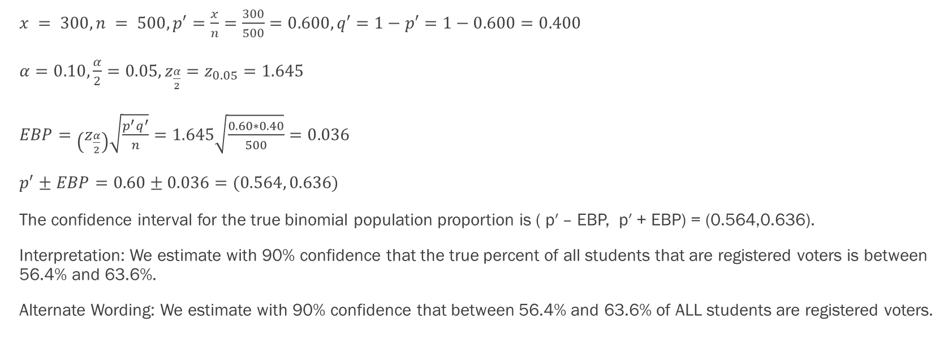
Example - Answers
$x = 300, n = 500, p′=\frac{x}{n}=\frac{300}{500}=0.600, q′=1−p′=1−0.600=0.400$
$α=0.10,\frac{α}{2}=0.05, z_{\frac{α}{2}}=z_{0.05}=1.645$
$EBP=\left(z_{\frac{α}{2}}\right)\sqrt{\frac{p^{′}q^{′}}{n}}=1.645\sqrt{\frac{0.60∗0.40}{500}}=0.036$
$p^{′}±EBP=0.60±0.036=(0.564, 0.636)$
The confidence interval for the true binomial population proportion is ( p′ – EBP, p′ + EBP) = (0.564,0.636).
Interpretation: We estimate with 90% confidence that the true percent of all students that are registered voters is between 56.4% and 63.6%.
Alternate Wording: We estimate with 90% confidence that between 56.4% and 63.6% of ALL students are registered voters.

Slide 54
“Plus Four” Confidence Interval for p
There is a certain amount of error introduced into the process of calculating a confidence interval for a proportion. Because we do not know the true proportion for the population, we are forced to use point estimates to calculate the appropriate standard deviation of the sampling distribution. Studies have shown that the resulting estimation of the standard deviation can be flawed.
Fortunately, there is a simple adjustment that allows us to produce more accurate confidence intervals. We simply pretend that we have four additional observations. Two of these observations are successes and two are failures. The new sample size, then, is n + 4, and the new count of successes is x + 2.
Computer studies have demonstrated the effectiveness of this method. It should be used when the confidence level desired is at least 90% and the sample size is at least ten.

Slide 55
Example
A random sample of 25 statistics students was asked: “Have you smoked a cigarette in the past week?” Six students reported smoking within the past week. Use the “plus-four” method to find a 95% confidence interval for the true proportion of statistics students who smoke.

Slide 56
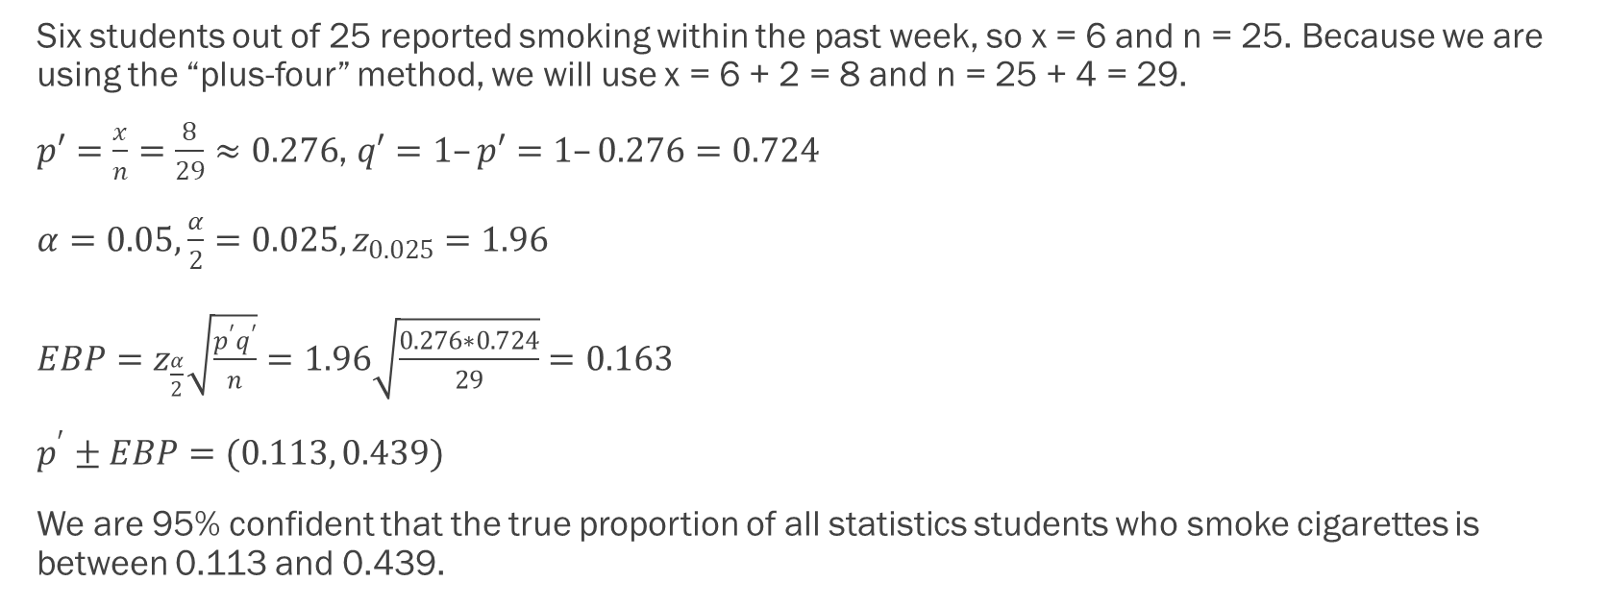
Example - Answers
Six students out of 25 reported smoking within the past week, so x = 6 and n = 25. Because we are using the “plus-four” method, we will use x = 6 + 2 = 8 and n = 25 + 4 = 29.
$p′=\frac{x}{n}=\frac{8}{29}≈0.276$, $q′=1–p′=1–0.276=0.724$
$α=0.05,\frac{α}{2}=0.025, z_{0.025}=1.96$
$EBP=z_{\frac{α}{2}}\sqrt{\frac{p^{′}q^{′}}{n}}=1.96\sqrt{\frac{0.276∗0.724}{29}}=0.163$
$p^{′}±EBP=(0.113, 0.439)$
We are 95% confident that the true proportion of all statistics students who smoke cigarettes is between 0.113 and 0.439.

Slide 57
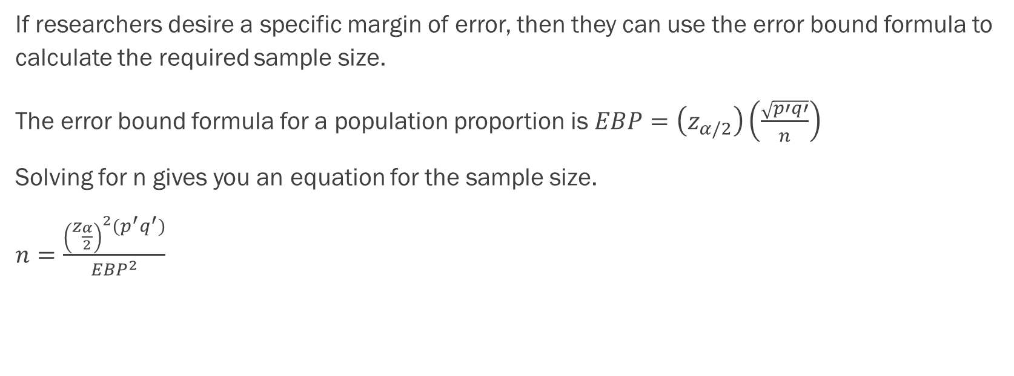
Calculating the Sample Size n
If researchers desire a specific margin of error, then they can use the error bound formula to calculate the required sample size.
The error bound formula for a population proportion is $EBP=\left(z_{α/2}\right)\left(\frac{\sqrt{p′q′}}{n}\right)$
Solving for n gives you an equation for the sample size.
$n=\frac{{\left(z_{\frac{α}{2}}\right)}^{2}(p^{′}q^{′})}{{EBP}^{2}}$

Slide 58
Example
Suppose a mobile phone company wants to determine the current percentage of customers aged 50+ who use text messaging on their cell phones. How many customers aged 50+ should the company survey in order to be 90% confident that the estimated (sample) proportion is within three percentage points of the true population proportion of customers aged 50+ who use text messaging on their cell phones.

Slide 59
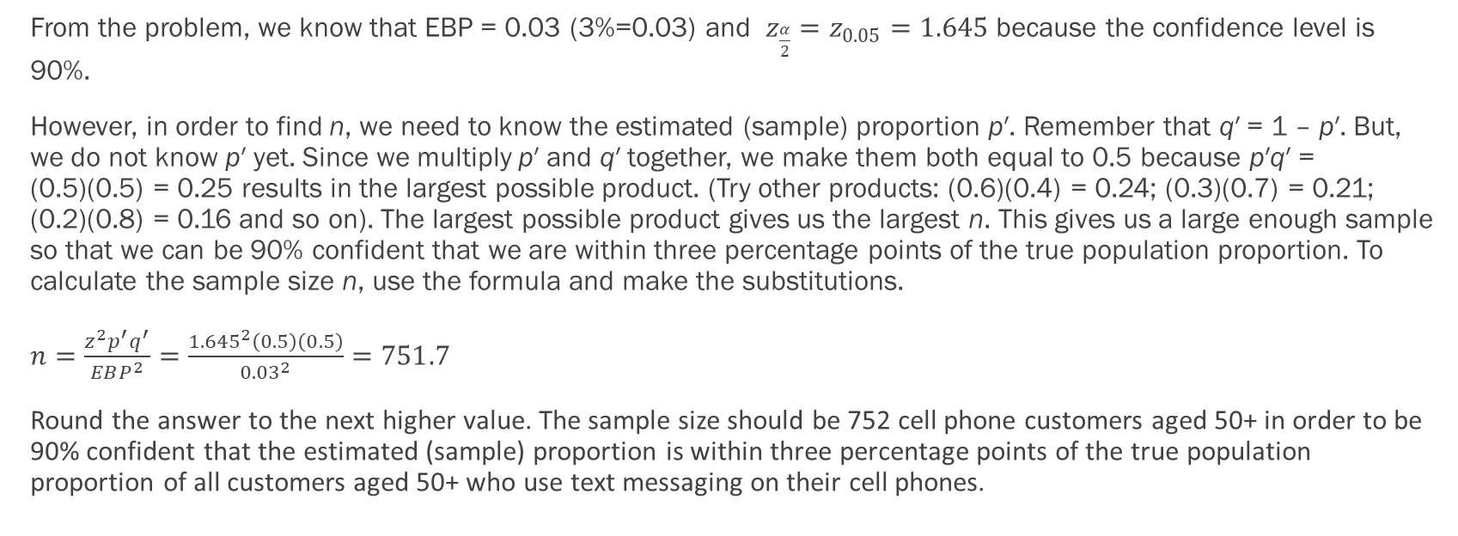
Example - Answers
From the problem, we know that EBP = 0.03 (3%=0.03) and $z_{\frac{α}{2}}=z_{0.05}=1.645$ because the confidence level is 90%.
However, in order to find n, we need to know the estimated (sample) proportion p′. Remember that q′ = 1 – p′. But, we do not know p′ yet. Since we multiply p′ and q′ together, we make them both equal to 0.5 because p′q′ = (0.5)(0.5) = 0.25 results in the largest possible product. (Try other products: (0.6)(0.4) = 0.24; (0.3)(0.7) = 0.21; (0.2)(0.8) = 0.16 and so on). The largest possible product gives us the largest n. This gives us a large enough sample so that we can be 90% confident that we are within three percentage points of the true population proportion. To calculate the sample size n, use the formula and make the substitutions.
$n=\frac{z^{2}p^{′}q^{′}}{EBP^{2}}=\frac{{1.645}^{2}\left(0.5\right)\left(0.5\right)}{{0.03}^{2}}=751.7$
Round the answer to the next higher value. The sample size should be 752 cell phone customers aged 50+ in order to be 90% confident that the estimated (sample) proportion is within three percentage points of the true population proportion of all customers aged 50+ who use text messaging on their cell phones.

Slide 60
Putting It All Together
A Review of All the Techniques

Slide 61
Example
A newsgroup is interested in constructing a 99% confidence interval for the proportion of all Americans who are in favor of a new Green initiative. Of the 504 randomly selected Americans surveyed, 390 were in favor of the initiative. Round answers to 4 decimal places where possible. Find the confidence interval.

Slide 62
Example
Assume that a sample is used to estimate a population proportion p. Find the 80% confidence interval for a sample of size 111 with 72 successes. Enter your answer as an open-interval (i.e., parentheses) using decimals (not percents) accurate to three decimal places.

Slide 63
Example
A random survey of enrollment at 35 community colleges across the United States yielded the following figures: 6,414; 1,550; 2,109; 9,350; 21,828; 4,300; 5,944; 5,722; 2,825; 2,044; 5,481; 5,200; 5,853; 2,750; 10,012; 6,357; 27,000; 9,414; 7,681; 3,200; 17,500; 9,200; 7,380; 18,314; 6,557; 13,713; 17,768; 7,493; 2,771; 2,861; 1,263; 7,285; 28,165; 5,080; 11,622. Assume the underlying population is normal. Construct a 95% confidence interval for the population mean enrollment at community colleges in the United States. Include a graph.

