Slide 1

Chapter 9 Hypothesis Testing with One Sample
Openstax statistics
Access for free at https://openstax.org/books/introductory-statistics-2e/pages/1-introduction

Slide 2
Objectives
By the end of this chapter, the student should be able to:
State the null and alternative hypothesis for a statement
Identify type 1 and type 2 errors
Choose the appropriate probability distribution needed for a hypothesis test
Complete a hypothesis test, using critical value or p-value approach

Slide 3
Section 9.1
Null and alternative hypotheses

Slide 4
Null and Alternative Hypotheses
H₀: The null hypothesis: It is a statement of no difference between the variables–they are not related.
  This can often be considered the status quo and as a result if you cannot accept the null it requires some action.
H_{a}: The alternative hypothesis: It is a claim about the population that is contradictory to H₀ and what we conclude when we cannot accept H₀.
  This is usually what the researcher is trying to prove.

Slide 5
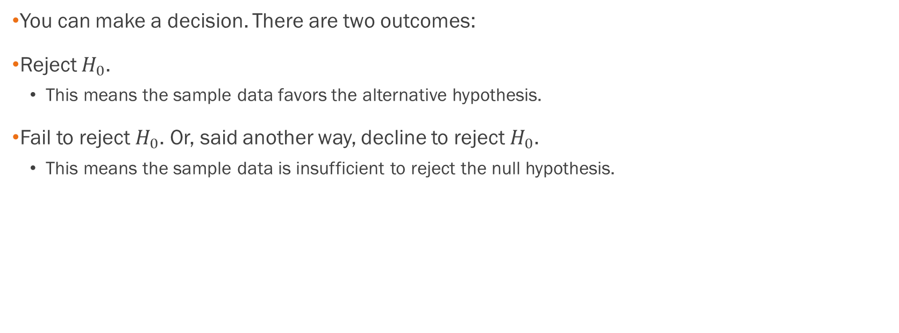
After Determining Which Hypothesis the Data Supports…
You can make a decision. There are two outcomes:
Reject $H_{0}$.
  This means the sample data favors the alternative hypothesis.
Fail to reject $H_{0}$. Or, said another way, decline to reject $H_{0}$.
  This means the sample data is insufficient to reject the null hypothesis.

Slide 6
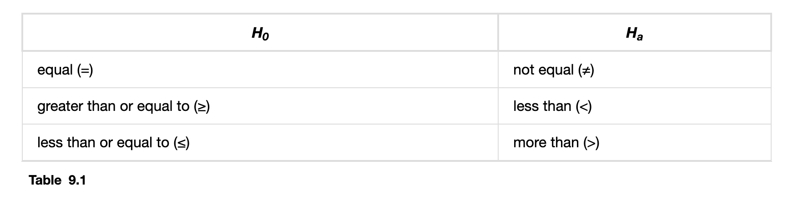
Standard Null and Alternative Hypotheses
Note: $H_{0}$ always has a symbol with an equal in it. $H_{a}$ never does.

Slide 7
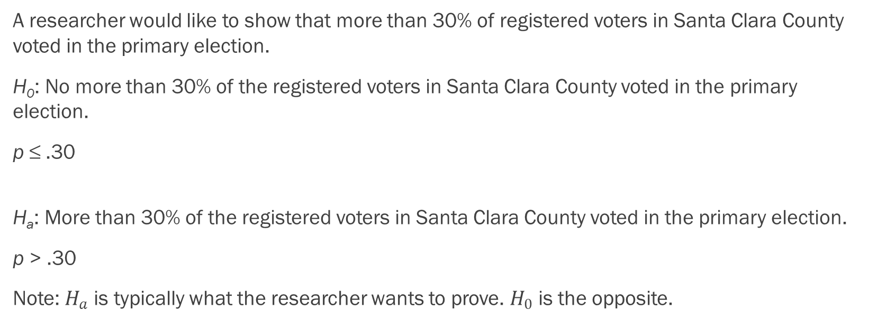
Example of Hypothesis Statements
A researcher would like to show that more than 30% of registered voters in Santa Clara County voted in the primary election.
H₀: No more than 30% of the registered voters in Santa Clara County voted in the primary election.
p ≤ .30
H_{a}: More than 30% of the registered voters in Santa Clara County voted in the primary election.
p > .30
Note: $H_{a}$ is typically what the researcher wants to prove. $H_{0}$ is the opposite.

Slide 8
More Examples of Hypothesis Statements
We want to test whether the mean GPA of students in American colleges is different from 2.0 (out of 4.0). The null and alternative hypotheses are:
H₀: μ = 2.0
H_{a}: μ ≠ 2.0
We want to test if college students take less than five years to graduate from college, on the average. The null and alternative hypotheses are:
H₀: μ ≥ 5
H_{a}: μ < 5

Slide 9
Example
Suppose that a recent article stated that the mean time spent in jail by a first–time convicted burglar is 2.5 years. A study was then done to see if the mean time has increased in the new century. A random sample of 26 first-time convicted burglars in a recent year was picked. The mean length of time in jail from the survey was 3 years with a standard deviation of 1.8 years. Suppose that it is somehow known that the population standard deviation is 1.5. If you were conducting a hypothesis test to determine if the mean length of jail time has increased, what would the null and alternative hypotheses be? The distribution of the population is normal.

Slide 10
Example - Answers
Suppose that a recent article stated that the mean time spent in jail by a first–time convicted burglar is 2.5 years. A study was then done to see if the mean time has increased in the new century. A random sample of 26 first-time convicted burglars in a recent year was picked. The mean length of time in jail from the survey was 3 years with a standard deviation of 1.8 years. Suppose that it is somehow known that the population standard deviation is 1.5. If you were conducting a hypothesis test to determine if the mean length of jail time has increased, what would the null and alternative hypotheses be? The distribution of the population is normal.
H₀: μ = 2.5 (or, H₀: μ ≤ 2.5)
H_{a} : μ > 2.5

Slide 11
Example
The National Institute of Mental Health published an article stating that in any one-year period, approximately 9.5% of American adults suffer from depression or a depressive illness. Suppose that in a survey of 100 people in a certain town, seven of them suffered from depression or a depressive illness. If you were conducting a hypothesis test to determine if the true proportion of people in that town suffering from depression or a depressive illness is lower than the percent in the general adult American population, what would the null and alternative hypotheses be?

Slide 12
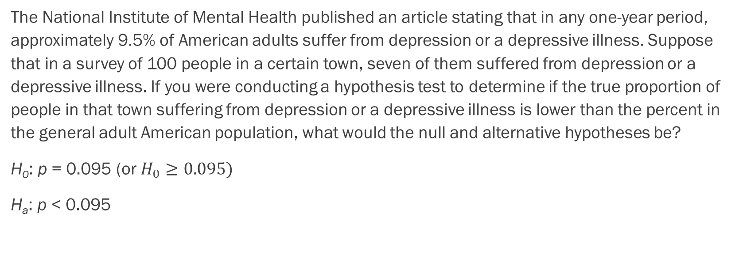
Example - Answer
The National Institute of Mental Health published an article stating that in any one-year period, approximately 9.5% of American adults suffer from depression or a depressive illness. Suppose that in a survey of 100 people in a certain town, seven of them suffered from depression or a depressive illness. If you were conducting a hypothesis test to determine if the true proportion of people in that town suffering from depression or a depressive illness is lower than the percent in the general adult American population, what would the null and alternative hypotheses be?
H₀: p = 0.095 (or $H_{0}≥0.095)$
H_{a}: p < 0.095

Slide 13
Section 9.2
Outcomes and type I and Type 2 errors

Slide 14
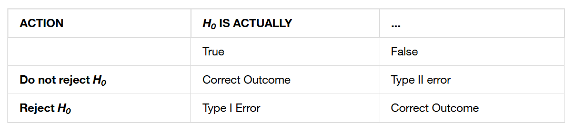
Four Possible Outcomes

Slide 15
Four Possible Outcomes
The four possible outcomes in the table are:
The decision is not to reject H₀ when H₀ is true (correct decision).
The decision is to reject H₀ when H₀ is true (incorrect decision known as aType I error).
The decision is not to reject H₀ when, in fact, H₀ is false (incorrect decision known as a Type II error).
The decision is to reject H₀ when H₀ is false (correct decision whose probability is called the Power of the Test).

Slide 16
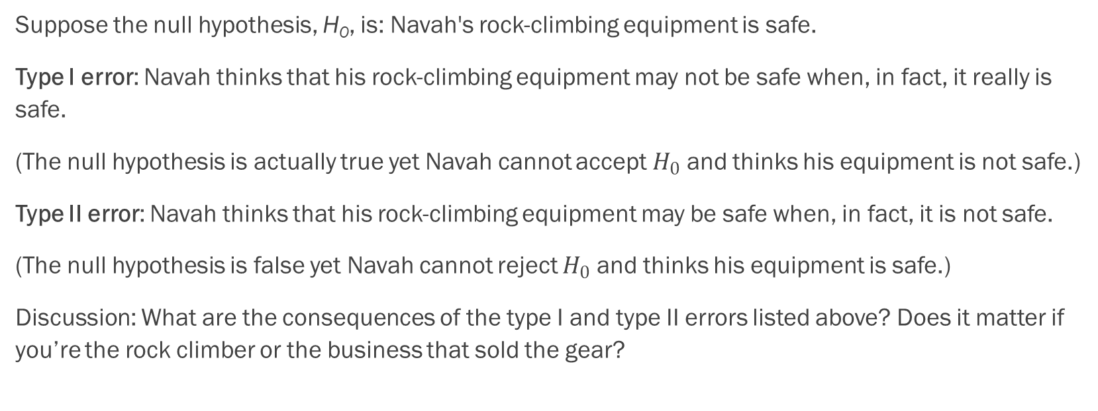
Example
Suppose the null hypothesis, H₀, is: Navah's rock-climbing equipment is safe.
Type I error: Navah thinks that his rock-climbing equipment may not be safe when, in fact, it really is safe.
(The null hypothesis is actually true yet Navah cannot accept $H_{0}$ and thinks his equipment is not safe.)
Type II error: Navah thinks that his rock-climbing equipment may be safe when, in fact, it is not safe.
(The null hypothesis is false yet Navah cannot reject $H_{0}$ and thinks his equipment is safe.)
Discussion: What are the consequences of the type I and type II errors listed above? Does it matter if you’re the rock climber or the business that sold the gear?

Slide 17
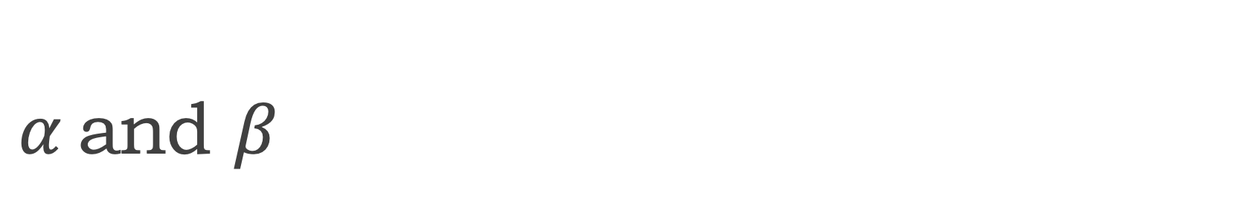
$α$and $β$
α = probability of a Type I error
P(Type I error) = probability of rejecting the null hypothesis when the null hypothesis is true: rejecting a good null.
β = probability of a Type II error
P(Type II error) = probability of not rejecting the null hypothesis when the null hypothesis is false.
(1 − β) is called the Power of the Test.
Note: alpha and beta should be as small as possible since they are the probability of errors.

Slide 18
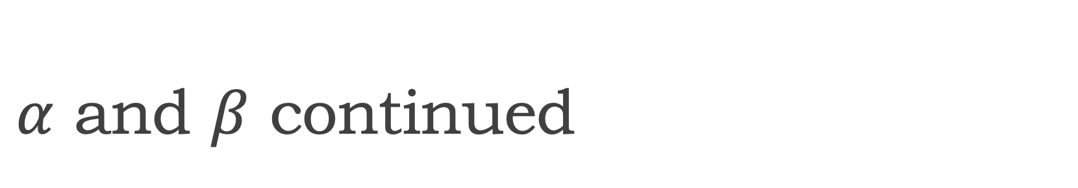
$α$ and $β$ continued
We can only set the alpha error, not the beta error.
We will not reject a null hypothesis unless there is a 90, 95, or even 99% chance that the null is false.
The same logic applies to test of hypotheses for all statistical parameters (mean, standard deviation, proportion, etc.).

Slide 19
Rock Climbing Example Cont.
Suppose the null hypothesis, H₀, is: Navah's rock-climbing equipment is safe.
α = probability that Navah thinks his rock-climbing equipment may not be safe when, in fact, it really is safe.
β = probability that Navah thinks his rock-climbing equipment may be safe when, in fact, it is not safe.

Slide 20
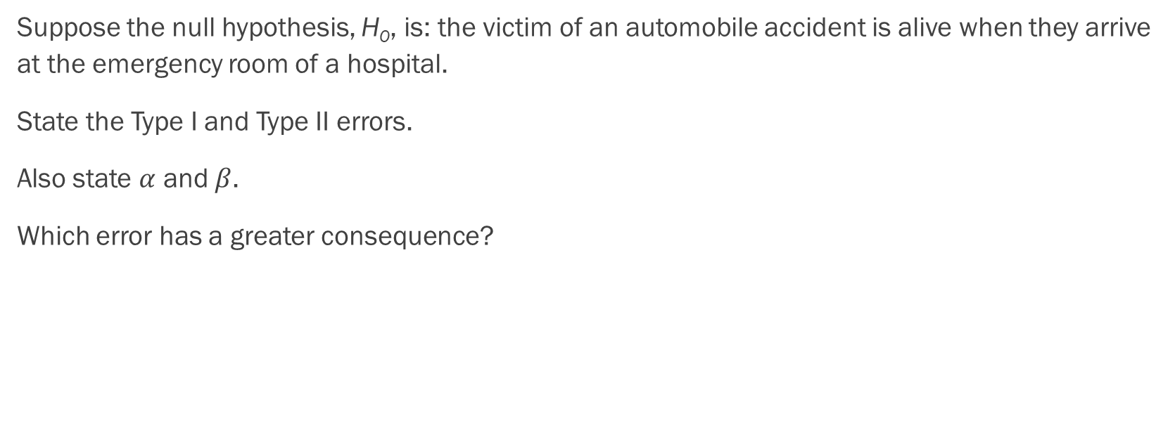
Example
Suppose the null hypothesis, H₀, is: the victim of an automobile accident is alive when they arrive at the emergency room of a hospital.
State the Type I and Type II errors.
Also state $α$ and $β$.
Which error has a greater consequence?

Slide 21
Example - Answers
Suppose the null hypothesis, H₀, is: The victim of an automobile accident is alive when they arrive at the emergency room of a hospital.
Type I error: The emergency crew thinks that the victim is dead when, in fact, the victim is alive. Type II error: The emergency crew does not know if the victim is alive when, in fact, the victim is dead.
α = probability that the emergency crew thinks the victim is dead when, in fact, the victim is really alive = P(Type I error). β = probability that the emergency crew does not know if the victim is alive when, in fact, the victim is dead = P(Type II error).
The error with the greater consequence is the Type I error. (If the emergency crew thinks the victim is dead, they will not treat them.)

Slide 22
Example
A company called Genetic Labs claims to be able to increase the likelihood that a pregnancy will result in a male being born. Statisticians want to test the claim. Suppose that the null hypothesis, H₀, is: Genetic Labs has no effect on sex outcome. Describe the Type I and Type II errors. Which has the greater consequence?

Slide 23
Example - Answers
Type I error: This results when a true null hypothesis is rejected. In the context of this scenario, we would state that we believe that Genetic Labs influences the sex outcome, when in fact it has no effect. The probability of this error occurring is denoted by the Greek letter alpha, α.
Type II error: This results when we fail to reject a false null hypothesis. In context, we would state that Genetic Labs does not influence the sex outcome of a pregnancy when, in fact, it does. The probability of this error occurring is denoted by the Greek letter beta, β.
The error of greater consequence would be the Type I error since people would use the Genetic Labs product in hopes of increasing the chances of having a male.

Slide 24
Example
A sleeping bag is tested to withstand temperatures of –15 °F. You think the bag cannot stand temperatures that low. State the Type I and Type II errors in complete sentences.

Slide 25
Example - Answers
A sleeping bag is tested to withstand temperatures of –15 °F. You think the bag cannot stand temperatures that low. State the Type I and Type II errors in complete sentences.
Type I: The bag can withstand -15 °F, but you conclude that it cannot stand temperatures that low. Type II: The bag cannot withstand -15 °F, but you conclude that it can.

Slide 26
Section 9.3
Probability distribution needed for hypothesis testing

Slide 27
There are 2 Distributions You Can Use for Hypothesis Testing
The Standard Normal Distribution
  Technically you can use the Normal Distribution, but for consistency, it will be better to just always use the Standard Normal Distribution
Student’s t Distribution

Slide 28
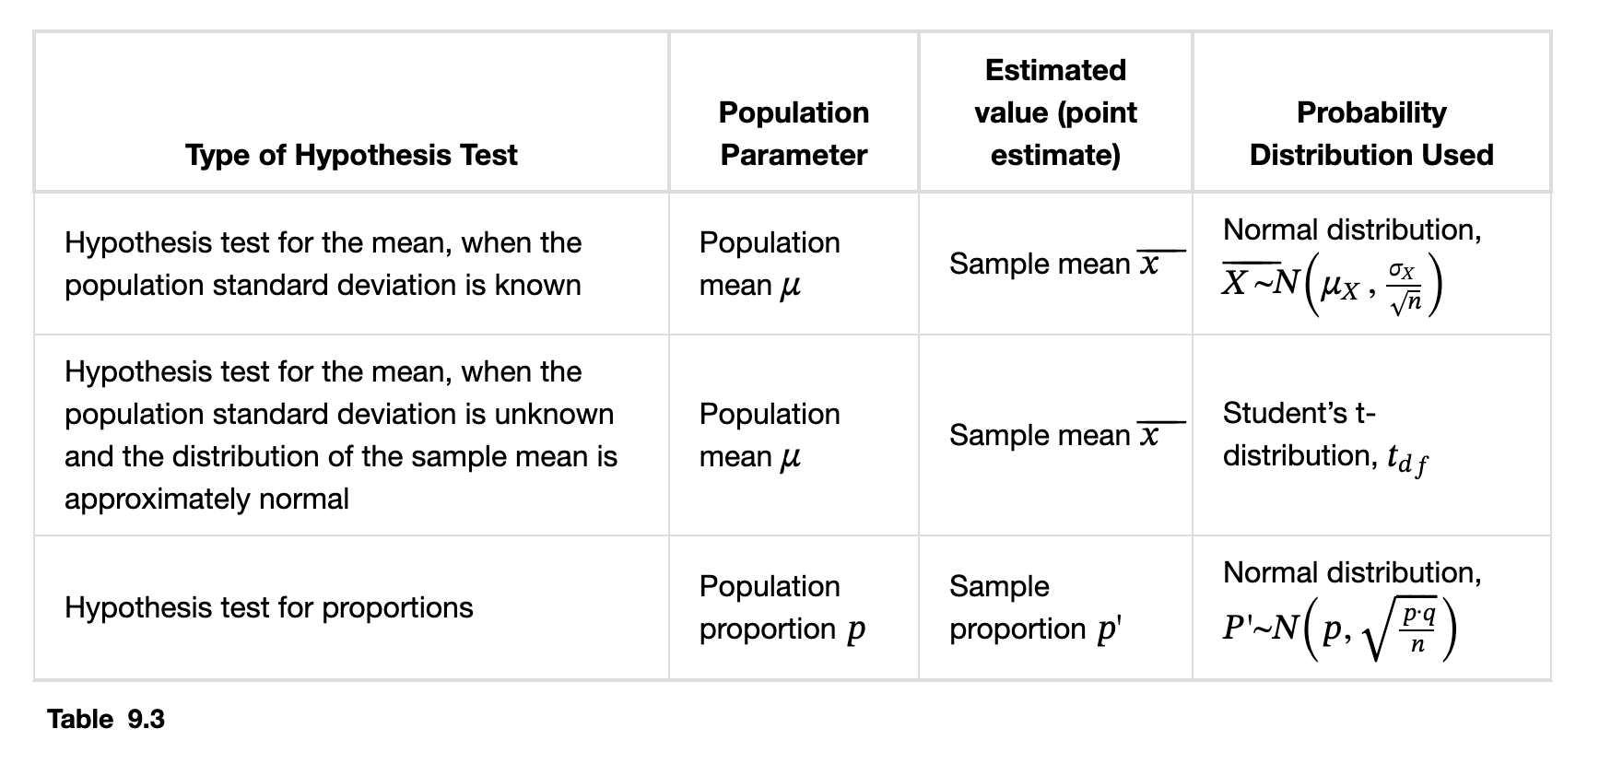
Appropriate Probability Distributions

Slide 29
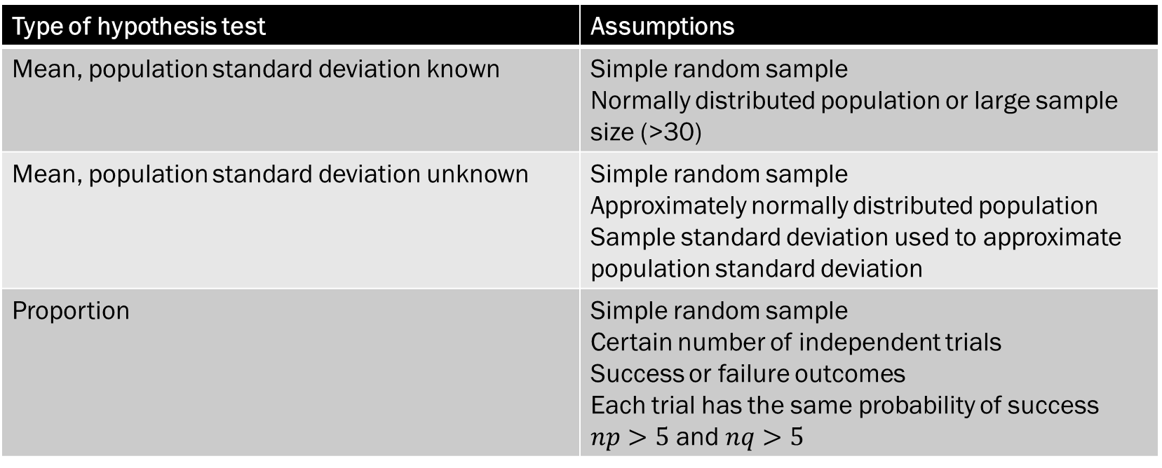
Assumptions
Type of hypothesis test | Assumptions
Mean, population standard deviation known | Simple random sample Normally distributed population or large sample size (>30)
Mean, population standard deviation unknown | Simple random sample Approximately normally distributed population Sample standard deviation used to approximate population standard deviation
Proportion | Simple random sample Certain number of independent trials Success or failure outcomes Each trial has the same probability of success $np>5$ and $nq>5$

Slide 30


Example
Which distribution do you use when you are testing a population mean and the population standard deviation is known? Assume a normal distribution, with n ≥ 30.

Slide 31

Example - Answers
Which distribution do you use when you are testing a population mean and the population standard deviation is known? Assume a normal distribution, with n ≥ 30.
You use the normal distribution because you know the population standard deviation $σ.$

Slide 32
Example
Which distribution do you use when the standard deviation is not known and you are testing one population mean? Assume sample size is large.

Slide 33

Example - Answers
Which distribution do you use when the standard deviation is not known and you are testing one population mean? Assume sample size is large.
Since you don’t know $σ,$ you will use Student’s t.

Slide 34
Example
You are performing a hypothesis test of a single population proportion. What must be true about the quantities of np and nq?

Slide 35
Example - Answers
You are performing a hypothesis test of a single population proportion. What must be true about the quantities of np and nq?
They both must be greater than 5.

Slide 36
Example
A population has a mean of 25 and a standard deviation of five. The sample mean is 24, and the sample size is 108. What distribution should you use to perform a hypothesis test?

Slide 37
Example - Answers
A population has a mean of 25 and a standard deviation of five. The sample mean is 24, and the sample size is 108. What distribution should you use to perform a hypothesis test?
a (standard) normal distribution for a single population mean

Slide 38
Example
It is thought that 42% of respondents in a taste test would prefer Brand A. In a particular test of 100 people, 39% preferred Brand A. What distribution should you use to perform a hypothesis test?

Slide 39
Example - Answers
It is thought that 42% of respondents in a taste test would prefer Brand A. In a particular test of 100 people, 39% preferred Brand A. What distribution should you use to perform a hypothesis test?
a (standard) normal distribution for a single population proportion

Slide 40
Section 9.4
Rare events, the sample, decision, and conclusion

Slide 41
Rare Events
The occurrence of rare events can cause you to doubt any prior hypothesis.
Suppose you make an assumption about a property of the population (this assumption is the null hypothesis). Then you gather sample data randomly. If the sample has properties that would be very unlikely to occur if the assumption is true, then you would conclude that your assumption about the population is probably incorrect.
Hypothesis testing allows us to determine whether our data is a rare event or if we had made a wrong prior conjecture about data.

Slide 42
Rare Event or Wrong Hypothesis?
You read that the average height at a college is 5’7” (this is your null).
Scenario 1: You survey the basketball team of 25 students only and find that the average height in your sample is 6’6”. Is this a rare event or was your initial null hypothesis wrong?
Scenario 2: You perform a simple random sample of 3,000 students and find that the average height of your sample is 5’10”. Is this a rare event or was your initial null hypothesis wrong?
With scenario 1, we could reframe the question. Is the basketball team taller than the average student at this college?
It’s hard to know in either case because we are missing key information – the standard deviation and z-score or t-score!

Slide 43
Rare Event or Wrong Hypothesis?
You are testing the quality of a new smart phone, where it has been designed to withstand being 1.5 meters underwater for 1 hour without damage
You randomly select 50 phones off the assembly line and submerge them 1.5 meters underwater. On average, the phones did not make it past 50 minutes.
Is this a rare event or is the hypothesis wrong?

Slide 44
Example of a Rare Event
The probability of winning the lottery is very low. Suppose Arianna played the lottery just once and won a lot of money. Because Ari assumed the probability of winning the lottery is low, Arianna hopes that her assumption is incorrect and hopes that it is indeed easy to win the lottery.
Ari winning the lottery is a rare event.

Slide 45
There are several ways that you can conduct a hypothesis test.
There are 2 methods frequently used, but we will focus on the p-value method

Slide 46
Testing the Null Hypothesis
Use the sample data to calculate the actual probability of getting the test result, called the p-value.
The p-value is the probability that, if the null hypothesis is true, the results from another randomly selected sample will be as extreme or more extreme as the results obtained from the given sample.
A large p-value calculated from the data indicates that we should not reject the null hypothesis.
The smaller the p-value, the more unlikely the outcome, and the stronger the evidence is against the null hypothesis. We would reject the null hypothesis if the evidence is strongly against it.

Slide 47
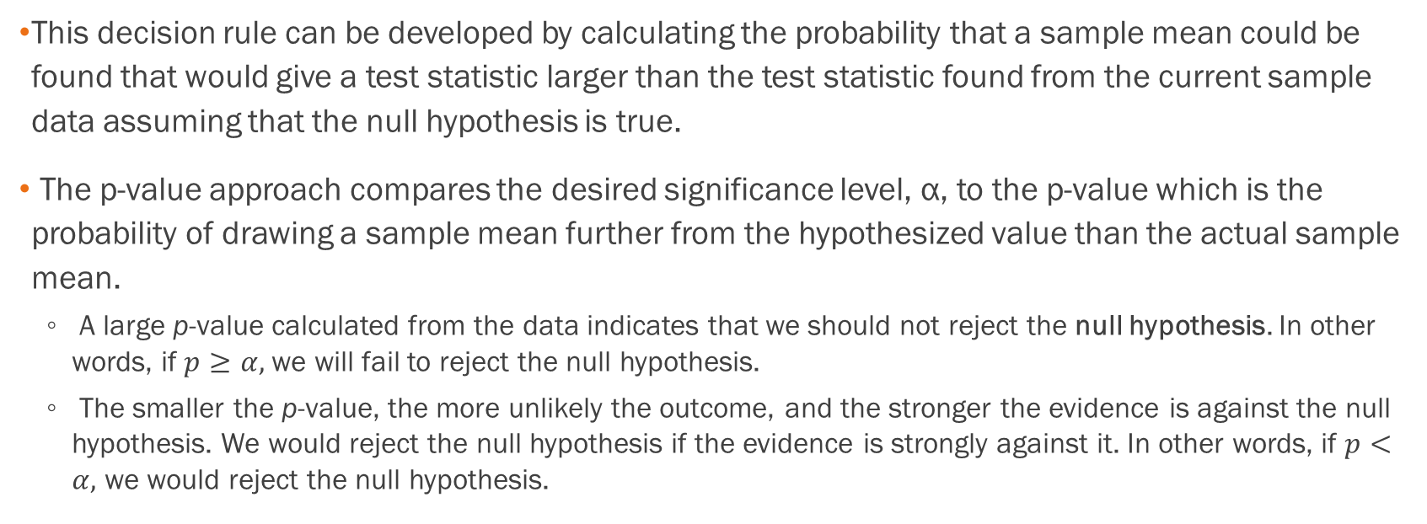
P-Value Approach
This decision rule can be developed by calculating the probability that a sample mean could be found that would give a test statistic larger than the test statistic found from the current sample data assuming that the null hypothesis is true.
The p-value approach compares the desired significance level, α, to the p-value which is the probability of drawing a sample mean further from the hypothesized value than the actual sample mean.
  A large p-value calculated from the data indicates that we should not reject the null hypothesis. In other words, if $p≥α,$we will fail to reject the null hypothesis.
  The smaller the p-value, the more unlikely the outcome, and the stronger the evidence is against the null hypothesis. We would reject the null hypothesis if the evidence is strongly against it. In other words, if $p<α,$ we would reject the null hypothesis.

Slide 48
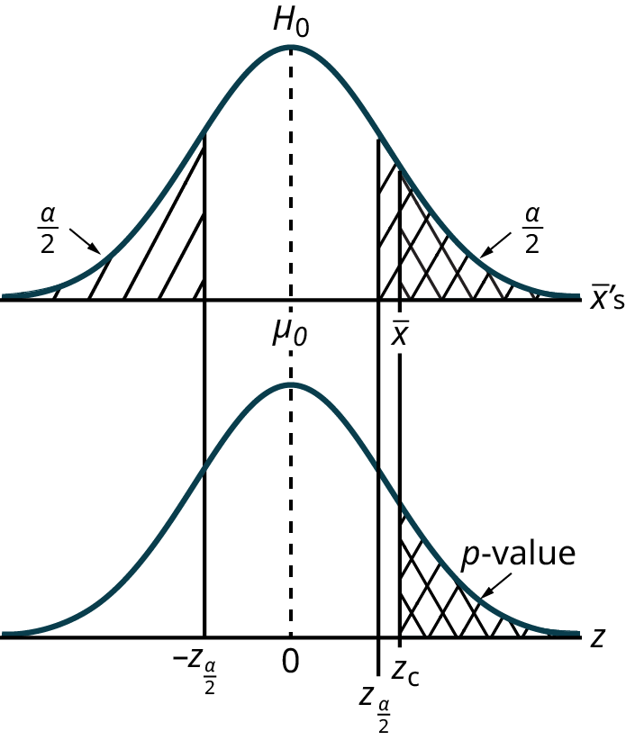
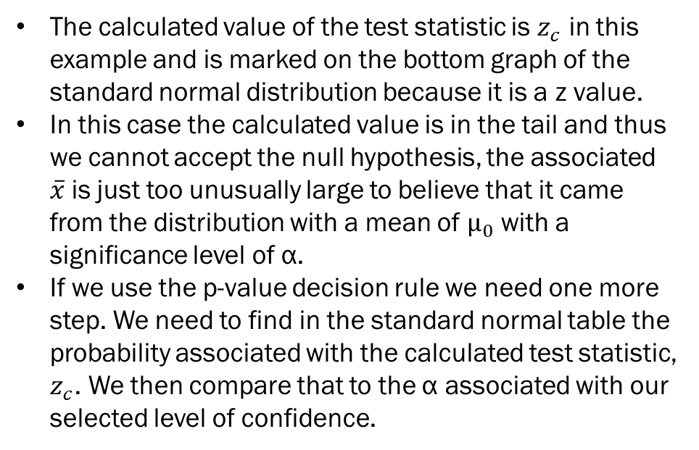
Values the Hypothesis Test with the P-value Approach
The calculated value of the test statistic is $z_{c}$ in this example and is marked on the bottom graph of the standard normal distribution because it is a z value.
In this case the calculated value is in the tail and thus we cannot accept the null hypothesis, the associated $\overline{x}$is just too unusually large to believe that it came from the distribution with a mean of $µ_{0}$ with a significance level of α.
If we use the p-value decision rule we need one more step. We need to find in the standard normal table the probability associated with the calculated test statistic, $z_{c}$. We then compare that to the α associated with our selected level of confidence.

Slide 49
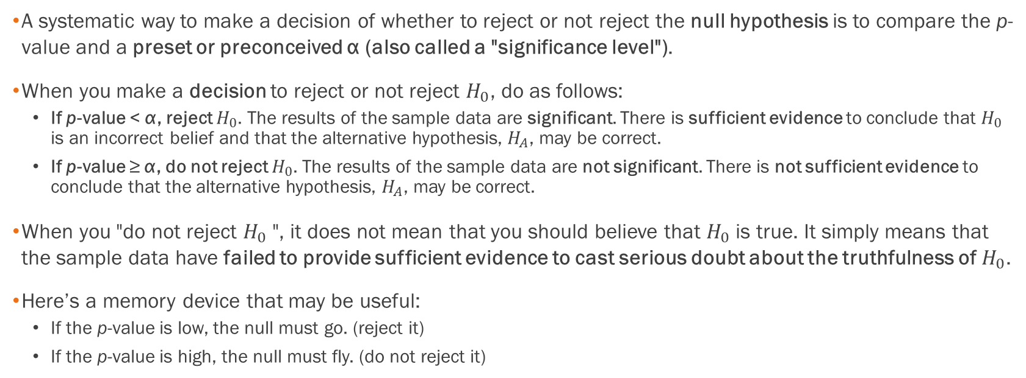
P-Value Decision and Conclusion
A systematic way to make a decision of whether to reject or not reject the null hypothesis is to compare the p-value and a preset or preconceived α (also called a "significance level").
When you make a decision to reject or not reject $H_{0}$, do as follows:
  If p-value < α, reject $H_{0}$. The results of the sample data are significant. There is sufficient evidence to conclude that $H_{0}$ is an incorrect belief and that the alternative hypothesis, $H_{A}$, may be correct.
  If p-value ≥ α, do not reject $H_{0}$. The results of the sample data are not significant. There is not sufficient evidence to conclude that the alternative hypothesis, $H_{A}$, may be correct.
When you "do not reject $H_{0}$", it does not mean that you should believe that $H_{0}$ is true. It simply means that the sample data have failed to provide sufficient evidence to cast serious doubt about the truthfulness of $H_{0}$.
Here’s a memory device that may be useful:
  If the p-value is low, the null must go. (reject it)
  If the p-value is high, the null must fly. (do not reject it)

Slide 50
Example
Suppose a baker claims that his bread height is more than 15 cm, on average. Several of his customers do not believe him. To persuade his customers that he is right, the baker decides to do a hypothesis test. He bakes 10 loaves of bread. The mean height of the sample loaves is 17 cm. The baker knows from baking hundreds of loaves of bread that the standard deviation for the height is 0.5 cm. and the distribution of heights is normal.
The null hypothesis could be H₀: μ ≤ 15 The alternate hypothesis is H_{a}: μ > 15
The words "is more than" translates as a ">" so "μ > 15" goes into the alternate hypothesis. The null hypothesis must contradict the alternate hypothesis.

Slide 51
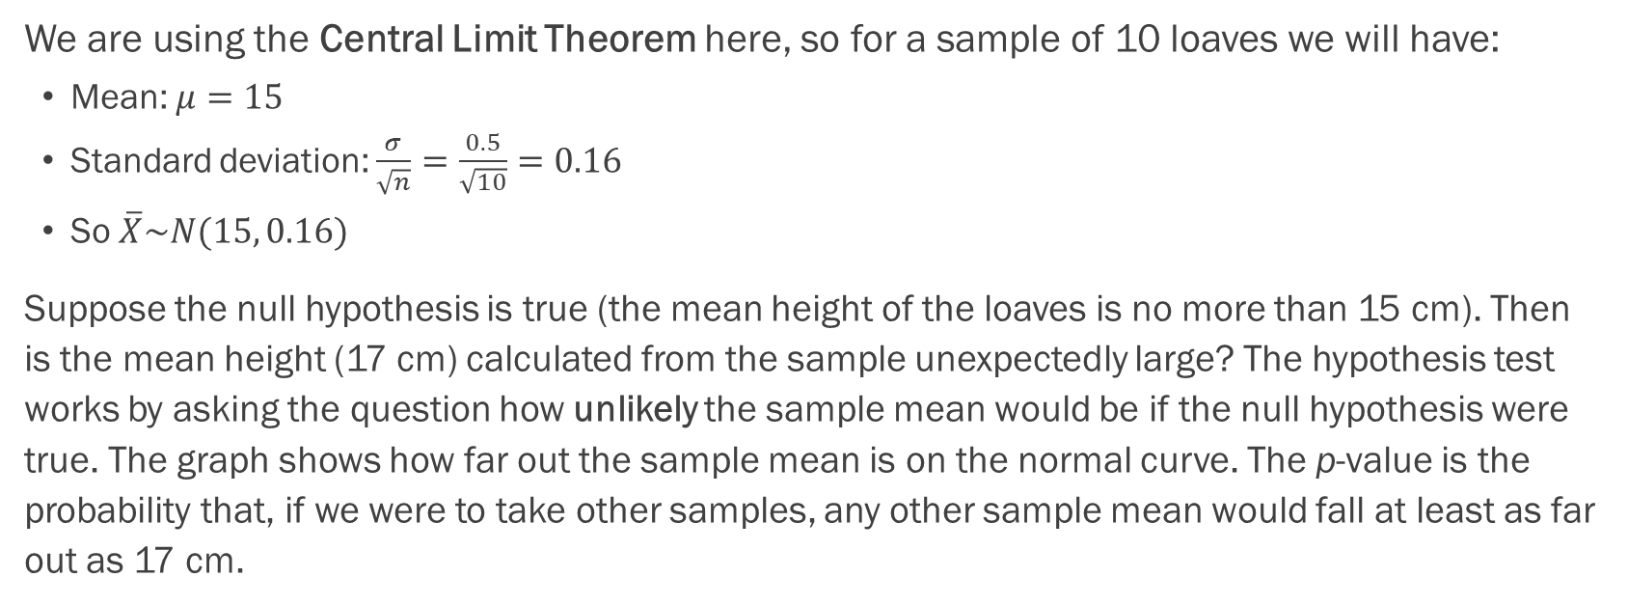
Example, Cont.
We are using the Central Limit Theorem here, so for a sample of 10 loaves we will have:
  Mean: $μ=15$
  Standard deviation: $\frac{σ}{\sqrt{n}}=\frac{0.5}{\sqrt{10}}=0.16$
  So $\overline{X}\sim N(15, 0.16)$
Suppose the null hypothesis is true (the mean height of the loaves is no more than 15 cm). Then is the mean height (17 cm) calculated from the sample unexpectedly large? The hypothesis test works by asking the question how unlikely the sample mean would be if the null hypothesis were true. The graph shows how far out the sample mean is on the normal curve. The p-value is the probability that, if we were to take other samples, any other sample mean would fall at least as far out as 17 cm.

Slide 52
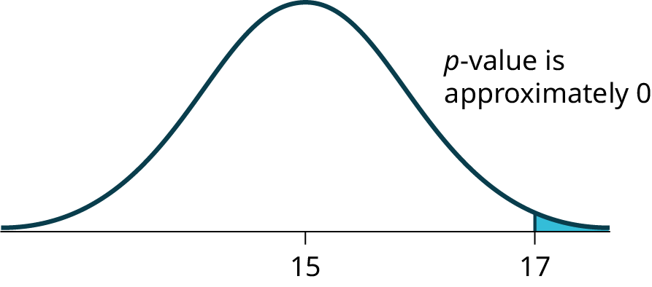
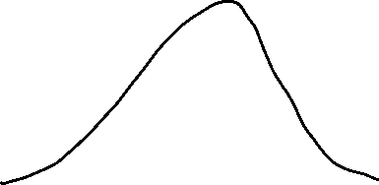

Example, Cont.
The p-value, then, is the probability that a sample mean is the same or greater than 17 cm. when the population mean is, in fact, 15 cm. We can calculate this probability using the normal distribution for means.

Slide 53
Example, Cont.
A p-value of approximately zero tells us that it is highly unlikely that a loaf of bread rises no more than 15 cm, on average. That is, almost 0% of all loaves of bread would be at least as high as 17 cm. purely by CHANCE had the population mean height really been 15 cm. Because the outcome of 17 cm. is so unlikely (meaning it is happening NOT by chance alone), we conclude that the evidence is strongly against the null hypothesis (the mean height is at most 15 cm.). There is sufficient evidence that the true mean height for the population of the baker's loaves of bread is greater than 15 cm.
Refer to the Excel workbook for how to calculate this situation with Excel.

Slide 54
Section 9.5
Additional information and full hypothesis test examples

Slide 55
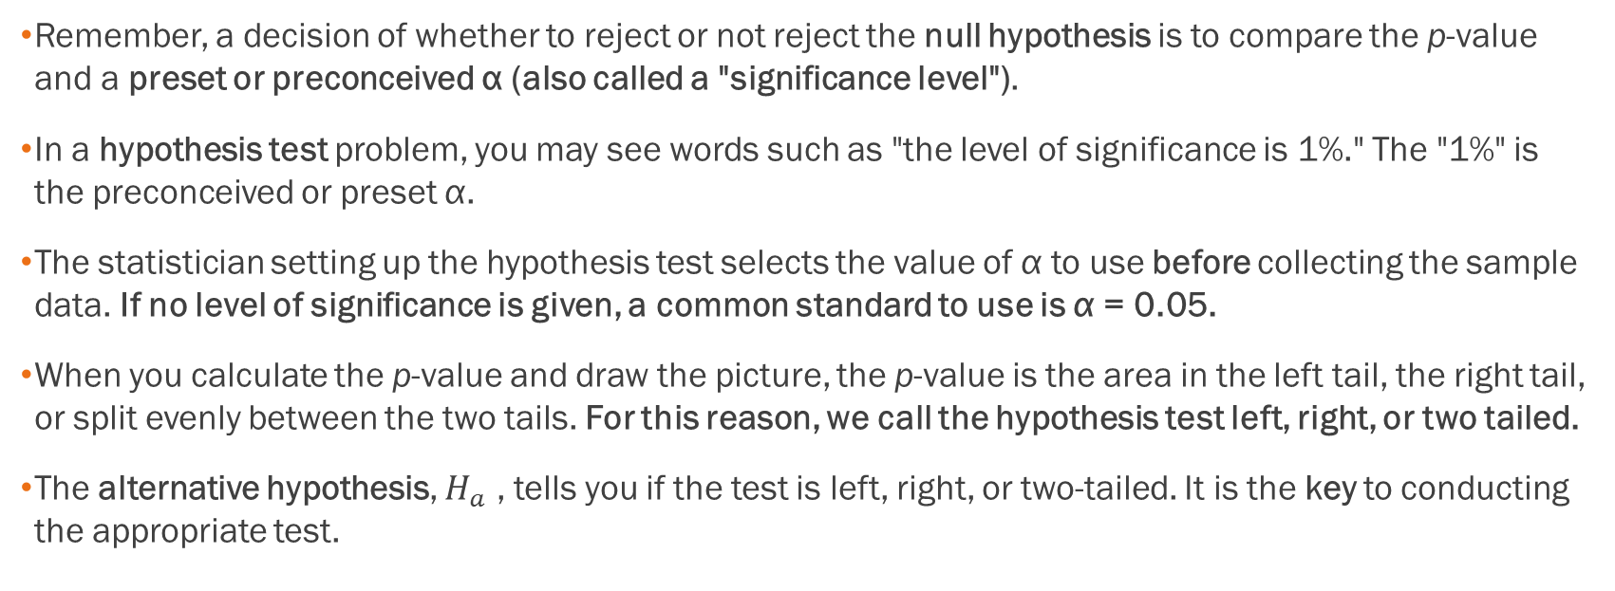
General Notes
Remember, a decision of whether to reject or not reject the null hypothesis is to compare the p-value and a preset or preconceived α (also called a "significance level").
In a hypothesis test problem, you may see words such as "the level of significance is 1%." The "1%" is the preconceived or preset α.
The statistician setting up the hypothesis test selects the value of α to use before collecting the sample data. If no level of significance is given, a common standard to use is α = 0.05.
When you calculate the p-value and draw the picture, the p-value is the area in the left tail, the right tail, or split evenly between the two tails. For this reason, we call the hypothesis test left, right, or two tailed.
The alternative hypothesis, $H_{a}$ , tells you if the test is left, right, or two-tailed. It is the key to conducting the appropriate test.

Slide 56
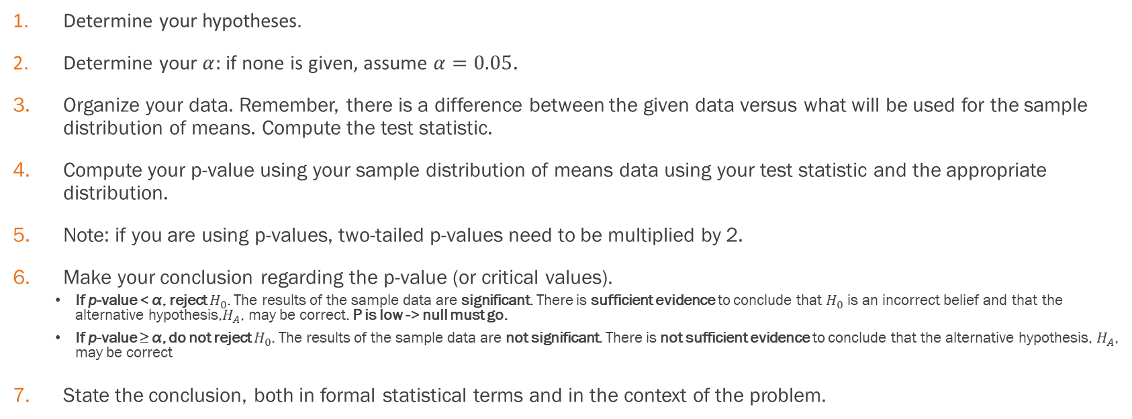
The Basic Setup
Determine your hypotheses.
Determine your $α:$ if none is given, assume $α=0.05$.
Organize your data. Remember, there is a difference between the given data versus what will be used for the sample distribution of means. Compute the test statistic.
Compute your p-value using your sample distribution of means data using your test statistic and the appropriate distribution.
Note: if you are using p-values, two-tailed p-values need to be multiplied by 2.
Make your conclusion regarding the p-value (or critical values).
    If p-value < α, reject $H_{0}$. The results of the sample data are significant. There is sufficient evidence to conclude that $H_{0}$ is an incorrect belief and that the alternative hypothesis,$H_{A}$, may be correct. P is low -> null must go.
    If p-value ≥ α, do not reject $H_{0}$. The results of the sample data are not significant. There is not sufficient evidence to conclude that the alternative hypothesis, $H_{A}$, may be correct
State the conclusion, both in formal statistical terms and in the context of the problem.

Slide 57
How to Organize Your Answer
State the hypotheses in symbols
In words, CLEARLY state what your random variable represents with a sentence.
State the distribution to use for the test.
What is the test statistic?
What is the p-value? In one or two complete sentences, explain what the p-value means for this problem.
Use the previous information to sketch a picture of this situation. CLEARLY, label and scale the horizontal axis and shade the region(s) corresponding to the p-value.
Indicate the correct decision (“reject” or “do not reject” the null hypothesis), the reason for it, and write an appropriate conclusion, using complete sentences.
  Alpha: _______
  Decision: _______
  Reason for decision: _______
  Conclusion: _______

Slide 58
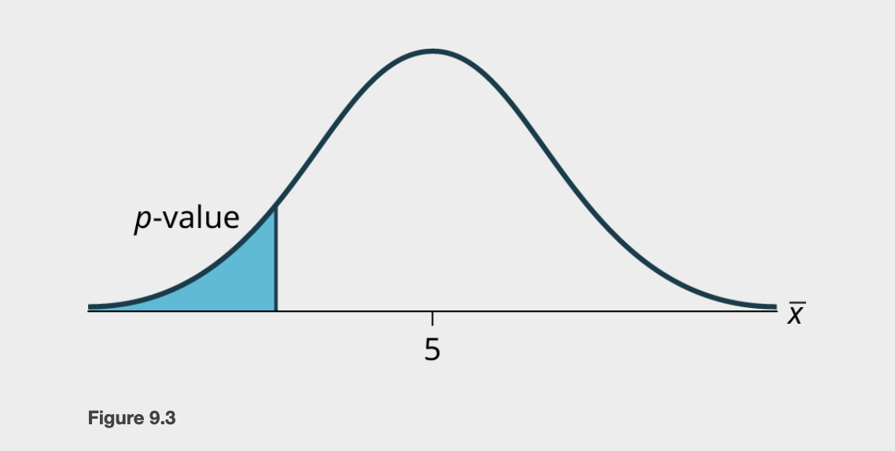
Example
H_{o}: μ = 5, H_{a}: μ < 5
Test of a single population mean. H_{a} tells you the test is left-tailed. The picture of the p-value is as follows:

Slide 59
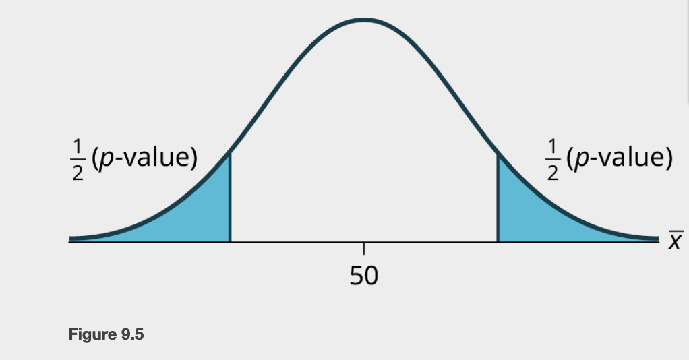
Example
H₀: p = 50 H_{a}: p ≠ 50
This is a test of a single population mean. H_{a} tells you the test is two-tailed. The picture of the p-value is as follows. In this case, we need to multiply the p-value by 2 to represent the area in the end of both tails.

Slide 60
Example – With P-values
Jeffrey, as an eight-year old, established a mean time of 16.43 seconds for swimming the 25-yard freestyle, with a standard deviation of 0.8 seconds. His dad, Frank, thought that Jeffrey could swim the 25-yard freestyle faster using goggles. Frank bought Jeffrey a new pair of expensive goggles and timed Jeffrey for 15 25-yard freestyle swims. For the 15 swims, Jeffrey's mean time was 16 seconds. Frank thought that the goggles helped Jeffrey to swim faster than the 16.43 seconds. Conduct a hypothesis test using a preset α = 0.05. Assume that the swim times for the 25-yard freestyle are normal.
See the Excel workbook.

Slide 61
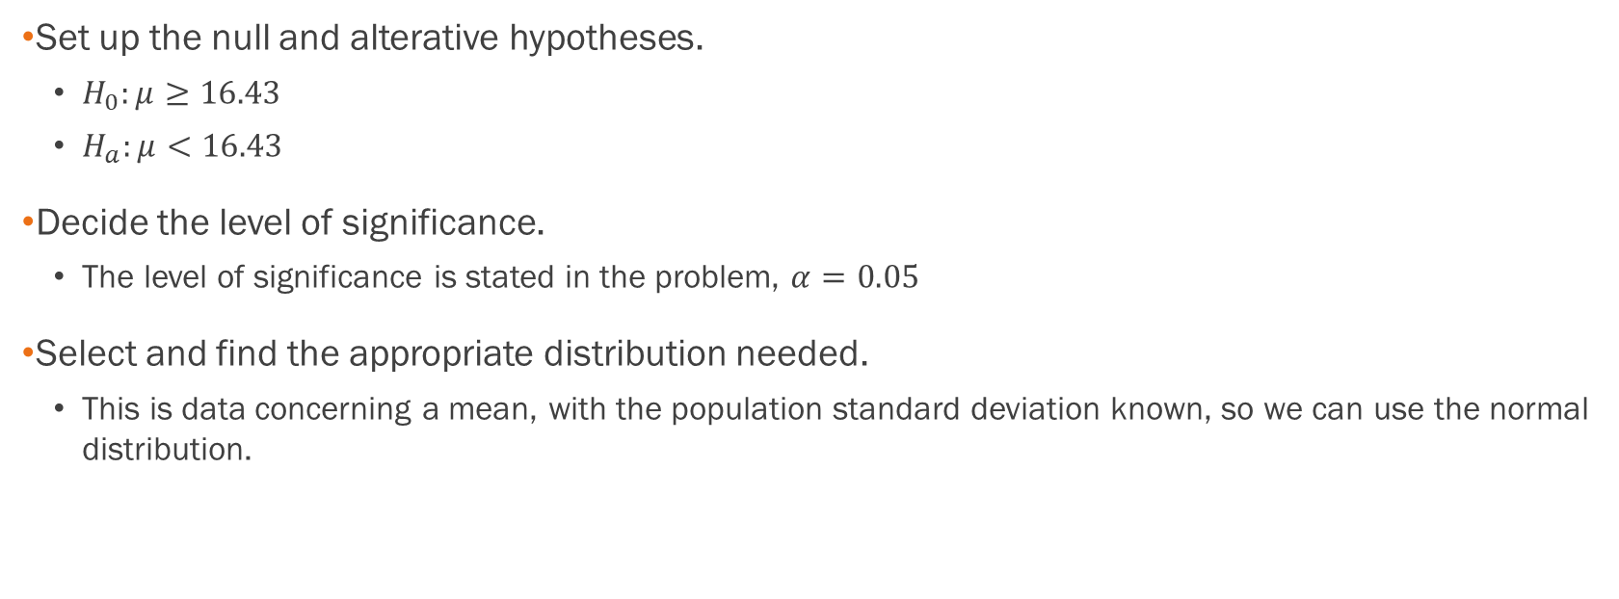
Example - Answers
Set up the null and alterative hypotheses.
  $H_{0}:μ≥16.43$
  $H_{a}:μ<16.43$
Decide the level of significance.
  The level of significance is stated in the problem, $α=0.05$
Select and find the appropriate distribution needed.
  This is data concerning a mean, with the population standard deviation known, so we can use the normal distribution.

Slide 62
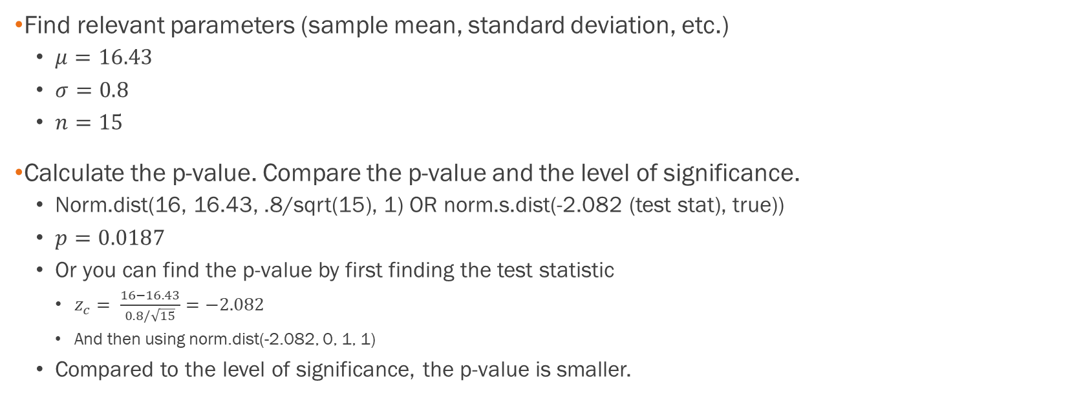
Example - Answers
Find relevant parameters (sample mean, standard deviation, etc.)
  $μ=16.43$
  $σ=0.8$
  $n=15$
Calculate the p-value. Compare the p-value and the level of significance.
  Norm.dist(16, 16.43, .8/sqrt(15), 1) OR norm.s.dist(-2.082 (test stat), true))
  $p=0.0187$
  Or you can find the p-value by first finding the test statistic
    $z_{c}= \frac{16−16.43}{0.8/\sqrt{15}}=−2.082$
    And then using norm.dist(-2.082, 0, 1, 1)
  Compared to the level of significance, the p-value is smaller.

Slide 63

Example - Answers
State the conclusion, both in formal statistical terms and in the context of the problem.
  Reject $H_{0}.$
  There is sufficient evidence that Jeffrey’s mean swim time is less than 16.43 seconds. Based on the sample data, we conclude that Jeffrey does indeed swim faster with the goggles.

Slide 64
Example – Note on Language
Jeffrey, as an eight-year old, established a mean time of 16.43 seconds for swimming the 25-yard freestyle, with a standard deviation of 0.8 seconds. His dad, Frank, thought that Jeffrey could swim the 25-yard freestyle faster using goggles. Frank bought Jeffrey a new pair of expensive goggles and timed Jeffrey for 15 25-yard freestyle swims. For the 15 swims, Jeffrey's mean time was 16 seconds. Frank thought that the goggles helped Jeffrey to swim faster than the 16.43 seconds. Conduct a hypothesis test using a preset α = 0.05. Assume that the swim times for the 25-yard freestyle are normal.
Note: the phrase “established” is what means we can assume that we are dealing with the normal distribution instead of Student’s T. Note in the next example how the language differs.

Slide 65
Example
A college football coach records the mean weight that the players can bench press as 275 pounds, with a standard deviation of 55 pounds. Three of the players thought that the mean weight was more than that amount. They asked 30 of their teammates for their estimated maximum lift on the bench press exercise. The data ranged from 205 pounds to 385 pounds. The actual different weights were (frequencies are in parentheses) 205(3); 215(3); 225(1); 241(2); 252(2); 265(2); 275(2); 313(2); 316(5); 338(2); 341(1); 345(2); 368(2); 385(1).
Conduct a hypothesis test using a 2.5% level of significance to determine if the bench press mean is more than 275 pounds. Use P-values.

Slide 66

Example - Answers
Set up the Hypothesis Test:
Since the problem is about a mean weight, this is a test of a single population mean.
$H_{0}$: μ = 275
$H_{a}$: μ > 275
This is a right-tailed test.

Slide 67
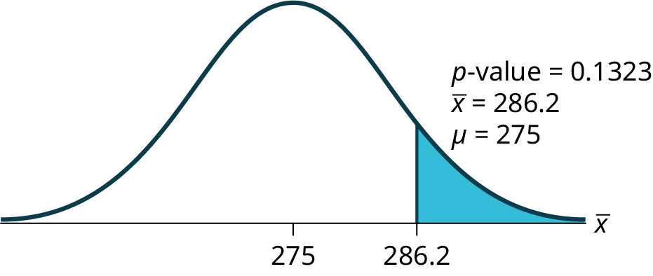
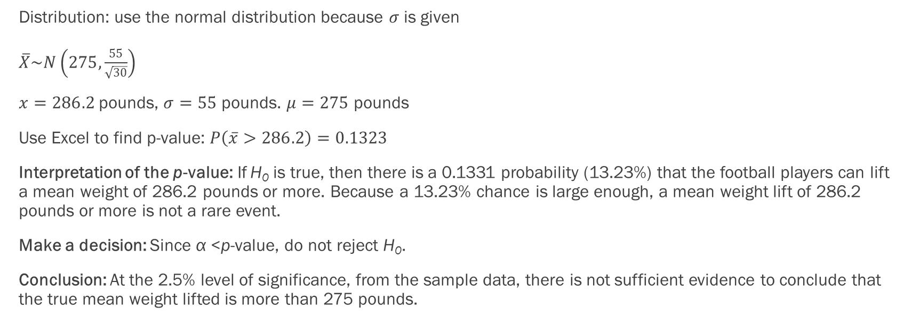
Example - Answers
Distribution: use the normal distribution because $σ$ is given
$\overline{X}\sim N\left(275,\frac{55}{\sqrt{30}}\right)$
$x=286.2$pounds, $σ=55$ pounds. $μ=275$ pounds
Use Excel to find p-value: $P\left(\overline{x}>286.2\right)=0.1323$
Interpretation of the p-value: If H₀ is true, then there is a 0.1331 probability (13.23%) that the football players can lift a mean weight of 286.2 pounds or more. Because a 13.23% chance is large enough, a mean weight lift of 286.2 pounds or more is not a rare event.
Make a decision: Since α <p-value, do not reject H₀.
Conclusion: At the 2.5% level of significance, from the sample data, there is not sufficient evidence to conclude that the true mean weight lifted is more than 275 pounds.

Slide 68
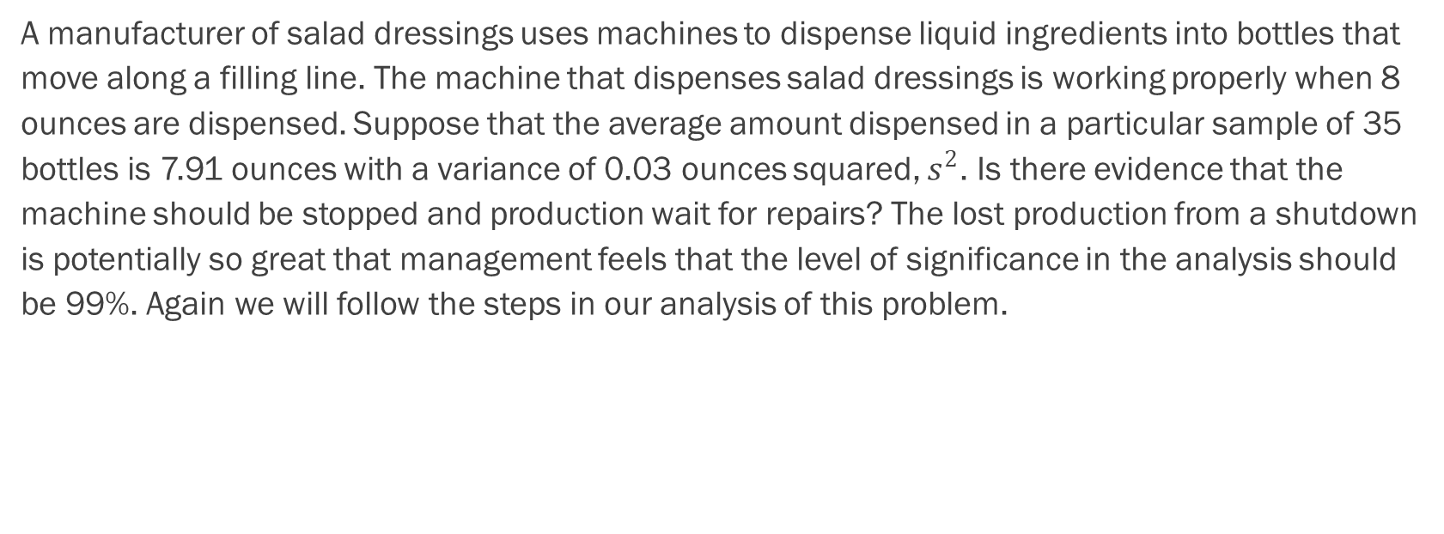
Example
A manufacturer of salad dressings uses machines to dispense liquid ingredients into bottles that move along a filling line. The machine that dispenses salad dressings is working properly when 8 ounces are dispensed. Suppose that the average amount dispensed in a particular sample of 35 bottles is 7.91 ounces with a variance of 0.03 ounces squared, $s^{2}$. Is there evidence that the machine should be stopped and production wait for repairs? The lost production from a shutdown is potentially so great that management feels that the level of significance in the analysis should be 99%. Again we will follow the steps in our analysis of this problem.

Slide 69
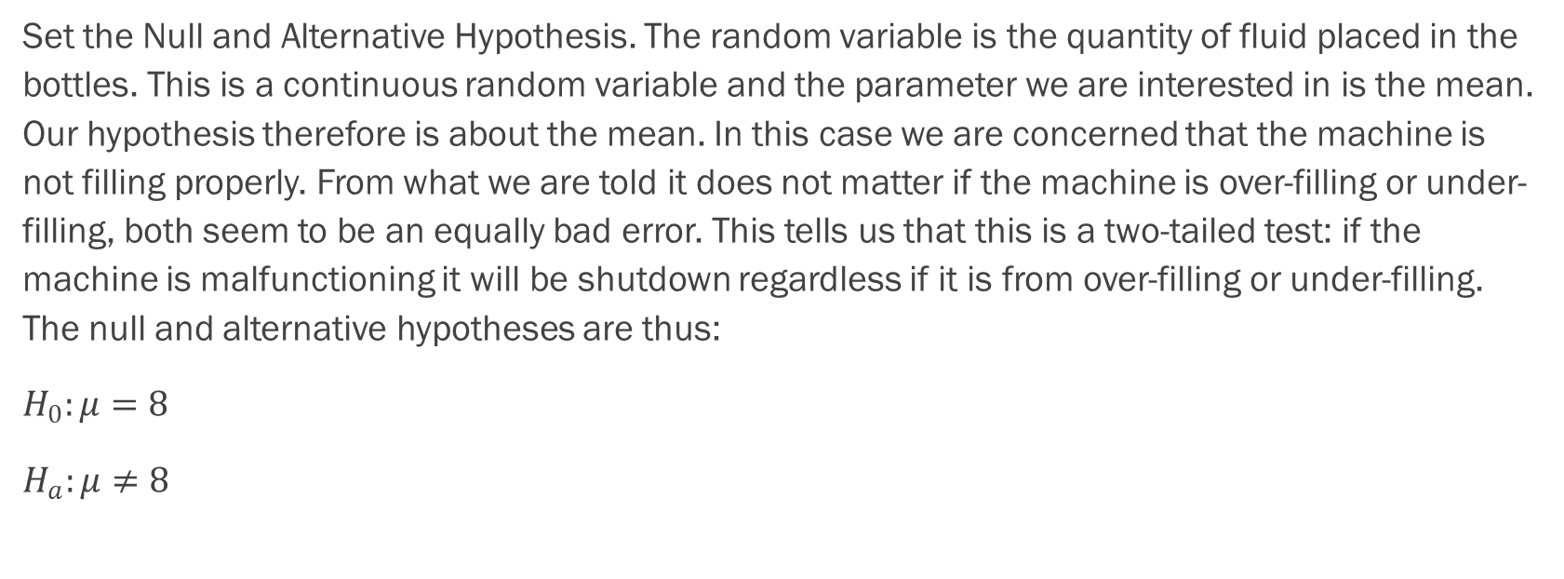
Example - Answers
Set the Null and Alternative Hypothesis. The random variable is the quantity of fluid placed in the bottles. This is a continuous random variable and the parameter we are interested in is the mean. Our hypothesis therefore is about the mean. In this case we are concerned that the machine is not filling properly. From what we are told it does not matter if the machine is over-filling or under-filling, both seem to be an equally bad error. This tells us that this is a two-tailed test: if the machine is malfunctioning it will be shutdown regardless if it is from over-filling or under-filling. The null and alternative hypotheses are thus:
$H_{0}:μ=8$
$H_{a}:μ≠8$

Slide 70
Example - Answers
Test Statistic: -3.074
For P-value, we have that 0.004 < 0.01.
In either case, we will reject the null hypothesis. At a 99% level of significance we cannot accept the hypothesis that the sample mean came from a distribution with a mean of 8 ounces” Or less formally, and getting to the point, “At a 99% level of significance we conclude that the machine is under filling the bottles and is in need of repair”.

Slide 71
Example
Statistics students believe that the mean score on the first statistics test is 65. A statistics instructor thinks the mean score is higher than 65. He samples ten statistics students and obtains the scores 65; 65; 70; 67; 66; 63; 63; 68; 72; 71. He performs a hypothesis test using a 5% level of significance. The data are assumed to be from a normal distribution.

Slide 72
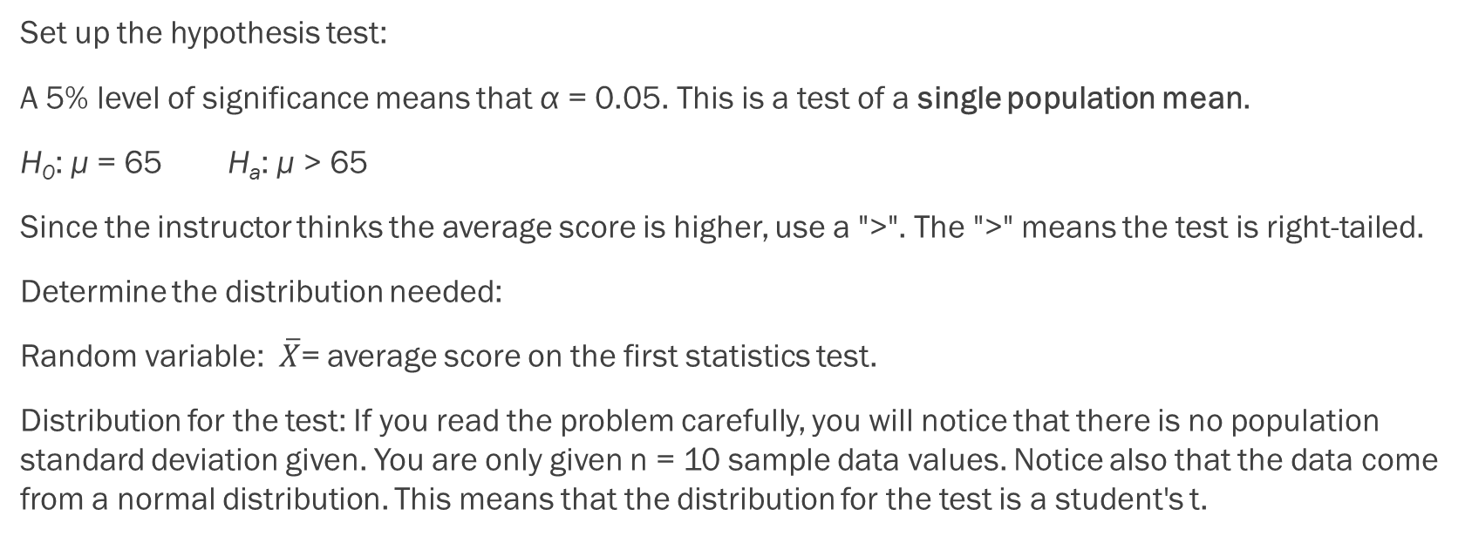
Example - Answers
Set up the hypothesis test:
A 5% level of significance means that α = 0.05. This is a test of a single population mean.
H₀: μ = 65 H_{a}: μ > 65
Since the instructor thinks the average score is higher, use a ">". The ">" means the test is right-tailed.
Determine the distribution needed:
Random variable: $\overline{X}$= average score on the first statistics test.
Distribution for the test: If you read the problem carefully, you will notice that there is no population standard deviation given. You are only given n = 10 sample data values. Notice also that the data come from a normal distribution. This means that the distribution for the test is a student's t.

Slide 73
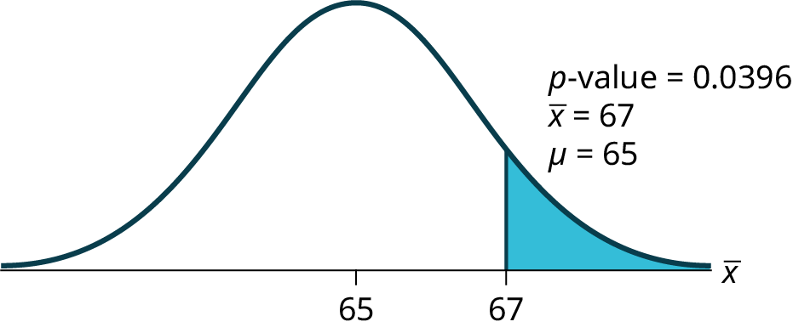
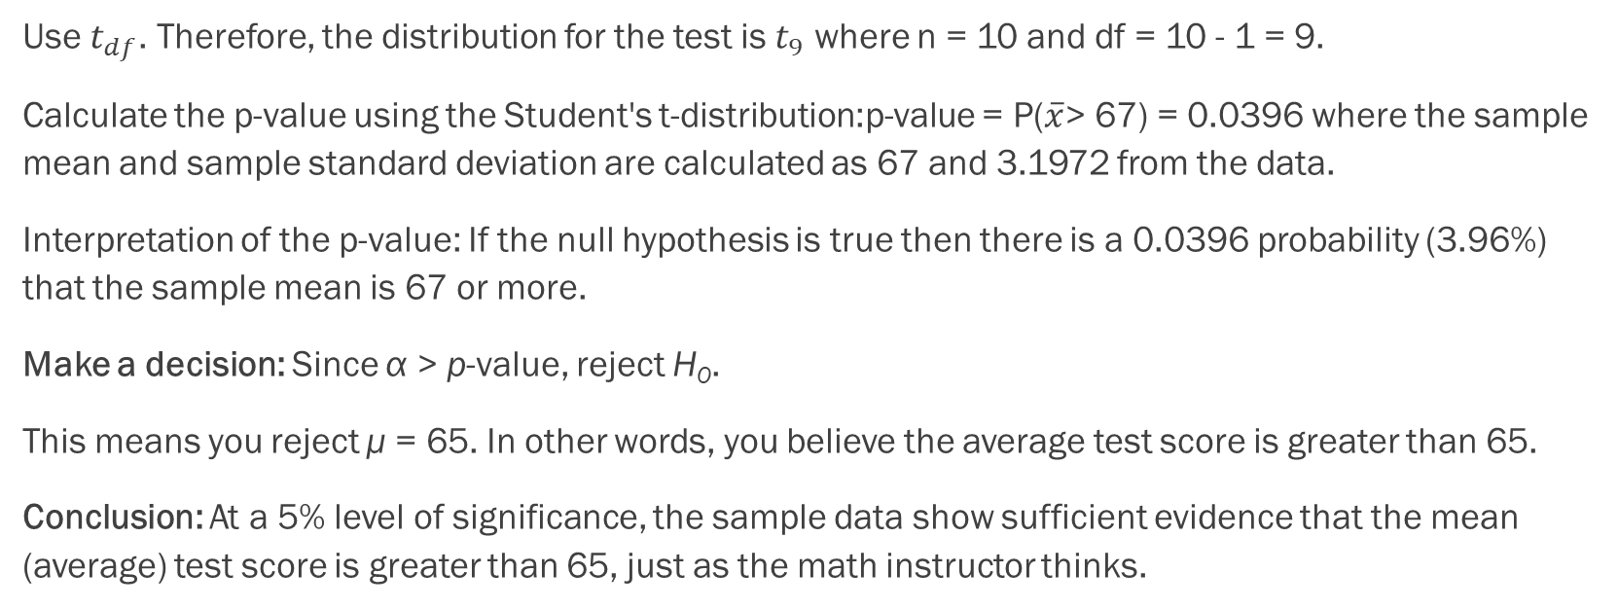
Example - Answers
Use $t_{df}$. Therefore, the distribution for the test is $t_{9}$ where n = 10 and df = 10 - 1 = 9.
Calculate the p-value using the Student's t-distribution:p-value = P($\overline{x}$> 67) = 0.0396 where the sample mean and sample standard deviation are calculated as 67 and 3.1972 from the data.
Interpretation of the p-value: If the null hypothesis is true then there is a 0.0396 probability (3.96%) that the sample mean is 67 or more.
Make a decision: Since α > p-value, reject H₀.
This means you reject μ = 65. In other words, you believe the average test score is greater than 65.
Conclusion: At a 5% level of significance, the sample data show sufficient evidence that the mean (average) test score is greater than 65, just as the math instructor thinks.

Slide 74
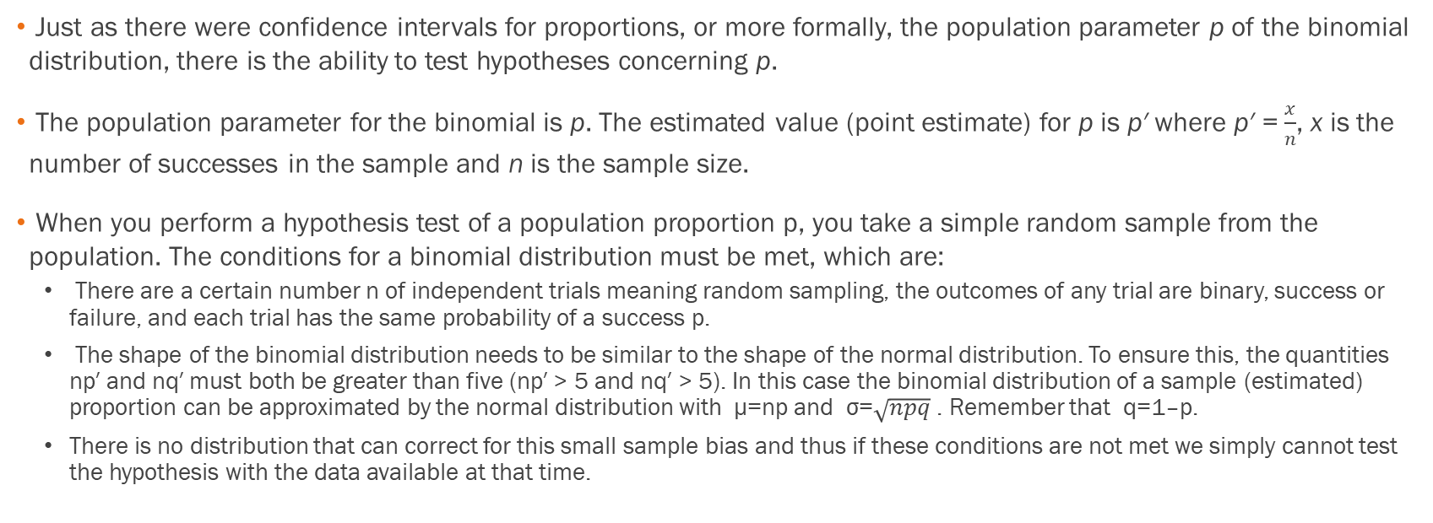
Hypothesis Test for Proportions
Just as there were confidence intervals for proportions, or more formally, the population parameter p of the binomial distribution, there is the ability to test hypotheses concerning p.
The population parameter for the binomial is p. The estimated value (point estimate) for p is p′ where p′ = $\frac{x}{n}$, x is the number of successes in the sample and n is the sample size.
When you perform a hypothesis test of a population proportion p, you take a simple random sample from the population. The conditions for a binomial distribution must be met, which are:
  There are a certain number n of independent trials meaning random sampling, the outcomes of any trial are binary, success or failure, and each trial has the same probability of a success p.
  The shape of the binomial distribution needs to be similar to the shape of the normal distribution. To ensure this, the quantities np′ and nq′ must both be greater than five (np′ > 5 and nq′ > 5). In this case the binomial distribution of a sample (estimated) proportion can be approximated by the normal distribution with μ=np and σ=$\sqrt{npq}$ . Remember that q=1–p.
  There is no distribution that can correct for this small sample bias and thus if these conditions are not met we simply cannot test the hypothesis with the data available at that time.

Slide 75

Test Statistic with Proportions
The test statistic is:
$$z_{c}=\frac{p^{′}−p}{\sqrt{\frac{pq}{n}}}$$

Slide 76
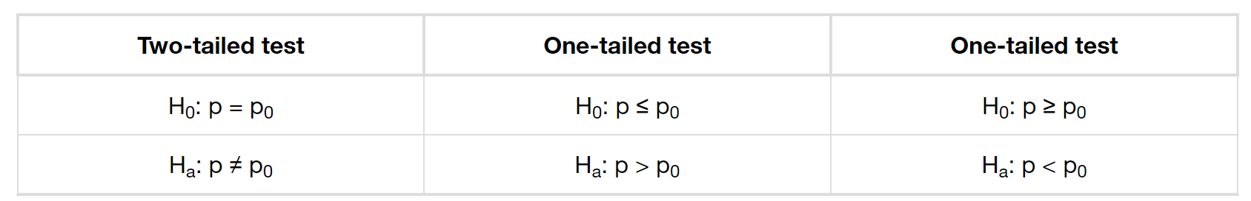
Forms of the Hypothesis Tests
This is the test statistic for testing hypothesized values of p, where the null and alternative hypotheses take one of the following forms:
The decision rule stated above applies here also: if the calculated value of Z_{c} shows that the sample proportion is "too many" standard deviations from the hypothesized proportion, the null hypothesis cannot be accepted. The decision as to what is "too many" is pre-determined by the analyst depending on the level of significance required in the test.

Slide 77
Example
  Joon believes that 50% of first-time brides in the United States are younger than their grooms. She performs a hypothesis test to determine if the percentage is the same or different from 50%. Joon samples 100 first-time brides and 53 reply that they are younger than their grooms. For the hypothesis test, she uses a 1% level of significance.

Slide 78
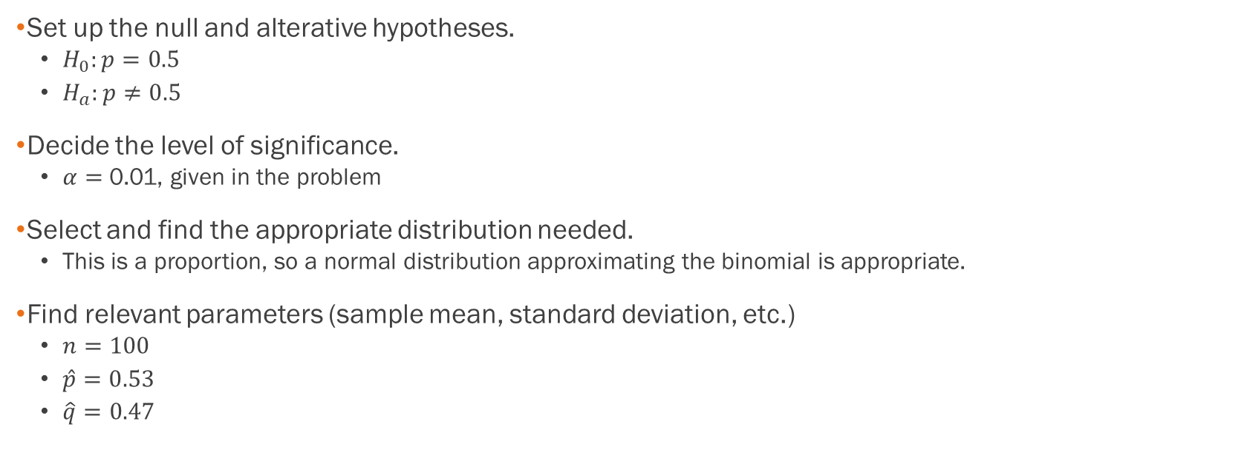
Example - Answers
Set up the null and alterative hypotheses.
  $H_{0}:p=0.5$
  $H_{a}:p≠0.5$
Decide the level of significance.
  $α=$0.01, given in the problem
Select and find the appropriate distribution needed.
  This is a proportion, so a normal distribution approximating the binomial is appropriate.
Find relevant parameters (sample mean, standard deviation, etc.)
  $n=100$
  $\hat{p}=0.53$
  $\hat{q}=0.47$

Slide 79
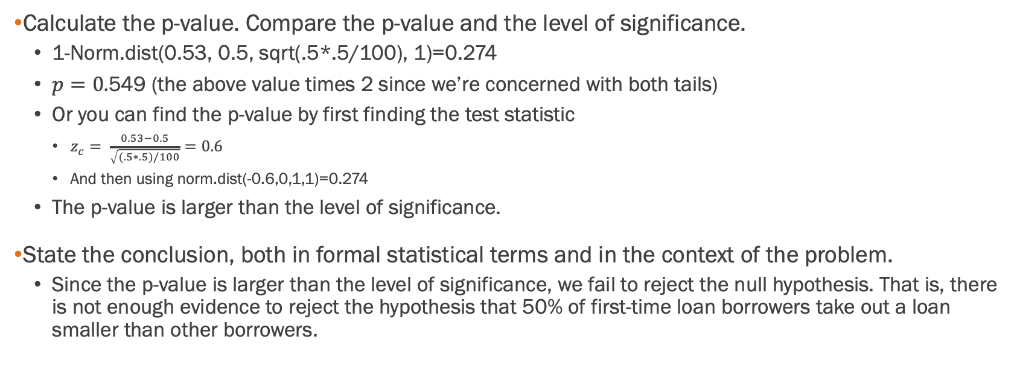
Example - Answers
Calculate the p-value. Compare the p-value and the level of significance.
  1-Norm.dist(0.53, 0.5, sqrt(.5*.5/100), 1)=0.274
  $p=0.$549 (the above value times 2 since we’re concerned with both tails)
  Or you can find the p-value by first finding the test statistic
    $z_{c}= \frac{0.53−0.5}{\sqrt{(.5∗.5)/100}}=0.6$
    And then using norm.dist(-0.6,0,1,1)=0.274
  The p-value is larger than the level of significance.
State the conclusion, both in formal statistical terms and in the context of the problem.
  Since the p-value is larger than the level of significance, we fail to reject the null hypothesis. That is, there is not enough evidence to reject the hypothesis that 50% of first-time loan borrowers take out a loan smaller than other borrowers.

Slide 80
Example
Statistical data indicates that in a certain country there are approximately 268,608,618 residents aged 12 and older. For a certain period of time, statistical data also indicates that the percentage of residents with blood type AB negative (AB-) is 207,754 individuals. This translates into a percentage of 0.078% with this rather rare blood type. In a certain province of the country, there were 11 people with blood type AB- out of the population of 37,937. Conduct an appropriate hypothesis test to determine if there is a statistically significant difference between the percentage of residents in the entire country with blood type AB- versus the percentage in the local province. Use a significance level of 0.01.

Slide 81
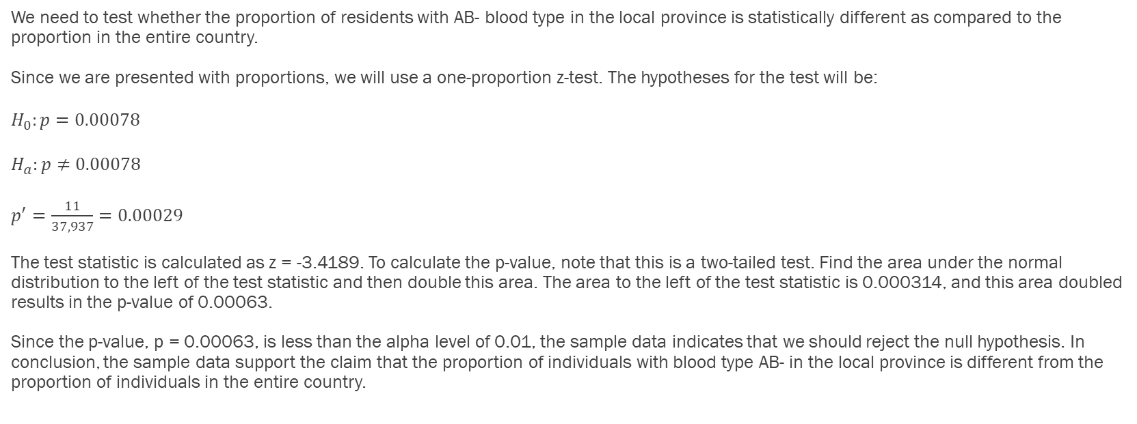
Example - Answers
We need to test whether the proportion of residents with AB- blood type in the local province is statistically different as compared to the proportion in the entire country.
Since we are presented with proportions, we will use a one-proportion z-test. The hypotheses for the test will be:
$H_{0}:p=0.00078$
$H_{a}:p≠0.00078$
$p^{′}=\frac{11}{37,937}=0.00029$
The test statistic is calculated as z = -3.4189. To calculate the p-value, note that this is a two-tailed test. Find the area under the normal distribution to the left of the test statistic and then double this area. The area to the left of the test statistic is 0.000314, and this area doubled results in the p-value of 0.00063.
Since the p-value, p = 0.00063, is less than the alpha level of 0.01, the sample data indicates that we should reject the null hypothesis. In conclusion, the sample data support the claim that the proportion of individuals with blood type AB- in the local province is different from the proportion of individuals in the entire country.

