Slide 1

Chapter 10 Hypothesis Testing with Two Samples
Openstax statistics
Access for free at https://openstax.org/books/introductory-statistics-2e/pages/1-introduction

Slide 2
Objectives
By the end of this chapter, the student should be able to:
Choose the appropriate probability distribution needed for a hypothesis test
Complete a hypothesis test for two samples, using critical value or p-value approach

Slide 3
Section 10.1
Two population means with unknown standard deviations

Slide 4
What if we want to compare 2 different groups’ means?
We can do this with statistics, but the type of test we use will depend on what information we know about the groups

Slide 5
What We Will Discuss
These are the situations we will cover in this chapter:
When we want to compare two population means but we don’t know the population standard deviations
When we want to compare two population means and we DO know the population standard deviations
Two independent population proportions
Matched or paired samples

Slide 6
Comparing Two Populations, Population Standard Deviation Unknown
The comparison of two independent population means is very common and provides a way to test the hypothesis that the two groups differ from each other.
  Example questions to ask: Is the night shift less productive than the day shift, are the rates of return from fixed asset investments different from those from common stock investments, and so on?
An observed difference between two sample means depends on both the means and the sample standard deviations.
Very different means can occur by chance if there is great variation among the individual samples.

Slide 7
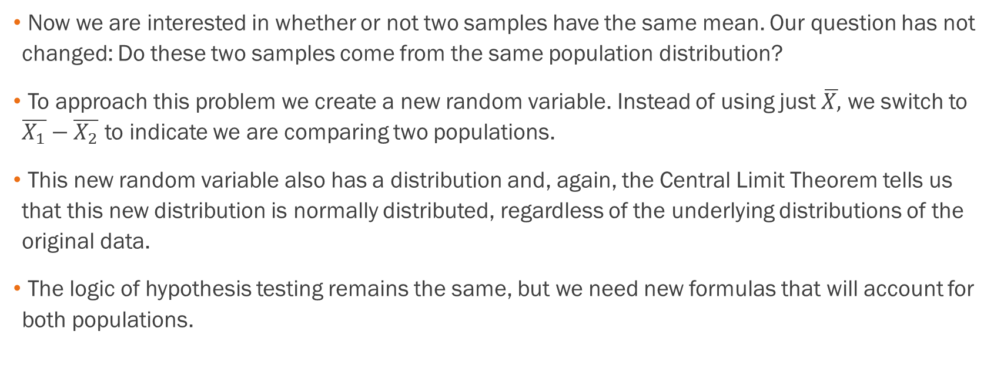
Comparing Two Populations, Cont.
Now we are interested in whether or not two samples have the same mean. Our question has not changed: Do these two samples come from the same population distribution?
To approach this problem we create a new random variable. Instead of using just $\overline{X,}$ we switch to $\overline{X_{1}}−\overline{X_{2}}$ to indicate we are comparing two populations.
This new random variable also has a distribution and, again, the Central Limit Theorem tells us that this new distribution is normally distributed, regardless of the underlying distributions of the original data.
The logic of hypothesis testing remains the same, but we need new formulas that will account for both populations.

Slide 8
The Population Standard Deviation is Unknown
Keeping with the logic of previous hypothesis tests, when the population standard deviation is unknown then we default to using Student’s t-distribution
Heads up: there are 2 ways to compute the degrees of freedom (a long method and a shorter method)

Slide 9
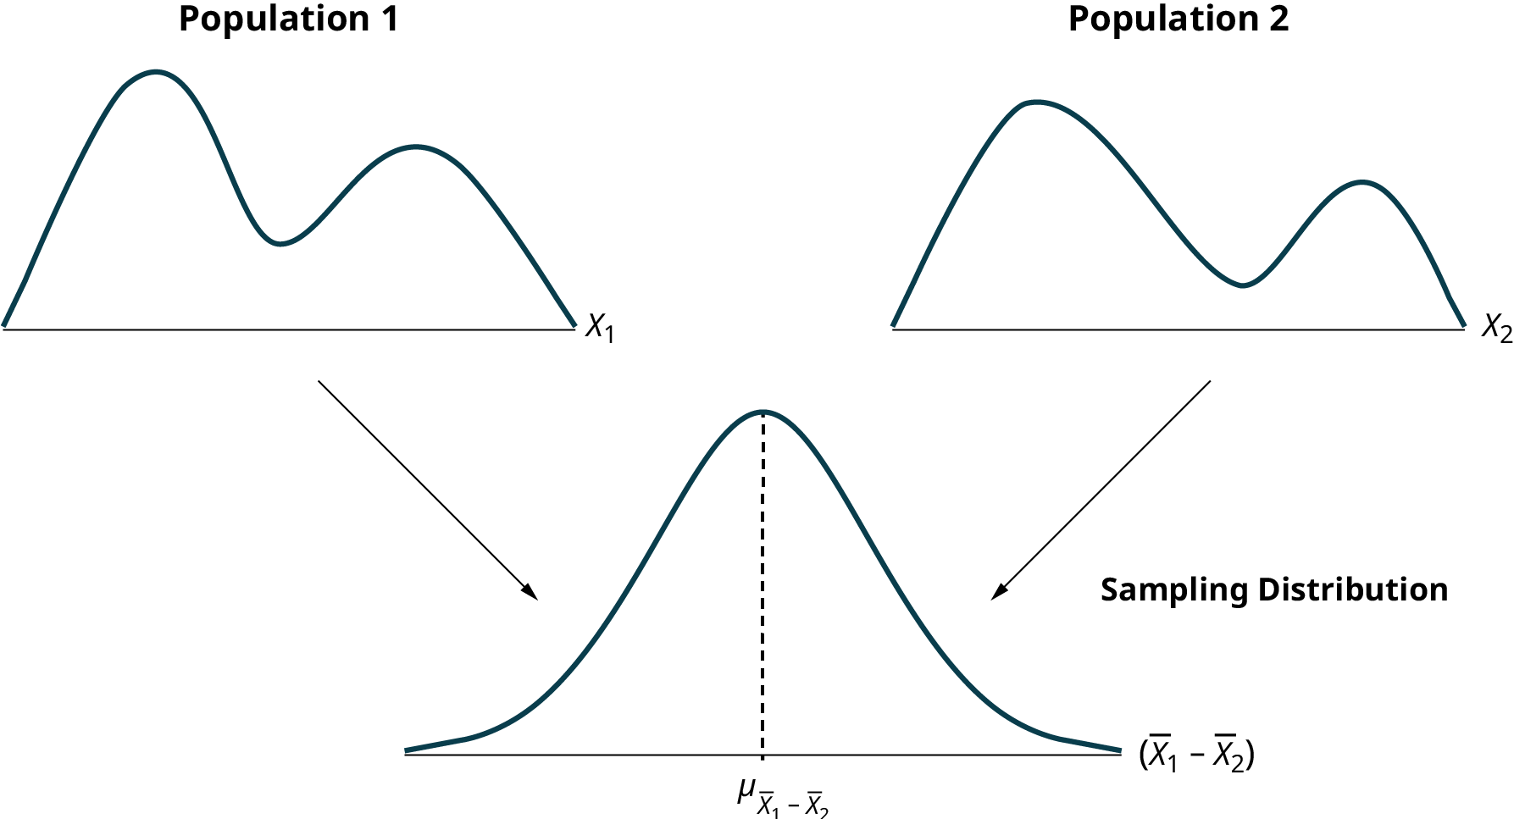
Graphical Representation

Slide 10

Formulas Needed
Standard error of the difference in sample means
$$\sqrt{\frac{s_{1}^{2}}{n_{1}}+\frac{s_{2}^{2}}{n_{2}}}$$
Test statistic (t-score)
$$\frac{\left(\overline{x_{1}}−\overline{x_{2}}\right)−(μ_{1}−μ_{2})}{\sqrt{\frac{s_{1}^{2}}{n_{1}}+\frac{s_{2}^{2}}{n_{2}}}}$$
←Note the denominator is the standard error

Slide 11
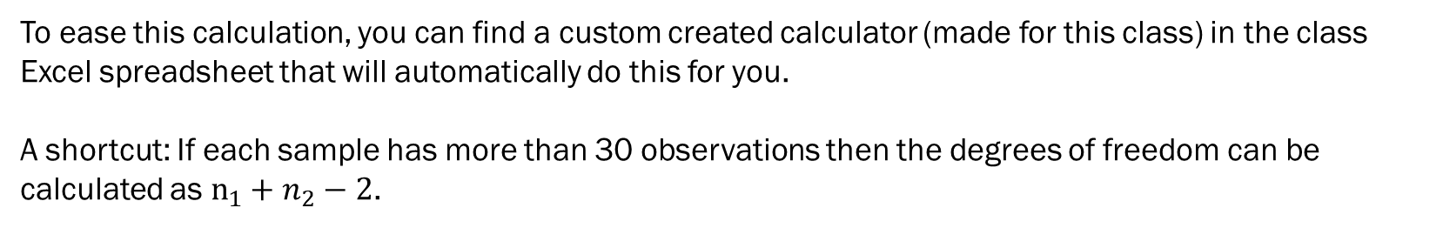

Formulas Needed, Cont.
  Degrees of freedom
  $$df=\frac{{\left(\frac{s_{1}^{2}}{n_{1}}+\frac{s_{2}^{2}}{n_{2}}\right)}^{2}}{\left(\frac{1}{n_{1}−1}\right){\left(\frac{s_{1}^{2}}{n_{1}}\right)}^{2}+\left(\frac{1}{n_{2}−1}\right){\left(\frac{s_{2}^{2}}{n_{2}}\right)}^{2}}$$
To ease this calculation, you can find a custom created calculator (made for this class) in the class Excel spreadsheet that will automatically do this for you.
A shortcut: If each sample has more than 30 observations then the degrees of freedom can be calculated as $n_{1}+n_{2}−2$.

Slide 12
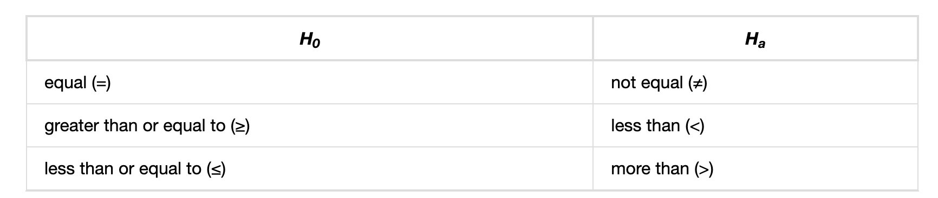
Standard Null and Alternative Hypotheses

Slide 13

Ways to Setup Hypotheses for Two Means
The null hypothesis is that the hours spent playing sports are equal. The alternative hypothesis is that the hours spent playing sports are not equal.
$$H_{0}:μ_{1}−μ_{2}=0$$
$$H_{a}:μ_{1}−μ_{2}≠0$$
Alternatively we could set this up as:
$$H_{0}:μ_{1}=μ_{2}$$
$$H_{a}:μ_{1}≠μ_{2}$$

Slide 14

Ways to Setup Hypotheses for Two Means
We want to test that the morning shift has greater sales volume that the evening shift on average.
$$H_{0}:μ_{m}−μ_{e}≤0$$
$$H_{a}:μ_{m}−μ_{e}>0$$
Alternatively we could set this up as:
$$H_{0}:μ_{m}≤μ_{e}$$
$$H_{a}:μ_{m}>μ_{e}$$

Slide 15
Example
We want to test that the blue team earns less points than the red team on average. How would you set up these hypotheses?

Slide 16

Example - Answers
We want to test if the blue team less points than the red team on average. How would you set up these hypotheses?
$$H_{0}:μ_{b}−μ_{r}≥0$$
$$H_{a}:μ_{b}−μ_{r}<0$$
Alternatively:
$$H_{0}:μ_{b}≥μ_{r}$$
$$H_{a}:μ_{b}<μ_{r}$$

Slide 17
Example
 | Sample Size | Average Number of Hours Playing Sports Per Day | Sample Standard Deviation
Girls | 9 | 2 | 0.866
Boys | 16 | 3.2 | 1.00
Table 10.1
The average amount of time boys and girls aged seven to 11 spend playing sports each day is believed to be the same. A study is done and data are collected. Each population has a normal distribution. Is there a difference in the mean amount of time boys and girls aged seven to 11 play sports each day? Test at the 5% level of significance. To solve this one, refer to the questions on the next slide and the Excel spreadsheet.

Slide 18
Example, Cont.
Is this a test of two means or two proportions?
Are the population standard deviations known or unknown?
Which distribution do you use to perform the test?
What is the random variable?
What are the null and alternative hypotheses?
Is this test right-, left-, or two-tailed?
What is the p-value?
Do you reject or not reject the null hypothesis?
Conclusion?

Slide 19
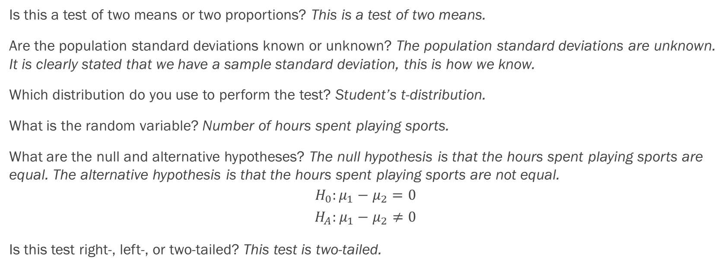
Example – Answers
Is this a test of two means or two proportions? This is a test of two means.
Are the population standard deviations known or unknown? The population standard deviations are unknown. It is clearly stated that we have a sample standard deviation, this is how we know.
Which distribution do you use to perform the test? Student’s t-distribution.
What is the random variable? Number of hours spent playing sports.
What are the null and alternative hypotheses? The null hypothesis is that the hours spent playing sports are equal. The alternative hypothesis is that the hours spent playing sports are not equal.
$$H_{0}:μ_{1}−μ_{2}=0$$
$$H_{A}:μ_{1}−μ_{2}≠0$$
Is this test right-, left-, or two-tailed? This test is two-tailed.

Slide 20
Example - Answers
What is the p-value? The p-value is 0.0054. See Excel for calculations!
Do you reject or not reject the null hypothesis? Since the p is low you reject the null hypothesis.
Conclusion?
At the 5% level of significance, the sample data show there is sufficient evidence to conclude that the mean number of hours that girls and boys aged seven to 11 play sports per day is different (mean number of hours boys aged seven to 11 play sports per day is greater than the mean number of hours played by girls OR the mean number of hours girls aged seven to 11 play sports per day is greater than the mean number of hours played by boys).

Slide 21
Example
A study is done by a community group in two neighboring colleges to determine which one graduates students with more math classes. College A samples 11 graduates. Their average is four math classes with a standard deviation of 1.5 math classes. College B samples nine graduates. Their average is 3.5 math classes with a standard deviation of one math class. The community group believes that a student who graduates from college A has taken more math classes, on the average. Both populations have a normal distribution. Test at a 1% significance level. Answer the following questions.

Slide 22
Example, Cont.
Is this a test of two means or two proportions?
Are the population standard deviations known or unknown?
Which distribution do you use to perform the test?
What is the random variable?
What are the null and alternative hypotheses?
Is this test right-, left-, or two-tailed?
What is the p-value?
Do you reject or not reject the null hypothesis?
Conclusion?

Slide 23
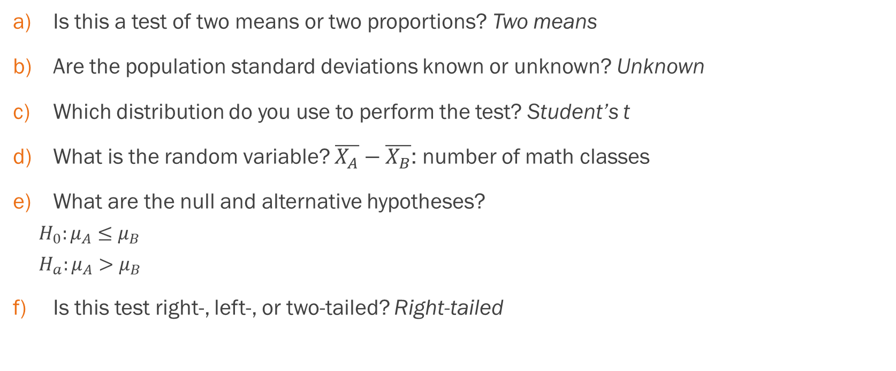
Example - Answers
Is this a test of two means or two proportions? Two means
Are the population standard deviations known or unknown? Unknown
Which distribution do you use to perform the test? Student’s t
What is the random variable? $\overline{X_{A}}−\overline{X_{B}}$: number of math classes
What are the null and alternative hypotheses?
  $H_{0}:μ_{A}≤μ_{B}$
  $H_{a}:μ_{A}>μ_{B}$
Is this test right-, left-, or two-tailed? Right-tailed

Slide 24
Example - Answers
What is the p-value? 0.1928
Do you reject or not reject the null hypothesis? Do not reject.
Conclusion? At the 1% level of significance, from the sample data, there is not sufficient evidence to conclude that a student who graduates from college A has taken more math classes, on the average, than a student who graduates from college B.

Slide 25
Example
A professor at a large community college wanted to determine whether there is a difference in the means of final exam scores between students who took his statistics course online and the students who took his face-to-face statistics class. He believed that the mean of the final exam scores for the online class would be lower than that of the face-to-face class. Was the professor correct? The randomly selected 30 final exam scores from each group are listed in the tables on the next slides, see the Excel spreadsheet. Is the mean of the Final Exam scores of the online class lower than the mean of the Final Exam scores of the face-to-face class? Test at a 5% significance level.

Slide 26
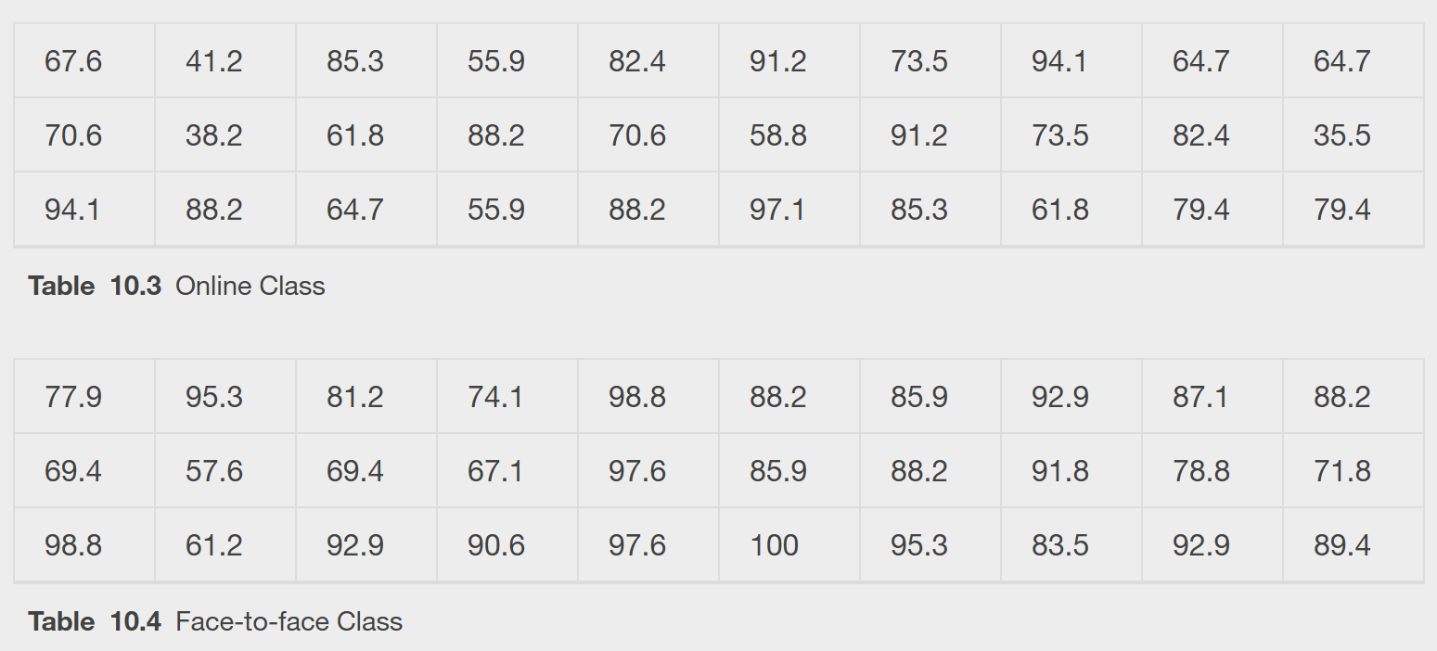
Example, Cont.

Slide 27
Example, Cont.
Is this a test of two means or two proportions?
Are the population standard deviations known or unknown?
Which distribution do you use to perform the test?
What is the random variable?
What are the null and alternative hypotheses?
Is this test right-, left-, or two-tailed?
What is the p-value?
Do you reject or not reject the null hypothesis?
Conclusion?

Slide 28
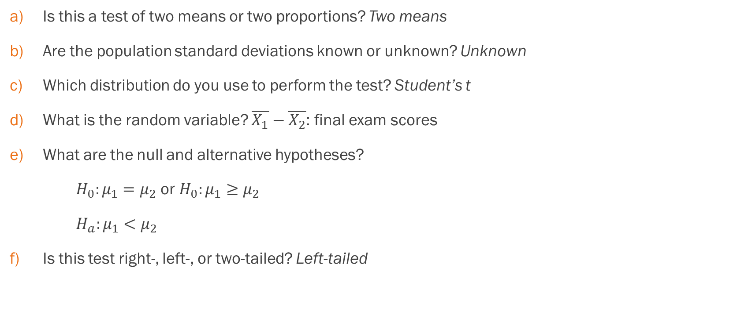
Example - Answers
Is this a test of two means or two proportions? Two means
Are the population standard deviations known or unknown? Unknown
Which distribution do you use to perform the test? Student’s t
What is the random variable? $\overline{X_{1}}−\overline{X_{2}}$: final exam scores
What are the null and alternative hypotheses?
$H_{0}:μ_{1}=μ_{2}$ or $H_{0}:μ_{1}≥μ_{2}$
$H_{a}:μ_{1}<μ_{2}$
Is this test right-, left-, or two-tailed? Left-tailed

Slide 29
Example - Answers
What is the p-value? 0.0011
Do you reject or not reject the null hypothesis? Reject the null
Conclusion? The professor was correct. The evidence shows that the mean of the final exam scores for the online class is lower than that of the face-to-face class. At the 5% level of significance, from the sample data, there is (is/is not) sufficient evidence to conclude that the mean of the final exam scores for the online class is less than the mean of final exam scores of the face-to-face class.

Slide 30
Cohen’s Standards for small, medium, and large effect sizes
Cohen's d is a measure of effect size based on the differences between two means. Cohen’s d measures the relative strength of the differences between the means of two populations based on sample data.
Table 10.7 Cohen's Standard Effect Sizes
Size of effect | d
Small | 0.2
Medium | 0.5
Large | 0.8

Slide 31

Cohen’s d formula
$d= \frac{\overline{x_{1}}−\overline{x_{2}}}{s_{pooled}}$ where $s_{pooled}= \sqrt{\frac{\left(n_{1}−1\right)s_{1}^{2}+\left(n_{2}−1\right)s_{2}^{2}}{n_{1}+n_{2}−2}}$

Slide 32
Example
Calculate Cohen’s d for the earlier example:
A study is done by a community group in two neighboring colleges to determine which one graduates students with more math classes. College A samples 11 graduates. Their average is four math classes with a standard deviation of 1.5 math classes. College B samples nine graduates. Their average is 3.5 math classes with a standard deviation of one math class. The community group believes that a student who graduates from college A has taken more math classes, on the average. Both populations have a normal distribution. Test at a 1% significance level. Answer the following questions.

Slide 33
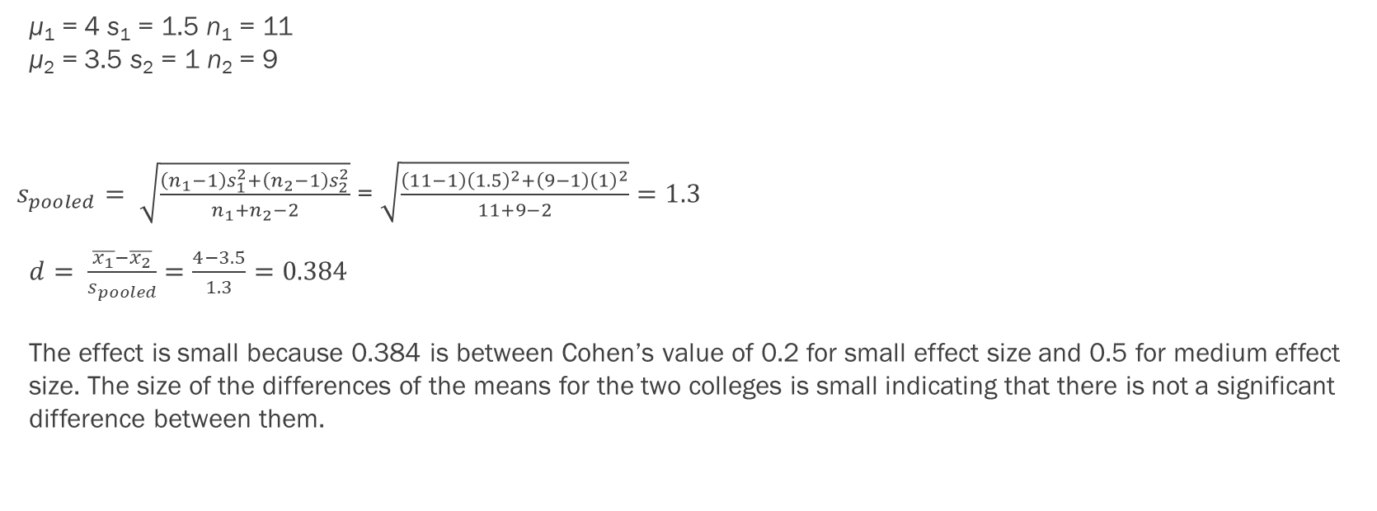
Example - Answers
μ₁ = 4 s₁ = 1.5 n₁ = 11
μ₂ = 3.5 s₂ = 1 n₂ = 9
$s_{pooled}= \sqrt{\frac{\left(n_{1}−1\right)s_{1}^{2}+\left(n_{2}−1\right)s_{2}^{2}}{n_{1}+n_{2}−2}}$ = $\sqrt{\frac{\left(11−1\right){\left(1.5\right)}^{2}+\left(9−1\right){\left(1\right)}^{2}}{11+9−2}}=1.3$
$d= \frac{\overline{x_{1}}−\overline{x_{2}}}{s_{pooled}}=\frac{4−3.5}{1.3}=0.384$
The effect is small because 0.384 is between Cohen’s value of 0.2 for small effect size and 0.5 for medium effect size. The size of the differences of the means for the two colleges is small indicating that there is not a significant difference between them.

Slide 34
Section 10.2
Two population means with known standard deviations

Slide 35
Now we will focus on the rare situation where both population standard deviations are known
The formulas for testing are very similar to when the population standard deviation was unknown

Slide 36

Calculations
Standard error
$$\sqrt{\frac{σ_{1}^{2}}{n_{1}}+\frac{σ_{2}^{2}}{n_{2}}}$$
Test statistic (z-score)
$$\frac{\left(\overline{x_{1}}−\overline{x_{2}}\right)−(μ_{1}−μ_{2})}{\sqrt{\frac{σ_{1}^{2}}{n_{1}}+\frac{σ_{2}^{2}}{n_{2}}}}$$

Slide 37
Discussion
Why is it a z-score instead of a t-score?
Do we need the degrees of freedom formula in this situation?

Slide 38
Example
The means of the number of revolutions per minute of two competing engines are to be compared. Thirty engines of each type are randomly assigned to be tested. Both populations have normal distributions. The table below shows the result. Do the data indicate that Engine 2 has higher RPM than Engine 1? Test at a 5% level of significance.
Engine | Sample Mean Number of RPM | Population Standard Deviation
1 | 1,500 | 50
2 | 1,600 | 60

Slide 39
Example, Cont.
Is this a test of two means or two proportions?
Are the population standard deviations known or unknown?
Which distribution do you use to perform the test?
What is the random variable?
What are the null and alternative hypotheses?
Is this test right-, left-, or two-tailed?
What is the p-value?
Do you reject or not reject the null hypothesis?
Conclusion?

Slide 40
Example – Answers
a. Is this a test of two means or two proportions?
This is a test of two means.
b. Are the population standard deviations known or unknown?
The population standard deviations are known.
c. Which distribution do you use to perform the test?
Normal distribution.

Slide 41
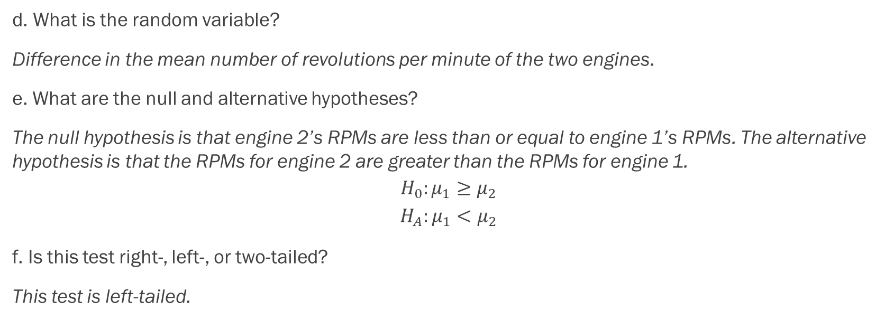
Example – Answers
d. What is the random variable?
Difference in the mean number of revolutions per minute of the two engines.
e. What are the null and alternative hypotheses?
The null hypothesis is that engine 2’s RPMs are less than or equal to engine 1’s RPMs. The alternative hypothesis is that the RPMs for engine 2 are greater than the RPMs for engine 1.
$$H_{0}:μ_{1}≥μ_{2}$$
$$H_{A}:μ_{1}<μ_{2}$$
f. Is this test right-, left-, or two-tailed?
This test is left-tailed.

Slide 42
Example – Answers
g) What is the p-value?
The p-value is close to 0.
h) Do you reject or not reject the null hypothesis?
Since the p is low you reject the null hypothesis.
i) Conclusion?
At the 5% level of significance, from the sample data, there is sufficient evidence to conclude that engine 2’s RPMs are greater than engine 1’s RPMs.

Slide 43
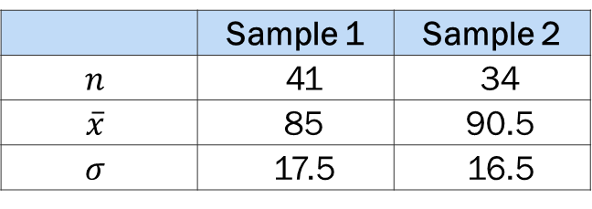

Example
A summary of two independent samples is given in the table below. Given the null and alternative hypotheses below, conduct a hypothesis test that the mean for sample 1 is less than the mean for sample 2 with significance level $α=0.05.$
 | Sample 1 | Sample 2
$$n$$ | 41 | 34
$$\overline{x}$$ | 85 | 90.5
$$σ$$ | 17.5 | 16.5

Slide 44
Example, Cont.
Is this a test of two means or two proportions?
Are the population standard deviations known or unknown?
Which distribution do you use to perform the test?
What is the random variable?
What are the null and alternative hypotheses?
Is this test right-, left-, or two-tailed?
What is the p-value?
Do you reject or not reject the null hypothesis?
Conclusion?

Slide 45
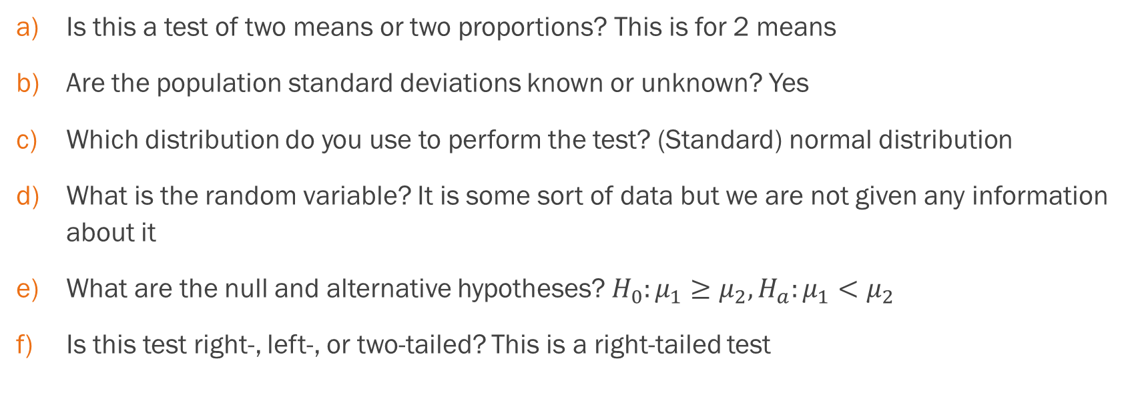
Example, Cont.
Is this a test of two means or two proportions? This is for 2 means
Are the population standard deviations known or unknown? Yes
Which distribution do you use to perform the test? (Standard) normal distribution
What is the random variable? It is some sort of data but we are not given any information about it
What are the null and alternative hypotheses? $H_{0}:μ_{1}≥μ_{2}, H_{a}:μ_{1}<μ_{2}$
Is this test right-, left-, or two-tailed? This is a right-tailed test

Slide 46
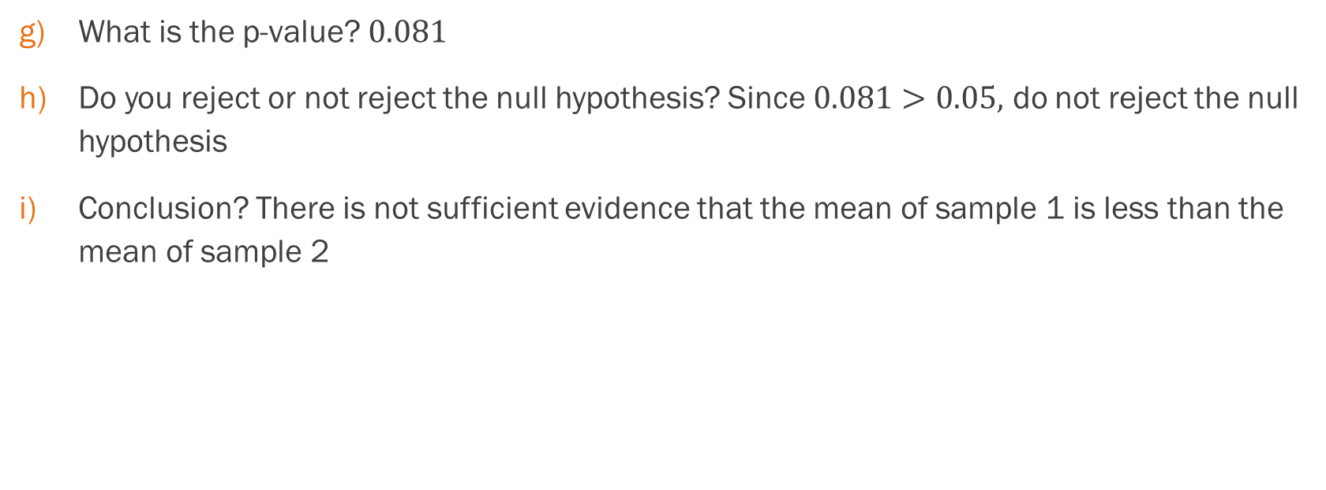
Example, Cont.
What is the p-value? $0.081$
Do you reject or not reject the null hypothesis? Since $0.081>0.05,$ do not reject the null hypothesis
Conclusion? There is not sufficient evidence that the mean of sample 1 is less than the mean of sample 2

Slide 47
Section 10.3
Comparing two independent population proportions

Slide 48
Now we will focus on a testing proportions for independent populations
How do we test two completely independent populations? We need to understand what this means …

Slide 49
Assumptions About the Populations
The two independent samples are simple random samples that are independent.
The number of successes is at least five, and the number of failures is at least five, for each of the samples.
Growing literature states that the population must be at least ten or 20 times the size of the sample. This keeps each population from being over-sampled and causing incorrect results.

Slide 50
Since we have two populations, we will need different proportion formulas to account for each population.
The logic of a hypothesis is still the same but we need different formulas.

Slide 51


Relevant Formulas
Standard deviation (standard error)
$\sqrt{p_{C}\left(1−p_{C}\right)\left(\frac{1}{n_{A}}+\frac{1}{n_{B}}\right)}$
Test statistic (z-score)
$\frac{\left(p`_{A}−p`_{B}\right)−(p_{A}−p_{B})}{\sqrt{p_{C}\left(1−p_{C}\right)\left(\frac{1}{n_{A}}+\frac{1}{n_{B}}\right)}}$
Sample proportions
$p`_{A}=\frac{X_{A}}{n_{A}}$ and $p`_{B}=\frac{X_{B}}{n_{B}}$
Pooled proportion
$p_{C}= \frac{X_{A}+X_{B}}{n_{A}+n_{B}}$

Slide 52
Formula Sheet!!
I have a formula sheet at DivideAndConquerMath.com for all these!

Slide 53
Example
Two types of medication for hives are being tested to determine if there is a difference in the proportions of adult patient reactions. Twenty out of a random sample of 200 adults given medication A still had hives 30 minutes after taking the medication. Twelve out of another random sample of 200 adults given medication B still had hives 30 minutes after taking the medication. Test at a 1% level of significance.

Slide 54
Example, Cont.
Is this a test of two means or two proportions?
Are the population standard deviations known or unknown?
Which distribution do you use to perform the test?
What is the random variable?
What are the null and alternative hypotheses?
Is this test right-, left-, or two-tailed?
What is the p-value?
Do you reject or not reject the null hypothesis?
Conclusion?

Slide 55
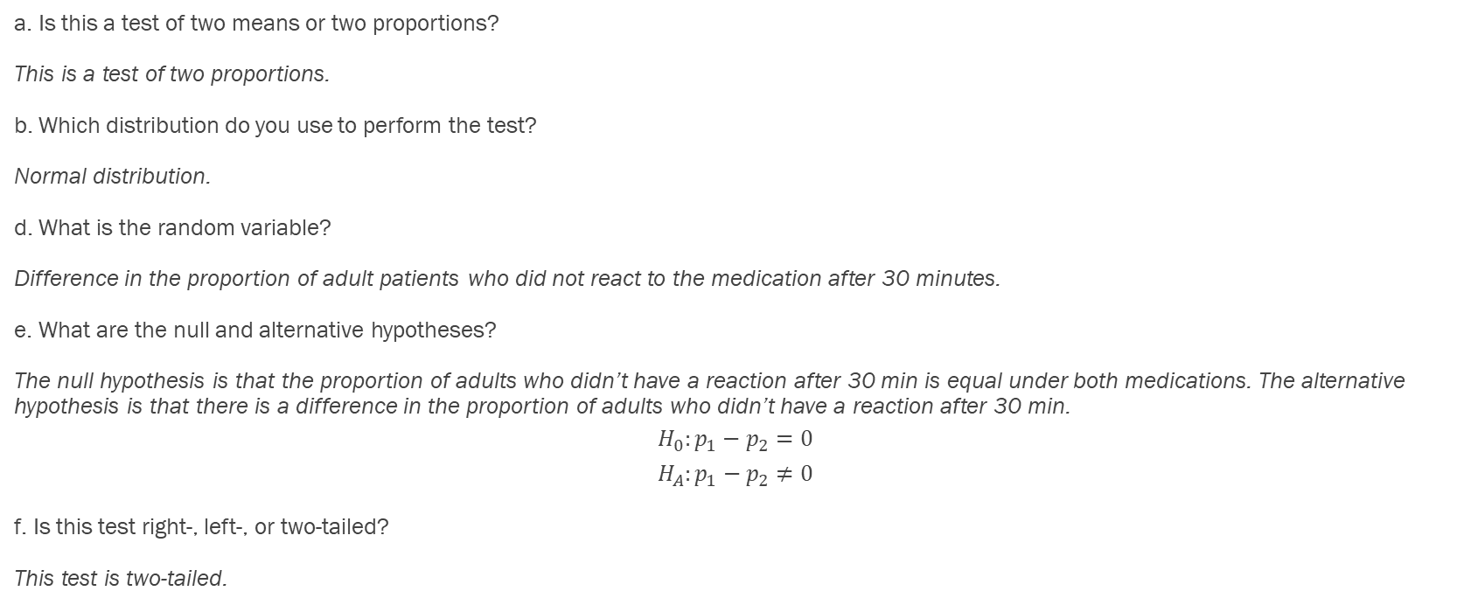
Example - Answers
a. Is this a test of two means or two proportions?
This is a test of two proportions.
b. Which distribution do you use to perform the test?
Normal distribution.
d. What is the random variable?
Difference in the proportion of adult patients who did not react to the medication after 30 minutes.
e. What are the null and alternative hypotheses?
The null hypothesis is that the proportion of adults who didn’t have a reaction after 30 min is equal under both medications. The alternative hypothesis is that there is a difference in the proportion of adults who didn’t have a reaction after 30 min.
$$H_{0}:p_{1}−p_{2}=0$$
$$H_{A}:p_{1}−p_{2}≠0$$
f. Is this test right-, left-, or two-tailed?
This test is two-tailed.

Slide 56
Example - Answers
g) What is the p-value?
The p-value is 0.1404.
h) Do you reject or not reject the null hypothesis?
We fail to reject the null hypothesis.
i) Conclusion?
At the 1% level of significance, from the sample data, there is not sufficient evidence to conclude that there is a difference in the proportion of adult patients who did not react to the medication after 30 min.

Slide 57

Example
Are freshmen psychology majors less likely to change their major before they graduate compared to freshmen business majors? 412 of the 629 freshmen psychology majors from a recent study changed their major before they graduated and 452 of the 660 freshmen business majors changed their major before they graduated. What can be concluded at the $α=0.05$level of significance?

Slide 58
Example, Cont.
Is this a test of two means or two proportions?
Are the population standard deviations known or unknown?
Which distribution do you use to perform the test?
What is the random variable?
What are the null and alternative hypotheses?
Is this test right-, left-, or two-tailed?
What is the p-value?
Do you reject or not reject the null hypothesis?
Conclusion?

Slide 59
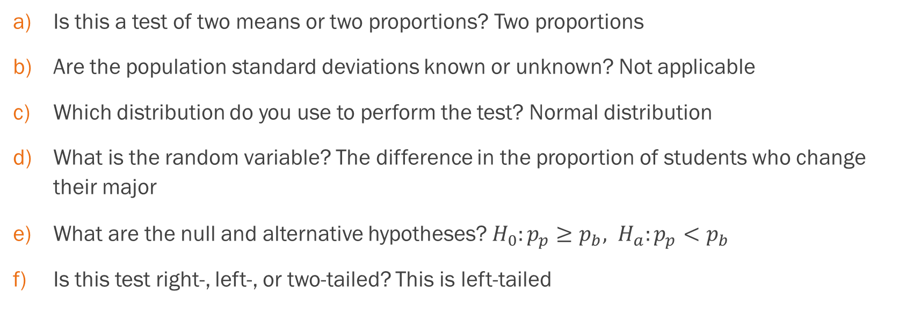
Example, Cont.
Is this a test of two means or two proportions? Two proportions
Are the population standard deviations known or unknown? Not applicable
Which distribution do you use to perform the test? Normal distribution
What is the random variable? The difference in the proportion of students who change their major
What are the null and alternative hypotheses? $H_{0}:p_{p}≥p_{b}, H_{a}:p_{p}<p_{b}$
Is this test right-, left-, or two-tailed? This is left-tailed

Slide 60
Example, Cont.
What is the p-value? 0.127
Do you reject or not reject the null hypothesis? Do not reject
Conclusion? There is not sufficient evidence that psychology majors are less likely to change their major than business majors.

Slide 61
Section 10.4
Matched or paired samples

Slide 62
What is a Paired Sample?
In a hypothesis test for matched or paired samples, subjects are matched in pairs and differences are calculated.
These differences are the data.
A classic example of a paired sample would be before and after metrics for a sample. You would take the difference between the measurements, and that would be your data.

Slide 63
Requirements
When using a hypothesis test for matched or paired samples, the following characteristics should be present:
Simple random sampling is used.
Sample sizes are often small.
Two measurements (samples) are drawn from the same pair of individuals or objects.
Differences are calculated from the matched or paired samples.
The differences form the sample that is used for the hypothesis test.
Either the matched pairs have differences that come from a population that is normal or the number of differences is sufficiently large so that distribution of the sample mean of differences is approximately normal.

Slide 64
Since we are conducting a hypothesis test on the differences, we can use the formulas from Chapter 9.
Notice how the relevant formulas for this type of hypothesis testing compare to the chapter 9 formulas

Slide 65

Calculations
Use student-t test for single population mean with $n−1$ degrees of freedom
Test statistic (t-score)
$\frac{\overline{x_{d}}−μ_{d}}{\left(\frac{s_{d}}{\sqrt{n}}\right)}$
Where each measurement is calculated off the differences between the data

Slide 66
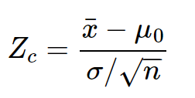

Review from Chapter 9
For comparison, here is formula for a test statistic from chapter 9 when we only had 1 population
Note how this compares to our new formula:
$$\frac{\overline{x_{d}}−μ_{d}}{s_{d}/\sqrt{n}}$$

Slide 67
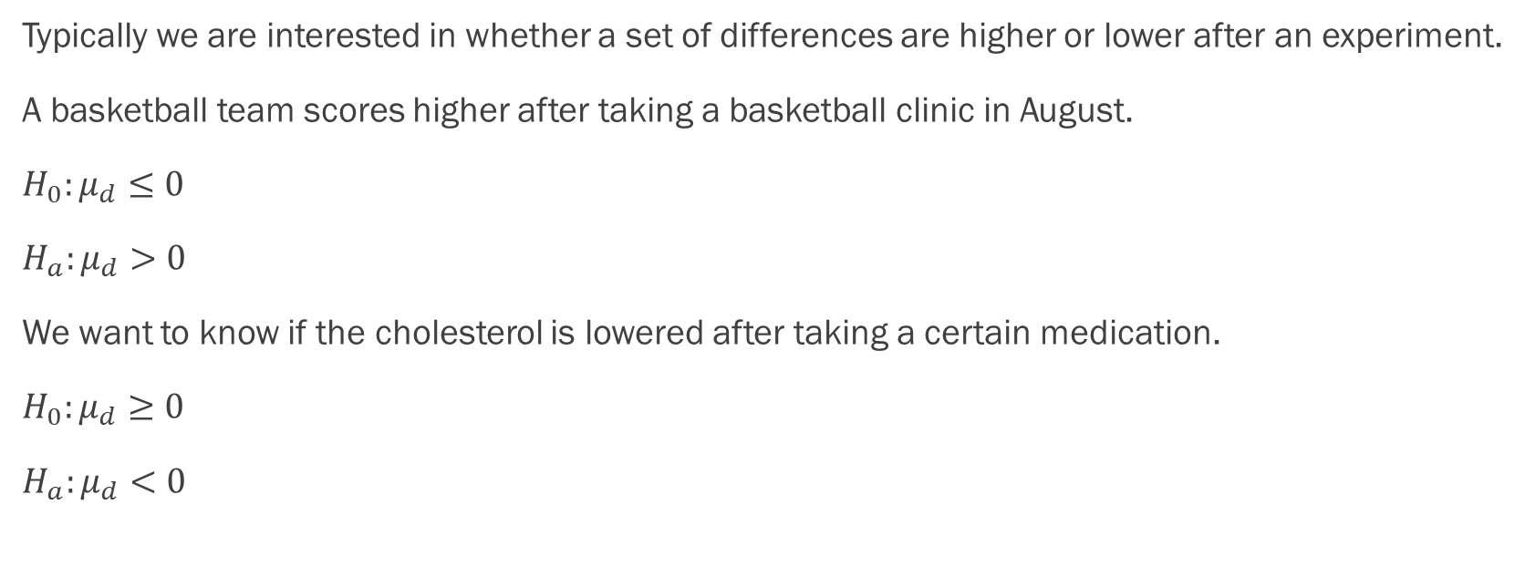
Setting Up the Hypotheses
Typically we are interested in whether a set of differences are higher or lower after an experiment.
A basketball team scores higher after taking a basketball clinic in August.
$H_{0}:μ_{d}≤0$
$H_{a}:μ_{d}>0$
We want to know if the cholesterol is lowered after taking a certain medication.
$H_{0}:μ_{d}≥0$
$H_{a}:μ_{d}<0$

Slide 68
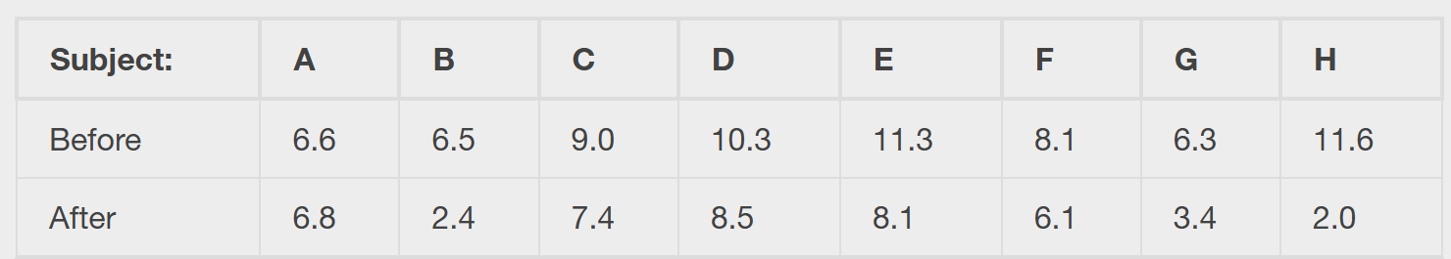
Example
A study was conducted to investigate the effectiveness of hypnotism in reducing pain. Results for randomly selected subjects are shown in the table and Excel spreadsheet. A lower score indicates less pain. The "before" value is matched to an "after" value and the differences are calculated. The differences have a normal distribution. Are the sensory measurements, on average, lower after hypnotism? Test at a 5% significance level.

Slide 69
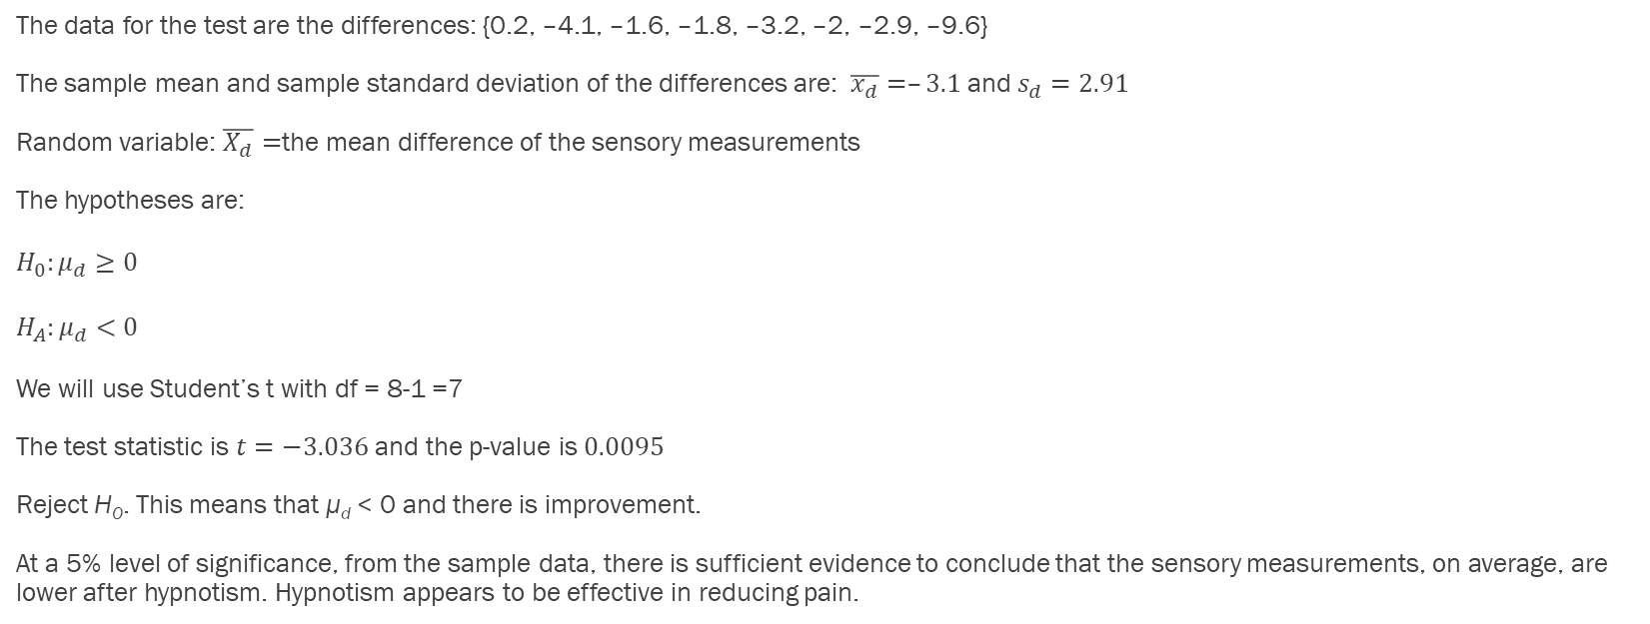
Example - Answers
The data for the test are the differences: {0.2, –4.1, –1.6, –1.8, –3.2, –2, –2.9, –9.6}
The sample mean and sample standard deviation of the differences are: $\overline{x_{d}}=–3.1$ and $s_{d}=2.91$
Random variable: $\overline{X_{d}}=$the mean difference of the sensory measurements
The hypotheses are:
$H_{0}:μ_{d}≥0$
$H_{A}:μ_{d}<0$
We will use Student’s t with df = 8-1 =7
The test statistic is $t=−3.036$ and the p-value is $0.0095$
Reject H₀. This means that μ_{d} < 0 and there is improvement.
At a 5% level of significance, from the sample data, there is sufficient evidence to conclude that the sensory measurements, on average, are lower after hypnotism. Hypnotism appears to be effective in reducing pain.

Slide 70
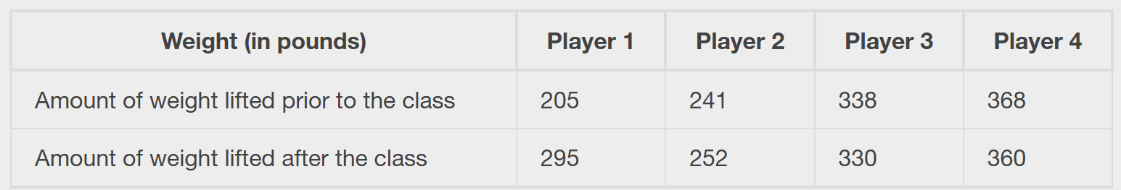
Example
A college softball coach was interested in whether the college's strength development class increased their players' maximum lift (in pounds). Four players participated in the study. The amount of weight they could each lift was recorded before they took the strength development class. After completing the class, the amount of weight they could each lift was again measured. The data are in the table and in the Excel spreadsheet. The coach wants to know if the strength development class makes the players stronger, on average.

Slide 71
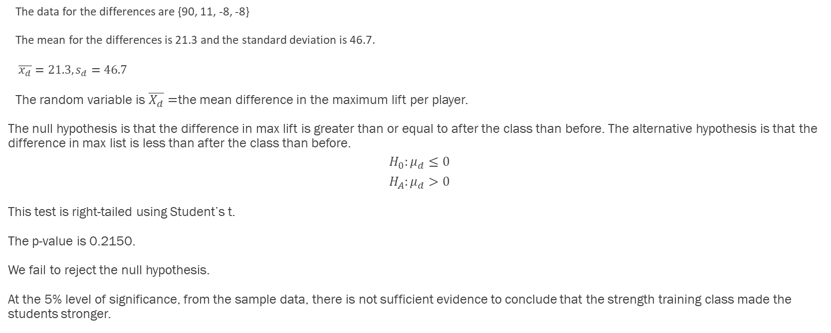
Example - Answers
The data for the differences are {90, 11, -8, -8}
The mean for the differences is 21.3 and the standard deviation is 46.7.
$\overline{x_{d}}=21.3, s_{d}=46.7$
The random variable is $\overline{X_{d}}=$the mean difference in the maximum lift per player.
The null hypothesis is that the difference in max lift is greater than or equal to after the class than before. The alternative hypothesis is that the difference in max list is less than after the class than before.
$$H_{0}:μ_{d}≤0$$
$$H_{A}:μ_{d}>0$$
This test is right-tailed using Student’s t.
The p-value is 0.2150.
We fail to reject the null hypothesis.
At the 5% level of significance, from the sample data, there is not sufficient evidence to conclude that the strength training class made the students stronger.

Slide 72
Putting It All Together
A Review of Hypothesis Tests

Slide 73
Any type of hypothesis test is fair game!!
We will cover four examples

Slide 74
Hypothesis Test #1
A Nissan Motor Corporation advertisement read, “The average man’s I.Q. is 107. The average brown trout’s I.Q. is 4. So why can’t man catch brown trout?” Suppose you believe that the brown trout’s mean I.Q. is greater than four. You catch 12 brown trout. A fish psychologist determines the I.Q.s as follows: 5; 4; 7; 3; 6; 4; 5; 3; 6; 3; 8; 5. Conduct a hypothesis test of your belief.

Slide 75
Hypothesis Test #2
Marketing companies have collected data implying that teenage girls use more social media apps on their smartphones than teenage boys do. In one particular study of 40 randomly chosen teenage girls and boys (20 of each) with smartphones, the mean number of social media apps for the girls was 3.2 with a standard deviation of 1.5. The mean for the boys was 1.7 with a standard deviation of 0.8. Conduct a hypothesis test to determine if the means are approximately the same or if the girls’ mean is higher than the boys’ mean.

Slide 76
Hypothesis Test #3
Driver error can be listed as the cause of approximately 54% of all fatal auto accidents, according to the American Automobile Association. Thirty randomly selected fatal accidents are examined, and it is determined that 14 were caused by driver error. Using α = 0.05, is the AAA proportion accurate?

Slide 77
Hypothesis Test #4
Ten individuals went on a low–fat diet for 12 weeks to lower their cholesterol. The data are in the table (see next slide/Excel). Do you think that their cholesterol levels were significantly lowered?

Slide 78
Table for #4
Starting cholesterol level | Ending cholesterol level
140 | 140
220 | 230
110 | 120
240 | 220
200 | 190
180 | 150
190 | 200
360 | 300
280 | 300
260 | 240

