Slide 1

Chapter 11 The Chi-Square Distribution
Openstax statistics

Slide 2
Objectives
By the end of this chapter, the student should be able to:
Interpret the chi-square probability distribution as the sample size changes.
Conduct and interpret chi-square goodness-of-fit hypothesis tests.
Conduct and interpret chi-square test of independence hypothesis tests.
Conduct and interpret chi-square homogeneity hypothesis tests.
Conduct and interpret chi-square single variance hypothesis tests.

Slide 3
The Chi-Square Distribution
In this chapter, you will learn the three major applications of the chi-square distribution:
  the goodness-of-fit test, which determines if data fit a particular distribution, such as in the lottery example
  the test of independence, which determines if events are independent, such as in the movie example
  the test of a single variance, which tests variability, such as in the coffee example

Slide 4
Section 11.1
Facts About the Chi-Square Distribution

Slide 5

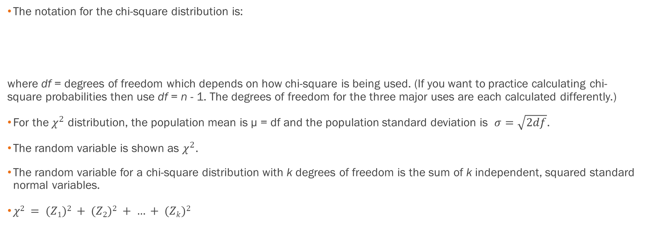
The Notation
The notation for the chi-square distribution is:
where df = degrees of freedom which depends on how chi-square is being used. (If you want to practice calculating chi-square probabilities then use df = n - 1. The degrees of freedom for the three major uses are each calculated differently.)
For the $χ^{2}$ distribution, the population mean is μ = df and the population standard deviation is $σ=\sqrt{2df}$.
The random variable is shown as $χ^{2}$.
The random variable for a chi-square distribution with k degrees of freedom is the sum of k independent, squared standard normal variables.
$χ2 = (Z1)2 + (Z2)2 + … + (Zk)2$

Slide 6
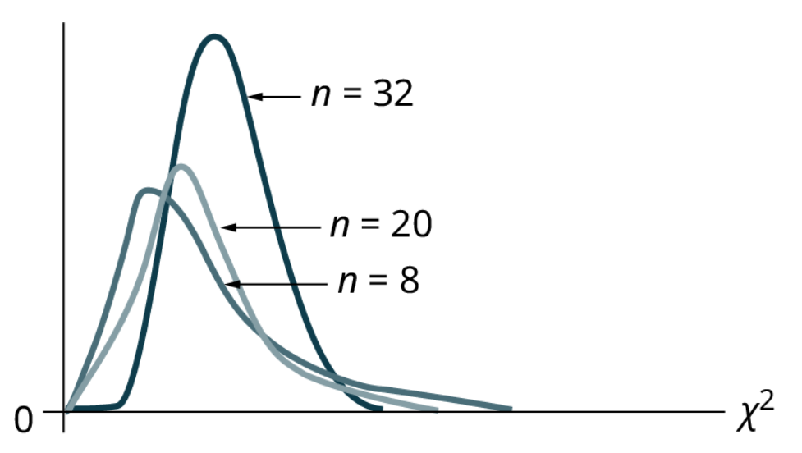
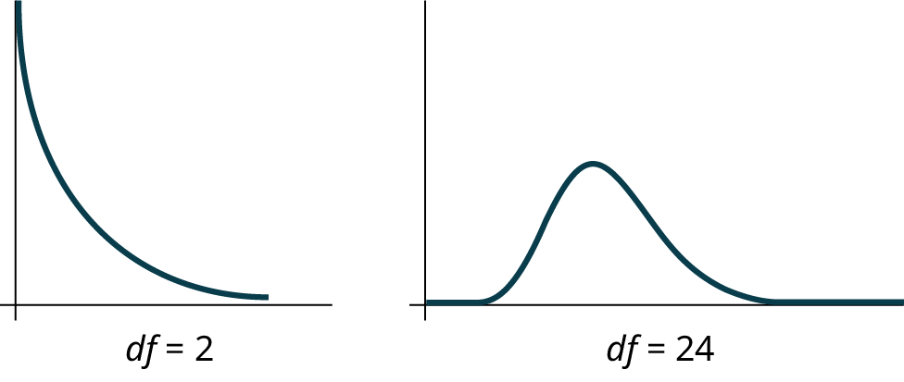
A Few Facts
  The curve is nonsymmetrical and skewed to the right.
  There is a different chi-square curve for each df.

Slide 7
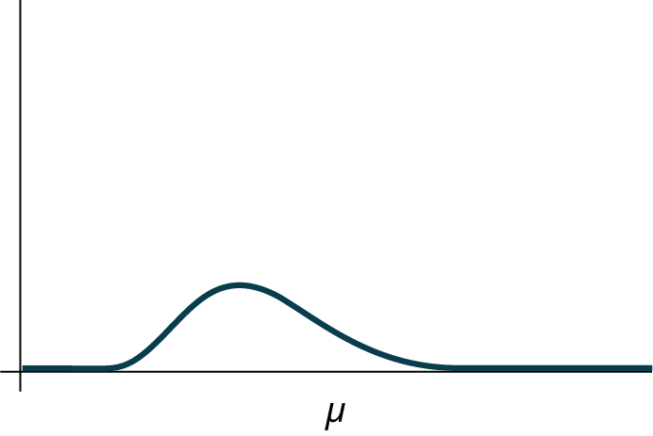
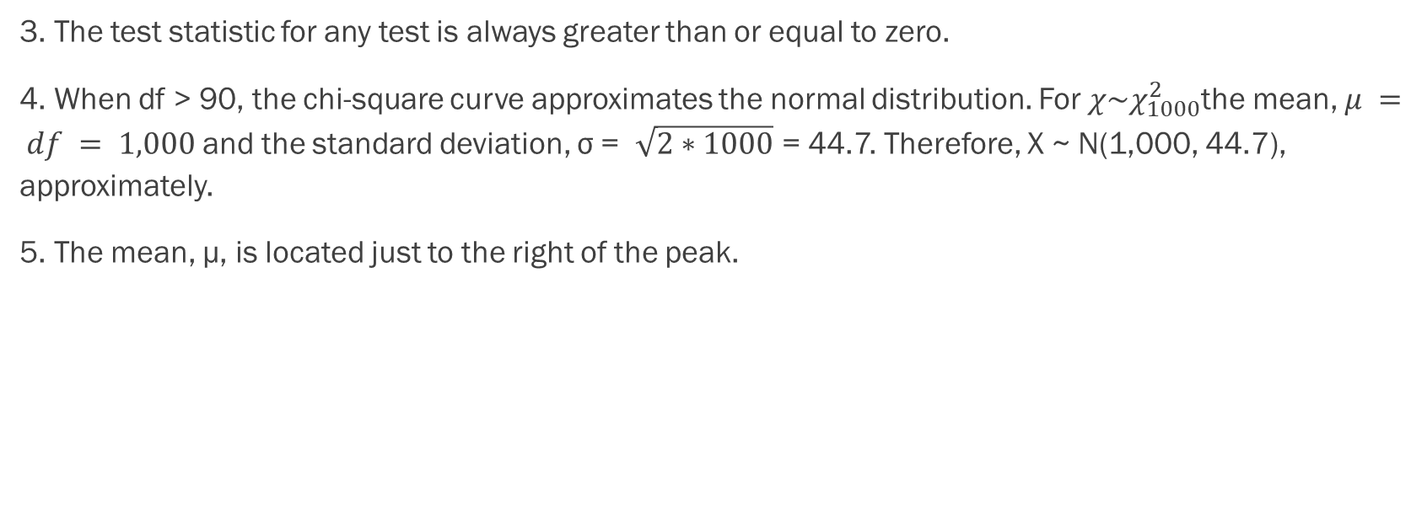
A Few Facts, cont.
3. The test statistic for any test is always greater than or equal to zero.
4. When df > 90, the chi-square curve approximates the normal distribution. For $χ\sim χ_{1000}^{2}$the mean, $μ = df = 1,000$and the standard deviation, σ = $\sqrt{2∗1000}$ = 44.7. Therefore, X ~ N(1,000, 44.7), approximately.
5. The mean, μ, is located just to the right of the peak.

Slide 8
Section 11.2
Goodness-of-Fit Test

Slide 9
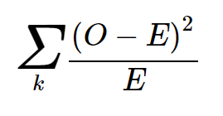
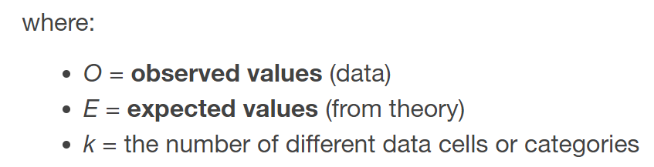
The Basics
In this type of hypothesis test, you determine whether the data "fit" a particular distribution or not. For example, you may suspect your unknown data fit a binomial distribution.
You use a chi-square test (meaning the distribution for the hypothesis test is chi-square) to determine if there is a fit or not. The null and the alternative hypotheses for this test may be written in sentences or may be stated as equations or inequalities.
The test statistic for a goodness-of-fit test is:

Slide 10
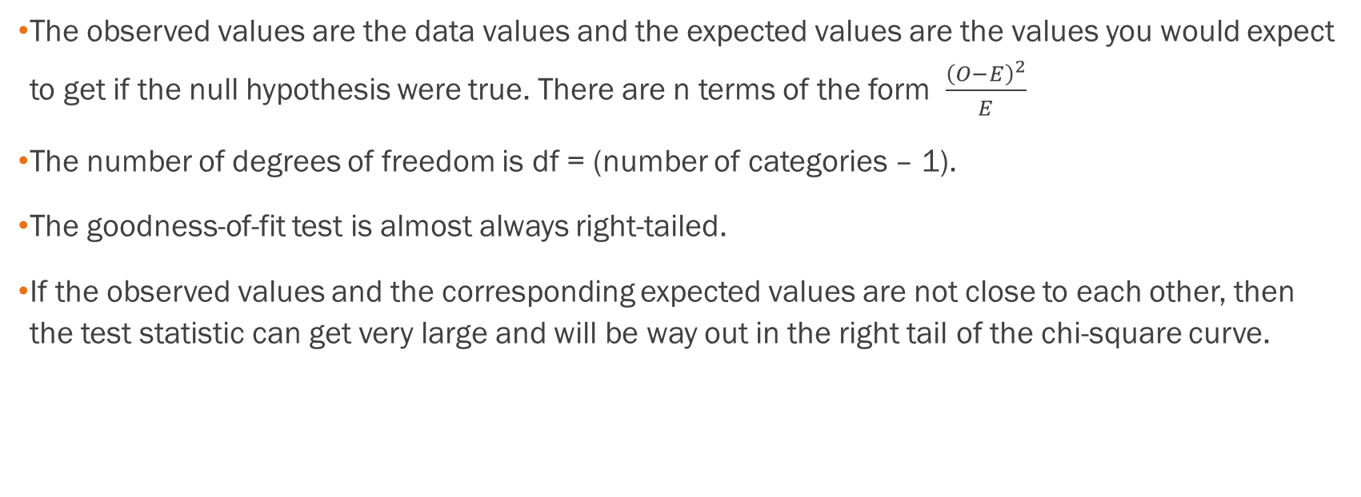
More on Hypothesis Testing
The observed values are the data values and the expected values are the values you would expect to get if the null hypothesis were true. There are n terms of the form $\frac{{\left(O−E\right)}^{2}}{E}$
The number of degrees of freedom is df = (number of categories – 1).
The goodness-of-fit test is almost always right-tailed.
If the observed values and the corresponding expected values are not close to each other, then the test statistic can get very large and will be way out in the right tail of the chi-square curve.

Slide 11
Example
Absenteeism of college students from math classes is a major concern to math instructors because missing class appears to increase the drop rate. Suppose that a study was done to determine if the actual student absenteeism rate follows faculty perception. The faculty expected that a group of 100 students would miss class according to the table in Excel. A random survey across all mathematics courses was then done to determine the actual number (observed) of absences in a course. The data is in the other table in Excel.
A. What is the null and alternative hypothesis?
B. Can you use the information as it appears in the charts to conduct the goodness-of-fit test?
C. What is the number of degrees of freedom (df)?

Slide 12
Example - Answers
A.
H₀: Student absenteeism fits faculty perception.
The alternative hypothesis is the opposite of the null hypothesis.
H_{a}: Student absenteeism does not fit faculty perception.

Slide 13
Example - Answers
B.
No. Notice that the expected number of absences for the "12+" entry is less than five (it is two). Combine that group with the "9–11" group to create new tables where the number of students for each entry are at least five.

Slide 14
Example - Answers
C.
There are four "cells" or categories in each of the new tables.
df = number of cells – 1 = 4 – 1 = 3

Slide 15
Example
Employers want to know which days of the week employees are absent in a five-day work week. Most employers would like to believe that employees are absent equally during the week. Suppose a random sample of 60 managers were asked on which day of the week they had the highest number of employee absences. The results were distributed as in the table below. For the population of employees, do the days for the highest number of absences occur with equal frequencies during a five-day work week? Test at a 5% significance level. See the Excel spreadsheet.
 | Monday | Tuesday | Wednesday | Thursday | Friday
Number of Absences | 15 | 12 | 9 | 9 | 15

Slide 16
Example - Answers
The null and alternative hypotheses are:
H₀: The absent days occur with equal frequencies, that is, they fit a uniform distribution.
H_{a}: The absent days occur with unequal frequencies, that is, they do not fit a uniform distribution.
If the absent days occur with equal frequencies, then, out of 60 absent days (the total in the sample: 15 + 12 + 9 + 9 + 15 = 60), there would be 12 absences on Monday, 12 on Tuesday, 12 on Wednesday, 12 on Thursday, and 12 on Friday. These numbers are the expected (E) values. The values in the table are the observed (O) values or data.

Slide 17
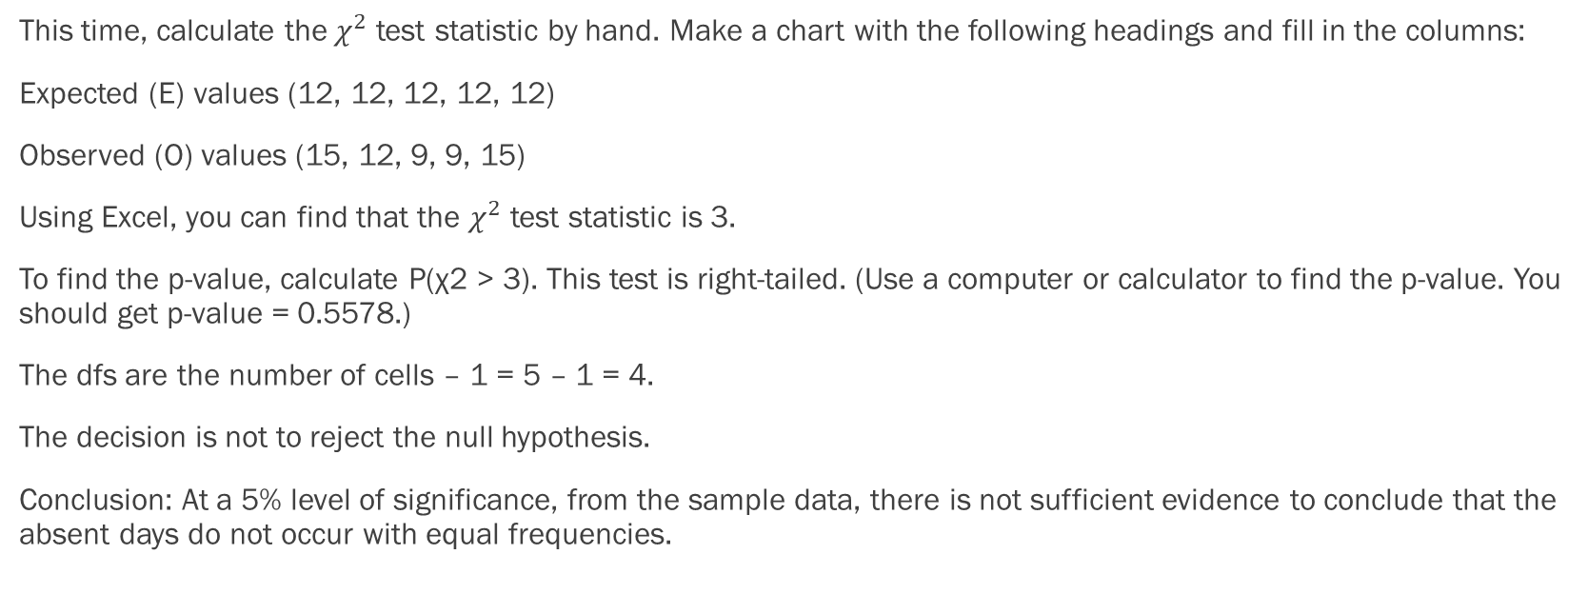
Example - Answers
This time, calculate the$χ^{2}$test statistic by hand. Make a chart with the following headings and fill in the columns:
Expected (E) values (12, 12, 12, 12, 12)
Observed (O) values (15, 12, 9, 9, 15)
Using Excel, you can find that the $χ^{2}$ test statistic is 3.
To find the p-value, calculate P(χ2 > 3). This test is right-tailed. (Use a computer or calculator to find the p-value. You should get p-value = 0.5578.)
The dfs are the number of cells – 1 = 5 – 1 = 4.
The decision is not to reject the null hypothesis.
Conclusion: At a 5% level of significance, from the sample data, there is not sufficient evidence to conclude that the absent days do not occur with equal frequencies.

Slide 18
Example
One study indicates that the number of streaming services that American families have is distributed (this is the given distribution for the American population) as in the table in Excel. The table contains expected (E) percents. A random sample of 600 families in the far western United States resulted in the data in the other table in Excel. The table contains observed (O) frequency values.
At the 1% significance level, does it appear that the distribution "number of streaming services" of far western United States families is different from the distribution for the American population as a whole?

Slide 19
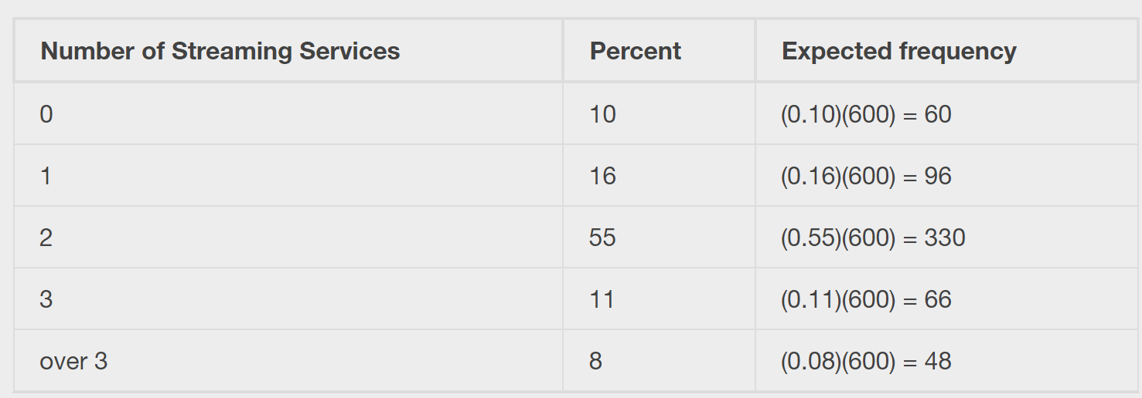
Solution
This problem asks you to test whether the far western United States families distribution fits the distribution of the American families. This test is always right-tailed.
The first table contains expected percentages. To get expected (E) frequencies, multiply the percentage by 600. The expected frequencies are shown:

Slide 20
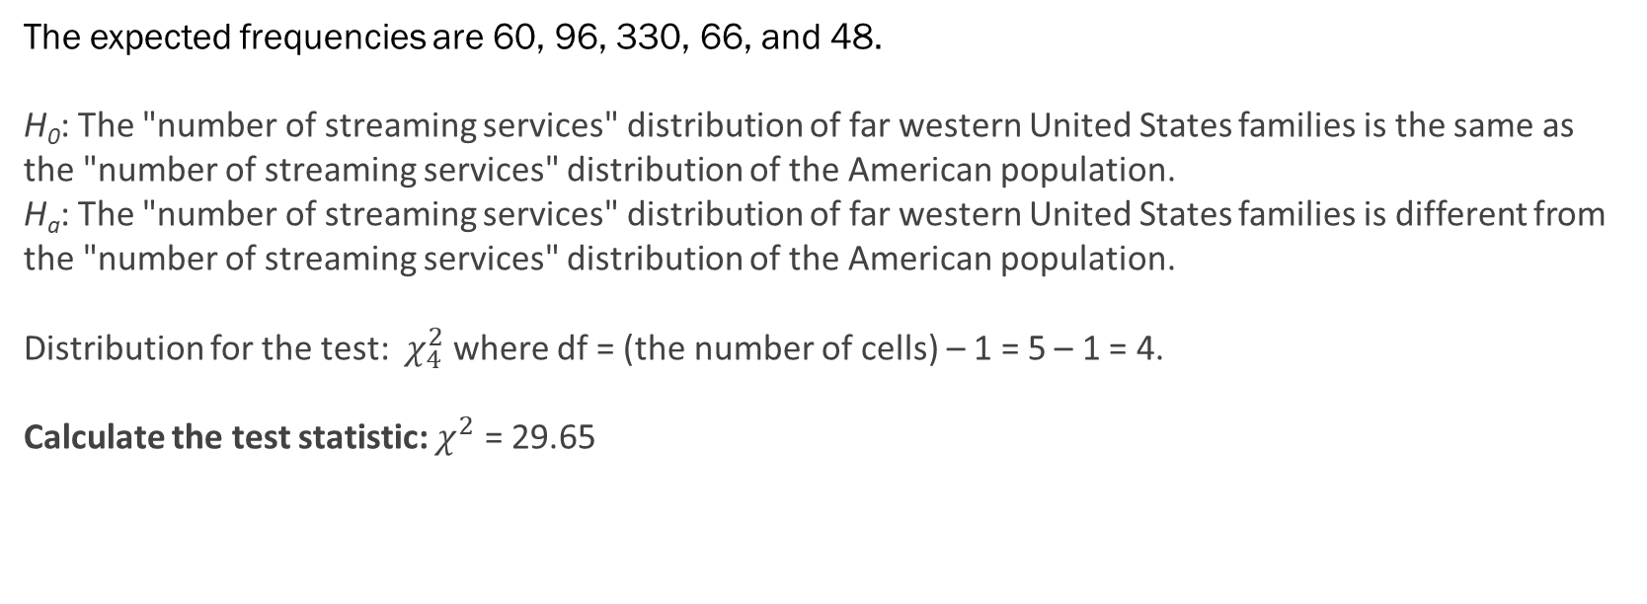
Solution
The expected frequencies are 60, 96, 330, 66, and 48.
H₀: The "number of streaming services" distribution of far western United States families is the same as the "number of streaming services" distribution of the American population.
H_{a}: The "number of streaming services" distribution of far western United States families is different from the "number of streaming services" distribution of the American population.
Distribution for the test: $χ_{4}^{2}$ where df = (the number of cells) – 1 = 5 – 1 = 4.
Calculate the test statistic: $χ^{2}$ = 29.65

Slide 21
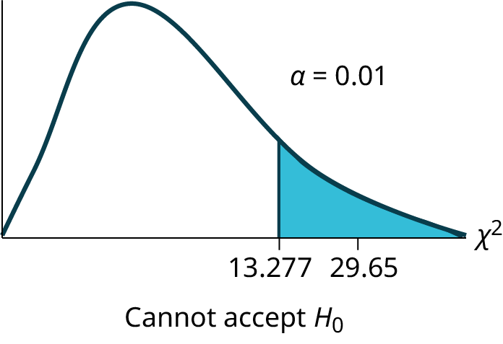
Solution

Slide 22
Solution
The graph of the Chi-square shows the distribution and marks the critical value with four degrees of freedom at 99% level of confidence, α = .01, 13.277. The graph also marks the calculated chi squared test statistic of 29.65. Comparing the test statistic with the critical value, as we have done with all other hypothesis tests, we reach the conclusion.
Make a decision: Because the test statistic is in the tail of the distribution we cannot accept the null hypothesis.
This means you reject the belief that the distribution for the far western states is the same as that of the American population as a whole.
Conclusion: At the 1% significance level, from the data, there is sufficient evidence to conclude that the "number of streaming services" distribution for the far western United States is different from the "number of streaming services" distribution for the American population as a whole.

Slide 23
Section 11.3
Test of Independence

Slide 24
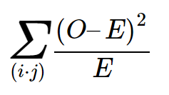
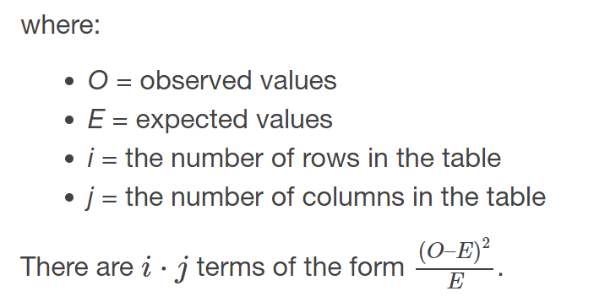
The Basics
Tests of independence involve using a contingency table of observed (data) values.
The test statistic for a test of independence is similar to that of a goodness-of-fit test:
A test of independence determines whether two factors are independent or not. You first encountered the term independence in Independent and Mutually Exclusive Events earlier.

Slide 25
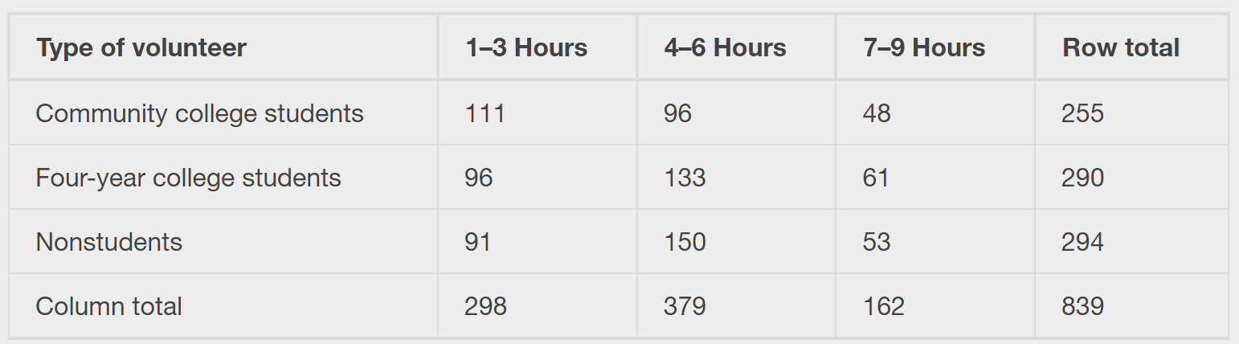
Example
A volunteer group, provides from one to nine hours each week with disabled senior citizens. The program recruits among community college students, four-year college students, and nonstudents. In the table is a sample of the adult volunteers and the number of hours they volunteer per week.
Is the number of hours volunteered independent of the type of volunteer?

Slide 26
Example - Answers
The observed table and the question at the end of the problem, "Is the number of hours volunteered independent of the type of volunteer?" tell you this is a test of independence. The two factors are number of hours volunteered and type of volunteer. This test is always right-tailed.
H₀: The number of hours volunteered is independent of the type of volunteer.
H_{a}: The number of hours volunteered is dependent on the type of volunteer.
The expected results are in the table.

Slide 27
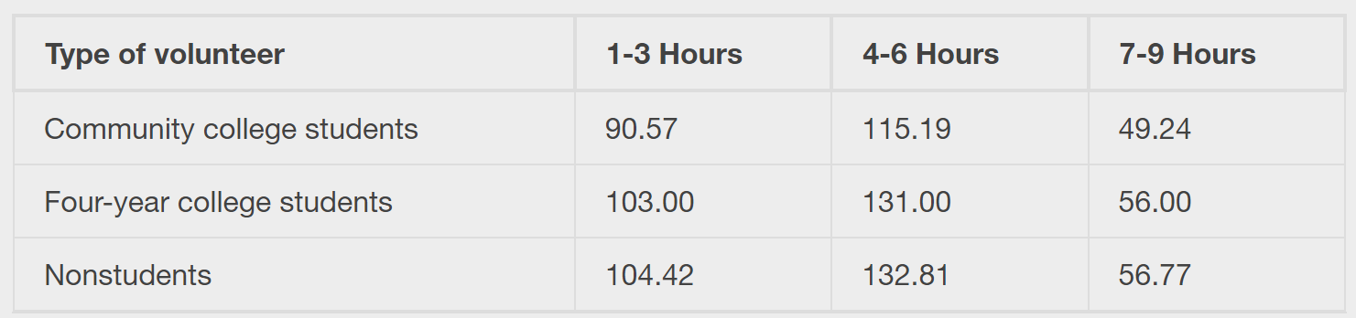
Example - Answers

Slide 28
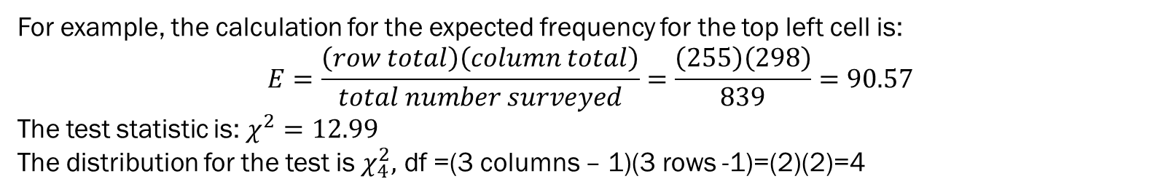
Example - Answers
For example, the calculation for the expected frequency for the top left cell is:
$$E=\frac{\left(row total\right)\left(column total\right)}{total number surveyed}=\frac{\left(255\right)\left(298\right)}{839}=90.57$$
The test statistic is: $χ^{2}=12.99$
The distribution for the test is $χ_{4}^{2},$ df =(3 columns – 1)(3 rows -1)=(2)(2)=4

Slide 29
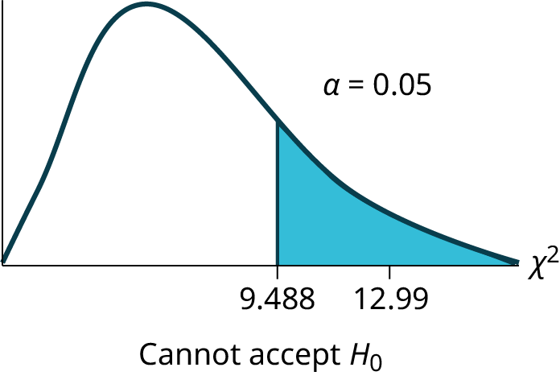
Example - Answers

Slide 30
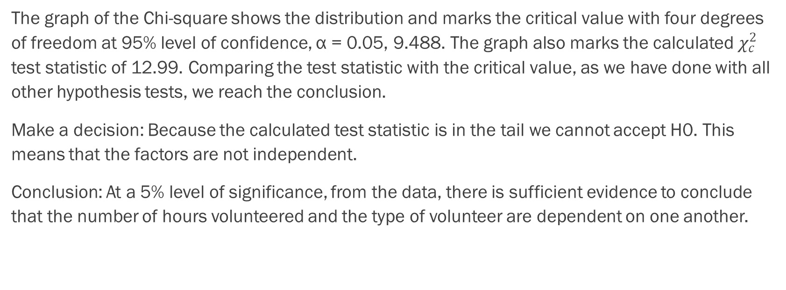
Example - Answers
The graph of the Chi-square shows the distribution and marks the critical value with four degrees of freedom at 95% level of confidence, α = 0.05, 9.488. The graph also marks the calculated $χ_{c}^{2}$ test statistic of 12.99. Comparing the test statistic with the critical value, as we have done with all other hypothesis tests, we reach the conclusion.
Make a decision: Because the calculated test statistic is in the tail we cannot accept H0. This means that the factors are not independent.
Conclusion: At a 5% level of significance, from the data, there is sufficient evidence to conclude that the number of hours volunteered and the type of volunteer are dependent on one another.

Slide 31
Section 11.4
Test for Homogeneity

Slide 32
The Basics
The goodness–of–fit test can be used to decide whether a population fits a given distribution, but it will not suffice to decide whether two populations follow the same unknown distribution.
A different test, called the test for homogeneity, can be used to draw a conclusion about whether two populations have the same distribution.
To calculate the test statistic for a test for homogeneity, follow the same procedure as with the test of independence.
The expected value inside each cell needs to be at least five in order for you to use this test.

Slide 33
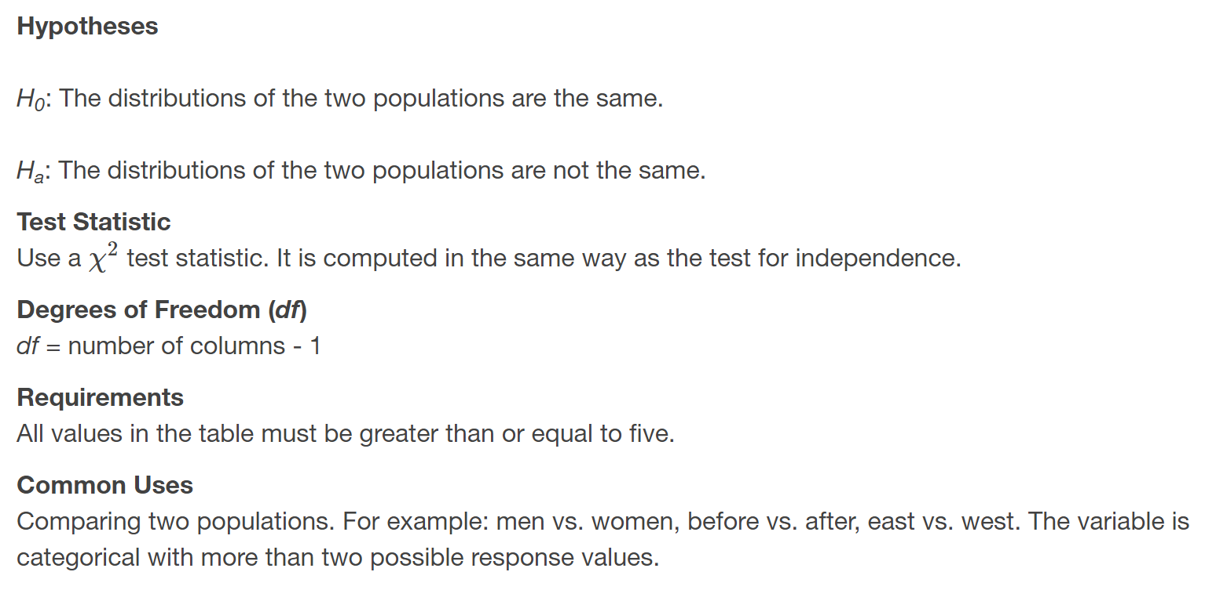
Hypothesis Testing

Slide 34
Example
Do men and women college students have the same distribution of living arrangements? Use a level of significance of 0.05. Suppose that 250 randomly selected men college students and 300 randomly selected women college students were asked about their living arrangements: dormitory, apartment, with parents, other. The results are shown in the table in Excel. Do men and women college students have the same distribution of living arrangements?

Slide 35
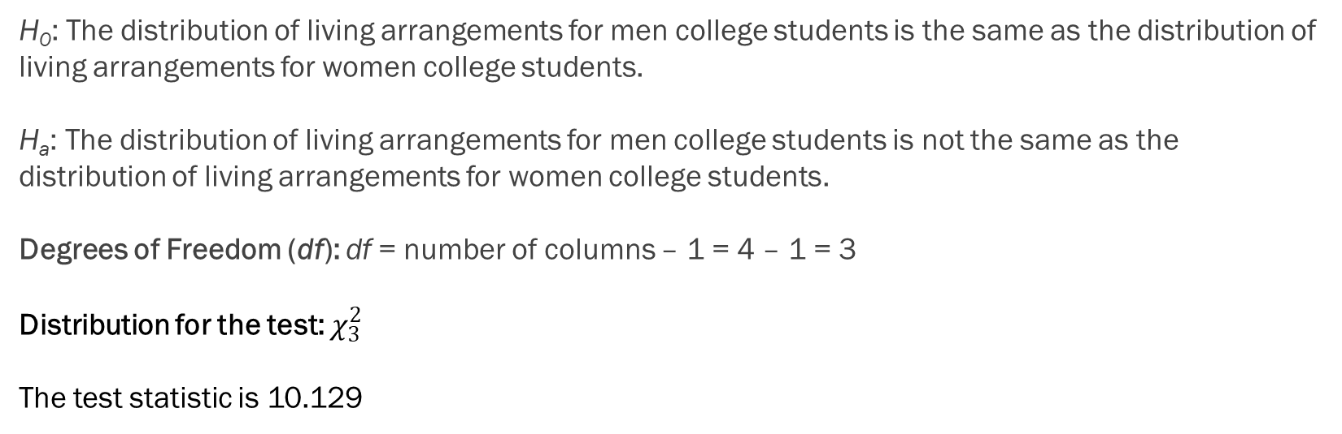
Example - Answers
H₀: The distribution of living arrangements for men college students is the same as the distribution of living arrangements for women college students.
H_{a}: The distribution of living arrangements for men college students is not the same as the distribution of living arrangements for women college students.
Degrees of Freedom (df): df = number of columns – 1 = 4 – 1 = 3
Distribution for the test: $χ_{3}^{2}$
The test statistic is 10.129

Slide 36

Example - Answers

Slide 37
Example - Answers
The graph of the Chi-square shows the distribution and marks the critical value with three degrees of freedom at 95% level of confidence, α = 0.05, 7.815. The graph also marks the calculated χ² test statistic of 10.129. Comparing the test statistic with the critical value, as we have done with all other hypothesis tests, we reach the conclusion.
Make a decision: Because the calculated test statistic is in the tail we cannot accept H₀. This means that the distributions are not the same.
Conclusion: At a 5% level of significance, from the data, there is sufficient evidence to conclude that the distributions of living arrangements for men and women college students are not the same.
Notice that the conclusion is only that the distributions are not the same. We cannot use the test for homogeneity to draw any conclusions about how they differ.

Slide 38
Section 11.5
Comparison of tests

Slide 39
Comparison of Tests
Goodness-of-Fit: Use the goodness-of-fit test to decide whether a population with an unknown distribution "fits" a known distribution. In this case there will be a single qualitative survey question or a single outcome of an experiment from a single population. Goodness-of-Fit is typically used to see if the population is uniform (all outcomes occur with equal frequency), the population is normal, or the population is the same as another population with a known distribution. The null and alternative hypotheses are:
H₀: The population fits the given distribution.
H_{a}: The population does not fit the given distribution.
Independence: Use the test for independence to decide whether two variables (factors) are independent or dependent. In this case there will be two qualitative survey questions or experiments and a contingency table will be constructed. The goal is to see if the two variables are unrelated (independent) or related (dependent). The null and alternative hypotheses are:
H₀: The two variables (factors) are independent.
H_{a}: The two variables (factors) are dependent.
Homogeneity: Use the test for homogeneity to decide if two populations with unknown distributions have the same distribution as each other. In this case there will be a single qualitative survey question or experiment given to two different populations. The null and alternative hypotheses are:
H₀: The two populations follow the same distribution.
H_{a}: The two populations have different distributions.

Slide 40
Section 11.6
Tests for a single variance

Slide 41
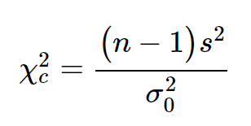
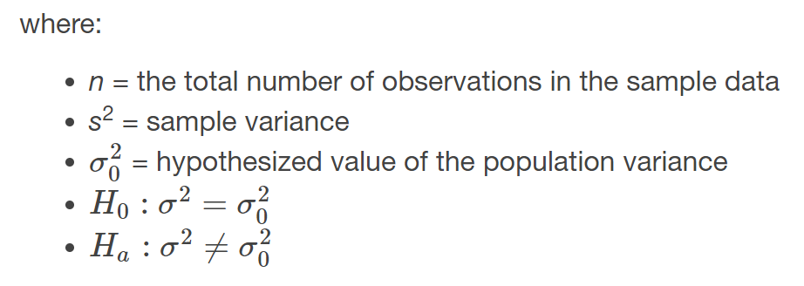
The Basics
A test of a single variance assumes that the underlying distribution is normal. The null and alternative hypotheses are stated in terms of the population variance. The test statistic is:
You may think of s as the random variable in this test. The number of degrees of freedom is df = n - 1. A test of a single variance may be right-tailed, left-tailed, or two-tailed.

Slide 42
Example
Math instructors are not only interested in how their students do on exams, on average, but how the exam scores vary. To many instructors, the variance (or standard deviation) may be more important than the average.
Suppose a math instructor believes that the standard deviation for his final exam is five points. One of his best students thinks otherwise. The student claims that the standard deviation is more than five points. If the student were to conduct a hypothesis test, what would the null and alternative hypotheses be?

Slide 43
Solution
Even though we are given the population standard deviation, we can set up the test using the population variance as follows.
H₀: σ² ≤ 5²
H_{a}: σ² > 5²

Slide 44
Example
With individual lines at its various windows, a post office finds that the standard deviation for waiting times for customers on Friday afternoon is 7.2 minutes. The post office experiments with a single, main waiting line and finds that for a random sample of 25 customers, the waiting times for customers have a standard deviation of 3.5 minutes on a Friday afternoon.
With a significance level of 5%, test the claim that a single line causes lower variation among waiting times for customers.

Slide 45
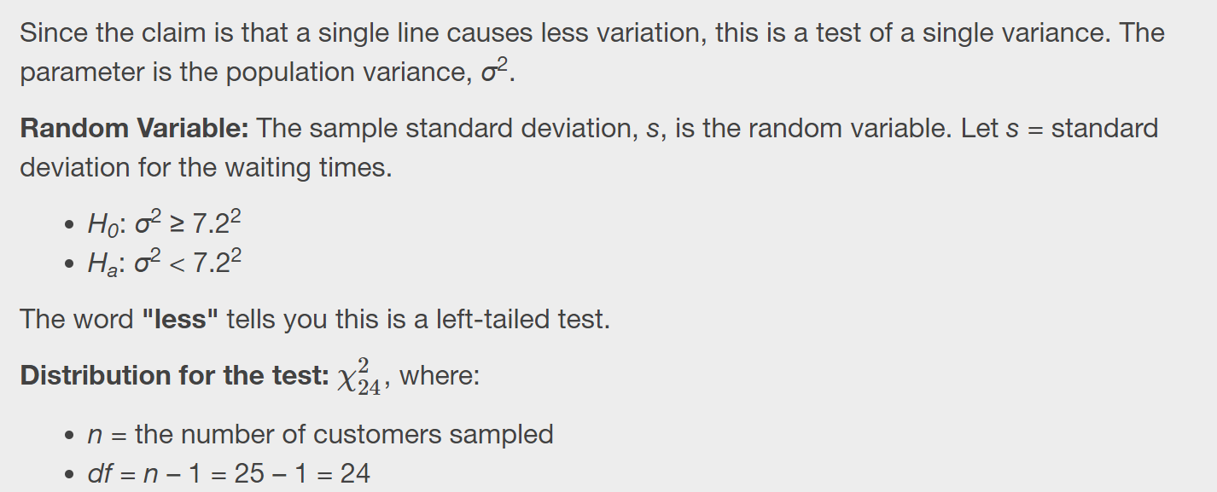
Solution

Slide 46
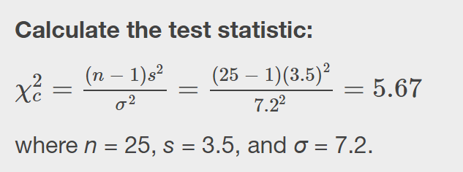
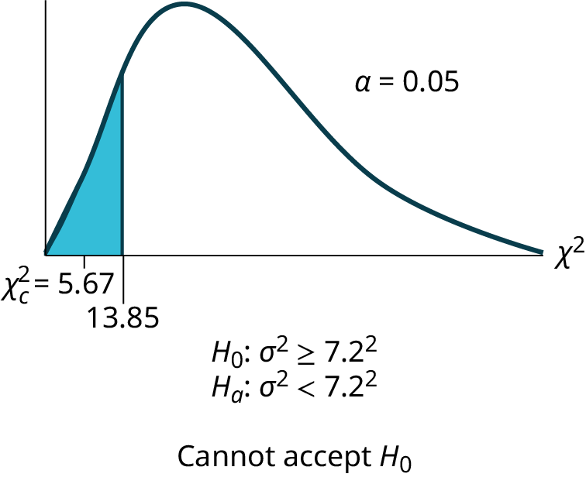
Solution

Slide 47
Example
Professor Holmes has a weakness for cream filled donuts, but they believe that some bakeries are not properly filling the donuts. A sample of 24 donuts reveals a mean amount of filling equal to 0.04 cups, and the sample standard deviation is 0.11 cups. Professor Holmes has an interest in the average quantity of filling, of course, but he is particularly distressed if one donut is radically different from another. Professor Holmes does not like surprises. Test at 95% the null hypothesis that the population variance of donut filling is significantly different from the average amount of filling.

Slide 48
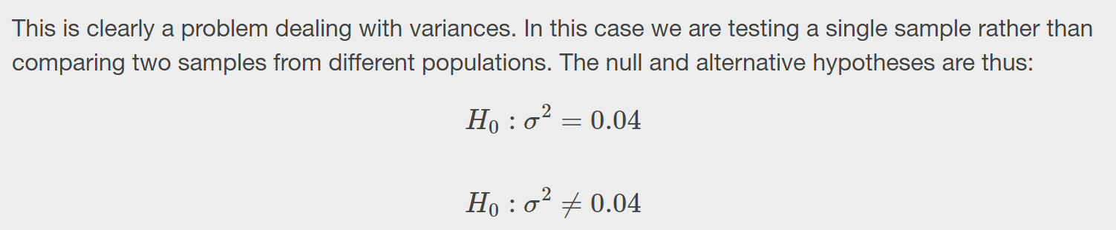
Solution

Slide 49
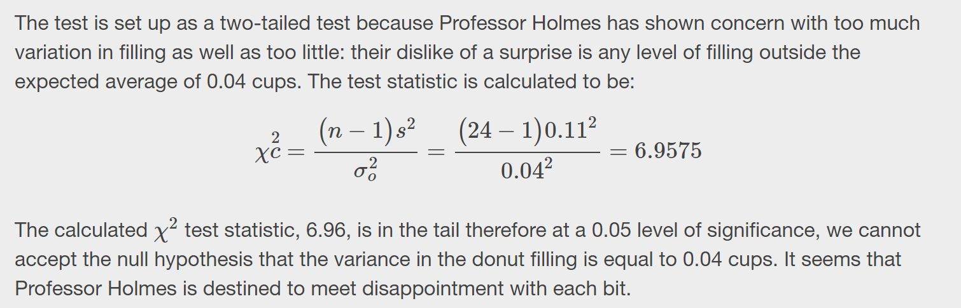
Solution

Slide 50
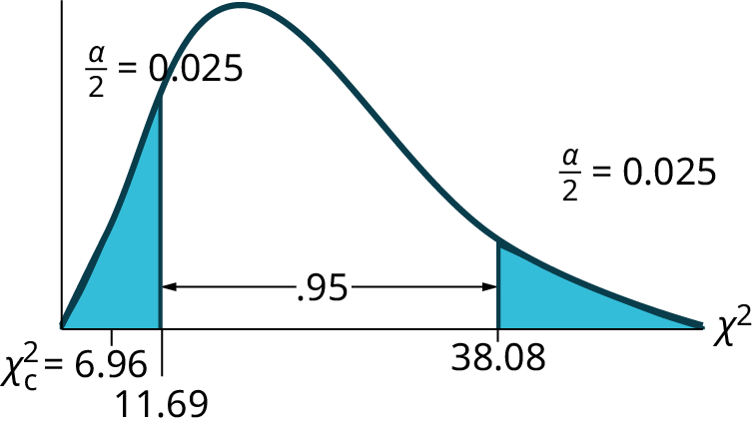
Solution

